Slide 1
Ancient and Medieval
Economic Thought
Part 1

Slide 2
Introduction
“Where shall we start ...?” Buchholz, 5-7
  “The Bible provided little inspiration for [Adam Smith’s] theorizing.”
  “The Middle Ages theologians . . . duty was to guide the flock to Heaven, not to a higher standard of living.”
  “Aristotle left few marks on the annals of economic discipline.”

Slide 3
Introduction
I respectfully disagree--
the ancient writers
  raised ethical and conceptual issues that would be addressed by Smith and others
  established influential habits of thought and reasoning
  Secularization of economics is a recent phenomenon (see Francis Wayland (1845) and George W. Harris (1929)

Slide 4
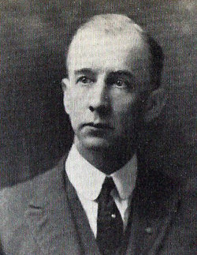
Introduction
George Winfield Harris
Lived: 1869-1932
Taught at Baylor: 1920-1932
Became “chairman” of the Business Department in 1927, and later had sabbatical to write an economics textbook

Slide 5

The Bible
As you know, The Bible has been used to support VERY different political agendas. Our purpose here is to explore how it influenced later economic thought.

Slide 6
The Bible
Methodology
  Mainly normative and inductive
Rational Choice
  I Cor 3:19 “The wisdom of this world is foolishness with God.”
  Philippians 4:8 “Whatsoever things are true … honest … pure … lovely … good report … think on these things.”
Self Interest
  Golden Rule—Love your neighbor as yourself-- Lev 19:18, Mat 19:19, Mat 22:39, Mark 12:31
  I Cor 10:24 “Let no man seek his own, but every man another’s wealth.”

Slide 7
Ownership
  Ultimately divine—feudal model
    Gen. 1—Creation
    Lev 25:23 --“The land shall not be sold permanently, for the land is Mine; for you are but aliens and sojourners with me.”
    Psalm 24:1—“The earth is the Lord’s and the fullness thereof. . . for He has founded it upon the seas.”
    Matthew 25:14-30—Parable of the talents—master is still owner

Slide 8
Public/Private Ownership
  Recognition of private ownership rights in Ten Commandments (Exodus 20:1-17) and laws of inheritance (Numbers 27:8-11).
    `If a man dies, and has no son, you shall cause his inheritance to pass to his daughter. And if he has no daughter, you shall give his inheritance to his brothers. And if he has no brothers, . . . to his father's brothers. And if his father has no brothers, . . . to his kinsman that is next to him of his family, and he shall possess it. And it shall be to the people of Israel a statute and ordinance, as the LORD commanded Moses."

Slide 9
Public/Private Ownership
  Also recognized communal ownership, at least under special circumstances (Acts 4:32-37).
    “Those who believed were of one heart and soul, and no one said that any of the things which he possessed was his own, but they had everything in common. . . There was not a needy person among them, for as many as were possessors of lands or houses sold them, and brought the proceeds of what was sold and laid it at the apostles' feet; and distribution was made to each as any had need.”
  But this was voluntary and particular

Slide 10
Accumulation of Wealth
  Old Testament--wealth often a sign of favor
    Prov. 13:21-22 “Misfortune pursues sinners, but prosperity rewards the righteous. A good man leaves an inheritance to his children's children.”
    Lives of Abraham, Job, and Solomon
    BUT: Isaiah 5:8 “Woe to those who join house to house, who add field to field, until there is no more room, and you are made to dwell alone in the midst of the land.”

Slide 11
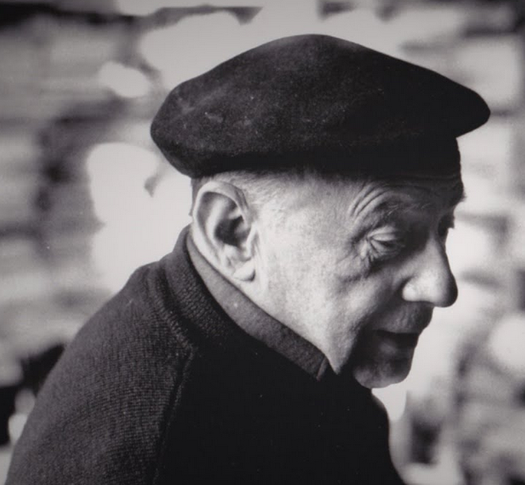

Accumulation of Wealth
  New Testament--“Jesus Christ strips wealth of the sacramental character that we have recognized in the Old Testament,” Jacques Ellul, Money and Power (1984)
    [1Tim 6:10] “For the love of money is the root of all evil; it is through this craving that some have wandered away from the faith…”
    [Mat 19:23-24] And Jesus said . . . , "Truly, I say to you, it will be hard for a rich man to enter the kingdom of heaven . . . it is easier for a camel to go through the eye of a needle than for a rich man to enter the kingdom of God."

Slide 12
Accumulation of Wealth
  Balanced approach in OT and NT
    [Prov 30:8-9] Give me neither poverty nor riches; feed me with the food that is needful for me, lest I be full, and deny thee, and say, "Who is the LORD?" or lest I be poor, and steal, and profane the name of my God.
    [Phil 4:11-13] I have learned, in whatever state I am, to be content. I know how to get along with humble means, and I know how to live in prosperity; . . .. I can do all things in him who strengthens me.
    [Gal 3:28] There is neither Jew nor Greek, there is neither slave nor free, there is neither male nor female; for you are all one in Christ Jesus.

Slide 13
Work and Providence
  Old Testament Work Ethic
    [Gen 2:15] People put in Garden to “keep and to till it.” Humans were made to work and care for creation.
    [Gen 3:17] Cursed is the ground because of you; in toil you shall eat of it all the days of your life.”
    [Prov 14:23] In all labor there is profit, but mere talk tends only to want.
    [Ecclesiastes 5:18] Behold, what I have seen to be good and to be fitting is to eat and drink and find enjoyment in all the toil with which one toils under the sun the few days of his life which God has given him, for this is his reward.

Slide 14
Work and Providence
  Other side of the Old Testament
    Institutions of the Sabbath Day, the Sabbath Year, and the Year of Jubilee. Unique in ancient world.
    [Ecclesiastes 4:7-8] Again, I saw vanity under the sun: a person who has no one, either son or brother, yet there is no end to all his toil, and his eyes are never satisfied with riches, so that he never asks, "For whom am I toiling and depriving myself of pleasure?" This also is vanity and an unhappy business.

Slide 15
Work and Providence
  New Testament Work Ethic
    Barry Gordon, in Economic Analysis Before Adam Smith (1975), claims it was weakened by Greek influence.
      Paul’s expectation of end times.
      [Luke 10:38-41] He entered a village; and a woman named Martha received him into her house. And she had a sister called Mary, who sat at the Lord's feet and listened to his teaching. But Martha was distracted with much serving; and she went to him and said, "Lord, do you not care that my sister has left me to serve alone? Tell her then to help me." But the Lord answered her, "Martha, Martha, you are anxious and troubled about many things; one thing is needful. Mary has chosen the better part, which shall not be taken away from her."

Slide 16
Work and Providence
    New Testament Work Ethic (continued)
      In defense of NT work ethic:
      Jesus born into a carpenter’s family
      Martha was criticized for “worrying,” not for working
      [II Thessalonians 3:7-12] You know how you ought to imitate us; we were not idle when we were with you, we did not eat any one's bread without paying, but with toil and labor we worked night and day, that we might not burden any of you. It was not because we have not that right, but to give you in our conduct an example to imitate. For even when we were with you, we gave you this command: If any one will not work, let him not eat. For we hear that some of you are living in idleness, mere busybodies, not doing any work. Now such persons we command and exhort in the Lord Jesus Christ to work in quietness and to earn their own living.

Slide 17
Work and Providence
Gardner Conclusion (OK if it’s not yours)
    Purpose of work is to live creative and disciplined life. Providing for ourselves is the incentive system, not the ultimate purpose of work.
    “Miraculous” providence is given in Bible when people are told not to work:
      [Exodus 16] Manna from heaven
      [Leviticus 25: 20-22] And if you say, `What shall we eat in the seventh year, if we may not sow or gather in our crop?' I will command my blessing upon you in the sixth year, so that it will bring forth fruit for three years.
      [John 7: 1-29] Loaves and fish to feed the crowd

Slide 18
Care for the Poor
  Old Testament
    Sabbath Day--rest for workers, slaves, animals
    Sabbath Year (7th year)
      Land fallow
      Cancel debts (don’t withhold loans Deut 15:9)
      Release Hebrew slaves
    Jubilee Year (50th year)
      Land fallow additional year
      Land returns to previous owners (Lev 25:13-16).
    Tithes for care of the poor (Deut 14: 28-29)
    Leaving grain in fields for the poor (Lev 19-: 9-10)
    No interest charges on Hebrews (Deut 23: 19-20)
    Don’t hold pledges that risk livelihood (Deut 24: 6-17)

Slide 19
Care for the Poor
  New Testament
    Old Testament laws elevated. [Luke 6:34-35] “And if you lend to those from whom you hope to receive, what credit is that to you? Even sinners lend to sinners, to receive as much again. But love your enemies, and do good, and lend, expecting nothing in return; and your reward will be great…”
    [Acts 4: 32-37] Believers had “all things in common” and there were “no poor among them.”
    [Mat 25:34-40] Then the King will say to those at his right hand, `... inherit the kingdom prepared for you ... for I was hungry and you gave me food, I was thirsty and you gave me drink, I was a stranger and you welcomed me, I was naked and you clothed me, I was sick and you visited me ... Then the righteous will answer him, `Lord, when did we [do these things]? . . . And the King will answer , ‘…As you did it to one of the least of these …, you did it to me.'

Slide 20
Immigration/Refugees
  Old Testament
    [Leviticus 19:34] “The alien who resides with you shall be to you as the citizen among you; you shall love the alien as yourself, for you were aliens in the land of Egypt.”
    [Psalm146:9] “The Lord watches over the strangers; he upholds the orphan and the widow, but the way of the wicked he brings to ruin.”
  New Testament
    [Matthew 25:35] “I was hungry and you gave me food, I was thirsty and you gave me drink, I was a stranger and you welcomed me.”
    [Hebrews 13:1-2] “Let mutual love continue. Do not neglect to show hospitality to strangers, for by doing that some have entertained angels without knowing it.”
    An important part of Catholic social teaching. In 2018, the U.S. Conference of Catholic Bishops filed a Supreme Court brief against the Trump Muslim ban.

Slide 21
Value, Price, and Exchange
  [Lev 25:13-17 – The Message paraphrase] “If you sell or buy property from one of your countrymen, don’t cheat him. Calculate the purchase price on the basis of the number of years since the Jubilee. He is obliged to set the sale price on the basis of the number of harvests remaining until the next Jubilee. The more years left, the more money; you can raise the price. But the fewer years left, the less money; decrease the price. What you are buying and selling in fact is the number of crops you’re going to harvest. Don’t cheat each other. Fear your God. I am God, your God.”
  [II Kings 6:25 The Message] A siege on Samaria “brought on a terrible famine, so bad that food prices soared astronomically. Eighty shekels for a donkey’s head! Five shekels for a bowl of field greens!.”

Slide 22
Specialization
    [Gen 25:27] When the boys grew up, Esau was a skillful hunter, a man of the field, while Jacob was a quiet man, dwelling in tents.
    [Romans 12:-6-7] Having gifts that differ according to the grace given to us, let us use them: if prophecy, in proportion to our faith; if service, in our serving; the one who teaches, in his teaching;
    [1Cor 12:14-] For the body does not consist of one member but of many. If the foot should say, "Because I am not a hand, I do not belong to the body," that would not make it any less a part of the body. . . . As it is, there are many parts, yet one body. . . . If one member suffers, all suffer together; if one member is honored, all rejoice together. Now you are the body of Christ and individually members of it.

