Slide 1
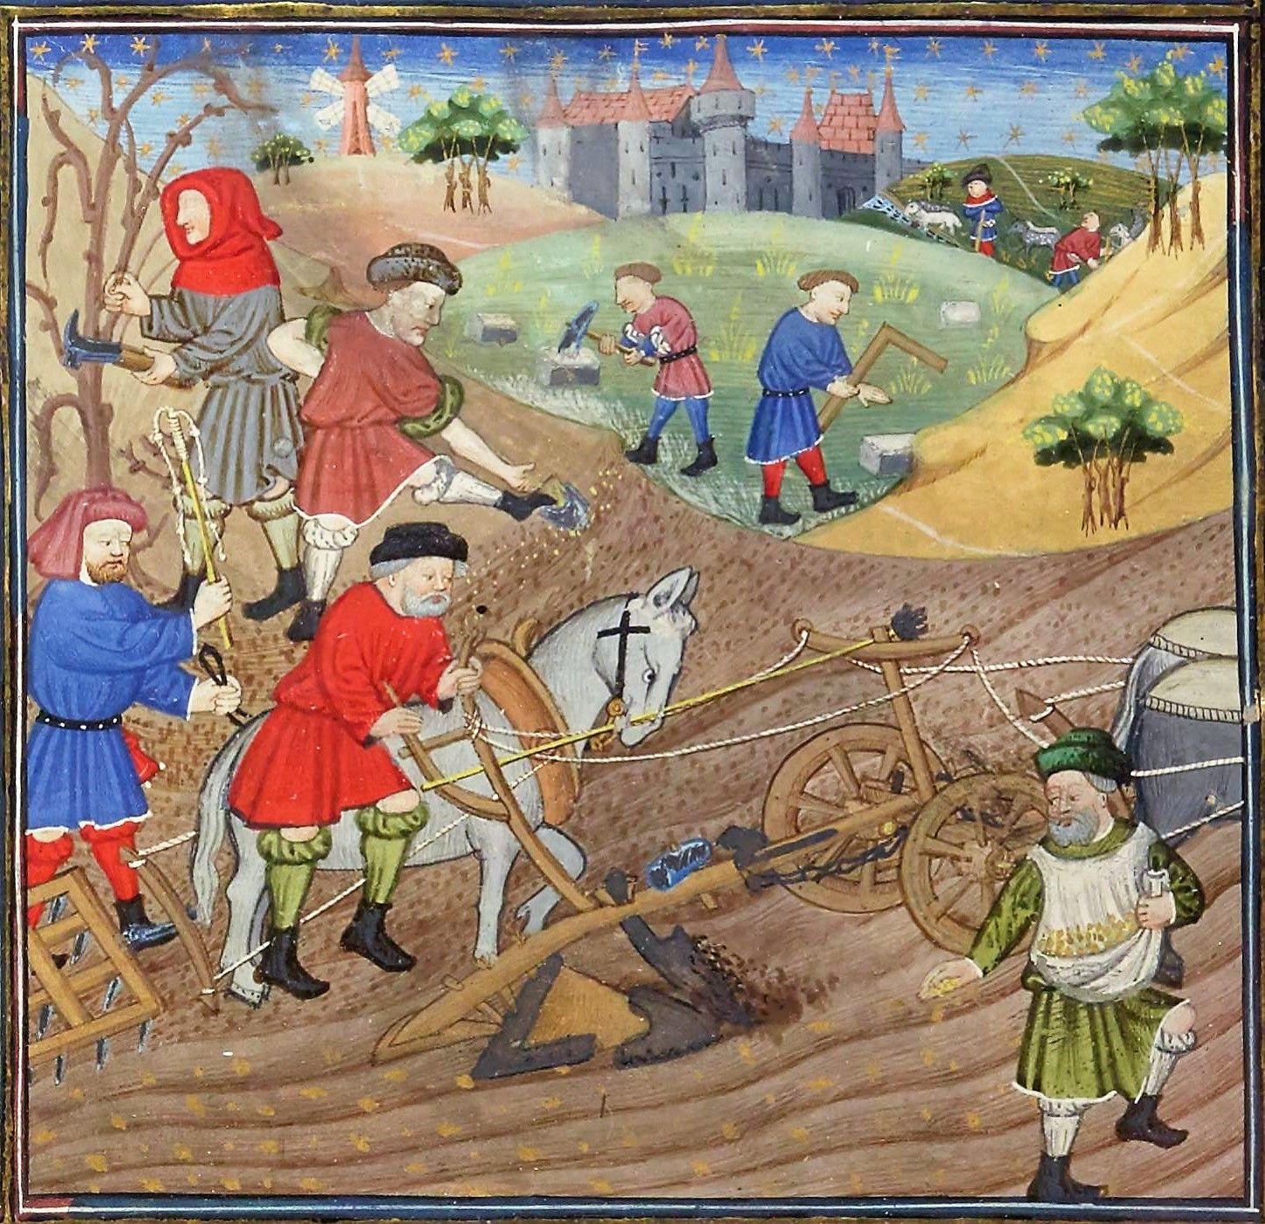
The Physiocrats or
Les Économistes or
The Agricultural System of Political Economy

Slide 2
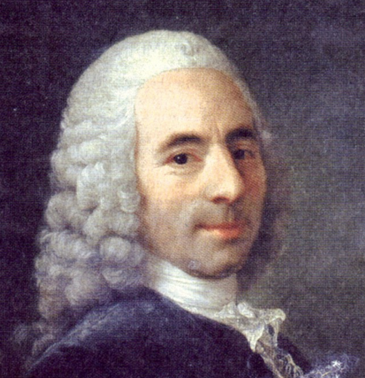
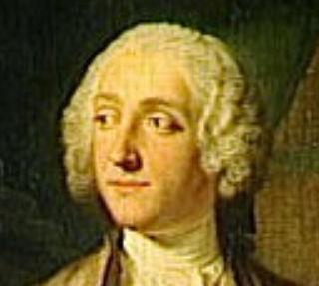
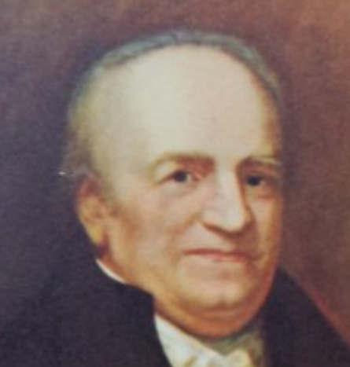
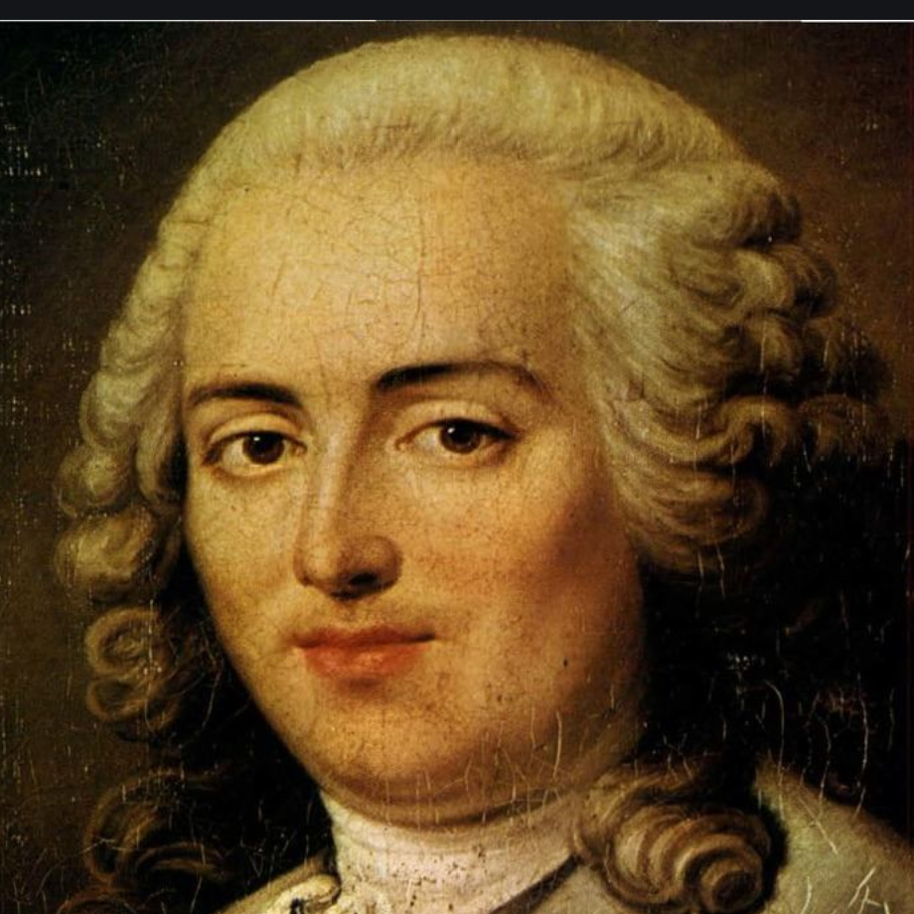
Who Were They?
François Quesnay (1694-1774) - Leader of the school and inventor of the Tableau économique. Came to economics in his 60s, after serving as physician to King Louis XV at Versailles and writing in medicine, biology, and philosophy
Victor Riqueti, Marquis de Mirabeau (1715-1789) – Quesnay’s first disciple. Wrote Explication du Tableau économique (1759)
Pierre Samuel du Pont de Nemours (1739-1817) Editor of school’s journal and published La Physiocratie (1767). During the French Revolution, he moved to U.S., and his son, a chemist, founded a major corporation that continues today.
Anne Robert Jacques Turgot (1727-81) Not fully a Physiocrat, but defended and popularized their doctrines and implemented them as as Finance Minister, 1774-76.

Slide 3
Significance
First school of economists
Policy
  Brief impact (Turgot, Fin. Min., 1774-76)
  Laissez faire rooted in natural law
  Single tax on agricultural rents
  Defense of usury
Theory (Tableau Economique)
  Wealth = consumables
  Importance of domestic trade
  Circular flow concept (Marx, Keynes, Leontief)
  Analysis of productive/unproductive classes

Slide 4
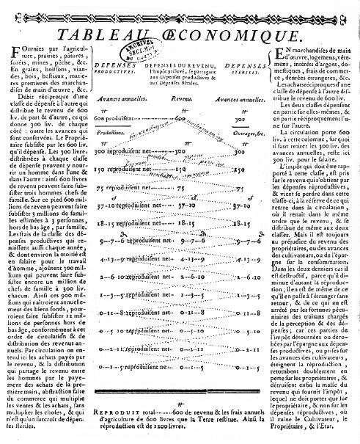
“Incontestably the most brilliant idea of which political economy had hitherto been guilty.”
Karl Marx

Slide 5
Social Classes, Production, and Exchange
Landlords / “Proprietors”
Manufacturers / “Artisans”
Luxury Goods | Agricultural Tools
Rent Payment
Food | Food | Food | Agricultural Raw Materials | Artisan Raw Materials
Farmers / “Husbandmen” / “Cultivators”

Slide 6
After Exchange – Basis for New Production
Landlords / “Proprietors”
Manufacturers / “Artisans”
Food | Artisan Raw Materials
Food | Luxury Goods
Food | Agricultural Raw Materials | Agricultural Tools
Farmers / “Husbandmen”

Slide 7
After next round of production, back to previous output (steady state)
Landlords / “Proprietors”
Manufacturers / “Artisans”
Consumed two boxes,
produced nothing
Luxury Goods | Agricultural Tools
Consumed two boxes,
produced two – no “surplus”
Consumed three boxes,
produced five – a “surplus” that made it possible to pay rent
Food | Food | Food | Agricultural Raw Materials | Artisan Raw Materials
Farmers / “Husbandmen” / “Cultivators”

Slide 8
Conclusion from the Tableau
This may have been a reasonably accurate description of patterns of production in France in and before the 18th century. However…
Logical errors:
Asserting that the future will be the same as the past, because the past is a reflection of the unchanging “natural” system. Led to the conclusion that artisans/manufacturers will never generate wealth and the ability to pay rent.
Confusion of a physical surplus (seed growing into plants) with a value surplus (dependent on prices).

Slide 9
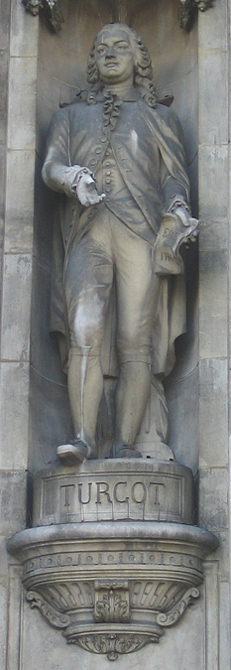
Turgot, Reflections on . . . Wealth, 1774
5. Pre-eminence of the husbandman who produces, over the artisan who prepares. The husbandman is the first mover in the circulation of labour: it is he who causes the earth to produce the wages of every artificer.
This is not a pre-eminence of honour or of dignity, but of physical necessity. The husbandman can, generally speaking, subsist without the labour of other workmen; but no other workmen can labour, if the husbandman does not provide him wherewith to exist. . . . There is here a very essential difference between these two species of labour, on which it is necessary to reflect...
Statue of Turgot at the Hôtel de Ville, Paris

Slide 10
Turgot, Reflections on . . . Wealth, 1774
6. The wages of the workman is limited by the competition among those who work for a subsistence.
The mere workman, who depends only on his hands and his industry, has nothing but the labour he is able to dispose of to others. He sells it at a cheaper or a dearer price; but this high or low price does not depend on himself alone; it results from the agreement he has made with the person who employs him. The latter pays him as little as he can help, and as he has the choice from among a great number of workmen, he prefers the person who works cheapest. The workmen are therefore obliged to lower their price in opposition to each other. In every species of labour it must, and, in effect, it does happen, that the wages of the workman is confined merely to what is necessary to procure him a subsistence.

Slide 11
Turgot, Reflections on . . . Wealth, 1774
7. The husbandman is the only one whose industry produces more than the wages of his labour. He, therefore, is the only source of all Wealth.
The situation of the husbandman is materially different. The soil, independent of any other man, or of any agreement, pays him immediately the price of his toil. Nature does not bargain with him, or compel him to content himself with what is absolutely necessary.

Slide 12
Turgot, Reflections on . . . Wealth, 1774
12. Inequality in the division of property: causes which render that inevitable.
The original proprietors would . . .occupy as much land as their strength would permit them with their families to cultivate. A man of greater strength, more laborious, more attentive about the future, would occupy more than a man of a contrary character. He, whose family is the most numerous having greater wants and more hands, extends his possessions further; this is a first cause of inequality. -- Every piece of ground is not equally fertile; . . . this is a second source of inequality. Property in descending from fathers to their children, divides into greater or less portions, . . . this is a third source of inequality. The difference of knowledge, of activity, and, above all, the oeconomy of some, contrasted with the indolence, inaction, and dissipation of others, is a fourth principle of inequality, and the most powerful of all: . . . .

Slide 13
Turgot, Reflections on . . . Wealth, 1774
15. A new division of society into three classes. Cultivators, Artisans, and Proprietors, or the productive, stipendiary, and disposible classes.
We now behold society divided into three branches; the class of husbandmen, whom we may denominate cultivators; the class of artisans and others, who work for hire upon the productions of the earth; and the class of proprietors, the only one which, not being confined by a want of support to a particular species of labour, may be employed in the general service of society, as for war, and the administration of justice, either by a personal service, or by the payment of a part of their revenue, with which the state may hire others to fill these employments. The appellation which suits the best with this division, for this reason, is that of the disposable class.

Slide 14
Turgot, Reflections on . . . Wealth, 1774
73. Errors of the schoolmen refuted.
It is for want of having examined the lending of money on interest in its true point of view that moralists, more rigid than enlightened, would endeavour to make us look on it as a crime.. . A loan of money is a reciprocal contract, free between both parties, and entered into only by reason of its being mutually advantageous. It is evident, if the lender finds an advantage in receiving an interest for his money, the borrower is not less interested in finding that money he stands in need of, since otherwise he would not borrow and submit himself to the payment of interest. Now on this principle, can any one look on such an advantageous contract as a crime, in which both parties are content, and which certainly does no injury to any other person?

Slide 15
Turgot, Reflections on . . . Wealth, 1774
76. The rate of interest ought to be fixed, as the price of every other merchandise, by the course of trade alone.
I have already said, that the price of money borrowed, is regulated like the price of all other merchandize, by the proportion of the money at market with the demand for it: thus, when there are many borrowers who are in want of money, the interest of money rises; when there are many possessors who are ready to lend, it falls. It is therefore an error to believe that the interest of money in trade ought to be fixed by the laws of princes. It has a current price fixed like that of all other merchandize. This price varies a little, according to the greater or less security which the lender has; but on equal security, he ought to raise and fall his price in proportion to the abundance of the demand, and the law no more ought to fix the interest of money than it ought to regulate the price of any other merchandizes which have a currency in trade.

