Slide 1
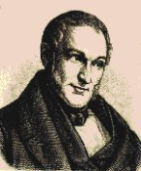
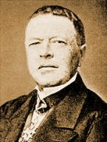
Early Neoclassical Economists
Part 1
Thünen and Cournot

Slide 2
Calculus and Economics
Informally, Neoclassical Economics = Classical Economics (the market-oriented ideas of Adam Smith and his followers) + Differential Calculus
Differential Calculus was first developed in the late 17th century by Isaac Newton and Gottfried Wilhelm Leibniz, who were great philosophers and theoretical mathematicians,
Calculus found its way into economics in the early 19th century in Germany and France, led by a farm owner (Thünen) who wanted to improve the efficiency of his operation and a mathematician (Cournot) who was looking for practical applications of his skills.
These methods reached a larger audience in the English-speaking world in the late 19th century through the work of W.S. Jevons and Alfred Marshall.

Slide 3
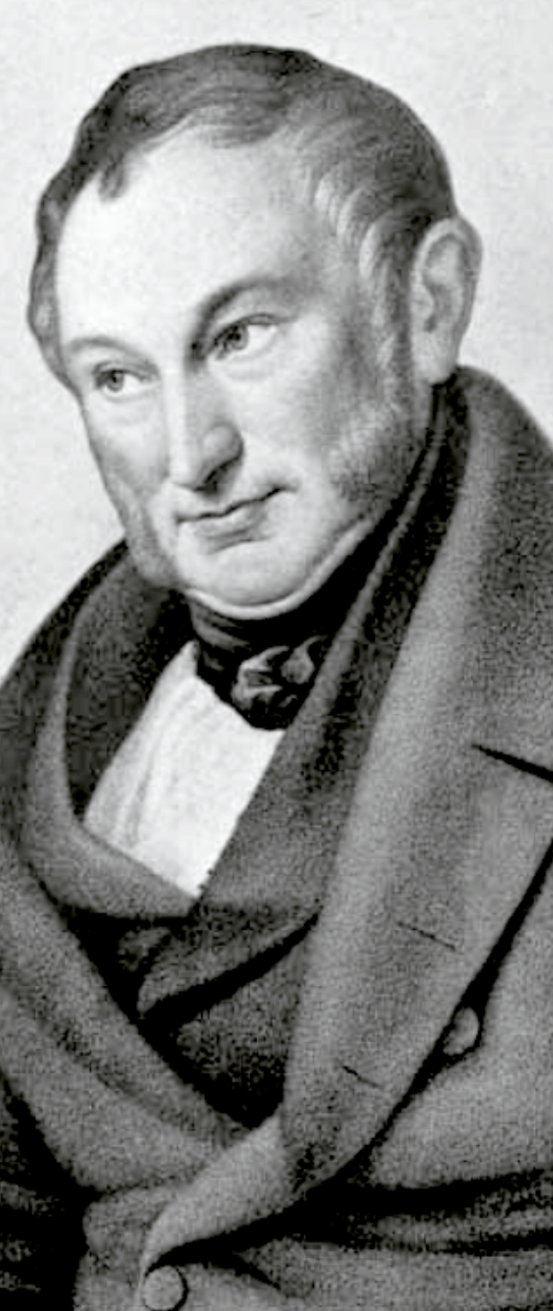
Johann Heinrich von Thünen (1783-1850)
Born to a landed family in Mecklenburg (northeast) Germany, he attended an agricultural college and spent two semesters at the University of Göttingen. Farmed most of the year, but wrote books in the winter. Later, Marshall would say he loved Thünen’s work “above my other masters,” and Schumpeter would declare him to be a better theorist in his time than Ricardo. Still, his work was poorly understood during his life and initially reached a small audience. Unlike Ricardo, was not aimed at changing public policy.

Slide 4
Johann Heinrich von Thünen (1783-1850)
Schumpeter lists these accomplishments:
First to use calculus in economic reasoning
Derived his results from numerical data – Schumpeter says he should be considered a “patron saint of econometrics”
His theory of rent and founding of the economics of location (focus here)
Second after Cournot to represent the economy with a system of equations.
Introduced explicitly the idea of a steady state in economics – a long-run equilibrium.
Developed a marginal productivity theory of income distribution, setting wages and interest rates.

Slide 5
The Isolated State
In the first volume of his book, The Isolated State, published in 1826, Thünen developed a theory of economic geography/location and rent, based on several strong simplifying assumptions:
A town is located in the center of a vast plane of land.
The town does not trade with other towns – all products come from the surrounding land, and are not exported.
All of the land has equal/uniform fertility (unlike Ricardo)
There are no roads or streams that make one acre of land more desirable than another – transportation with overland carts and watering with rain.
So the ONLY thing that makes one acre of land different from another is its proximity to the population center – the market.

Slide 6
The Isolated State
An acre of land will be used by the sector of the economy that is willing/able to pay the highest rent for it, where:
R_{ij} = (P_{i} – C_{i})Q_{i} – F_{i}Q_{i}D_{j}
R_{ij} = Willingness/ability of product i to pay rent on acre j.
P_{i} and C_{i} = Selling price and unit cost (including normal profit) of producing product i
Q_{i} = Quantity (tons) of product i that be produced on an acre of land in a month
F_{i} = Freight rate ($/ton/mile) for product I
D_{j} = Distance of acre j from the population center.

Slide 7
The Isolated State
If P_{i}, C_{i}, Q_{i}, and F_{i} are all known constants, then the rent formula becomes a linear equation with R_{ij} as the dependent variable and D_{j} as the independent variable
R_{ij} = (P_{i} – C_{i})Q_{i} – F_{i}Q_{i} D_{j} R_{ij} = intercept – slope D_{j}
The intercept term will be larger for products that can generate a lot of profits on an acre of land, and the negative slope will be steeper for products that are expensive to transport, either because they are heavy (steel) and/or have high freight rates (milk, for example, needs refrigeration).

Slide 8
The Isolated State
R
Milk
Clothing
Wheat
Distance
M
C
W

Slide 9
The Isolated State
The circles allocate land to those who can pay the highest rent. Suppose that this allocation produces less clothing than is demanded by consumers at current prices. The shortage would cause the price of clothing to rise, which would cause a land reallocation…
Under the strong assumptions of the theory, production would arrange itself in concentric circles. Roads or streams would cause some rearrangement.
Wheat
Clothing
Milk
●

Slide 10
The Isolated State
R
A shortage of clothing would cause its price to rise, causing its rent/distance line to shift upward, causing more land (M’C’) to be allocated to clothing production, reducing the shortage. These adjustments would continue until themarkets for the three products are in a general (simultaneous) equilibrium with a corresponding allocation of land.
Milk
Clothing
Wheat
M’
C’
Distance
M
C
W

Slide 11
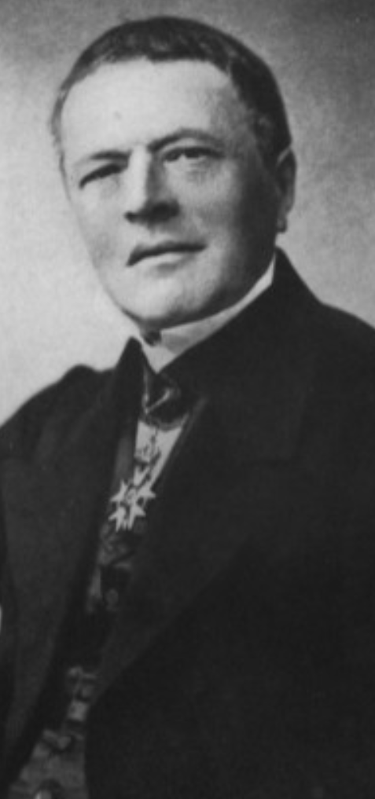
Antoine Augustin Cournot
Born and educated in the small town of Gray in northern France, Cournot first worked as a legal clerk, but continued to study philosophy and law. Inspired by the work of Laplace, he enrolled in a math prep course, and then was accepted by the prestigious École Normale Supérieure in Paris, continuing his studies at the Sorbonne with Laplace and Lagrange. For 10 years, he was a literary advisor for a military Marshal and tutor to his son – providing free time to continue studies in mechanics and astronomy.
With help from Poisson, he launched an administrative and academic career, and published his economics masterpiece (which, again, was not well known at the time), the Recherches sur les principes mathématiques de la théorie des richesses. During his life, his contributions in probability were better known, laying groundwork for modern-day econometrics.

Slide 12
Duopoly Theory
Duopoly (2 producers) is a special case of oligopoly theory (small number of producers).
Why is it more difficult to formulate an oligopoly theory than one for perfect competition or monopoly? Because of interdependence of strategies – the substance of modern-day game theory.
Any oligopoly theory is based on the theorist’s assumptions about the assumptions that the agents (business people) make about each other.

Slide 13
Duopoly Theory
Let’s start with monopoly theory, and then move to duopoly. And Cournot starts with the simplified case of a monopolist selling high-quality mineral water at zero cost. The purchasers pay a price per bucket of taking water from the owner’s spring, so it costs nothing to “produce” the water. The seller will set a price that maximizes revenues, which equal profits. Also, to keep things simple, the demand curves are straight lines. All of these simplifying assumptions can be relaxed, but the analysis and results will grow more complex.

Slide 14
Duopoly Theory
Price
For the zero-cost monopolist, revenues/profits will maximize where marginal revenue = 0, which will happen (with linear demand) at Q_{m}/2 and the corresponding price on the demand curve.
P*
Marginal Revenue
Demand = Average Revenue
Quantity
Q_{m}/2
Q_{m}

Slide 15
Duopoly Theory
Price
Now, if Producer B discovers a new source of zero-cost mineral water and enters the market, what quantity will she decide to sell? If she assumes that Producer A will continue to sell what he is already selling, Producer B will want to produce and sell half of the remaining available market: Q_{A} = (Q_{M}-Q_{A})/2 = Q_{M}/4
P*
Marginal Revenue A
MR_{B}
Demand = Average Revenue
Quantity
Q_{A} =
Q_{m}/2
Q_{B}
Q_{m}

Slide 16
Duopoly Theory
Price
In the first round, Producer B assumed that Producer A would keep his quantity unchanged, but she was wrong! Producer A will now recalibrate, using the same assumptions and logic that Producer B used in round one. Producer A will try to maximize income by producing (Q_{M} – Q_{B})/2 = 3/8 of Q_{M}
P*
Demand = Average Revenue
Quantity
Q_{B} = Q_{M}/4
Q_{A}
Q_{m}

Slide 17
Duopoly Theory
In each round, the two producers attempt to adjust production so that:
Q_{A} = (Q_{M} – Q_{B})/2 and
Q_{B} = (Q_{M} – Q_{A})/2
Q_{M} is a known quantity, so we have two simultaneous equations in two unknowns that can be solved by simple substitution, leading to these results:
Q_{A} = Q_{M}/3 and Q_{B} = Q_{M}/3 Total production = (2/3)Q_{M}
This is a Cournot Equilibrium (very similar to a Nash Equalibrium in game theory), because at those production levels, neither producer has an incentive to change her/his production again.

Slide 18
Monopoly to Perfect Competition
In the Monopoly case, total production was (1/2)Q_{M}
In the Duopoly case, total production was (2/3)Q_{M}
If we had a third competitor, there would be three equations in three unknowns , and total production would be (3/4)Q_{M}
With 1,000 competitors, the total would be (1000/1001)Q_{M}, which is roughly equal to Q_{M}, the result we would expect in a zero-cost competitive industry.
So Cournot’s theory gives results for everything from monopoly to perfect competition, but it is only one of many theories of oligopoly because of the problem of interdependence or strategic behavior.

