Slide 1
Mercantilism
Part 1

Slide 2
Questions Raised by Studying Mercantilism
Why do countries trade with one another?
Is a trade surplus a good thing?
How important is monetary growth?
What are the proper economic functions of government?
Is industry superior, in some sense, to agriculture? Should we protect industry to aid its development?

Slide 3
Who Were They?
Not a single “school”
Wrote over long time in several countries
  Thomas Mun 1571-1641
  Edward Misseldon 1608-1654
  John Locke 1632-1704
  Charles Davenant 1656-1714
  Richard Cantillon 1685-1734 (but he was a genius whose work both supported the Mercantilists in some ways, and inspired the Physiocrats and Smith

Slide 4
Doctrines:
Wealth consists of specie (gold and/or silver)
To increase wealth, maintain a positive trade balance (exports greater than imports)
This requires government intervention
  Support exports
  Restrict imports
  Favor industry over primary production

Slide 5
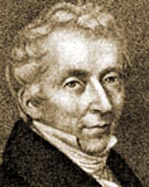
Mun, England’s Treasure, 1664 (after his death)
Ch.1 Qualities . . . required in a perfect Merchant...
A good Penman, a good Arithmetician, and a good Accountant
Attain the speaking of divers Languages, . . . laws, customs, policies, manners, religions, arts . . .
It (at least) required, that in his youth he learn the Latin tongue, which will the better enable him in all the rest of his endeavors
Thomas Mun
1571-1641

Slide 6
Mun, England’s Treasure, 1664
Ch.2 The Means to Enrich this Kingdom
Although a Kingdom may be enriched by gifts received, or by purchase taken from some other Nations, yet these are things uncertain and of small consideration when they happen. The ordinary means therefore to increase our wealth and treasure is by Foreign Trade, wherein we must ever observe this rule; to sell more to strangers yearly than wee consume of theirs in value.
It cometh to pass in the stock of a Kingdom, as in the estate of a private man; who has …two thousand pounds of ready money in his Chest: If such a man through excess shall spend one thousand five hundred pounds per annum, all his ready money will be gone in four years.

Slide 7
Mun, England’s Treasure, 1664
Ch.3 The … Ways and Means to Increase … Exportation … and decrease ... Consumption of Foreign Wares
Laying the waste grounds ... into ... employments
Soberly refrain from excessive consumption of foreign wares in our diet and raiment, with such often change of fashions
Not only regard our .. superfluities, but ...our neighbors’ necessities
Exportations ... perform it ourselves in our own Ships
It is needful also not to charge the native commodities with too great customs, lest by endearing them to the strangers use, it hinder their vent…

Slide 8
Criticisms of Mercantilism
Adam Smith
Mercantilists have wrong conception of wealth
David Hume
Mercantilist trade surpluses are unsustainable and self limiting

Slide 9
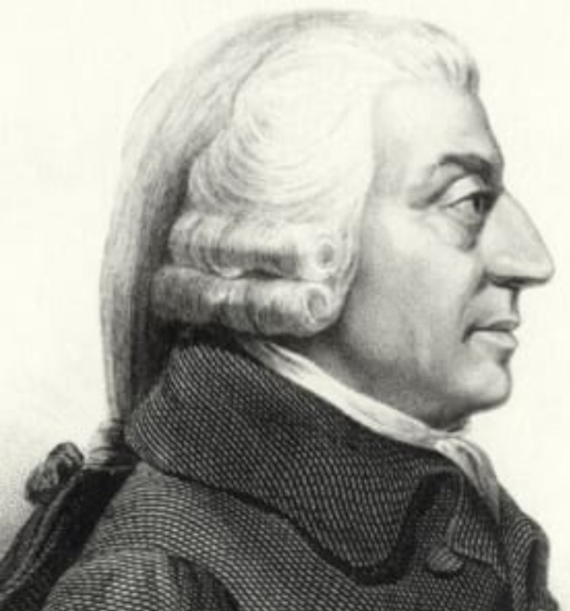
Adam Smith on Mercantilism
Erroneous conception of wealth
[Adam Smith, Wealth of Nations IV, 8, 49, p. 660]
Consumption is the sole end and purpose of all production; and the interest of the producer ought to be attended to only so far as it may be necessary for promoting that of the consumer. The maxim is so perfectly self evident that it would be absurd to attempt to prove it. But in the mercantile system the interest of the consumer is almost constantly sacrificed to that of the producer; and it seems to consider production, and not consumption, as the ultimate end and object of all industry and commerce.
Adam Smith
1723-1790

Slide 10
Adam Smith on Mercantilism
Source of the misconception: Fallacy of composition
[Wealth of Nations IV, 1, 1, p. 429]
That wealth consists in money, or and silver, is a popular notion which naturally arises from the double function of money, as the instrument of commerce and as the measure of value... We say of a rich man that he is worth a great deal, and of a poor man that he is worth very little money....
A rich country, in the same manner as a rich man, is supposed to be a country abounding in money; and to heap up gold and saver in any country is supposed to be the readiest way to enrich it.

Slide 11
Defense of Wealth Conception
Historical Relativism
Gold was important during era of nation-building to buy armaments, hire mercenaries, etc.
J.M. Keynes
Control of the trade balance was a tool of expansionary monetary policy to stimulate growth and employment.

Slide 12
Defense of Wealth Conception
[Mun, England's Treasure by Foreign Trade, Ch. 21]
Behold then the true form and worth of foreign Trade, which is, The great Revenue of the King, The honor of the Kingdom, The Noble profession of the Merchant, The School of our Arts, The supply of our wants, The employment of our poor, The improvement of our Lands, The Nursery of our Mariners, The walls of the Kingdoms, The means of our Treasure, The Sinews of our wars, The terror of our Enemies.

Slide 13
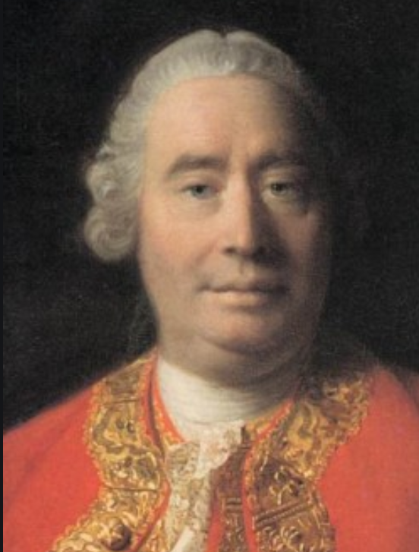
Hume’s Specie Flow Mechanism
X>I => +G => +M => +P => -X,+I
Where: X = Exports
I = Imports
G = Gold Stock
M = Money Supply
P = Price Level
David Hume
1711-1776

Slide 14
Answers to Specie Flow Mechanism
X>I => [+G =?> +M] => +P => -X,+I
Mun versus Bullionists (England’s Treasure, Ch. 4)
If we were once poor, and now having gained some store of money by trade with resolution to keep it still in the Realm; shall this cause other Nations to spend more of our commodities than formerly they have done, whereby we might say that our trade is Quickened and Enlarged? No verily, it will produce no such good effect: but rather ... we may expect the contrary; for all men do consent that plenty of money in a Kingdom doth make the native commodities dearer, which as it is to the profit of some private men in their revenues, so is it directly against the benefit of the Public in the quantity of the trade; for as plenty of money makes wares dearer, so dear wares decline their use and consumption.
So Mun apparently understood the Specie Flow Mechanism, but wanted to avoid it.

Slide 15
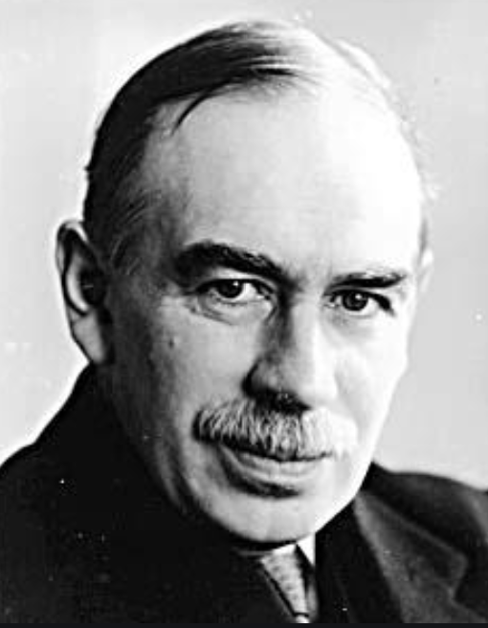
Answers to Specie Flow Mechanism
X>I => +G => [+M =?> +P] => -X,+I
J.M. Keynes:
If the economy is not fully employed,
+M => -Interest rate => + production and employment, not +P
see Keynes, pp. 335-338
John Maynard
Keynes
1883-1946

Slide 16
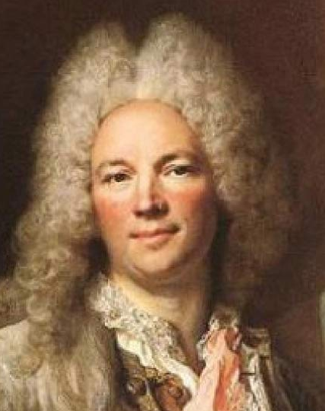
Answers to Specie Flow Mechanism
X>I => +G => +M => [+P =?> -X,+I]
[Richard Cantillon, Essay on the Nature of Commerce, III, 1]
The increase in the quantity of silver circulating in a state gives it great advantages in foreign trade so long as this abundance of money lasts. The state then exchanges a small quantity of produce and labor for greater. It raises its taxes more easily and finds no difficulty in obtaining money in case of public need.
It is true that the continued increase of money will at length by it abundance cause a dearness of land and labor in the state. The goods and manufactures will in the long run cost so much that the foreigner will gradually cease to buy them, and will accustom himself to get them cheaper elsewhere, and this will by imperceptible degrees ruin the work and manufactures of the state.
Richard
Cantillon
1680-1734

