Slide 1
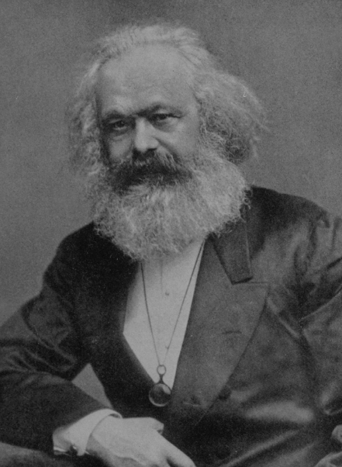
Karl Marx
Part 2
The Future of Capitalism,
The Rise of Socialism, and
the critique of Marx’s Theories of
Value and Exploitation

Slide 2
The Future of Capitalism
Falling Profits
Adam Smith and David Ricardo - profits falling because of rising wages. Smith thinks rising real wages, caused by economic growth; Ricardo thinks rising nominal wages, caused by rising food prices. Smith – not a problem. Ricardo – can be halted
Marx - Caused by rising competition among capitalist businesses, requiring them to use more and more machinery to improve efficiency and reduce costs of production. The innovation would provide higher short-term profits to the first adopters of new technologies, but would reduce profits for the capitalist class in the long run, because machines, unlike labor, cannot be exploited. An inevitable result of capitalism.

Slide 3
The Future of Capitalism
Falling Profits
Machines cannot, in the long run, be exploited, because, according to the labor theory of value, only live labor can create new value. Workers can create new value, and more than their own value, but machines can only transfer the labor value that was used to produce them. If it took 1,000 hours to build a machine, and then the machine can be used to produce 1,000 widgets (before the machine falls apart), then 1 hour of original labor will be transferred into each widget through the machine. The machine, unlike labor, cannot create surplus value, so it cannot be exploited. In the long run, a machine has a zero rate of return.

Slide 4
The Future of Capitalism
Falling Profits
So why would capitalists buy machines if they are not profitable in the long run? Marx’s answer: Because the machines reduce production costs, which provide higher short-term profits to the first adopters.
Eventually, though, as more capitalists adopt the machines, the prices of goods will fall with declining costs of production and rising competition. When a new long-run equilibrium is reached, the rate of profit will be lower than it was at the beginning, because capitalists are now putting more of their investment dollars into machines, which have a zero long-term rate of return, instead of hiring more workers, who produce surplus value and can be exploited.

Slide 5
The Future of Capitalism
Falling Profits
Wage Labour and Capital, in Reader, p. 212-213,
“The one capitalist can drive the other from the field and carry off his capital only by selling more cheaply. . .
And so there arises among the capitalists a universal rivalry for the increase of the division of labor and of machinery and for their exploitation upon the greatest possible scale.
If, now, by a greater division of labor, by the application and improvement of new machines… a capitalist has found the means of producing … a larger amount of products of commodities than his competitors … how will this capitalist act? . . .
But the privilege of our capitalist is not of long duration. Other competing capitalists introduce the same machines, the same division of labor, and introduce them upon the same or even upon a greater scale. And finally this introduction becomes so universal that the price of the linen is lowered not only below its old, but even below its new cost of production.”

Slide 6
The Future of Capitalism
Falling Wages
Wage Labor and Capital, in Reader, p. 214-215
“The greater division of labor enables one laborer to accomplish the work of five, 10, or 20 laborers; it therefore increases competition among the laborers fivefold, tenfold, or twentyfold. The laborers compete not only by selling themselves one cheaper than the other, but also by one doing the work of five, 10, or 20; and they are forced to compete in this manner by the division of labor, which is introduced and steadily improved by capital.
Furthermore, to the same degree in which the division of labor increases, is the labor simplified. The special skill of the laborer becomes worthless. He becomes transformed into a simple monotonous force of production, with neither physical nor mental elasticity. His work becomes accessible to all; therefore competitors press upon him from all sides. Moreover, it must be remembered that the more simple, the more easily learned the work is, so much the less is its cost to production, the expense of its acquisition, and so much lower must the wages sink -- for, like the price of any other commodity, they are determined by the cost of production. Therefore, in the same manner in which labor becomes more unsatisfactory, more repulsive, do competition increase and wages decrease.”

Slide 7
The Future of Capitalism
Rising Concentration, Socialization of Wealth
Capital, vol I, Chapter 32, Reader, 436-38
“As soon as this process of transformation has sufficiently decomposed the old society from top to bottom, … the further expropriation of private proprietors, takes a new form. That which is now to be expropriated is no longer the laborer working for himself, but the capitalist exploiting many laborers. This expropriation is accomplished by … the centralization of capital. One capitalist always kills many… Along with the constantly diminishing number of the magnates of capital, … grows the mass of misery, oppression, slavery, degradation, exploitation; but with this too grows the revolt of the working-class… Centralization of the means of production and socialization of labor at last reach a point where they become incompatible with their capitalist integument. Thus integument is burst asunder. The knell of capitalist private property sounds. The expropriators are expropriated. . .”

Slide 8
The Future of Capitalism
Revolution
Socialism: Utopian and Scientific, Reader, 717
The proletariat seizes the public power, and by means of this transforms the socialized means of production, slipping from the hands of the bourgeoisie, into public property. . . . Socialized production upon a predetermined plan becomes henceforth possible. The development of production makes the existence of different classes of society thenceforth an anachronism.
Speech delivered to The First International Working Men's Association, September 8, 1872, in Amsterdam, Reader, 523
But we have not asserted that the ways to achieve that goal are everywhere the same.
You know that the institutions, mores, and traditions of various countries must be taken into consideration, and we do not deny that there are countries -- such as America, England … -- where the workers can attain their goal by peaceful means. This being the case, we must also recognize the fact that in most countries on the Continent the lever of our revolution must be force; it is force to which we must someday appeal in order to erect the rule of labor.

Slide 9
The Nature of Socialism/Communism
Any discussion of Marx’s views on the nature and future of socialism should take two realities into account:
  Marx and Engels were competing with a LOT of other people for leadership of the socialist movements in Europe and the UK during their time, and some of those people had large followings.
  Marx wrote MUCH more about the nature of capitalism and the forces that (he thought) would cause it to fail than he ever wrote about the nature and future of socialism.

Slide 10
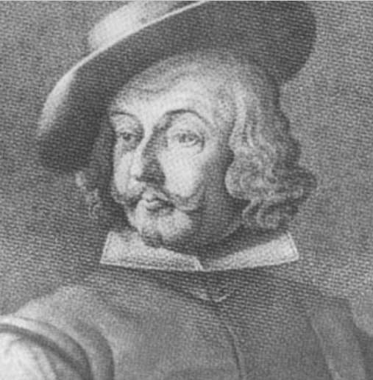
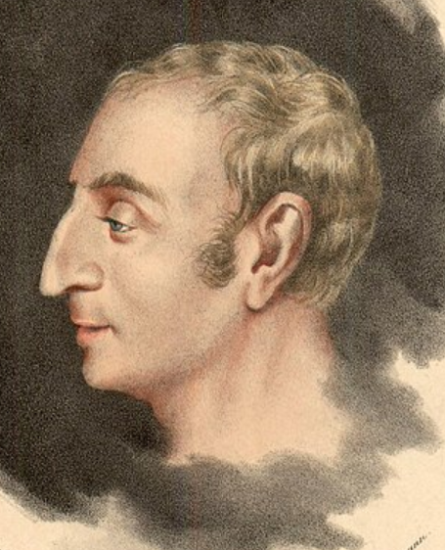
Other Socialists: Christian Socialists
Jakob Hutter (c1500-1536) Tyrolean (now part of northern Italy) Anabaptist leader who led his congregations to practice of communal ownership of goods, following the example of the early church in Acts, in addition to their Anabaptist beliefs of nonviolence, and adult baptism. Today, Hutterites, like the Amish, still live in rural minimalist communities.
Henri de Saint-Simon (1760-1825) In New Christianity, he argued that “The whole of society ought to strive towards the amelioration of the moral and physical existence of the poorest class.” To that end, he wanted to elevate the status of all productive and creative people, including businesspeople, artists, scientists, and bankers, along with manual labourers.

Slide 11

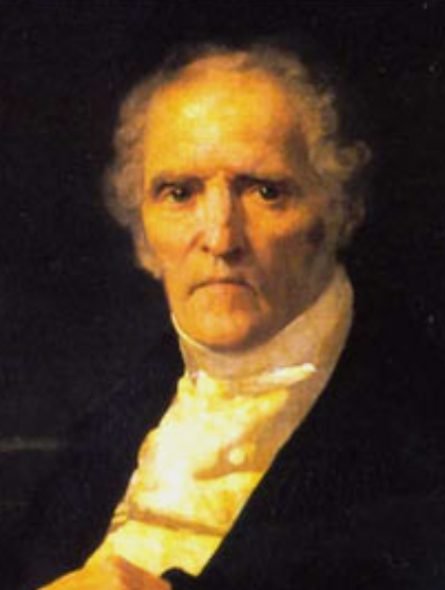
Other Socialists: Utopians
Robert Owen (1771-1858) Welsh manufacturer who introduced universal education and other social reforms in his New Lanark mills in Scotland, and then proposed a voluntary reorganization of society into producer cooperatives, such as his “utopian” community in New Harmony, Indiana, U.S.
Charles Fourier (1772-1837) French feminist who proposed communitarian socialism organized around self-sufficient "phalansteries," such as Brook Farm in Massachusetts and La Reunion in Dallas.

Slide 12
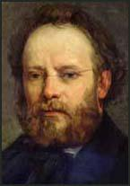
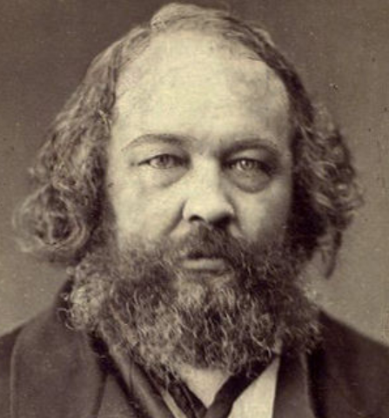
Other Socialists: Anarchists
Pierre-Joseph Proudhon (1809-1865) French libertarian author/parliamentarian who declared that “property is theft” and supported voluntary workers’ councils. “It is industrial organization that we will put in place of government… In place of laws, we will put contracts… In place of political power, we will put economic forces… In place of standing armies, we will put industrial associations. In place of police, we will put identity of interests.”
Mikhail Bakunin (1814- 1876) Proudhon’s Russian-born anarchist disciple who was involved in revolu-tionary movements in several countries.

Slide 13
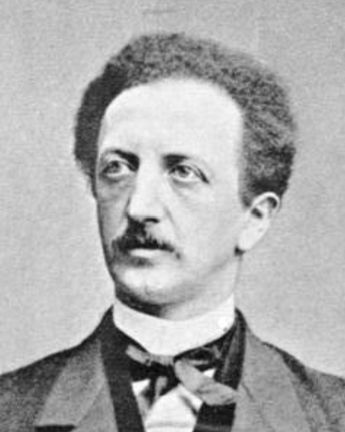
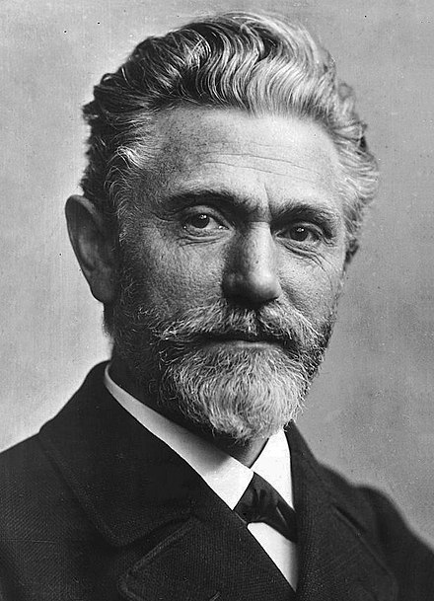
Other Socialists: Democratic Socialists
Ferdinand LaSalle (1825-1864) Prussian-German lawyer/philosopher established the first social democratic party in Germany. As a nationalist, he was able to find common ground with Bismarck on German unification, leading to parliamentary reforms that are still popular today.
August Bebel (1840- 1914) German parliamentarian and a founder of the Social Democratic Workers' Party in 1869 that merged at Gotha in 1875 into the Socialist Workers' Party. As a leading figure of the social democratic movement, he served as chairman of the Social Democratic Party of Germany from 1892 until his death in 1914. Generally opposed rising racial supremacism, militarization, and colonial policies in Africa.

Slide 14
The Nature of Socialism/Communism
Most of the writing of Marx and Engels was focused on the history, nature, “laws of motion,” and eventual fate of the capitalist system. They predicted that capitalism would eventually fail, but most of their writing told us very little about their proposal for a future socialist system that would replace capitalism. Even in his tract, “Socialism: Utopian and Scientific,” Engels primarily discussed various socialist critiques of capitalism.
We get some idea, however, of the Marxian view of socialist institutions in two of their publications: The Communist Manifesto and Critique of the Gotha Program

Slide 15

The Nature of Socialism/Communism
In 1847, a financial crisis and rising unemployment sparked a revolutionary movement in 1848 that broke out in France and quickly spread to other countries. In London, the new Communist League, invited Marx and Engels (early in their careers – Marx was 30 years old) to write a program for their organization, and the result was The Communist Manifesto, which opened, “A spectre is haunting Europe — the spectre of communism… To this end, Communists of various nationalities have assembled in London and sketched the following manifesto, to be published in the English, French, German, Italian, Flemish and Danish languages.”

Slide 16
The Nature of Socialism/Communism
The Communist Manifesto included these details about the nature of the new socialist society:
“These measures will, of course, be different in different countries. Nevertheless, in most advanced countries, the following will be pretty generally applicable.
1. Abolition of property in land and application of all rents of land to public purposes.
2. A heavy progressive or graduated income tax.
3. Abolition of all rights of inheritance.
4. Confiscation of the property of all emigrants and rebels.
5. Centralization of credit in the banks of the state, by means of a national bank…
6. Centralization of the means of communication and transport in the hands of the state.
7. Extension of factories and instruments of production owned by the state…
8. Equal obligation of all to work. Establishment of industrial armies, especially for agriculture.
9. Combination of agriculture with manufacturing industries; gradual abolition of all the distinction
between town and country by a more equable distribution of the populace over the country.
10. Free education for all children in public schools. Abolition of children's factory labor in its present
form.

Slide 17
The Nature of Socialism/Communism
Marx, as we have seen, thought that existing national governments were controlled by the capitalist class, so socialist goals could NOT be accomplished by simple democratic action and reforms of existing institutions – they usually required violent revolution
Ferdinand LaSalle had argued (correctly) that Bismarck could be convinced to create a parliament, and the socialists could win elections and enact major reforms, such as unemployment compensation.
In 1875, the followers of Marx and LaSalle (now Bebel) met in Gotha, Germany, to unite under a single party and program. When Marx’s followers delivered the new program to him, he wrote an impassioned critique that included interesting insights on his conception of socialism.

Slide 18
The Nature of Socialism/Communism
Marx, Critique of the Gotha Programme, 1875
What we have to deal with here is a communist society … as it emerges from capitalist society; which is thus in every respect, economically, morally, and intellectually, still stamped with the birthmarks of the old society from whose womb it emerges. Accordingly, the individual producer … receives a certificate from society that he has furnished such-and-such an amount of labor . . .; and with this certificate, he draws from the social stock of means of consumption as much as the same amount of labor cost. The same amount of labor which he has given to society in one form, he receives back in another. . .
In a higher phase of communist society, . . . after labor has become not only a means of life but life's prime want; after the productive forces have also increased with the all-around development of the individual, and all the springs of co-operative wealth flow more abundantly -- only then then can the narrow horizon of bourgeois right be crossed in its entirety and society inscribe on its banners: From each according to his ability, to each according to his needs!
… The question then arises: What transformation will the state undergo in communist society? In other words, what social functions will remain in existence there that are analogous to present state functions? . . .
Between capitalist and communist society there lies the period of the revolutionary transformation of the one into the other. Corresponding to this is also a political transition period in which the state can be nothing but the revolutionary dictatorship of the proletariat.

Slide 19
The Nature of Socialism/Communism
Gardner Summary
  Soon after the revolution, the “new socialist people” have not yet been conditioned, so people still need material incentives. Distribution will be “to each according to his work” – which is already, according to Marx, Mill, and other authors, a big change from the current system
  Only later, after people have become unselfish and hard-working, and there’s an abundance of goods, will it be “to each according to his needs.”
  Also soon after the revolution, class struggle continues, so the government will be a “dictatorship of the proletariat” (an ironic term coined by Joseph Weydemeyer, a Prussian general and socialist who also fought for the Union in the U.S. Civil War). Only later will there be a “withering away of the state,” which was wanted immediately by Proudhon and the other socialist anarchists.
  So Marx, in many ways, considered himself to be the “adult in the room.”

Slide 20
Criticisms of Marx
“The Great Contradiction”
  From the beginning, Marx’s ideas were criticized by Austrians, who continue, to this day, to be devoted to free markets.
  In particular, Eugen Böhm-Bawerk, in his History and Criticism of Interest Rate Theories (1884), noted a problem in Marx‘s theory of exploitation, rooted in the Labor theory of value. It suggests that labor-intensive sectors (say, textiles), would have higher rates of return than capital-intensive sectors (say, steel). But we know that rates of return, adjusted for risk, tend to equalize in market economies, suggesting that Marx‘s theory of exploitation (which he considered his most important contribution) must be incorrect:
  “Either products do actually exchange in the long run in proportion to the labor attaching to them—in which case an equalization of the gains of capital is impossible; or there is an equalization of the gains of capital—in which case it is impossible that products should continue to exchange in proportion to the labor attaching to them.”

Slide 21
Criticisms of Marx
“The Great Contradiction”
  When the third volume of Capital was published after Marx’s death, it turned out that Marx had an answer to Böhm-Bawerk‘s critique. Yes, it‘s true, he said, that profit rates tend to equalize across sectors in the long run, causing the market prices of goods to depart from their true labor values, but that doesn‘t change the overall volume of „surplus value“ (profit) collected by the capitalist class – it only redistributes profits from one capitalist to another, so the „transformation of values to prices“ doesn‘t change the basic expoitive nature of capitalist society.
  The debate over the „transformation problem“ (the relationship between labor values and market prices) continues to this day

Slide 22
Criticisms of Marx
Reform versus Revolution
In a May 3, 2018 article, The Economist declares that “the chief reason for the continuing interest in Marx … is that his ideas are more relevant than they have been for decades. The post-war consensus that shifted power from capital to labor and produced a ‘great compression’ in living standards is fading. Globalization and the rise of a virtual economy are producing a version of capitalism that once more seems to be out of control.”
However, The Economist concludes that “Marx’s greatest failure … was that he underestimated the power of reform—the ability of people to solve the evident problems of capitalism through rational discussion and compromise… The great theme of history in the advanced world since Marx’s death has been reform rather than revolution. Enlightened politicians extended the franchise so working-class people had a stake in the political system. They renewed the regulatory system so that great economic concentrations were broken up or regulated...
“Today’s great question is whether those achievements can be repeated. The backlash against capitalism is mounting—if more often in the form of populist anger than of proletarian solidarity. So far liberal reformers are proving sadly inferior to their predecessors in terms of both their grasp of the crisis and their ability to generate solutions. They should use the 200th anniversary of Marx’s birth to reacquaint themselves with the great man—not only to understand the serious faults that he brilliantly identified in the system, but to remind themselves of the disaster that awaits if they fail to confront them.”

