Slide 1
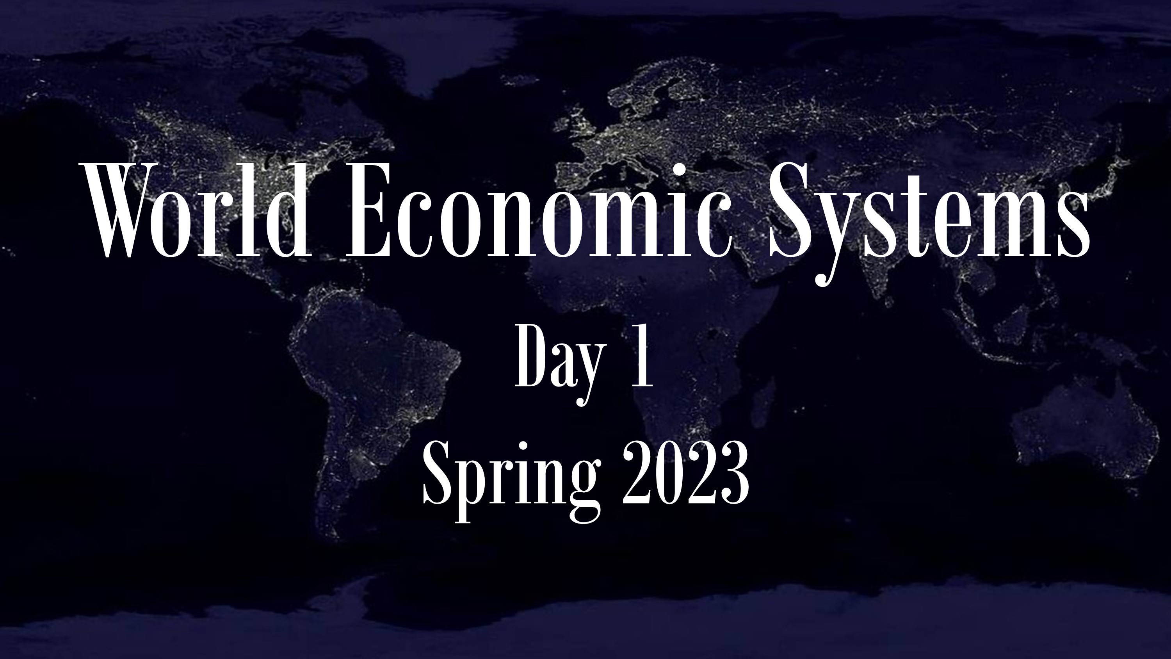

Slide 2
Information Card
Name (as you wish to be known)
Degree program
Phone (if you have one)
Hometown
Lived in these countries
Hope to learn/discuss…

Slide 3
SELECTED SPRING 2023 EVENTS
February 1, Ozomotley (Chicano Rock), Woodway Arboretum, 7pm
February 8, tickets go on sale for the Tony-award winning musical, “Once,” that will be performed Feb 22-26, Mabee Theater
February 20, Chamber Singers and A Capella Choir, First Baptist Church, 7:30-9:00pm
February 23, Ukraine event with Volodymyr Kulikov and others, 3:20pm
February 23, Concert Jazz Ensemble, Jones Concert Hall, 7:30-9:00pm
February 24, Keston Symposium, TBA
March 2, Baylor Symphony, Jones Hall, 7:30-9:00pm
March 15-18, Pruit Symposium, Andrae Crouch
April 11, tickets go on sale for Shakespeare’s “Comedy of Errors,” performed April 25-30
April 26, Baylor Symphony, Jones Hall, 7:30-9:00pm
Pruit Symposium
Baylor Theater

