Slide 1
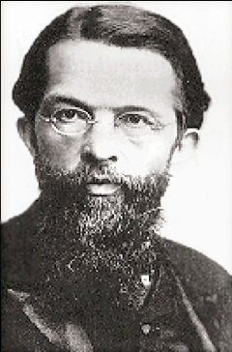
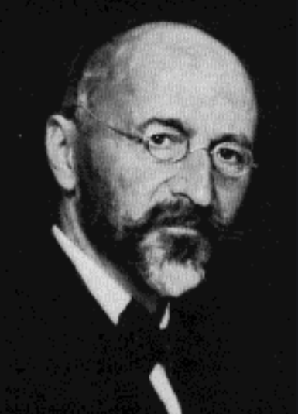
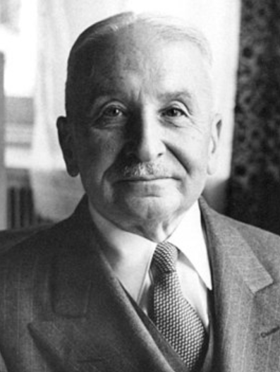
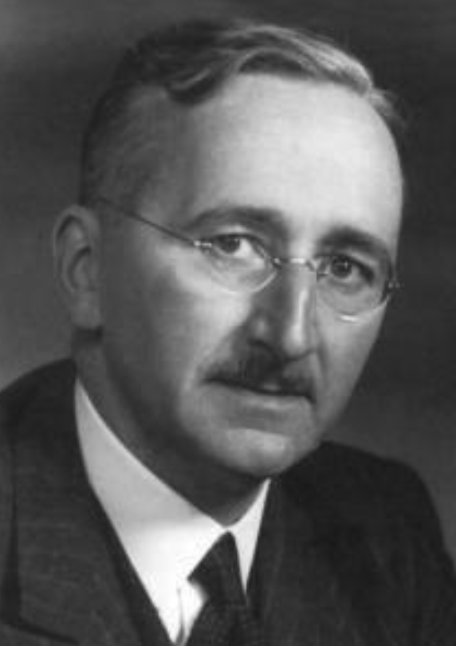
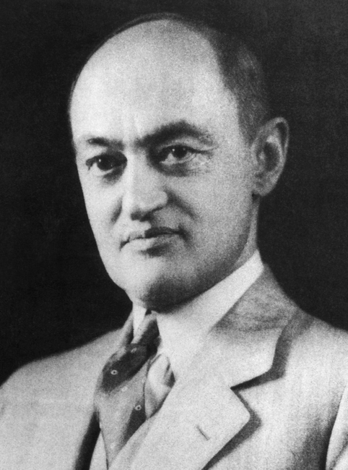
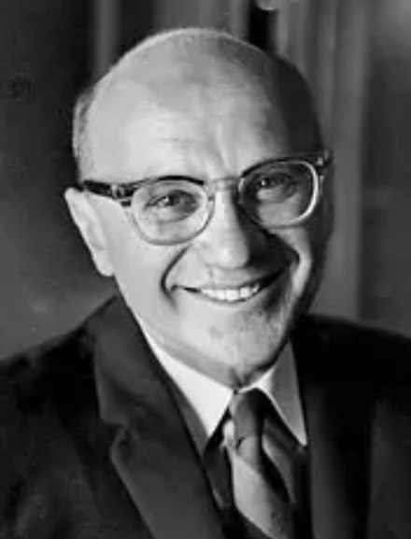
Austrian Economics, Milton Friedman, and The Chicago School
Carl
Menger
1840-1921
Eugen von
Böhm-Bawerk
1851-1914
Ludwig
von Mises
1881-1973
Friedrich
von Hayek
1899-1992
Joseph Schumpeter
1883-1950
Milton
Friedman
1912-2006
Gary
Becker
1930-2014

Slide 2
Introduction
I’m blending a bit of Austrian economics into this lecture that’s mainly about Milton Friedman, who is associated with Monetarism and the approach of the “Chicago School.” However, it should be understood that the Austrian economists and the followers of Friedman have both similarities and differences.
Similarities – Most of these authors had/have a strong preference for protecting individual liberties and restricting governmental intervention in the economy – including their opposition to Keynesian attempts to tame the business cycle.
Differences – Austrian economics is rooted in a radically subjective theory of value, while Chicago and other neoclassical economists follow the Marshallian “scissors” synthesis of objective and subjective factors. Members of the Austrian School are/were opposed to using calculus or modern statistical analysis in their work while it is fully accepted in Chicago/neoclassical economics.
For more, see Bryan Caplan’s “Why I Am Not An Austrian Economist.”

Slide 3


Austrians
Carl Menger (1840-1921) is known as the father of the Austrian
School of economics. A professor at he University of Vienna, he was one of the founders of the Marginal Revolution, offering a subjective theory of value as a substitute for the labor theory of value, and he argued for a deductive approach to analysis in contrast with the inductivism of the German Historical School.
Eugen von Böhm-Bawerk (1851-1914) was a follower of Menger at in Innsbruck and Vienna who developed a theory of the interest rate based on the concept of “time preference” (we would prefer to be satisfied sooner rather than later), but he may be best known for his criticism of Marx’s theory of exploitation based on flaws in the labor theory of value.

Slide 4

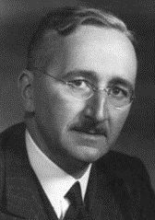
Austrians
Ludwig von Mises (1881-1973) earned a doctorate at the University of Vienna and worked closely with Böhm-Bawerk in his early career. He held public and academic posts in Austria and Switzerland but came to the U.S. in 1940 and taught at New York University for 24 years. He was a voluminous writer on Austrian methodology and monetary theory but may be best known for his argument against the possible efficiency of socialism.
Friedrich von Hayek (1899-1992), also trained at the University of Vienna, gained his greatest recognition in economics (and a Nobel prize) for his 1945 article, “The Use of Knowledge in Society,” describing the efficiency with
which the market system delivers information to those who need it. He also
worked on monetary theory and business cycles, became better known for
his The Road to Serfdom, warning that economic planning could lead to
despotism. However, he supported intervention in some cases, drawing criticism from Ayn Rand.

Slide 5

Austrians
Joseph Schumpeter (1883-1950) was considered by Peter Drucker, the famous management theorist, to be one of the “two greatest economists of this century” (together with Keynes). He was born in Moravia, then part of Austria-Hungary (now part of the Czech Republic) and studied under Böhm-Bawerk at the University of Vienna where he earned his PhD. He held a series of public, financial, and academic appointments in Europe, but moved to the U.S. in 1940 and spent much of his career at Harvard.
Like the other Austrians, Schumpeter was critical of socialism, and warned that it could lead to dictatorship, but he rejected the methodological constraints of the Austrian School, and it’s difficult to put him in any conventional category. Obviously, Drucker loved him because of his emphasis on the importance of entrepreneurship – that capitalist competition was not so much about prices, but more about new products and productions processes and higher quality. Competition was a process of “creative destruction,” so he had little concern about the rise of “big business,” and thought the business cycle was part of the creative process.

Slide 6
Joseph A. Schumpeter, Capitalism, Socialism and Democracy, 3rd ed., 1950
Chapter VII: The Process of Creative Destruction
“The opening up of new markets, foreign or domestic, and the organizational development
from the craft shop and factory to such concerns as U. S. Steel illustrate the same process of industrial mutation … that incessantly revolutionizes the economic structure from within, incessantly destroying the old one, incessantly creating a new one. This process of Creative Destruction is the essential fact about capitalism. It is what capitalism consists in and what every capitalist concern has got to live in…
But economists who … look for example at the behavior of an oligopolist industry - an industry which consists of a few big firms - and observe the well-known moves and countermoves within it that seem to aim at nothing but high prices and restrictions of
output are [looking only at] the momentary situation as if there were no past or future to it and think that they have understood… In other words, the problem that is usually being visualized is how capitalism administers existing structures, whereas the relevant problem is how it creates and destroys them.”

Slide 7

Milton Friedman
Although some would claim this for Schumpeter or Hayek*, I would argue that the most influential economist of the 20th century, other than Keynes, was Milton Friedman (1912-2006). Born in Brooklyn, New York, of immigrant Jewish parents, Friedman earned his BA at Rutgers, his MA at U. Chicago, and his PhD at Columbia U. After earlier academic appointments he spent most of
his career (1946-1977) at U. Chicago where he continued a tradition of rigorous incentives-based neoclassical economics (following the lead of Frank Knight, Jacob Viner, and other) and moved it more strongly in a market-oriented rejection of Keynesian “fine tuning” and other forms of governmental intervention, an emphasis on a steady monetary policy and flexible exchange rates, etc. We’ve seen that he argued in favor of theories that predict well, even if based on unrealistic assumptions. He won the Nobel price in 1976.
* I noted Peter Drucker’s adulation of Schumpeter in the previous slide. On Hayek, see Nicholas Wapshott’s book, Keynes Hayek: The Clash that Defined Modern Economics or this lecture by Wapshott or the humorous Keynes/Hayek “rap battles,” rounds one and two. Or see Hayek himself on Keynes.

Slide 8
A Few of the Issues Addressed by Friedman
Inflation
Unemployment
International Balances of Payments
Poverty
Ineffective Schools
Drug Crime and Addiction

Slide 9
Inflation: Analysis
“Inflation is always and everywhere a monetary phenomenon.”
Milton Friedman, Studies in the Quantity Theory of Money, 1956

Slide 10
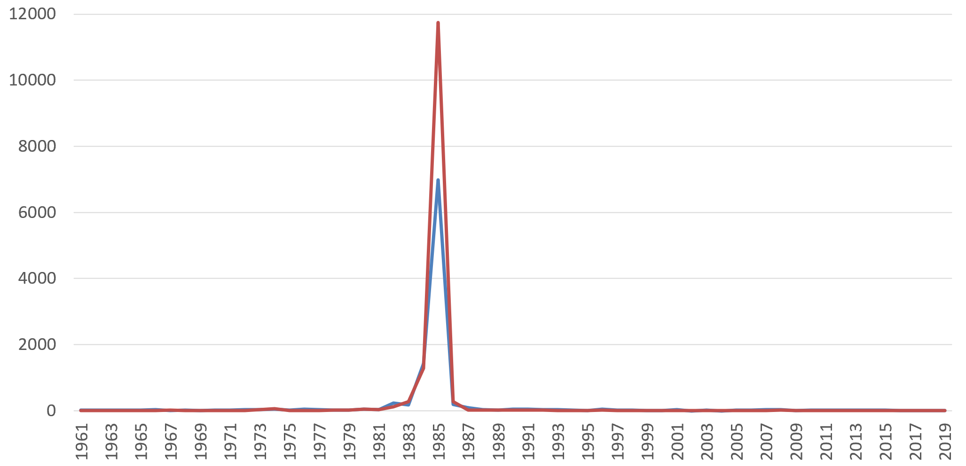
Bolivian Money Growth (blue) and Inflation (red)
Source: World Bank World Development Indicators

Slide 11
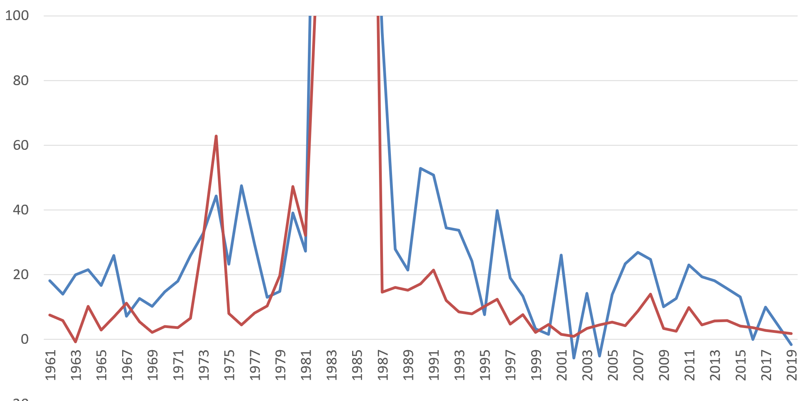
Bolivian Money Growth (blue) and Inflation (red)
Source: World Bank World Development Indicators

Slide 12
Inflation: Friedman Prescription
The “Constant Monetary Growth Rule”
If the velocity of circulation of money (V) is constant (based on institutional factors, as assumed in the simple Quantity Theory, and if real GDP (y) is growing, on average, by, say 4%/year, then the Money Supply (M) can also grow by about 4%/year without causing inflation of prices (P).
4%
4%
MV = P y
So Friedman suggested that the Central Bank (such as the Federal Reserve) should maintain a slow and steady growth of the money supply, regardless of whether the economy is in a boom or recession – don’t try to “fine tune” the economy. But there were two problems: (1) the constant velocity assumption has not remained true and (2) the Fed has a “dual mandate” to control inflation and unemployment.

Slide 13
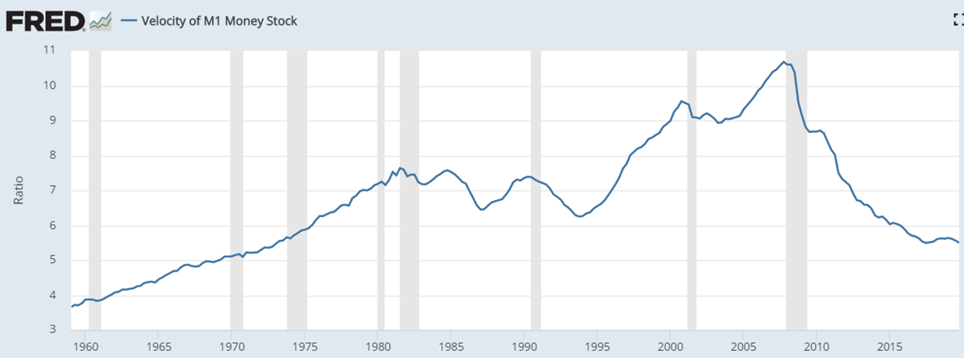
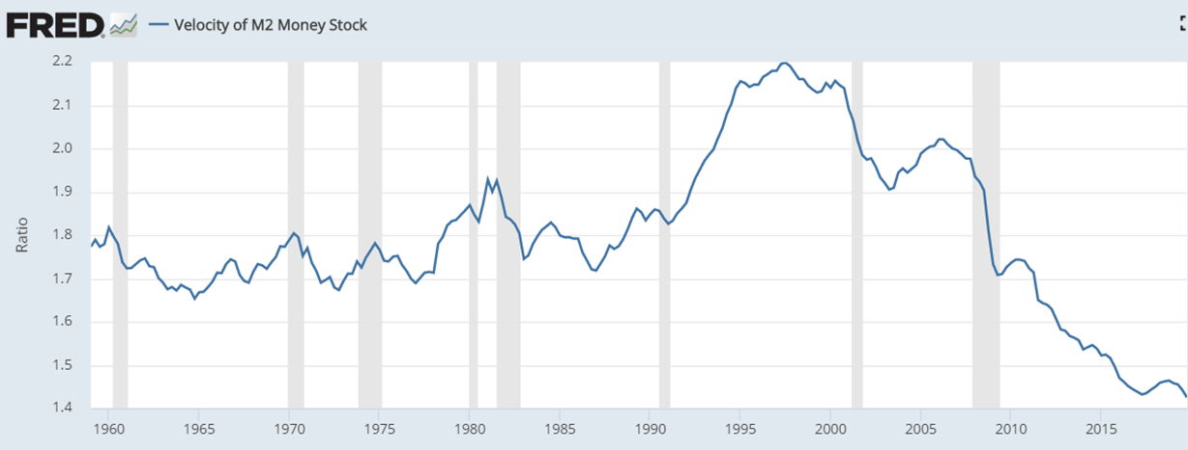
M2 velocity was somewhat stable before 1990, but not after

Slide 14
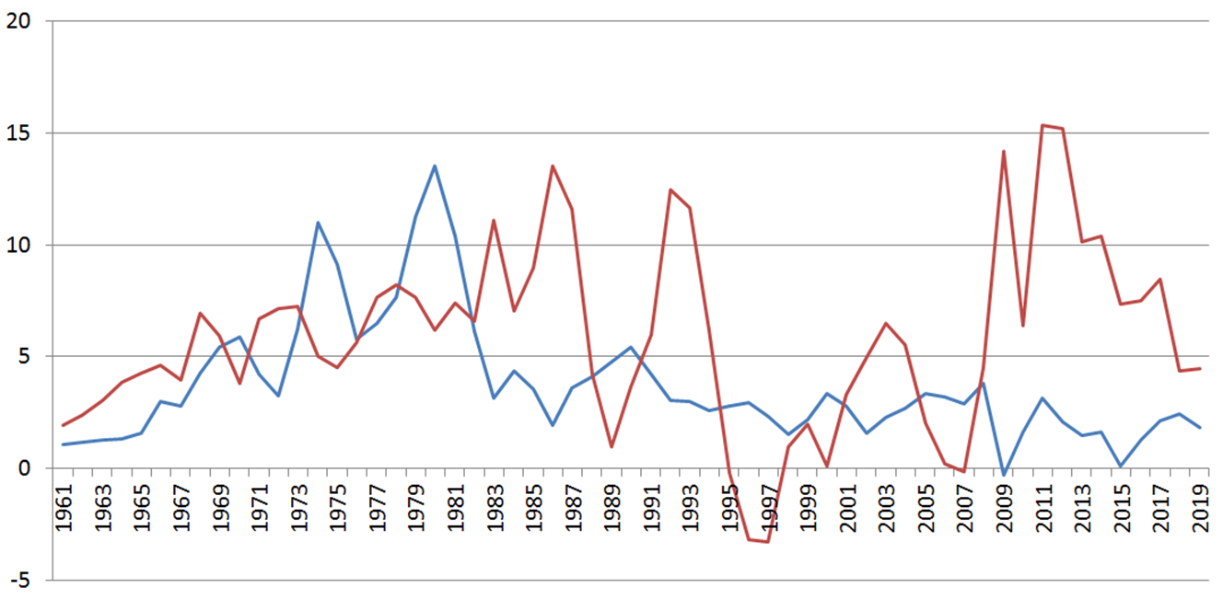
So the relationship between Money Growth and Inflation has broken down

Slide 15
Friedman on Unemployment
In his Nobel Lecture, “Inflation and Unemployment,” and elsewhere, Friedman argued against the notion that there is a stable Phillips Curve – a stable long-term trade-off between inflation and unemployment. Yes, in the short run, if the central bank stimulates the economy with rapid monetary growth, it will cause inflation to accelerate and unemployment to fall temporarily, but then people will start expecting the higher inflation, and unemployment will return to its “natural” level, determined by institutional factors, such as the availability of job search information and assistance. If inflation continues to accelerate, it may cause institutional inefficiencies that will increase unemployment in the long run.
So what can be done? Reduce the natural rate of unemployment by improving institutions and market flexibility – NOT inflationary macro policies.

Slide 16
Friedman on Foreign Exchange Markets
The Bretton Woods system, adopted in the major countries after World War II (with Keynes’s involvement) to rebuild global trade, was based on the U.S. Dollar as a central currency with other countries maintaining fixed exchange rates against the Dollar.
Friedman argued that an exchange rate is a price, and markets do not operate well with fixed/inflexible prices, so the world should move to floating exchange rates.
That happened after 1971, not so much because of Friedman’s advice, but because inflationary policies caused the fixed-rate system to fall apart.

Slide 17
Friedman on Poverty Programs
“Most of the present welfare programs should never have been enacted. If they had not been, many of the people now dependent on them would have become self-reliant individuals instead of wards of the state.”
Milton and Rose Friedman, Free to Choose, 1979

Slide 18
Friedman Proposal on Poverty
Replace existing programs with a “negative income tax” – cash benefits that decline fractionally as a person earns income. Advantages:
Maintains work incentives – no sudden loss of benefits (remember J.S. Mill).
Cash gives the poor more discretion, choice, and dignity
Cheaper to manage than multiple programs.
More targeted than a Universal Basic Income program, so the poor could be helped more for the same cost.
$
Pre-Tax Income
After-Tax Income
See Friedman speak on the negative income tax
Minimum
income
45º
Pre-Tax Income
The Earned Income Tax Credit, introduced by President Ford and increased by others, is similar.

Slide 19
Friedman on Education
Public school systems are bureaucratic and monopolistic, so they have little competitive pressure to operate efficiently, provide choice, and deliver a high-quality product. Monopoly power reduces the incentive of the individual to act in the public interest.

Slide 20
Friedman Education Proposal
School Choice Program: Allow families (especially those with children in low-performing schools) to select their own schools in an open “marketplace,” paying with publicly-funded vouchers.
Milton and Rose Friedman, Free to Choose, 1979
Note, again the similarity to John Stuart Mill’s position “that the government must claim no monopoly for its education, either in the lower or in the higher branches; must exert neither authority nor influence to induce the people to resort to its teachers in preference to others, and must confer no peculiar advantages on those who have been instructed by them.”
In the U.S., this has become a left/right ideological struggle, but “liberal” Sweden has a school choice program with state-controlled standards.

Slide 21
Friedman on Drug Crime
Our system of drug laws and controls, like the attempted Prohibition of alcohol, isn’t solving the drug problem, but it is “destroying our poorer neighborhoods in city after city, creating a climate that is destructive to the people who live there.”
This is an example of “the philosophical disagreement between Plato's view that it is right for some of us ("philosopher kings") to tell others of us what they must do because it is good for them, and the doctrine of John Stuart Mill that the role of government is simply to prevent people from doing harm to others…”
Milton Friedman, “The War We Are Losing,” 1991

Slide 22
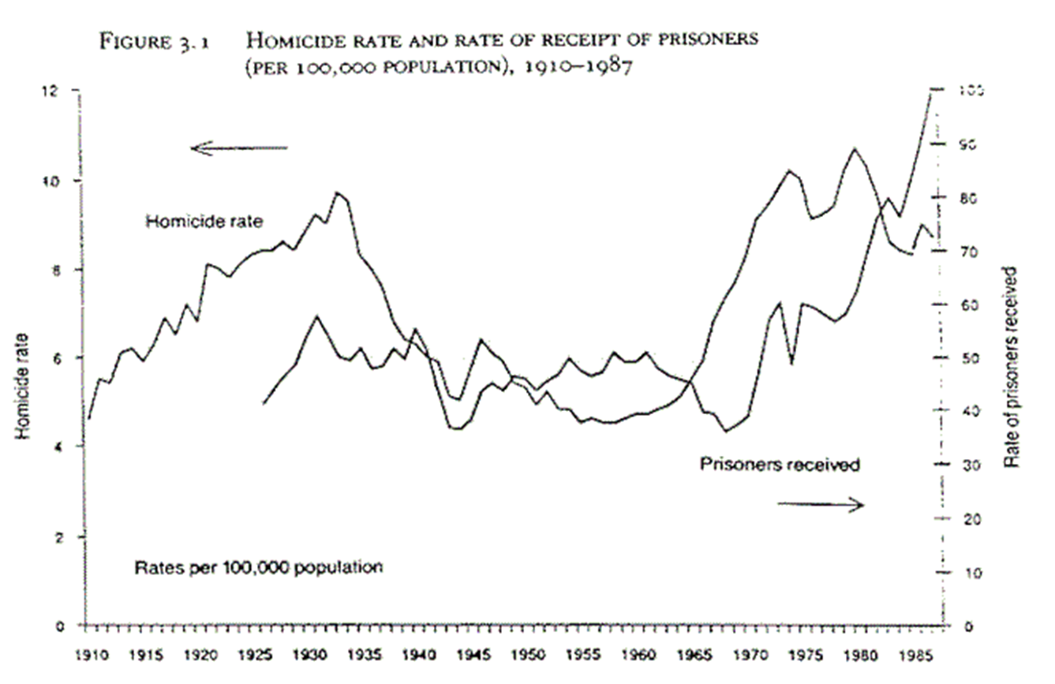

Slide 23
Friedman on Drug Crime - Solutions
The Wrong Solution
“We could … eliminate drugs if we were willing to … cut off the hands of a drug offender; if we were willing to impose capital punishment on drug dealers… Those are cures that are clearly worse than the disease.”
Friedman’s Proposal - Decriminalization
Decriminalize drug use for people over 18 years old. Drug use would increase, Friedman concedes, unless prevention becomes effective, but associated drug crime and use of dangerous street drugs would decline. Resources saved from enforcement could be used for prevention and rehabilitation.

Slide 24
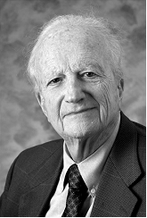
The Continuing Chicago Tradition
After Friedman’s retirement from U. Chicago in 1977 and move to the Hoover Institution at Stanford, the neoclassical tradition was continued by a cast of super-stars in economics, many of whom received Nobel prizes, and it continues as one of the top few departments in the world. Gary Becker’s (1930-2014) influence extends into sociology and political science, because he played an
important role in popularizing the rational-choice (utility-maximizing) framework to issues such as marriage, immigration, racial discrimination, and terrorism.
Super-stars on the Chicago faculty today include Michael Kremer, James Heckman, Steve Levitt, Thomas Sargent, David Galenson, and many others.

