Slide 1

SURVIVING & THRIVING IN ORGANIZATIONS

Slide 2
All of the 42 topics on these 300+ slides play an important role in promoting your professional savvy about organizations. Some of the topics will be more relevant to you than others. Select those of greatest personal interest for your 25 write-ups. Come to class to “chew the fat” on these peak interest slides. That’s where any learning you take with you into the real world will come from.

Slide 3
The slides are designed to present lean, bite-size chunks of information & conclusions. Most of the slides are fairly self-explanatory, but you may find some to be a bit too cryptic or “fuzzy.” If you have a personal interest in some of these, please ask for clarification in class. The online alpha list of course definitions may also be of help.

Slide 4
#1 AMBIDEXTERITY,
ORG

Slide 5


Slide 6
Internal value employees (IVEs) perform technical work (accounting, computer systems, numerical analysis, employee services, etc.) for people inside their org. External value employees (EVEs) handle the business side of things (sales, marketing & comptitiveness), with people outside the org. IVES cost the company money (“cost center”); EVEs make the company money (“profit center”).

Slide 7

AMBIDEXTROUS professionals are
the org “superheros”
capable of generating
both
internal &
external value.
Ambi-pros
usually progress fast & far in their careers,
especially in managing tech work projects.

Slide 8
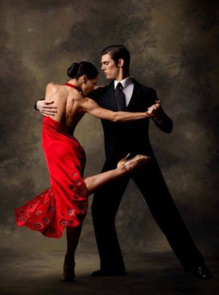
The IVE-EVE tango
Just as the tango involves opposites (male + female), so does
org productivity (IVEs + EVEs).
To perform well, dancers must
perform on a WE, not ME
wavelength. IVEs & EVEs
work best generating both
(ambidextrous) internal &
external value streams.

Slide 9
IVE-EVE GAPOLOGY occurs
when IVES generate:
Too much control-focused information that stifles EVE operating freedom (“IVEitis”)
Inaccurate or outdated operating info
Hard-to-interpret info
To close the gap, EVEs must develop teamwork synergy with IVEs in 3 basic ways:

Slide 10
Link IVEs to the external clients they process info from to empower a synergized relationship that builds a stronger bridge to good client service & loyalty
Arrange for key IVEs to regularly attend key EVE meetings to provide technical advice & counsel (consulting)
Reward IVEs for expanding their professional ambidexterity capabilities.

Slide 11

AMBIDEXTROUS EMPLOYEES:
Understand org operations more clearly & fully
Are above-average problem-solvers & decision-makers
Network well
Excel in
professional development

Slide 12
#2 AMORAL ORGANIZATIONS

Slide 13

Our only agenda
is achieving our
(self-benefitting)
agenda.
“Our agenda is the enda.”

Slide 14
Amoral org behavior = values-neutral (values other than the org’s not considered) actions to achieve a self-serving agenda (greater org success & competitive dominance). Due to the hyper-competitive nature of capitalism in individualism nations, it is necessary to put self-interest before community interests. Government regulations are thus required to hold amoral orgs in check, since most orgs lack a true agenda of community service.

Slide 15
AMORAL TURF
Corporations: profit max, cost min. If you don’t push your org agenda, your competitors will push you right out of business.
Sports: winning is the only thing that matters
Consumers: price is all that matters
Marketing: sell only what people will buy & brainwash them to buy it NOW.
Stock markets: never mind who the company is or what it does, will it make you quick money in the market?

Slide 16
COMMON AMORAL CORPORATE BEHAVIORS
“Off-shoring”: Domestic unemployment caused by relocating operations to much cheaper foreign factories & suppliers
Corp. downsizing: eliminating some employees while doubling the work of others
Debt-financed consumerism to stimulate corporate growth/profit

Slide 17
Numerous large orgs, industry groups, & foreign officials regularly legally donate mega-bucks to U.S. politicians in return for political and personal favors. This determines which 2 political candidates voters can vote for.
Most oil company “fracing” (pumping waste water deep underground in the hopes of freeing up residual oil reserves) has caused numerous damaging earthquake “tremblers” in many areas across the U.S. Oklahoma’s largest ever earthquake (2016) is attributed to fracing activities.
Several major U.S. industries (construction, agriculture, hotels & restaurants, day-care, domestic help) are highly dependent on illegal aliens paid non-subsistence wages.

Slide 18
Volkswagen ($16 billion of world-wide pollution control cheating) & General Motors (cover-up of deadly car defects)
Continuous pro sports drug scandals
Donald Trump “University”
Pharmaceutical companies marketing thousand-dollar per pill drug blackmail
NFL player concussion cover-up
College sports NCAA violations

Slide 19
AMORAL CONSUMER BEHAVIORS
Purchasing products made in “sweatshops”
Staying permanently in debt or “escaping” via bankruptcy
Buying stock in companies that engage in socially irresponsible activities
Buying products (such as gas-guzzler vehicles & illegal drugs) that damage society.

Slide 20
THE POSSIBLE NEGATIVE AFFECTS (“COLLATERAL DAMAGE”) OF AMORAL OPERATIONS ON ORG LIFE
Business as fight-for-your-life warfare
Viewing org constituents as something to exploit > serve
“Pragmatic” (necessary for winning the competitive wars) corruption of orgs
Settling suits over unintended consequences of amoral agenda-seeking
Employee disrespect for their org

Slide 21
Employees with families lose jobs due to outsourcing or downsizing & often have to draw on limited unemployment pay or welfare (thus increasing public taxes) until another job is found.
Industry-related global warming & pollution clean-up are paid by public taxes, not corporate profits.
Companies must hire more & more clerical workers to deal with increasing business regulations designed to protect communities from org amorality.

Slide 22
AMORALITY CAN BE TOUGH ON EMPLOYEES
Firing or demoting employees who don’t benefit the org enough
Looking the other way at exploitative org actions
Covering up for org malfeasance or incompetence
Over-stressing employees
Telling employees one thing but doing another
Going “too far” in public relations or advertising

Slide 23

CLICK for amoral power moves
See topic #31 (“Org Within an Org”) below for perspective on dealing with amoral values in orgs.

Slide 24
#3 CAREER DEVELOPMENT,
TARZAN

Slide 25
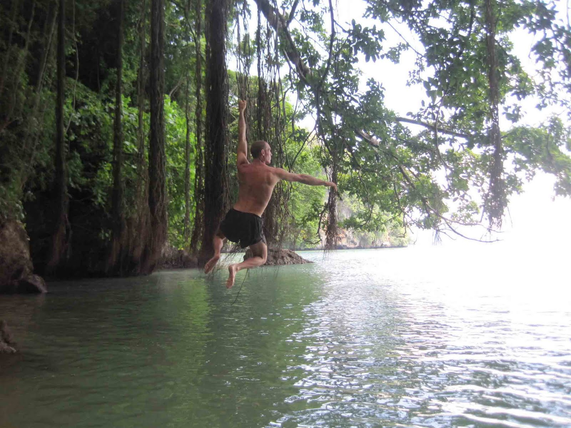
Jungle = the world of your org
Vines = project opportunities in your org
River = the value stream your projects create

Slide 26

How many vines do you want on your wall (career)? Do you want to see solid vines & no wall? Do you want to expand the size of your wall? How long can you keep your vines healthy & green? Who will help you grow new vines? Who will benefit from your vines?

Slide 27
#4 CHANGE MANAGEMENT

Slide 28
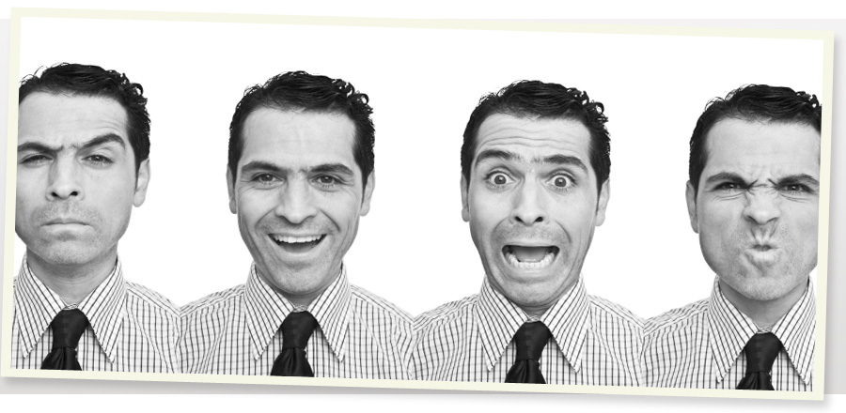
CHANGE is a complex mindset

Slide 29
Change is always agenda-based, or why else would busy professionals tax themselves trying to alter the comfortable org status quo? Thus change is often riddled with “push-back” conflict from those negatively affected by the change, thus limiting the effectiveness of most change management techniques.

Slide 30

THE PSYCHOLOGY BEHIND
4 CHANGE STRATEGIES

Slide 31
#1. STRUCTURAL CHANGE: Job descriptions; org “chart” modifications; org rules, regulations, policies
Most orgs “lower the boom” of structural (power-based) change on employees because it’s easy & quick to implement & impersonal. Unfortunately, power-fueled change tends to alienate employees, reminding them that they are mere “slaves” of the org.

Slide 32
#2. ICE CUBE MODEL:
Making small experimental changes in one area of the org as a pilot test for more extensive & effective future changes
Works at grass roots org level
Requires savvy employee-led leadership & management
Best suited for process (how work is done) change

Slide 33
#3. SUNSET CLAUSE: Employees agree to try out a change & vote several weeks or months later on whether or not to continue with it
Participative & authentic
Potentially compromises org control
Waste of time & resources if later voted down & could damage employee morale
Is too “idealistic” (unrealistic) for most orgs, which prefer the straight power approach to change.

Slide 34
#4. INTERNAL CHANGE AGENTS: Asking respected employees to influence their co-workers to back an org change
Requires employees with a high influence profile who are highly respected by co-workers
May be perceived as political or exploitative & thus “burn bridges”
The org can’t micromanage it.

Slide 35
#5 COMMUNICATION,
AUTHENTIC

Slide 36


Opaque = fake

Slide 37
Authentic communication = expressing your thoughts & feelings honestly, fully, & transparently, free of B.S., lies, bias, PR, ambitions, agendas, ideology, half-truths, political intent, manipulation, game-playing, brainwashing, telling others what they want to hear, empire-building, or self-service.

Slide 38
YOU ARE AN AUTHENTIC COMMUNICATOR WHEN YOU:
Tell people what they need (not want) to hear.
Disclose any agendas or biases you may have.
Present the whole truth, not just the part that benefits you.
Admit when you’re wrong.

Slide 39
Mention the potential negative side of things along with the positive.
Mention what others think, not just one point of view.
Encourage others to make up their own minds.
Answer questions honestly with what you know, but point out what you don’t know.

Slide 40

TRANSPARENCY TRAPS
What does your org want you to keep quiet?
Do you act on rumors?
Co-worker: “Don’t tell anybody about this.”
Informing some
co-workers but not others
Playing the blame game

Slide 41
#6 COMMUNICATION,
THREE-SIXTY

Slide 42
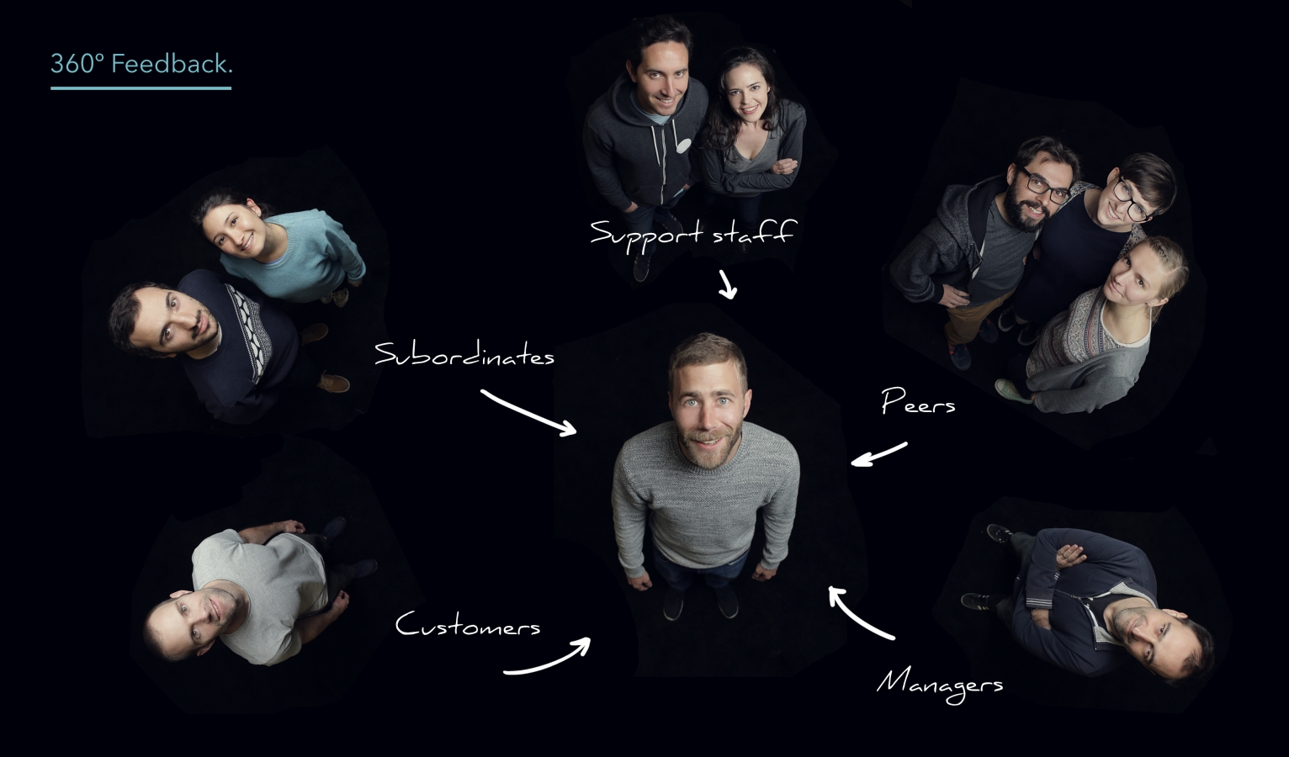

Slide 43
The Delphi process (named after a future-predicting ancient Greek) involves systematically-gathering feedback from diverse org constituents (employees, clients, community leaders, etc.) to facilitate informed, participative group decision-making.

Slide 44
DELPHI process
Prep electric (thought/emotion-churning) questions for electric feedback
Constituents you depend on most respond anonymously via email
#2 summarized & emailed back with new Qs for feedback on the feedback
Repeat circulation rounds until a “gestalt” (big picture group consensus) coalesces

Slide 45
SAMPLE ELECTRIC DELPHI QUESTIONS
What would happen if our organization didn’t exist?
What should be happening differently around here? Why isn’t it?
What would happen to your constituents if you no longer worked here?
How do we define success?

Slide 46
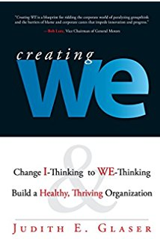
Delphi 360 feedback keeps teams in touch with evolving reality & in touch with the team’s evolving culture & mission.

Slide 47
#7 COMMUNITIES,
ORG

Slide 48


Execs
$
Pros
825ers

Slide 49
Org members with similar job/career interests/skills naturally gravitate together into informal “communities” that create psychological, & sometimes physical location (departmental), togetherness.
Often org members in different org departments & work zones share membership in the same community in an abstract way.
How much an org’s various extended communities “synergize” with one another hinges on how much members throughout the org have internalized the org’s real mission.

Slide 50
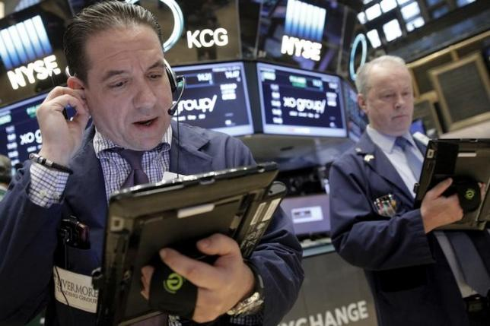
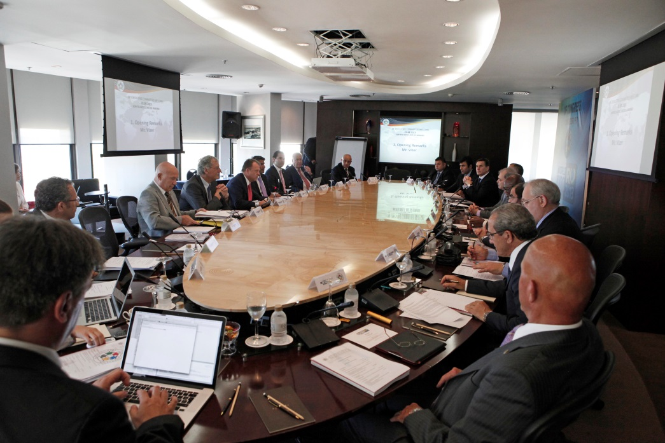
Community Of Wealth
Here are 6 org communities & 2 isolation zones:

Slide 51
COW = Becoming financially wealthy by increasing the wealth of org stockholders/owners
In most corporations, the COW = the upper echelon executives hired to maximize profit & shareholder wealth + various corp. non-employee insiders (board members, investment companies, politicians, etc.) who gain from their often invisible liaisons within the COW. Execs are exceptionally bright b/c they must learn on the fly, absorbing, processing & utilizing everything they hear, see, & experience in order to keep their orgs on the fly.

Slide 52

Executives are DETACHED from the concrete organization because they pursue 3 impersonal abstractions: Money, Markets, Mission
Orgs actually have 2 abstract missions: the official mission = a PR statement to continuously spotlight the org’s image.
And the “secret” mission =
the org’s nebulous future
plan for more money &
markets (which it keeps invisible until everything clicks for the plan’s future launch).

Slide 53

Due to their riveting focus on impersonal org performance issues, execs know little about the human dimension of their organization.
Execs face less job freedom & more job stress due to their never-ending responsibility for org competitiveness & performance—the
higher you go in your
career, the more your
org IS your life.

Slide 54
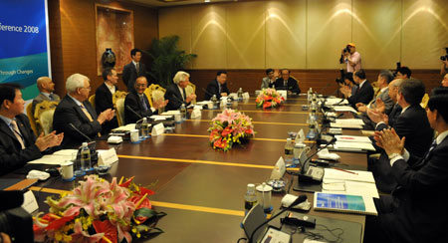

So orgs = 2 DIFFERENT worlds: concrete people vs. abstract management & control

Slide 55
Becoming a COWboy or COWgirl requires:
Executive-rank power to directly impact investment returns for stockholders
Membership in or ready access to the org’s COP (see next slide)
Political & networking expertise (street smarts) to increase
power & business opportunities

Slide 56
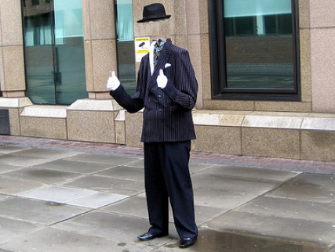
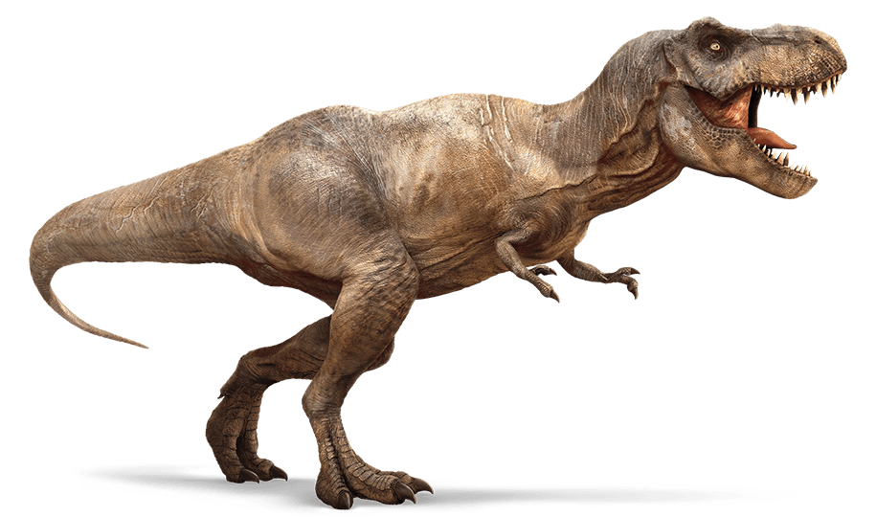
Community Of Power
Powersaur
Here are 6 org communities & 2 isolation zones:

Slide 57
COP = Board members, executives, & well-networked non-employees (independent investors, politicians, lobbyists, foreign officials, etc.), who unilaterally make most of the org’s major decisions/strategies. Many “POWERsaurs” (especially board members) are org outsiders not employed by the org in order to reduce their accountability & visibility & increase opportunistic networking.

Slide 58
The main reason why COPs are often secretive & invisible in their org actions is because most orgs have a gap between their “official” (idealistic, advertised) mission agenda and their actual operative (competitive/self-serving) agenda. Example: auto makers make most of their profits off auto financing, not car selling, but they don’t want the public to realize just how much interest they will end up paying on a 36-60 month auto loan.

Slide 59
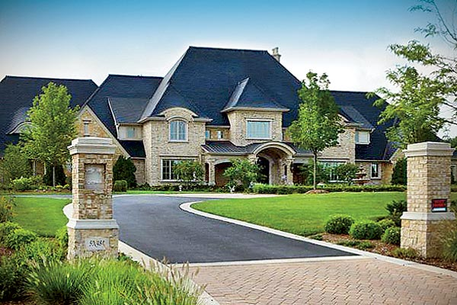

statUS
community
is all about
Here are 6 org communities & 2 isolation zones:

Slide 60
Career success: promotions & upward mobility
Affluence: upper tier of middle-class income & material wealth
Recognition: professional awards & civic status
Enjoyable, fulfilling work
Energy & networking
Raises & promotions readily available

Slide 61


Community Of Service & Teamwork
Here are 6 org communities & 2 isolation zones:

Slide 62
C.O.S.T. = WE > ME employees who focus on serving (deriving significant personal meaning from) co-workers & clients often in largely invisible ways. This is the only org community that stays focused on internal & external org constituents (co-workers, different departments, customers, the local community, etc.)
Org service opportunities are available to all employees all the time.

Slide 63



AlonEm zONEs
A regular job vs.
a dysfunctional career

Slide 64
The ALONE Zone = mostly “blue-collar” employees, part-timers, & temps who work alone or in an independent environment “making a living,” not building a career. Community in the alone zone is typically limited to superficial relationships (like work breaks) due to non-interdependent work. Also, many lower level employees prefer to work in the alone zone to avoid org politics & responsibility for the work of others.

Slide 65
ME zone = ambitious professionals who build their careers by taking fullest advantage (self-gain) of org resources (co-workers, clients, networks, budgets, information, etc.) for building resume & promotion opportunities. ME-zoners put their career before people.
Common ME-moves: (1) Taking credit for the contributions of others; (2) Mingling with the org “winners” to also shine in their adulation; (3) Wrangling your own staff to make you look good; (4) Telling others only what they want to hear; (5) Making influential people look good

Slide 66
#8 CONCENTRICITY

Slide 67
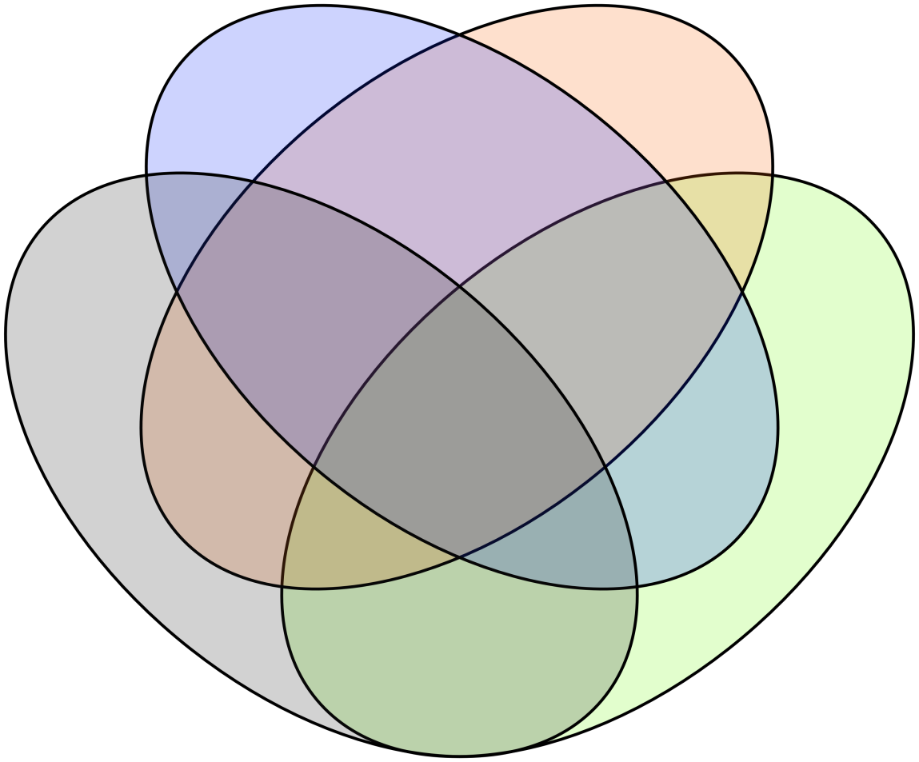
ORG CONCENTRICITY
Org pockets of mission overlap

Slide 68
“CONCENTRICITY”
1 2
3
4 5
mission overlap & employee synergy cycle

Slide 69

NON-PROFESSIONAL EMPLOYEE SPARSE MISSION PARTICIPATION & MINIMAL INTERDEPENDENCE
The green worker interacts
with his red boss
(black zone) only to get
work orders. Otherwise, green
has no co-worker network or
interdependencies → not much of a career future, b/c little synergy is produced that impacts the org mission

Slide 70

Professional employee mission-sharing
Red, green, & blue have created high
synergistic (= pink, gray, yellow, light
blue) networking, reflecting mission-
sharing wavelength commitment.

Slide 71
#9 CONFLICT MANAGEMENT

Slide 72
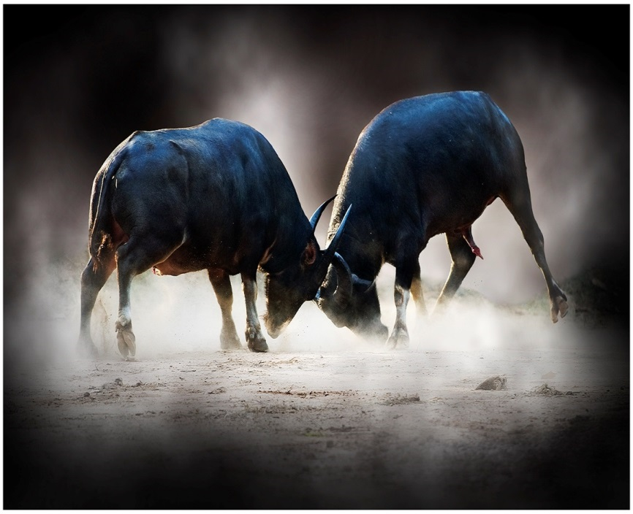
Conflict comes from
SELF-AGENDAS

Slide 73
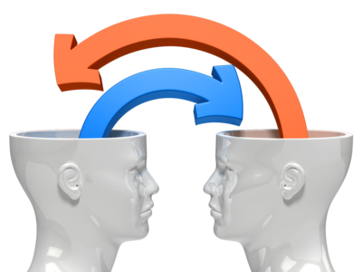
The FACT-FEELING DIALECTIC of psychological conflict resolution

Slide 74

Conflict issues won’t be resolved if they short-circuit full human wiring (intellect + emotions)

Slide 75
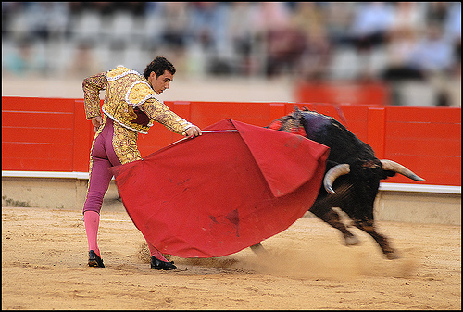
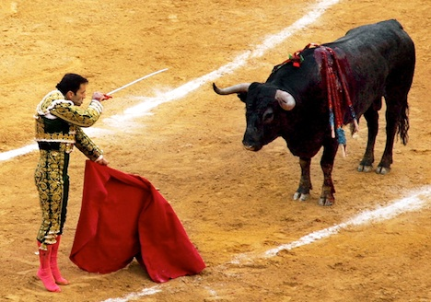
Matadors use the cape to protect themselves from the bull, who thinks the cape is part of the matador.

Slide 76
The F-F dialectic is a simple strategy for neutralizing (a la the matador’s cape) or “killing” interpersonal conflict (the bull) through facilitating a dialogue that alternates between sharing facts (cool conflict objective information) and feelings (hot conflict subjective emotions).
factsFEELINGSfactsFEELINGS

Slide 77
FACILITATOR PROMPTS
What do you know about…” (fact)
“What’s your reaction to that?” (feeling)
“What do you think we should do?” (fact)
“How will others feel about that?” (feeling)

Slide 78
THE CONFLICT MANAGER
Help employees realize that feelings usually change over time.
Delay decision-making until emotions have settled down.
Strive to generate good feelings about HOW decisions are made via an authentic participative process

Slide 79
#10 COUNTERINTUITIVE
INNOVATIVE THINKING

Slide 80
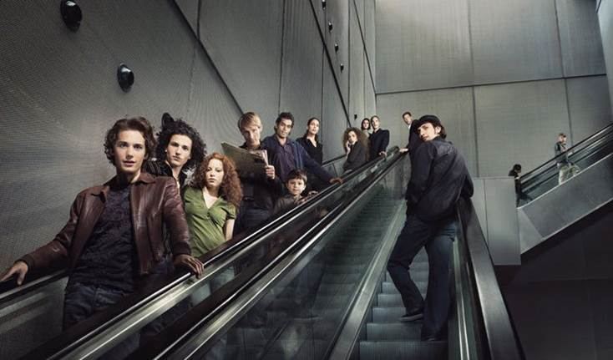
Konventionality kills the kat.

Slide 81

CITers
Create permanent pools of 360 feedback from constituent groups:
project teams; clients; org resource providers; local communities, etc.

Slide 82
INNOVATION INVITATIONS
Empowering employees to manage themselves
Flexwork (time + locations) & self-scheduling
Contributions descriptions replacing job descriptions
Asking WHY more often than how

Slide 83
INNOVATION MINDSET
Be Konventional (overlook status quo silly rules) not conventional
Break precedents & create new ones
Avoid IVE work
Regularly listen to clients

Slide 84
#11 CREATING YOUR OWN JOB

Slide 85

It’s your career, it’s your life, so manage them yourself

Slide 86
Don’t depend on your employer to run your career unless you’re a “golden boy.”
Know where your org needs help & pinpoint what you can contribute.
Increase pro visibility by networking where success is already happening in org triPs (People, Products, Processes).

Slide 87
Job-stretching: Look inside & outside the org for new ways to serve new clients you recruited yourself.
Look for opportunities to be a company-wide consultant in technical skills coveted by upper level managers.
Find ways to build “concentricity” (interdependent working relationships) within pros in org projects that could use your pro expertise.

Slide 88
#12 CULTURE,
ORG

Slide 89
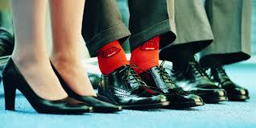
The org’s
unique
personality
(what it’s
like to work there)

Slide 90
8 ORG CULTURES
OC1 MATERIALISTIC: things > people blue collar; long work hours = manufacturing; agriculture; retailing; fashion, etc.
OC2 BUREAUCRATIC: routine, repetitive work; 8-to-5 = govt. agencies; insurance; military; credit checks; clerks & secretaries, etc.

Slide 91
OC3 SOCIAL DARWINIST: hyper-competitive work environment = sales; hyper-growth franchises; entertainment; sports, etc.
OC4 INNOVATIVE: creating, experimenting, searching, changing = high tech; digital entertainment; research science, medical, etc.

Slide 92
OC5. TECHNICAL: systematizing; tracking; recording; tabulating; verifying; checking = accounting; computers; transportation; work supervisors; engineers
OC6. HUMANISTIC: serving; helping; accommodating; healing = health care; public education; religious & social services, etc.

Slide 93
OC7 ALIEN (“blended”): An org built around the constant coming & going of diverse “outsiders” from other orgs due to outsourcing, temp workers, & trans-national legal & illegal workers = construction firms; government agencies; agriculture; hotels/motels & restaurants; day car centers; universities, military

Slide 94
OC8 HIDDEN (facades & secrets)
High org potential for controversy dealing with the org mission or questionable operating practices
Image-making false front
Secrets, rumors, cover-ups
Minimal accountability to outsiders
CIA & military; sports teams; politics; Hollywood; cult religions; some PR & law firms; some law enforcement agencies; some consumer products firms

Slide 95
#13 DISCOVERING YOURSELF PROFESSIONALLY

Slide 96

Your co-workers know you better than you know yourself. They got you mapped, b/c they see you objectively, which you can’t. You don't even know what your own voice sounds like. Career success is more OTHERS than you. LISTEN your way to discovering yourself professionally.

Slide 97

The most valuable part of going to a school like BU isn’t academics, but rather how positive peer presence & pressure sharpen & mature you as a pre-professional. You absorb the can-do mindset of your peers without even
realizing it.

Slide 98

Unlocking your pro capacities →
Pro networking (people with opportunities) →
Team-building →
Discovering your full
range of pro
contributions via
co-worker feedback &
“set-ups” (implementing new opportunities others have provided you)

Slide 99
WHO ARE YOU PROFESSIONALLY?
What do you want from your career?
Which co-workers are most valuable to you & vice-versa?
When & how do you “surf” your org’s wave?
How effective are your interpersonal skills?
What’s your IVE-EVE balance?
What’s the productive potential of your concentricity circles?

Slide 100
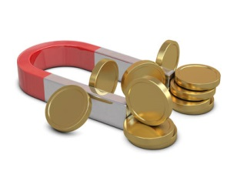
Attracting career opportunities:
Career Magnetism

Slide 101
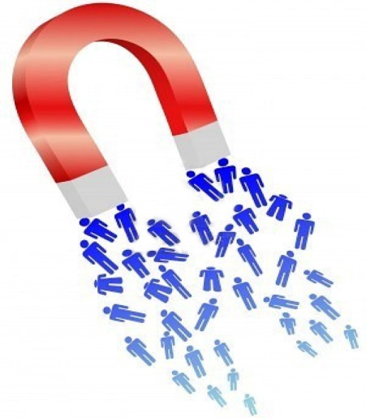
Professional success is a magnet
that magically attracts
new opportunities. But only
your co-workers know
when you’re ready for them.
ProDev is getting ready for the new opps. Your opportunities come from others who know you best & want to benefit from your growing pro savvy.

Slide 102
Continuously build your own professional balance sheet of pro assets & liabilities, & seek objective feedback from co-workers twice a year.
Build pro character (authenticity, service mentality, reliability), b/c the level of opportunities that come your way are matched to the level of your pro character: ethical standards, fairness, honesty, helpfulness, etc.

Slide 103
#14 FOUR I AMs

Slide 104

THE 4 I AMs
Productive
Appreciated
Needed
Unique
Building community through verbally respecting the contributions of co-workers

Slide 105

PANU can’t be bought or satisfied with $$$. These deep human needs validate our importance to others (professional pride) &
to ourselves (self-esteem). We depend on OTHERS to satisfy most of our professional needs.

Slide 106
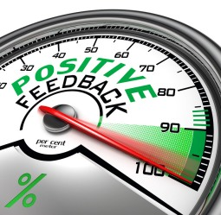
THE BIG FOUR 4 I AMS GENERATORS
Work interdependency
Interaction with clients
WE pods (employee-client partnerships)
Building individualized
jobs around employees.

Slide 107
#15 GAPITUS

Slide 108
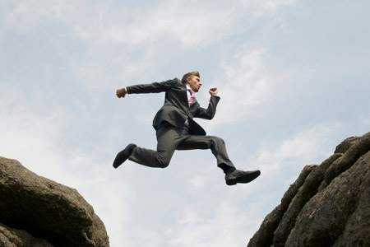

The dysfunctional gaps between the org & its internal & external constituents (employees, departments, OWOs, clients, financers, etc.)

Slide 109
EXECUTIVE FOCUS EMPLOYEE FOCUS
Impersonal Personal
Profit People
Markets Client service
Wealth Wages
Power Dependency
Competing Cooperating

Slide 110
ORGS ARE TWO-FACED
Pushing employees to adopt the org mission but not letting them participate in designing it.
Paying execs exponentially more than “regular” employees
Controlling employees more than empowering them
Being more loyal to clients than to employees
Withholding info from employees to hide org secrets & future plans

Slide 111
GAPITUS disease can be caught
from other employees
Employees who don’t speak up about fixable operations problems
Insensitive or incompetent bosses who demotivate employees
Employees relying on grapevine gossip to anticipate what their secretive org is really up to

Slide 112
Org Gaps Are:
The #1 weaknesses of ALL orgs
The #1 challenge of org pros
The single biggest source of org dramas
Org-community killers

Slide 113
#16 GRAVITATION,
ORG

Slide 114


Slide 115

Just like the force that holds planets together & keeps them in orbit, orgs are held together by the gravity of job interdependencies: I can’t do my job well unless others also do their jobs well. Despite all the rules & regulations most orgs have,
nobody is
really in control
or “independent.”

Slide 116
PEOPLE: The Center Of Org Gravity
The CONTROLLING (“formal,” written) side of orgs (job descriptions, org chart, rules & regulations, paperwork forms, etc.) rules our work lives to a significant extent.
The EMPOWERING (“informal,” human behavior) side of orgs frees us for relational employee work interactions, network building, & furthering our jobs or careers.

Slide 117
People don’t go “to work,” they go to a daily organizational DRAMA in which they play the part of interacting with others for productivity. There are two categories of characters in the drama: those who feel they leave their life at home (because their job is unfulfilling) versus those who feel their career is their life. Whether you work to live (“job”) or live to work (“career”), work is a major portion of your life, & hence so are organizations.

Slide 118
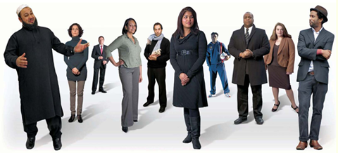
Most orgs, even if their missions differ,
are highly similar in the way they operate & deal with people. And org members also tend to behave in similar ways, since human behavior is fairly universal, as are organizations. Human drama is the essence of org/human behavior everywhere.

Slide 119
What “work” life is REALLY
Adapting to the org’s demands on your life
Adapting to idiosyncratic co-workers
Serving yourself + your org simultaneously
Perceiving invisible org reality “behind the screen”

Slide 120
Org success & fulfilling careers require a mix of psychological factors blended to fit the personality, temperament, & aspirations of your org, yourself, & the psych profiles of your co-workers. How much are you willing to be controlled by your org? How empowered? How independent vs. interdependent? How much into “right-answer” work vs. judgment calls? Orgs & their members work constantly to find a workable mix of all these factors, & most of all

Slide 121

How much do we want to mix/blend our personal life with our professional/organizational life? To what extent are we willing to be “owned” by an organization
because of how
much you need
what it
pays you?

Slide 122

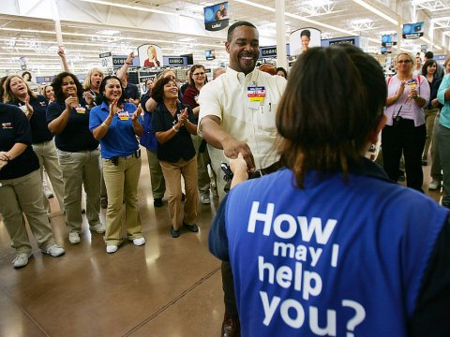
Employees care when their org cares about employees more than $$.

Slide 123
EARNING MORE EMPLOYEE RESPECT & LOYALTY @ WM:
Valuing employees more than cost control
Giving individual WM stores individual personalities (instead of the uniform blah look)
Treating customers personally instead of impersonally (like zombies)
Paying more to get younger, more personable workers.

Slide 124
#17 GROUP DYNAMICS

Slide 125

You’re a DIFFERENT person in groups

Slide 126
Groups control you more than you control groups.
Groups usually conform more than individuals do.
Groups usually value following > leading.
Groups thrive on the status quo > change.

Slide 127
Group decision-making reduces personal accountability → “risky-shift” phenomenon: when group members sometimes back riskier group decisions than they would make on their own
Groups favor short-term, efficient (quick & EZ)
operations > effective, change- drenched long-term operations.

Slide 128
Groups don’t like uncertainty & unconsciously tend towards consensus-building (conformity).
Groups often operate out of a false sense of harmony & agreement that may not actually exist.
Group members tend to take information at face value, even when it’s speculative or unverified.
Groups often act out of a poor sense of timing & reach decisions prematurely or procrastinate.

Slide 129
Groups tend to over-focus on process (protocols & rules) & under-focus on mission/purpose.
Groups often over-rely on popular or respected members to make meetings & decisions gel.
Most group members hesitate to stop the momentum of group deliberations & hesitate to ask questions.
Group members tend to assume that all members are well-informed about issues discussed, sympathetic to the group’s mission, & satisfied with the group’s way of doing things.

Slide 130
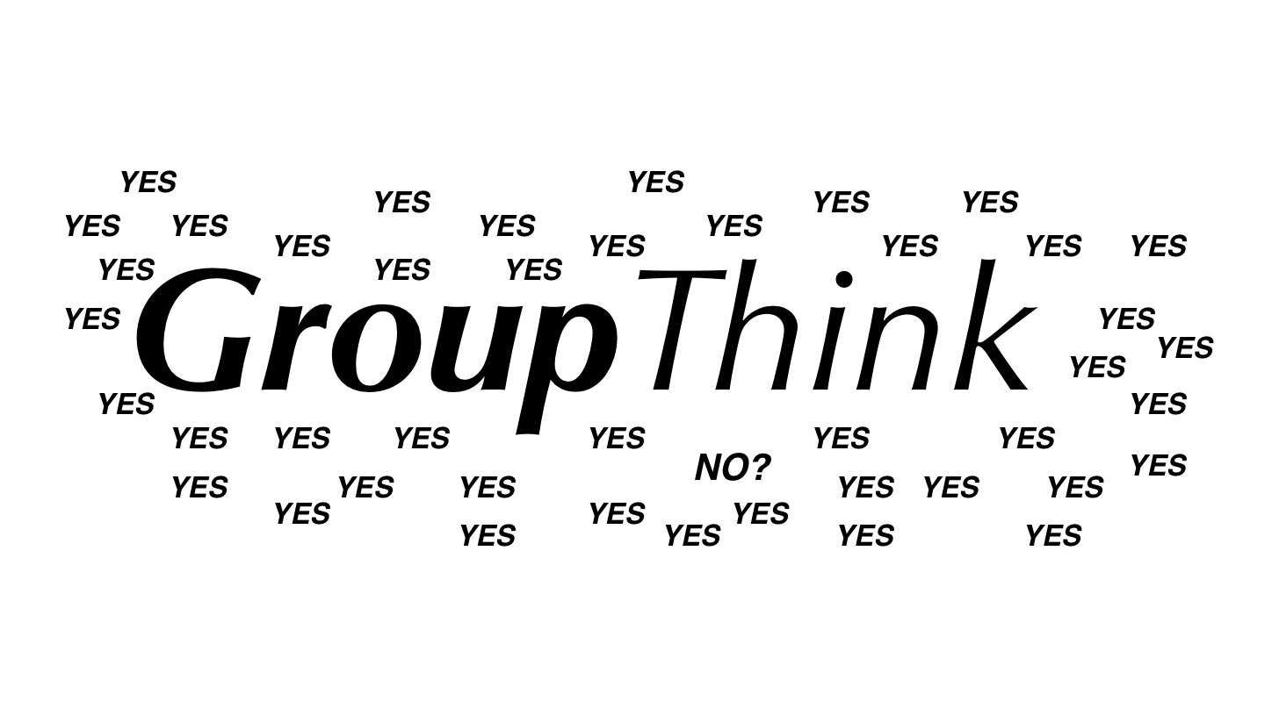

IN ACTION

Slide 131
Conforming & performing for group acceptance
Fudging the truth to justify group actions & beliefs
Turning group loyalty into a “religion”
Shunning or vilifying outsiders who think, believe, or act differently from your group
Isolating group members from the influence of rival groups

Slide 132

Sports fandom
Religious group isolationism
“Foreigners/aliens/illegals”
Street & motorcycle gangs
Hazing & secret initiations
Racism
Masonry
Rock
concerts

Slide 133
#18 INTENEDED & UNINTENDED CONSEQUENCES

Slide 134



Slide 135



INTENTION-UNINTENTIONAL
Wells Fargo bank employee cross-selling bonus pay campaign
Dallas Cowboys Dac Prescott
VW pollution cover-up
Hillary vs. Donald

Slide 136
UNINTENTIONAL CONSEQUENCES
Nationwide product recalls
Class-action suits
Negative reviews/ratings on social media consumer review sites
Blitz PR campaigns to counteract company image damage

Slide 137

REACTIVE U-C: Paying the price of operations incompetency or honest mistakes: Chipotle; Blue Bell; car recalls; Samsung exploding phones
PROACTIVE U-C: Paying the penalty of wonton org exploitation: Mylan/Epipen; Wells Fargo Bank; Volkswagen; mid-2000s mortgage scams; drug dealer arrests; NFL

Slide 138
CORE CAUSES OF U-C
Amoral org culture
Executive disengagement from ICONs & ECONs
Lack of org 360 feedback
Empire-building

Slide 139

U-C PREVENTIVE MAINTENANCE
Insurance/bonding
Ops scenario mapping
Built-in 360 feedback system
Taking the A off amoral
What price will others pay for our gain?

Slide 140
#19 JUDGMENT CALLS

Slide 141


Slide 142
JUDGING PROFESSIONALS
Employee staffing & evaluation
Department budgeting
Using global supply chains instead of domestic suppliers
Managing change & conflict
Managing your career

Slide 143
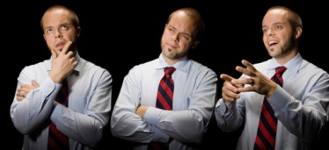
IN JUDGMENT CALL CITY:
Right answers, certainty, rules, routines, formulas, & black/white are replaced by shades of gray, pro experience, org politics reality zones, & subjective agendas.

Slide 144

GETTING JUDGED
WhoWhatWhenWhereWhyHow
MACRO analysis: org culture, expectations, exposure, & politics
MICRO analysis: Pockets of grassroots insight
Fact-feelings dimensions
Intended vs. unintended consequences probabilities

Slide 145
#20
leadingfollowingmanaging

Slide 146
LFM are verbs (things we do), not nouns (things we are).
Throughout the day, we all temporarily engage in leading, following, & managing ourselves & co-workers (ME + WE).
Continuous LFMing is the job description for all true professionals.

Slide 147

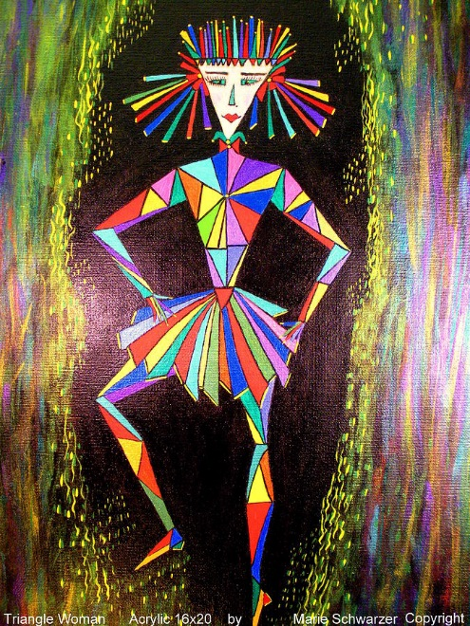
L= envisioning the NEW
F= voluntarily supporting L’s
M= coordinating L’s & F’s

Slide 148

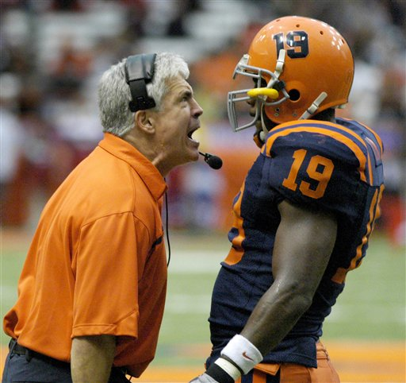
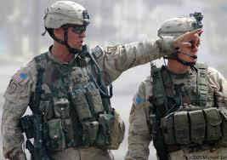
Any signs of leading here?
(Are they voluntarily following)?

Slide 149
LEADING AIN’T:
Commanding: using org-backed power to force people to follow “chain-of-command” orders (military; sports; police)
Becoming an “operator”: exploiting others for self-serving agendas (politicians; promotors; ME zoners)
Charisma: brainwashing people into following your agenda like the Pied Piper (celebrities; good looks; news broadcasters)
Empire-building: mass exploiting with mass resources for personal gain (entrepreneurs; military leaders)

Slide 150
Fake LFM
Lying to ourselves: Promising yourself to do something & then “changing your mind”
Acting: Pretend to be a “leader” via commanding, operating, charisma, or empire-building
Passive-aggression against co-workers: Faking your commitment to follow co-workers by telling them what they want to hear

Slide 151
#21 MAKING PLAYS

Slide 152

The making of a professional

Slide 153

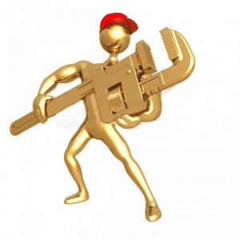
“Making a pro play” = on-the-spot, no-prep, value-adding judgment call

Slide 154
MAKING PLAYS COMES FROM YOUR:
Pro experience “bank account”
Knack for reading human behavior
Understanding the culture of your org & how “the game” is played.

Slide 155
PRO PLAY-MAKING
Solving an old org problem in a new way
Using contributions descriptions > job descriptions
Asking people instead of telling people
Breaking outmoded precedents by creating new ones
Interacting > analyzing

Slide 156
#22 MARRYING YOUR ORG

Slide 157
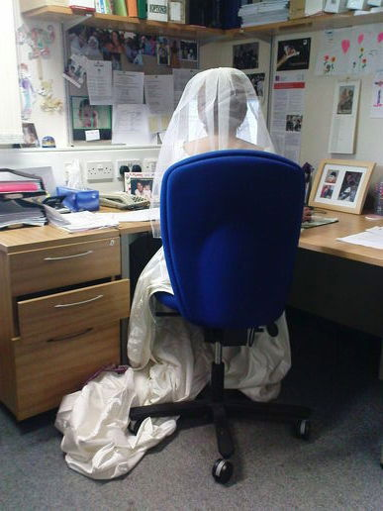
Org community is built by
successful, lasting marriages

Slide 158

  Stage 1. DATING A COMPANY
  Learning how the org system (how to play the game) works & then becoming part of the system

Slide 159

  Stage 2. “GOING STEADY”
  Dating regularly with the same employer & co-workers
  Co-workers begin to rely on you & you on them.

Slide 160

  Stage 3. GETTING ENGAGED TO YOUR COMPANY
  Taking on significantly more company responsibility & accountability in your job

Slide 161
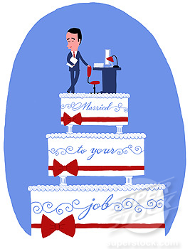
  Stage 4. MARRYING YOUR COMPANY
  Creating value for external org clients

Slide 162

  Stage 5. HAVING CHILDREN
  Responsibility for the work & success of others → org family

Slide 163

  Stage 6. GETTING DIVORCED (?)
  Quitting your job
  Losing your job
  Demotion
  Loss of authority

Slide 164
#23 MATURITY,
PRO

Slide 165


me for WE
not
Me before we/ me using we/ me first.
Pro maturity is an attitude more than a basket of pro skills.

Slide 166
PROFILE OF A MATURE PRO
Internalization of org mission
Serving constituents > self-agendas
Mastery of leadingfollowingmanaging (“triangle” pro)
Capacity for “making plays” benefitting the org + its constituents

Slide 167
#24 MENTORING

Slide 168
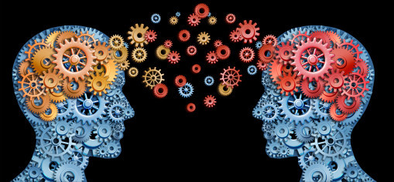
MENTORING
Developing people professionally through a personal relationship + confirmation
Mutual magnetic pull (“You remind me of myself.”)
Career focus > job focus (coaching)
Encouragement > cheerleading
Wisdom >
info

Slide 169
THE MENTORING EXPERIENCE
“Shadowing” your mentor
Attending important org meetings with your mentor
Occasionally filling in for your mentor
Mentor-led performance critique sessions or your work
Confirmation feedback on your sense of reality, professional-positives, wonderings, & hopes

Slide 170
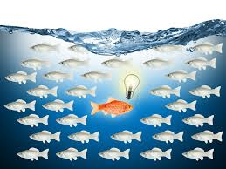
Are you mentoring-magnetic?
Learning-hungry?
Hungry for pro development?
Experiential-learner?
Professionally non-konforming?
Service-
minded?

Slide 171
#25 MISALIGNMENT,
PRO

Slide 172
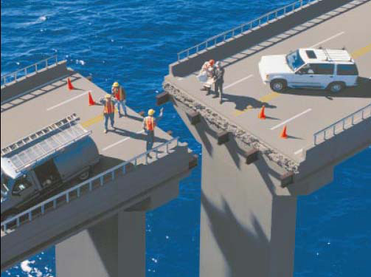

Slide 173
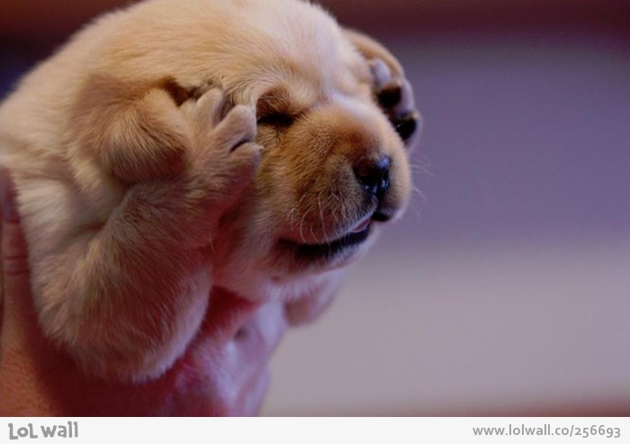
What’s your
DON’T WANNA
stress quotient?
Don’t-wanna-do
Don’t-wanna-be

Slide 174
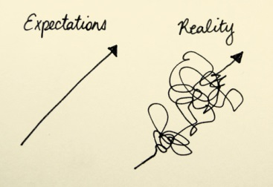
The more you are professionally or personally misaligned with the expectations of your org (your don’t wannas), the greater your
job stress.

Slide 175
You’re in marketing but want to work in HR.
You face too many judgment calls & not enough right answer assignments.
You’re working on commission & they keep raising your sales quotas.
You have to please your boss, but you want to be in charge.
You’ve been there, done that too many times & are professionally bored.

Slide 176
GET A TUNE-UP
Career path redirection
Org-within-your-org role make-over
Pro ambidexterity
New job training
Tinkering with your leadingfollowingmanaging ratios

Slide 177
#26 MOTIVATION

Slide 178
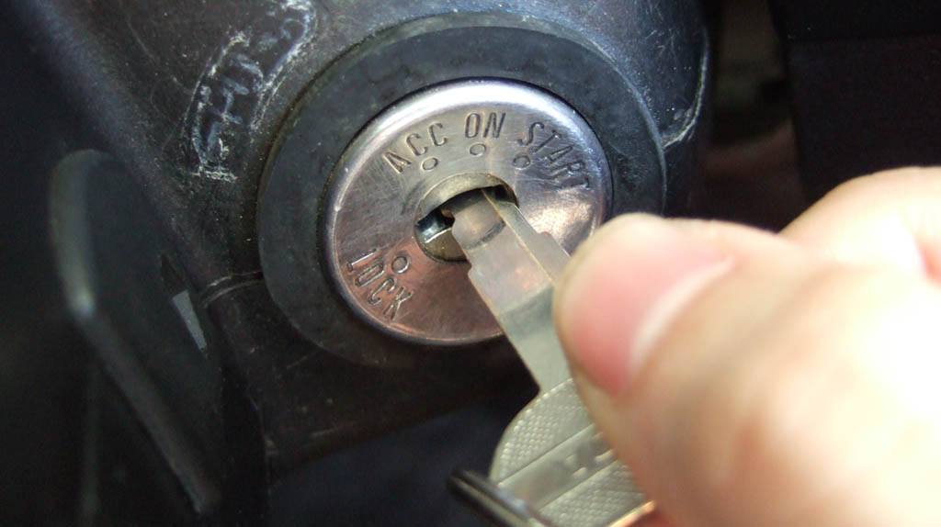

What starts your car & drives you

Slide 179
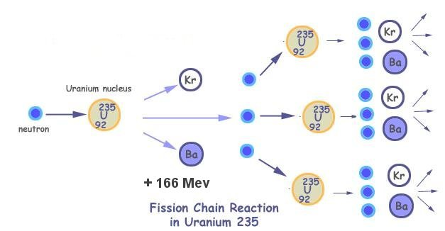
Motives are built around a complex psychological chain reaction of conscious decisions/actions seeking to satisfy your needs & wants. But most orgs aren’t psychologically complex.

Slide 180
I WANT to be in charge (POWER) → I need to be around higher status professionals → I have to join a prestigious country club→ I need to become better friends with Joel who is member of the club→ I’ll have Joel & his family over for a cook out→ Maybe Joel will ask me to play golf with his cronies→ I gotta get a golf coach & some better clubs → Gotta dress my wife & kids in fancier duds for the country club.

Slide 181
ORG PSYCH-OUT
Most orgs do a better job of satisfying the simple physical needs (food, security, materialism) of the majority of their employees (825 non-pros) than the far more complex psychological needs (self-fulfillment, self esteem, unconditional acceptance, etc.) of pros. Thus, the most common employee motivation strategy of most orgs is:

Slide 182
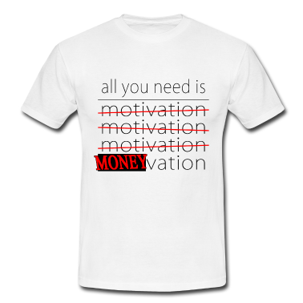

  MONEYvation
$Paycheck motivation

Slide 183
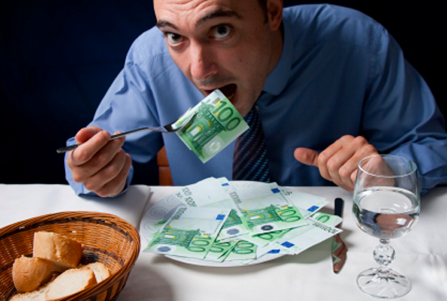
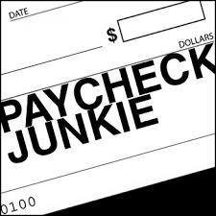
Hire (green) VEGETARIANS!
$$Paycheck addicted employees (both 825ers & pros)
are EZ to moneyvate

Slide 184
825ers are addicted to their $paycheck to satisfy physical needs (food & material goods).
StatUS pros are $addicted to satisfy status-related psych needs.
Sophisticated org motivation techniques are NOT needed to crack the whip on employees.

Slide 185
EASIEST TO MONEYvate
Members of the org’s statUS (a psych motive) community: more money → more status (exclusive neighborhoods; expensive cars; first class travel; glistening apparel, etc.)
New employees: eager to prove themselves (psych motivator), with $$ as the sign of pro success

Slide 186
TOUGHEST TO MONEYvate
Blue collar workers stuck in 2 ruts: modest income + stagnant professional development
College-degree IVEs accustomed to low-increment annual raises due to their low value-added work
WE (service-oriented) employees internally-motivated via idealistic
values > money & status

Slide 187


Slide 188
Career-Focused Employee Motivation Profile
Ambitious, future-focused, resume-conscious
“Scoring” for the org
Paying the price of success
High maintenance from desiring a an optimal performance environment to succeed in

Slide 189
Job-Focused Employee Motivation Profile
Dependable & stable
Status quo-oriented (routine work) > change
Follower > leader
EZ to manage: cooperative & prefer being told what to do

Slide 190
#27 NON-PROFESSIONALS, MANAGING

Slide 191

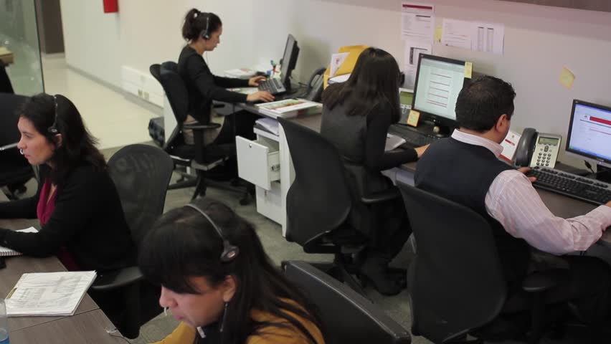


Slide 192
CATEGORIES OF NON-PROs
Blue & white collar: Part timers & temps; newbies & oldies
Uniskilled vs. multiskilled
Learners vs. repeaters
Steady Eddies vs. transients
Energized vs. passive
Internal vs. external
locus of control

Slide 193
THE 825er MINDSET
Job > career orientation
Reactive work style
IVE > EVE
Negative toward job change
Job & family dependency

Slide 194
MANAGING 825ers
Respectful supervision
Team-based work flow
Periodic training upgrades & personalized coaching
Some paternalism & community

Slide 195
Take the A off amorality for 825ers
Most non-professionals look up to their bosses & professionals out of respect for their education & giftedness. But they usually want no part of the amoral (values- neutral) environment in the upper echelons of many orgs: unethical practices; abusive or exploitative behavior towards others; perceived unfairness to employees, etc. It’s a psychological SHOCK! for many hard-working, traditional-values 825ers when they encounter org amorality for the first time. Their respect for ALL pros & higher-ups can quickly cave in.

Slide 196
#28 ORGOLOGY

Slide 197

Orgs do more positive & negative things to people than any other human creation.

Slide 198
ORGOLOGY: Seeing reality like a real world pro
Understanding how orgs behave towards people & how people behave in orgs
Developing the professional savvy & skills that enable you to both survive & thrive in orgs & your career
Learning how to build your career around your org as much as around yourself
Reading orgs intuitively based on your intuitive real world experiences with people

Slide 199
#29 ORG REALITIES

Slide 200
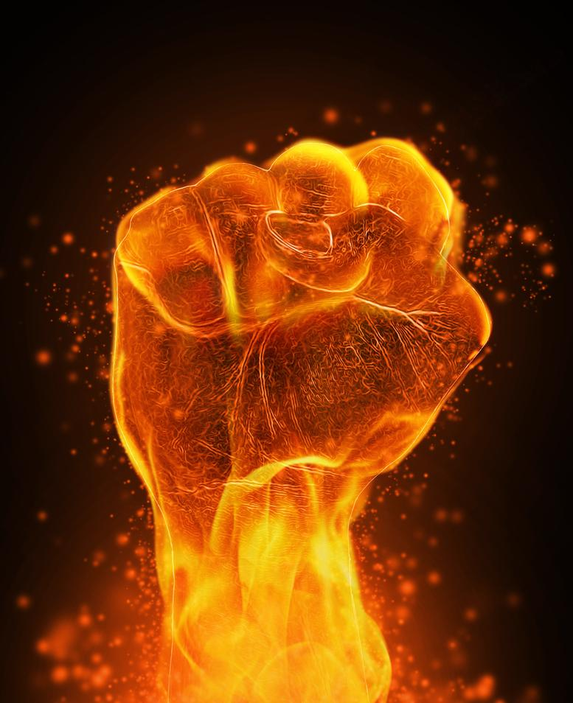
Orgs are the most powerful entities on earth.
Because they control so much of our lives, societies, & world events.

Slide 201

Orgs are the real culture we live in.

Slide 202

Org Dramaland

Slide 203

Your career is a continuous series of human dramas. Work is what we do between dramas.

Slide 204
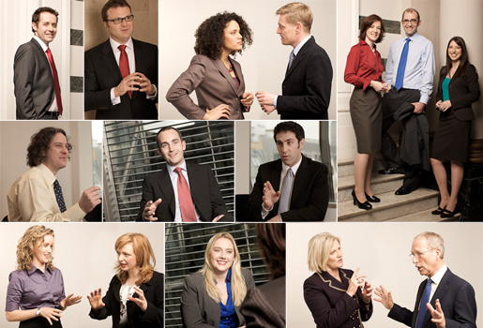
People skills + org savvy, not technical expertise, are the key to success in ALL professions & orgs.

Slide 205

You can be the world’s greatest ____, but still fail in orgs if you can’t work & fit in with diverse people.

Slide 206

You are a different person in an org than when alone.

Slide 207
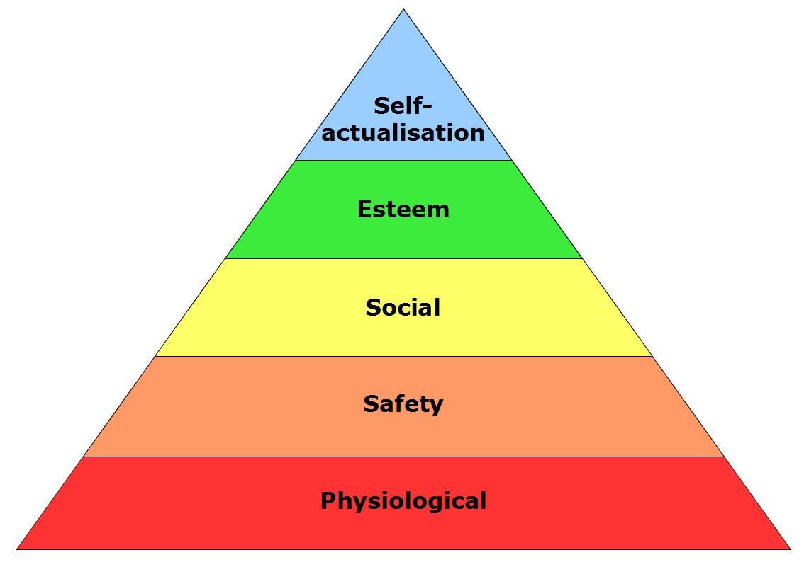
Orgs help deliver most of your needs in life.

Slide 208
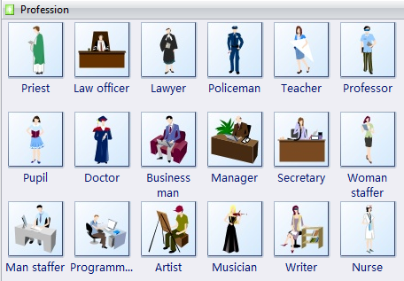
Self identity springs largely from what you do in & for orgs

Slide 209
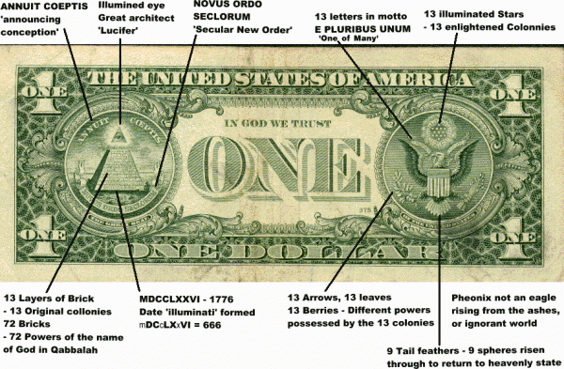
As long as the org pays you, it owns you.

Slide 210

Only in orgs can you maximize your professional potential. It takes many people to raise a steeple.

Slide 211

Org reality is looking BEHIND the movie screen. The movie on the screen isn’t real.

Slide 212
#30 ORG RENEWAL,
GRASSROOTS

Slide 213

Employees take a more personal interest in products/services/clients
than moneycentric
executives do.

Slide 214
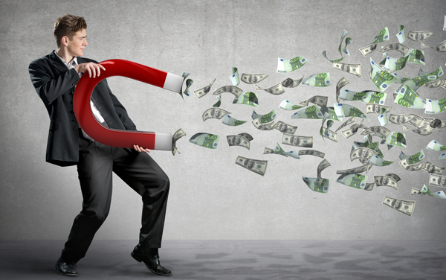
When orgs stagnate (lose competitive momentum), it’s usually from the top-down due to exec $$-tunnel vision & distance from the triPs:
Products, People, & Processes
Thus, org renewal must emerge from grassroots org communities (OWOs).

Slide 215
Org renewal depends on electricity at lower levels of an org, b/c employees have a much greater interest in & closeness to products/services & clients than moneycentric executives do.
TriP employees can synergize org renewal only when they are empowered at the OWO team level to break status quo practices dealing with people, products, & processes = innovative change.

Slide 216
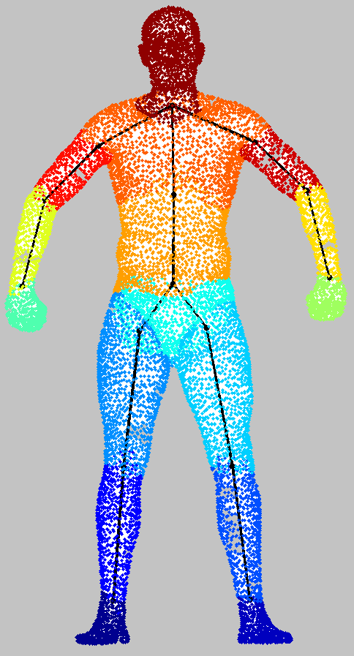
The human hierarchy of triPs org renewal
Execs (brain)
Pros (heart & muscles)
8 to 5ers (tech supporters)
Alone zoners (physical movers)
Thriving OWOs focusing on
the triPs: Products, People, & Processes

Slide 217
#31 ORG WITHIN AN ORG

Slide 218


The organization you actually belong to

Slide 219

Most OWOs are found at the grass roots level where interdependent work processes meld co-workers together in pursuing a shared micro-mission. OWOs give employees a sense of grass-roots
org-ownership.

Slide 220

Your OWO is the only personalized part of the org for you. The rest of the org is more impersonal & controlled. Your OWO also empowers you to manage much of your own work & career, including the fit between your personal/pro values vs. those of your org.

Slide 221

OWOs are led & managed by any & every member with the desire & pro competence to do so. OWO members are also held together by the gravity of work interdependencies. Those most needed by others generally have greatest (informal) influence in the OWO.
What happens in OWOs
is mostly up to
its members.

Slide 222
OWOs At Your Service
You have influence in your OWO, especially if you have interpersonal & leadership skills. Thus, you have more say about “things” that go on in your OWO: how work in done; co-worker attitudes & morale; shaping professional goals and standards, etc.
You also have a greater opportunity to use your own personal values & ideals in many aspects of your work, especially being of genuine service to others & neutralizing org amorality to some extent.

Slide 223
#32 POWER & INFUENCE

Slide 224

Org-backing vs.
co-worker backing

Slide 225
Power = the “official” (org-backed & controlled) right to assume designated org responsibilities & order others to assist you

Slide 226

Influence = succeeding informally (not backed by official org power) in getting others to cooperatively back an agenda.

Slide 227
Power makes things EZ to do, since you can order people around. However, it carries the high price of being personally accountable for the work of others.
Influence works only if co-workers voluntarily back you & authentically believe in your agenda.

Slide 228
The more power you acquire over time, the more you must
USE-it-or-lose-it.
The more you use power, the more competitive sources of power will be used against you.

Slide 229

The deeper you penetrate your org’s power center, the more dangerous it potentially becomes:
Becoming aware of
power agendas you
were previously naïve
about.
Stumbling into the cross-fire of political battles you must now take sides in.

Slide 230
In your quest for power, you may have to “look the other way” at exploitative or amoral practices of the powersaurs. To prove yourself a loyalist, you will have to support the “company line” at all times even when it involves “swamp” work (dealing with snakes & alligators). With some administrators, your career status is based on how much you help them advance their own self-agenda--help them move up or you move out.

Slide 231

The more you use positive influence, the more co-workers might support you.

Slide 232
The potential for influence is greatest in the heat of the moment of human engagement: interpersonal productivity + genuine emotion. Make your move when participants first envision the potential pay-offs of your idea for both CONs & for themselves.

Slide 233
WANT POSITIVE INFLUENCE?
Be authentic (telling the truth & what co-workers need to know).
Develop personalized relationships within your OWO.
Focus on WE, especially CONs
Give credit instead of taking credit.

Slide 234
#33 PSYCHOLOGICAL CONTRACT

Slide 235

The Psycon:
The slowly evolving “feeling” of what is acceptable & unacceptable behavior for the
org & for employees
The “OK” zone for pro behavior
(which varies across
org turf zones = gapitas)
A high-emotion, sensitive
part of the org

Slide 236

KEY INDICATORS OF PSYCON HEALTH
Employees have internalized the org’s mission
Employee loyalty
Positive employee morale
Authentic communication
& 360 feedback

Slide 237
BU’s 4 PSYCON Clashes
#1. Incompatible parallel missions: religiosity (moral) vs. “secularism” (amoral)
#2. Serving others vs. social status
#3. Undergraduate teaching-orientation blended with graduate school research orientation
#4. Concentration of power in BU non-employees (Regents) vs. influence of BU constituents: students, campus faculty & staff, Waco

Slide 238
#34 PSYCHOLOGICAL LISTENING

Slide 239


Slide 240




Slide 241
Psych listening = using emotional intelligence to listen for what people mean vs. what they say
Listening for people’s agendas, intentions, & emotional state
Perceiving what really transpired psychologically in a group conversation or event

Slide 242

Most of the time our ears are hearing but not listening. Listening is WORK because it takes concentration & focus on
others > self

Slide 243

Emotional intelligence + pull-down professional psych maps

Slide 244
MENTAL MAPS TO HAVE OF YOUR
CO-WORKERS
Interpersonal skills map
Self-agenda map
Authenticity map
Pro values/priorities map
Personal dysfunctions map

Slide 245

PsychList is largely innate (inborn) but can be sharpened via feedback from other “ears.” Most women have better PsychEars than men.

Slide 246
#35 SILOS,
ORG

Slide 247

Isolated, uncoordinated,
org departments

Slide 248

The
silo
detachment
point
of
view

Slide 249
“Silo” departments “do their own thing” with little coordination or communication with other departments
Employees give a higher emphasis to the goals/mission of their department or personal careers than they give to the overall org mission.
Departments engage in rivalries over resources (budgeting, new hires, autonomy) & influence in the org.

Slide 250
SILO-MAKERS:
Large % of mainly technical employees who don’t directly contribute to the org mission (IVE-dominated orgs: engineers, computer techs, etc.): They’re isolated from org clients & EVEs
Multiple products/services in different divisions = brand rivalries (General Motors): “We work for Chevrolet (Buick, Cadillac, Pontiac, etc.), not for GM.

Slide 251
SILO-MAKERS:
Bureaucratic org culture = run by rules & regulations (Obama Care & IRS): Doing things the prescribed way is my job; not being flexible to meet client needs.
Social Darwinist culture = raw competition between employees & depts (brokerage houses; pro sports; sales): “The only way I’m going to play is if the quarterback gets knocked out of the game—I hope the line backers get him soon”; I’m not sharing what I know with the new sales reps, b/c they take sales away from me.”

Slide 252

The SIGNS OF
FRACTURED SILOS

Slide 253

Hidden agendas
Cover ups
Rivalries
Disputes
Complaints
Turnover
Decaying org communication

Slide 254
THE BEST MEASURES OF ORG UNITY-DISUNITY
Concentricity IVEs-EVEs Org encounters Org silos Org wavelengths Psychological contract Surf-boarding
Two-faced orgs

Slide 255
#36 SURFING,
PRO

Slide 256

The way to fulfill your personal agenda thru helping your org fulfill its agenda:
Your org provides the ocean & waves;
you provide the surf board.

Slide 257
Achieve your professional goals by helping your org achieve its goals.
Your org pays you to help it attain its mission & goals, which must receive a higher priority than your own personal-professional goals.
Surf the org’s profit maximization more often than surfing your personal career wave.
Nothing energizes your personal career more than advancing the org’s core mission.

Slide 258

How many surfers were involved in landing you a summer internship?
1. Baylor
2. Professor
3. Intern company
4. Company’s HR Dept.
5. The student who
turned it down before you
6.U

Slide 259
#37 SYNCHRONICITY

Slide 260



Slide 261


TAS is a simple model for creating your way out of conflict by…

Slide 262
… achieving cooperation via synthesizing a thesis (one point of view) & antithesis (a second, conflicting, POV) into a win-win synthesis of an agreeable third position.

Slide 263
Thesis: Employee pay raise (stable paycheck mindset)
Antithesis: Pay cut (stable paycheck mindset)
Synthesis: Commission or bonus pay (variable paycheck mindset)
Thesis: more 8:00 a.m. classes
Antithesis: Evening classes
Synthesis: Online class

Slide 264
Thesis: Construct a new office building
Antithesis: Stay in the old building
Synthesis 1: Renovate the old building
Synthesis 2: Keep the old building as unit A and
buy/renovate adjacent building as complementary unit B

Slide 265
Thesis: Status quo (no operating changes) for the NCAA
Antithesis: Reform the NCAA
Synthesis 1: Let the 5 “power conferences” regulate themselves
Synthesis 2: Make college football, basketball, & baseball “minor league” paid pro teams

Slide 266
#38 TRIANGULAR PROFESSIONALS

Slide 267

LEVELS OF PROFESSIONALISM
#1 Synergizing yourself
#2 Synergizing co-pros
#3 Synergizing your OWO
#4 Synergizing your org

Slide 268
PRO SYNERGY LEVEL 1 The TRIANGLE professional:
competent &
active in all
3 pro skills &
self-managed
L
F
M

Slide 269

PRO SYNERGY LEVEL 2
L
L
L
F M
F M
F M
Synergistic OWO pro team leaders

Slide 270

dependency
INTER
personal
The BIG 2 essential pro skills

Slide 271
Professionals become “grafted” into the LFM triangle & triP’s of OWOs (orgs within an org) when they are willing to put US (me + you, + them) ahead of money.
Grafted US pods = an OWO’s evolving productive DNA: members, talents, synergies, & mutual LFM (leadingfollowingmanaging)

Slide 272

PRO SYNERGY LEVEL 3
US (new org entity)
You + Me + Them → GRAFTED PROS

Slide 273
Annotations explaining the previous slide on pro grafting:
The arrows on the triangle = me, you, & them grafting (exporting) our synergized (4th level of professionalism), pro & department skills (US) to various parts of the org

Slide 274
Grafted US pods morph/evolve into multi-dimensional Org Success-Service Pods (OSSPs) scattered throughout the grass roots level of orgs = pro SYNERGY LEVEL 4. No org has enough OSSPs, because so many non-professional employees aren’t “grafted” into OWOs & hence are limited in their triP contributions.

Slide 275
#39 TWENTY-FIRST CENTURY WORKPLACE

Slide 276


21st century employees bring 2 people to work: personal + professional

Slide 277


THE NEW DIGITAL HOLISM ORG CULTURE
Work in the 21st century is socially holistic (professional & personal at the same time), but not process holistic (doing work efficiently in a highly-organized manner). Personal & pro lives are blended in a real-time way, mixing work, leisure, friends, co-workers, family, meetings, & recreation into a blended recipe of 24/7 life.

Slide 278

Frequent pro + personal digital interruptions of the work flow: emails, texting, surfing, IPODing, social mediaing
Juggling multiple
pro + personal
projects
Time overloading
Real-time scheduling

Slide 279



21Trending
Your world in your pocket or purse
24/7 “bio-blending” office & home life
Team digital calendars

Slide 280
#40 UNISEX ORGS

Slide 281

The new frontier for 21st century competitive
success

Slide 282
UNISEX organizations accommodate BOTH masculine and feminine work & leadership styles, thus avoiding legal discrimination against women (via supporting only male productivity styles).

Slide 283
MALE STYLE FEMALE STYLE Competitive Cooperative
Directive Relational
Independent Interdependent
Goals Ideals
Individual Community
Proactive Reactive
Action Verbal

Slide 284
20TH CENTURY MINDSET 21ST CENTURY MINDSET
(Org control) (Org empowerment)
Command Consensus
Power Influence
Employees People
Rules Commitment
Routine Creative
Work Contributions
One size fits all Job tailoring

Slide 285


Males compete vs. their opponent = WIN-LOSE
A woman tends to compete against herself = WIN-WIN

Slide 286
The West’s most important competitive edge in global business is innovation, stimulated by a unisex culture of cooperation & flexible operations > rules-driven eight to five. Innovation requires a cooperative, community-based win-win org culture which won’t flourish under the traditional male command style of management.

Slide 287
THE UNISEX FLEX:
Flex org cultures (flex hours; flex-place; flex benefits):
Help women accommodate family commitments
Empower all employees to manage themselves in self-selected teams
Reward employees for building org community & cooperation

Slide 288
Discontinue generic job descriptions in favor of flexible grassroots contributions descriptions that build jobs around the unique needs of individual employees
Build the HR function around well-trained & experienced unisex professionals to achieve a better balance between male-female productivity styles.

Slide 289
#41 VIRTUAL TEAMS

Slide 290

Spawning & Spanning DigiPros
click for the
VT Made EZ
manual

Slide 291
Temp team members spawn projects…
Spanning physical-geographical operating zones…
Coordinated by PTP (person-to-person) &
PTT (person-to-technology) interactions…

Slide 292

To synergize org-multi-tasking projects…
Impacting multiple constituent groups…
In extended
real time
scenarios.

Slide 293

Virtual Teams = Virtual Tornados
whirling people, opportunities, resources, ideas, clients, & partnerships in productive directions

Slide 294
VT TECH
Avatars Chat rooms Conference calls Cyber-personalities Desktop sharing Discussion boards Emailing Faxing Netiquette Podcasts Team portfolios Telecommuting Teleconferencing Texting Virtual hoteling
Virtual work spaces Whiteboards

Slide 295
VT CAREER ELECTRICITY
Geographical expansion of your pro network & globalization opportunities
Digital leadingfollowingmanaging
Flextime, flexplace unisex work
Building competence in international business & culturally diverse business practices
Career-expanding travel opportunities

Slide 296
#42 WAVELENGTHS & ENCOUNTERS,
ORG

Slide 297




Are org members more tuned in to W.O.R.K. radio or their cell phone, gossip, & social media?

Slide 298

Where employees encounter their organization physically & psychologically

Slide 299
Job descriptions Org mission
Co-workers Bosses Clients Meetings Compensation
Office facilities
Org dramas
Competitors Technology
Physical facilities
Rules & regulations

Slide 300
POSITIVE
encounters bond employees to the org’s mission
NEGATIVE
org encounters make employees less secure, less trusting, & more cynical

Slide 301
POSITIVE ENCOUNTERS
Paycheck Co-workers
Pleasant boss Fulfilling work
Rewards for contributions
Moving ahead to move up
Managing your own work
Making significant decisions
Building a positive professional reputation
Comfortable work environment

Slide 302
NEGATIVE ENCOUNTERS
Work stress Office politics
Incompetent management
Low pay
Outsourcing & downsizing
Irrelevant meetings
Impersonal org culture
Substandard work facilities
Outdated technology
Exploitation & corner-cutting

Slide 303
5 WAYS TO BUILD RESPECT WITH EMPLOYEES TO GET THEM ON THE ORG’S WAVELENGTH
Authentic (transparent) org communication
360 feedback
Self-managed empowered teams
Serving, not exploiting, clients
Ideals-driven operations > amoral

Slide 304
FINDING THE RIGHT WAVELENGTH WITH YOUR CO-WORKERS
WE > ME
Derive work agendas transparently & anticipatively
Serve > deserve
Focus on contributions > job descriptions
Be Friendly, Flexible, & Forgiving

