Slide 1
Scandinavian
Culture
CHAPTER 6

Slide 2
Scandinavian Culture PRISMS
What is culturally best: equal opportunity vs. equal results?
Should a nation’s government strive to preserve its culture?
Lifestyle pragmatism: Should the state be values-neutral?
Jante law: Are some people “better” than others?
Unisex culture: Should women be treated differently than men?

Slide 3
Individualism
Extended family
Community
Monochronic
Poychronic
Low Context
High Context
Social Ambiguity
Social Certainty
Low Power Distance
High power Distance
Mastery
Adaptation
Emotionally Neutral
Emotionally Expressive
Quantity of Life
Quality of life

Slide 4
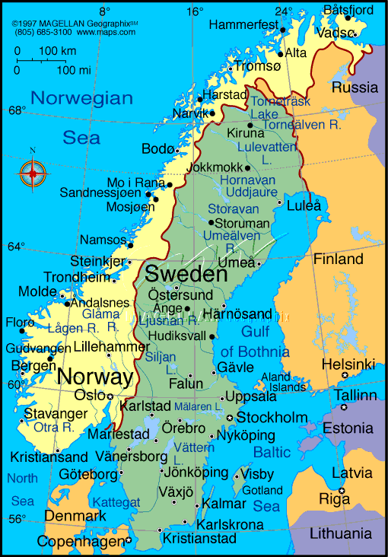

Slide 5
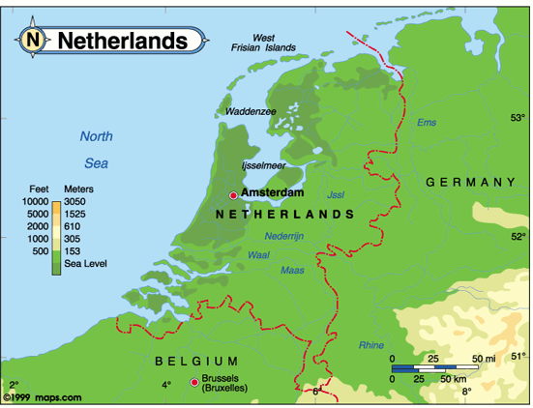

Slide 6
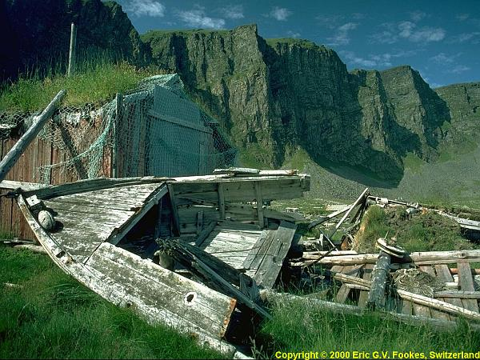
Norwegian Fjords

Slide 7
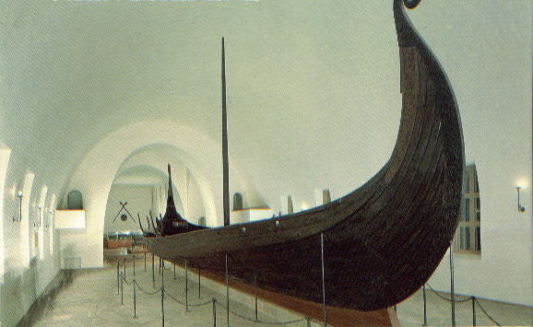
Norwegian Viking ship

Slide 8
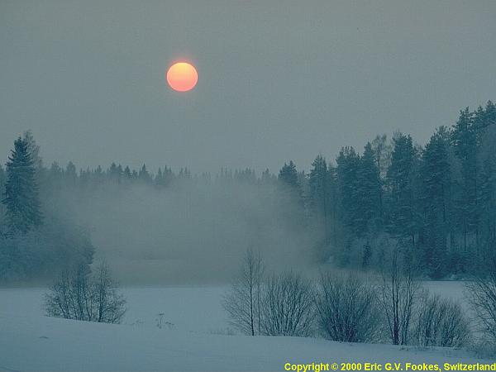
The midnight sun

Slide 9
SCANDINAVIAN
EGALITARIANISM

Slide 10
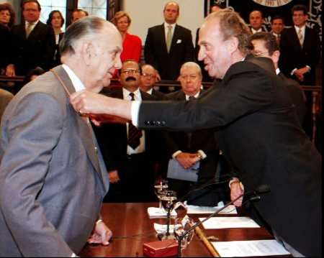
Egalitarian values: equal results, not just equal opportunity

Slide 11
“It is virtually impossible to become rich in Sweden, because the taxes are so high and the income differentials are so low. Thus there’s not much of a difference in the way people live because there isn’t much of a difference in spendable income.”
Both Swedish parents are entitled to up to a year in paternity leave. If a child has a significant illness, a parent can can take up to 60 days off at 90% pay.
Ombudsmen are readily available to represent workers in conflicts with their employer.

Slide 12
In contrast to Americans, most Scandinavians believe in
equal results rather than merely equal opportunity (because no society can truly provide equal opportunity for everyone)
A Scandinavian millionaire paid a
$174,000 speeding ticket because that
equaled the same percentage of his income
as a $200 fine for the common wage earner.

Slide 13
COMMON CAREER BARRIERS FACED BY AMERICAN WOMEN
Loss of workplace seniority when having or caring for children
Subordinating the wife’s career to the husband's career, especially when job transfers are involved
Working in a male corporate climate based on competition rather than cooperation & autocratic decision-making rather than participative

Slide 14
Equal opportunity doesn’t exist.
People aren’t equally intelligent & skilled.
Highly imperfect & rigged economic systems don’t give everyone a fair opportunity to provide for their needs.

Slide 15
How many people pay the price of your eco success?
High taxes are the foundation of economic equality & social stability.

Slide 16
You aren’t more important than anyone else. (“Jante law”)
Caring means sharing.
People’s basic needs must be met by community sacrifice.

Slide 17
  SCANDINAVIAN
SECURITY

Slide 18
ORIGINS OF SECURITY CULTURE IN MODERN SCANDINAVIA
Ethnically homogeneous population (promoting a strong social conscience)
A class-free society
Geographic isolation & the hostile northern climate
Strong feminine influence within the culture

Slide 19
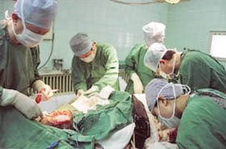
The (“cradle to grave”) welfare state
Free health care, college, pregnancy leave,
even euthanasia

Slide 20
CHILD POVERTY COMPARISONS
Scandinavian countries have the lowest child poverty rates in the world thanks to their welfare system; in Denmark just 2.4% of children live in poverty; 3.4% in Norway; 4.2% in Sweden
Mexico & the U.S. have the highest child poverty rates in the developed world: 27.7% for Mexico & 21.9% for the U.S.

Slide 21
WHY HASN’T AMERICA PURSUED “CRADLE TO GRAVE” WELFARE?
1. Opposition to & the lack of communal consciousness—perhaps due to America’s ethnic & religious diversity.
2. Higher income Americans have more ways to legally reduce their taxes than the middle class
3. Sales taxes, which America strongly relies on for tax revenue, discriminate against lower income Americans (who pay the same tax as rich Americans).

Slide 22
SCANDINAVIAN
vs.
AMERICAN
CULTURE

Slide 23
“Scandinavians have a strong sense of community responsibility. There is a willingness to make adjustments which other cultures might consider a sacrifice of individuality. “
Violent crime rates are low throughout most Scandinavian cultures. Only 6% of Swedes report being victims of violence.
“Despite high divorce rates, a high rate of unmarried parents, and shifting relationships, the number of people who live alone in isolation has not increased over time.“

Slide 24
WHERE THE AMERICAN EMOTIONAL PROFILE DIFFERS MOST FROM THE SCANDINAVIAN
Greater American propensity for risk-taking & uncertainty
American tend to be more aggressive & competitive
The American cult of personality (movie stars, rock stars, etc.)
American social status differences are based largely on money & “conspicuous consumption” (Kardashian hyper-materialism, extravagant weddings, mansions for homes, lifestyle excesses of rock stars, entertainers, & pro athletes, etc.)

Slide 25
American culture is less libertarian (no rules for “morality”) than Scandinavians because the Judeo-Christian ethic still has some influence in America & there is also a strain of religious personal piety left in America.
Americans are more Darwinian (“survival of the fittest”) than Scandinavians based on the success-orientation of Americans & rugged individualism.
Americans are more tolerant of class differences (based on wealth & standard of living) than Scandinavians.

Slide 26
America’s commercialized culture has generated an entire industry of promoters, agents, PR consultants to manufacture glamorous, larger-then-life celebrities who are icons of America wealth, success, & fame. Scandinavians prefer real people to celluloid holographs.
Swedish-born American actress Greta Garbo (famous in the 1930’s & 1940s) quit the movie business at the peak of her popularity and became a recluse because she couldn't stand being worshipped for her beauty and celebrity.

Slide 27
THE ULTIMATE UNISEX CULTURE
Scandinavian parents share household duties more than any other culture, including child-rearing.
Scandinavia leads the world in women elected to political office, sitting on boards, & holding executive corporate positions. This reflects the Scandinavian tradition of androgynous (masculine/feminine blend) organizational cultures.

Slide 28
The workplace equality of Scandinavian women is bolstered by generous paid pregnancy leave that enables women professionals not to lose their seniority level (the major reason women professionals in many other nations are paid less even when doing the same job as male counterparts).
Widespread utilization of across-the-board pay increases (vs. merit pay, which lends itself to corporate politics) also adds to Scandinavian greater workplace equality for women.

Slide 29
SCANDINVIAN LIFESTYLE PRAGMATISM
The Dutch acknowledge that morals can’t be legislated, as illustrated by the failure of Prohibition in the U.S., & don’t want to criminalize those addicted to vices.
Legalized prostitution and pornography
Government-provided drugs, abortions, and euthanasia (including babies with traumatic problems)
Highest percentage of cohabitating couples
State-sponsored euthanasia

Slide 30
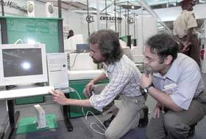
CULTURE OF THE SCANDINAVIAN WORKPLACE

Slide 31
Job security
Teamwork & consensus decision-making
Across-the-board compensation
Interpersonal sincerity & informality
Avoidance of interpersonal competition & aggressive business practices (reflecting the egalitarian mindset of Scandinavians: “We’re all in the same boat together”)

Slide 32
Downplaying artificial status differences (“Jante law”: “Don’t think you’re better than others”) based on physical attractiveness, wealth, fame, or religious affiliation.
Compromise viewed as a favorable option
Non-confrontational conflict avoidance & win-win decision-making
Reflecting Jante law, Scandinavians tend to dress plainly & behave in a low key manner to avoid calling attention to themselves (for fear of implying that they are better than others).

