Slide 1
CHAPTER 12
KOREAN
WORK
CULTURE

Slide 2
Korean Culture PRISMs
Is interpersonal harmony more important than honesty?
How far should employees go to keep superiors happy?
To what extent should family interests be sacrificed for company interests?
How much power should organizations have over our lives?
Should employees be held accountable for performance at the individual or group level?

Slide 3
Individualism
Extended family
Community
Monochronic
Poychronic
Low Context
High Context
Social Ambiguity
Social Certainty
Low Power Distance
High power Distance
Mastery
Adaptation
Emotionally Neutral
Emotionally Expressive
Quantity of Life
Quality of life

Slide 4
THE BASIC NATURE OF KOREAN CULTURE
Even more than other Asian cultures, South Korea has a strong sense of community that often spills over into nationalism. Koreans are highly competitive, reflecting their need to stand tough against frequent historical military incursions from both China and Japan. Reflecting their Confucian cultural heritage, Korean “obedience is typically unconditional and authority never questioned.”

Slide 5
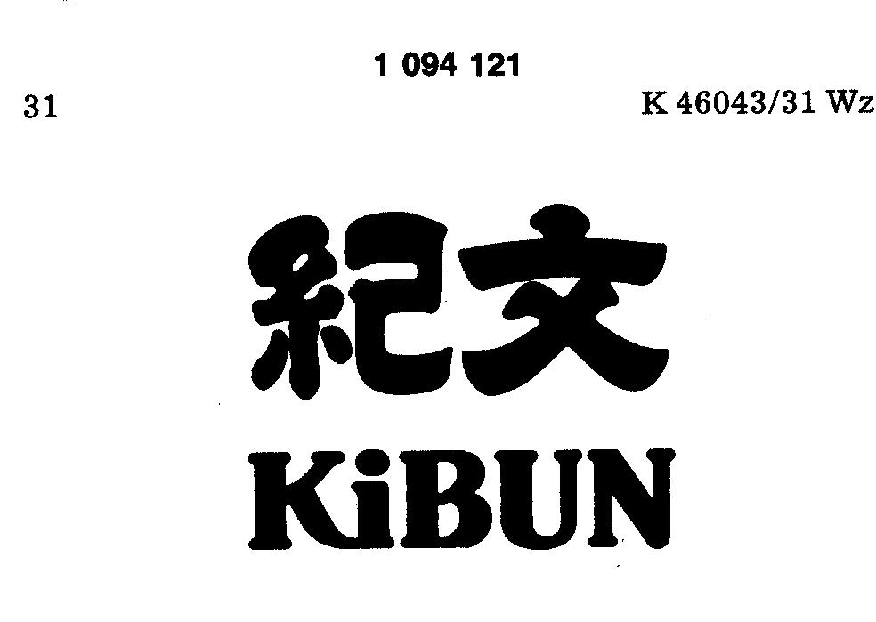
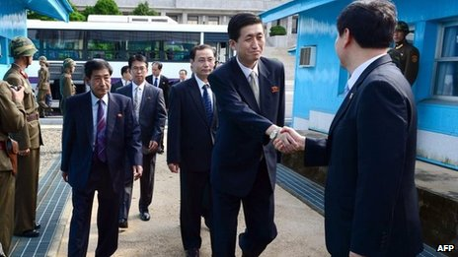
Positive frame
of mind

Slide 6
KIBUN
Keeping superiors in a harmonious state of mind—relaxed, comfortable, & happy
Treating managers with special respect & deference
Avoiding resentment or grudges (wohn mahng) in the workplace

Slide 7
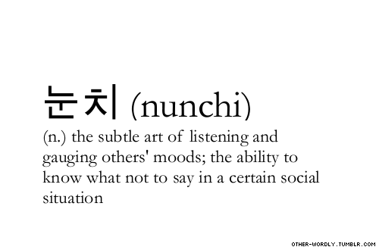
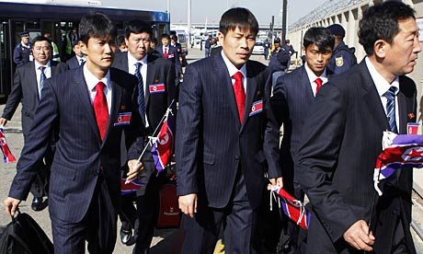
(eye
measure)

Slide 8
NUNCHI (EYE MEASURE)
Learning how to gauge the mood of superiors via “reading” organizational power networks, interpreting non-verbal communication, & mastering political protocol
Extensive protocol for catering to superiors
Bosses must themselves master the art of reading their own subordinates when they engage in the subtleties of “lying low” & avoiding bad news.

Slide 9
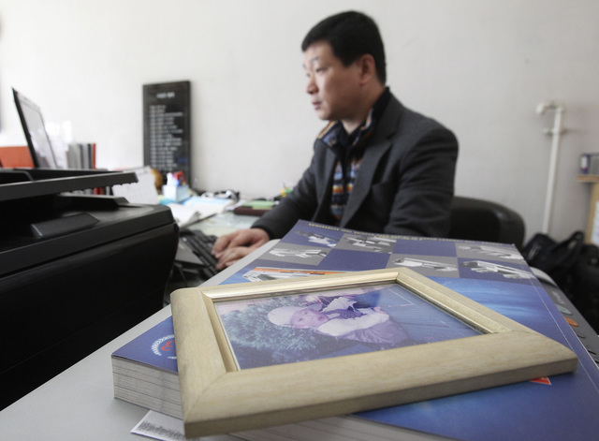
Joia sei (lying low)

Slide 10
JOJA SEI (LYING LOW)
Employees don’t want to “stick out” in the organization (by making mistakes or delivering bad news) in order to avoid upsetting the kibun of superiors.
Bad news is withheld until the end of the work day; mistakes remain invisible; criticism of the organization or its leaders is non-existent.

Slide 11
EMPLOYEE “WINDOWS”
Work teams select members to represent their team to other parts of the corporation—these team representatives are the “window” into the team.
“Windows” lack formal authority and serve solely to link teams to the organization
Korean teams act on consensus, never by the dominance of a strong personality.
In community/harmony cultures, team members form close professional bonds & hold each other accountable. Hence team leaders & representatives are accorded great respect & face.

Slide 12
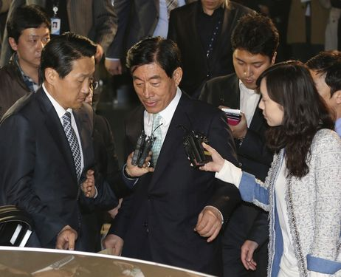
Jwa chon Chon choan
A change to the left

Slide 13
JWA CHON/WAH CHOAN
(“A CHANGE TO THE LEFT”)
This is a polite way to say that someone has been demoted or lost status (a huge loss of face) in the organization.
The phrase stems from the fact that subordinates traditionally sit to the left (an inferior position) of their superior.

Slide 14
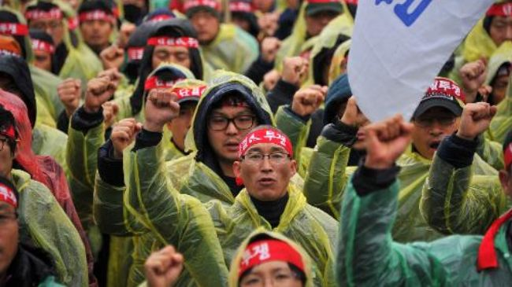
Ilch egam
sense of oneness

Slide 15
ILCH EGAM (SENSE OF ONENESS)
Promoting team spirit & sense of family in the Korean workplace
Singing the corporate song & reciting the corporate motto
Parties, recreation, bonding rituals

Slide 16
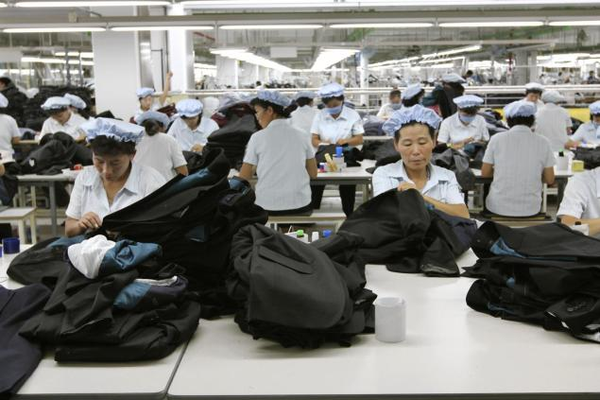
songsil
Total commitment

Slide 17
SONGSIL (SINCERITY)
Sacrificing personal & family interests in order to show maximum commitment to the company (similar to what it takes to succeed as a doctor, lawyer, CPA, entrepreneur, or corporate executive in Western culture)
Maintaining proper harmony-enhancing etiquette between superiors & subordinates at all times

Slide 18
CHIBANS & KYUL-JAE
(“FAMILIES” & NETWORKS”)
Employees are tied to their department (chiban) by “godfathers” (holding 80% of total power) who “pow-wow” via deals & trade-offs with one another (similar to the way Indian chiefs from different indigenous tribes in the Western U.S. parlayed to annihilate George Custer in the Battle of Little Bighorn in 1876).
These chibans are formed around intermarriage networks (kyul-jae), regional political networks, or school-based networks (somewhat analogous to how American grads of prestigious schools, such as Harvard or West Point, “take care” of each other professionally).

Slide 19
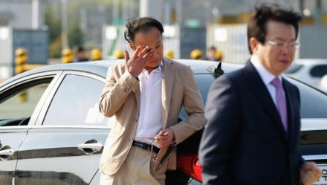
Head & foot space

Slide 20
HEAD & FOOT SPACE & STATUS SYMBOLS
“Head” space in an office, meeting room, car, etc., belongs to the highest-ranking executive, while lower rank personnel occupy the foot space.
In an office, foot space is nearest the entrance, while head space consists of private offices in the back.
Chairs with arms or high backs carry more status chairs without arms; desks with lots of drawers signify higher status than small desks.
South Korea goes further than any other Asian culture to make status differences visible as a sign of face & to maintain corporate harmony.

Slide 21
WATCH OUT FOR WOMEN SHOPPERS IN SOUTH KOREA!

Slide 22
Female shoppers in South Korea are more than demanding—they get even! “Keen bargain shopper, they have an eye for quality and if something falls short of their expectations, they are not shy of venting their anger.” For example, many shoppers post Internet pictures, complete with vivid criticism, of stores that don’t meet their expectations. Offending retailers are likely to suffer a silent boycott. Western firms have learned to seek product design & marketing decisions from Korean shoppers rather than to risk their wrath. “If you can please a Korean customer, the feeling goes, you can please anyone.”

