Slide 1
CHAPTER 11
JAPANESE
CULTURE

Slide 2
Japanese Culture PRISMs
Which are more powerful: goals or ideals?
Can people really rise above self-interest to embrace ideals?
Is it better to fail doing things the right way than it is to succeed by cutting corners?
Can cultures have both gender equality & gender role differences?

Slide 3
Individualism
Extended family
Community
Monochronic
Poychronic
Low Context
High Context
Social Ambiguity
Social Certainty
Low Power Distance
High power Distance
Mastery
Adaptation
Emotionally Neutral
Emotionally Expressive
Quantity of Life
Quality of life

Slide 4
KEY JAPANESE IDEALS
Ideal #1: Joy of living
Ideal #2: Beauty
Ideal #3 : Interpersonal
harmony
Ideal #4: Perfection
Ideal #5: Transformational management

Slide 5

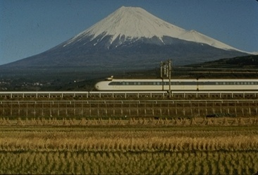
Mountainous, Volcanic Islands

Slide 6
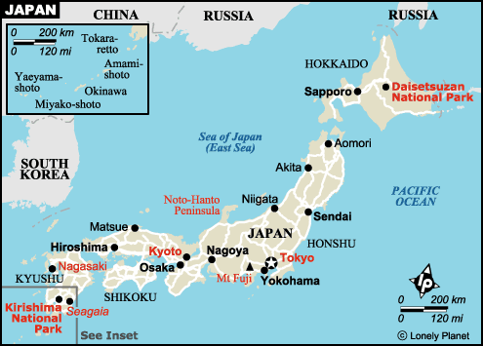

Slide 7
6800 islands
The main islands of Japan (Kyushu, Shikoku, Honshu, Hokkaido) = 98% of land
4% the size of the USA
71% mountainous
10% of world’s active volcanoes (Mt. Fuji being the largest)
126 M population
99% genetic homogeneity
Era of population decline projected to begin in 2010 (when a quarter of Japanese will be over 65)

Slide 8
A CULTURE
OF IDEALS

Slide 9
When something good “comes alive,” it’s an ideal. Ideals are the essence of life--both the ends and means of living. Westerners have little experience “experiencing” Asian ideas.
It’s hard for Westerners to understand Asian culture because ideals are less important to Westerners, who value individual freedom & independence more than community.
Westerners push away the ideal of community because of its emphasis on interdependency, sacrifice, duty, & etiquette, all of which detract from individual autonomy (driving fast, loud music & cell calls in public, smoking around others, etc.).

Slide 10
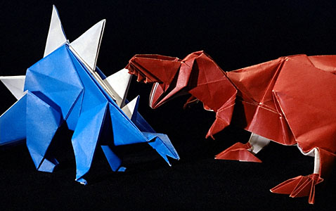
GETTING CONCRETE WITH IDEALS
Is your score the only thing that counts in golf? (How about your form & manners?)
        Why fold paper up? (Origami is an artistic approach to self-discipline)

Slide 11
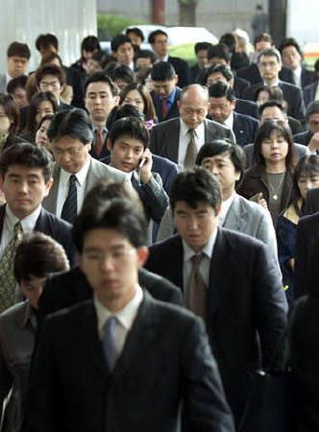
Shudan Ishiki
Why do the Japanese have such a strong group consciousness?

Slide 12
Ethnic & cultural homogeneity
Predictable & rigid behavioral etiquette for every social situation
The pursuit of common ideals

Slide 13
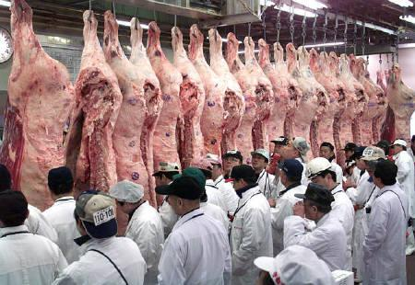
Shikata The ideal process for all social & business behavior

Slide 14
There is an ideal way to do everything in Japan, because the way you do something is just as important as what you accomplish.
Failure in doing something the ideal way is more honorable than being pragmatic by cutting corners to achieve success (such as steroid use in sports & NCAA cheating).

Slide 15
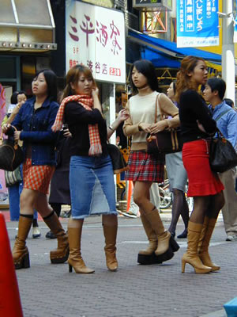
IDEAL #1: Iki Gai
(Joy of living)

Slide 16
Dress up, not down.
Eat healthy food, not junk.
Stay slim & trim.
Put art in all you do to live life on a higher plain.
Master the social graces.
Take pride in all around personal excellence.

Slide 17
Healthy forms of maximum relaxation: hot springs communal bathing; karaoke; wearing comfortable, clean, light weight slippers in domestic settings; sleeping on futons (to conserve living space in small Japanese houses & apartments)
Elaborate, sumptuous cuisine of maximum aroma, seasoning, & visual appeal.
Extraordinary cleanliness of personal hygiene, living space, & public space.

Slide 18
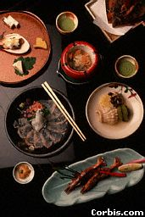
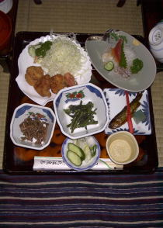
The world’s healthiest diet
(while 60% of Americans are overweight)

Slide 19
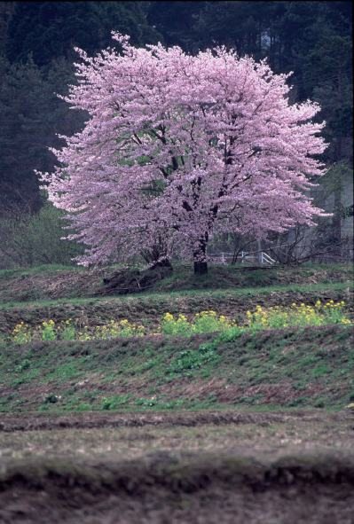
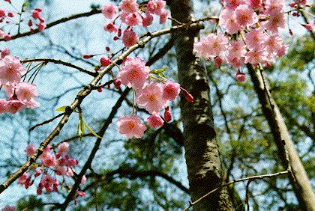
IDEAL #2: Yugen Myo
Ideal (Tao) beauty

Slide 20
DO CHERRY BLOSSOMS HAVE BEAUTY OR IS IT ALL IN YOUR HEAD?
Actually, it’s both. The Japanese believe our minds are “pre-programmed” to experience the ideals in life, such as beauty, perfection, cooperation, & community.
The purpose of Japanese life is to experience (“import”) as many ideals as possible into your life, thus transforming both your consciousness & your daily behavior.
Community, the nucleus of Asian culture, comes from the totality of human ideals.

Slide 21
4. Perhaps the best way for egocentric Westerners to understand community is via the analogy of peeling an onion. Onions do have a core, but you have to remove layer after layer of the onion to get to the core. In Japanese & Asian cultures, the layers surrounding community are behavioral etiquette, interpersonal harmony, interdependency, social niches, & dedication to abstract ideals, of which community is the totality.

Slide 22
MATERIALIZING IDEALS
INTO EXTERNAL REALITY
Turning the inner ideal of beauty into food presentation, feminine kimonos, high quality cars, etc.
Turning the Zen ideal of harmony into a bonsai tree or a cultivated meditation garden
Turning the ideal of interpersonal harmony into bowing etiquette & feminine-style (needs-focused) communication

Slide 23

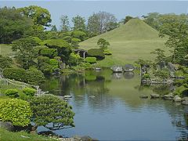
Japanese gardens
Bonsai
Meticulously shaping the gardens requires
internalization of harmonious ideals

Slide 24
Want a good laugh? Watch tourists stomp around in a public Japanese garden. Japanese gardens are actually an art form designed to promote peaceful, harmonious contemplation & meditation via a perfectly manicured (“civilized”) garden. Americans always want to “do” something—anything except be still.

Slide 25
WHAT’S THE PURPOSE OF
A BONSAI GARDEN?
Restless, on-the-go Westerners have a difficult time understanding the purpose of a garden that doesn’t yield produce. “What do you do with it?” To Asians a garden doesn’t have to have a “purpose”--it just exists in harmony. Being in the garden helps Asians to also just harmoniously exist—without an Western agenda of “making something happen” (non-stop “questing”). Westerners understand sharks much better than gardens--solitary and always on the move.

Slide 26
RESTLESS, HIGH- ACHIEVING WESTERNERS TAKE PRIDE IN…
Multi-taking, not focus
Over-commitment, not balance
Busyness, not contemplation
Doing, not being
Using up, not renewing
Performance, not practice
Doing what comes naturally, not discipline

Slide 27
BRINGING
ART
ALIVE

Slide 28
Zen art requires
that you
live in the moment.
You are art.

Slide 29
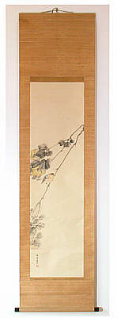
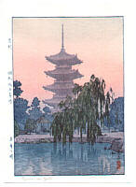
Japanese Painting

Slide 30
Zen art (become one with your environment) strives to paint “in the moment” (“go with the flow”) rather than by a predetermined plan (as in Western art). Most Zen paintings are executed in water colors in just a few minutes.
The ego-centrism (me-centered) nature of Western culture separates man from a sense of community & unity with the universe.

Slide 31
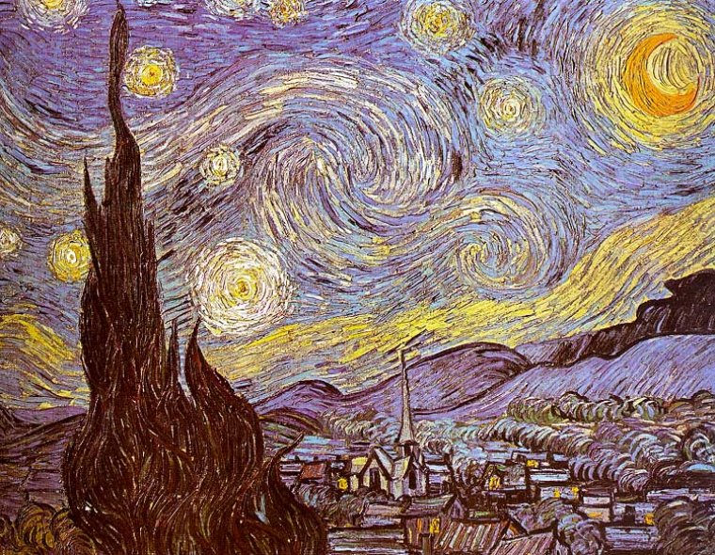
Dutch painter Vincent Van Gogh, who was heavily influenced by Japanese painting, achieved such Zen-like unity between his feelings (internal environment) & external environment that his paintings came alive, writhing in human emotion. The universe became him as he became the universe.

Slide 32
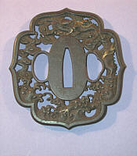
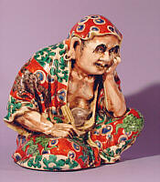
Netsuke (ceramics)
Tsuba (sword handles)

Slide 33
Bunraku puppet theaters
Inshu washi calligraphy on decorative papers made from plant fibers
Chado tea ceremony
Ukiyo-E woodblock prints
Kyo sensa folding fans
Ryukyu Bingata vividly colored dyed textiles
Mizuhiki colored paper strips for tying gifts
Bunka knitted cords used as trim on furniture & pillows, doll clothes, etc.
Temari decorative balls made from thread
Kubuki stylized dances that tell a historical drama

Slide 34
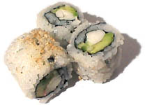
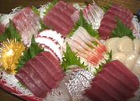
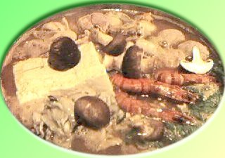
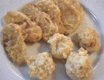

Slide 35
Art enables you
to become ideals.

Slide 36
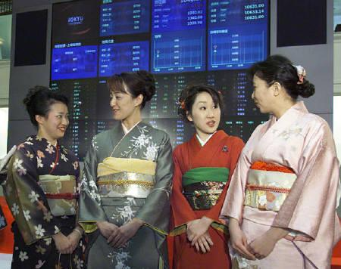
Jimusho no hana
Flowers of the office

Slide 37
To the Japanese, femininity is the embodiment of all artistic ideals (The “Greek Muses” in the Western tradition).
The traditional Japanese geisha was a living exponent of the rich cultural tradition of art in all its forms. She maintained these art forms and passed them along to the next generation.

Slide 38

“Men for competition, women for beauty”
Women as “organic art” (the Geisha)
Performing
ceremonial ideals in work life

Slide 39
Ain’t this sorta sexist,
politically
incorrect, and demeaning
to women?
(Only in unisex/materialistic
cultures)

Slide 40
In contrast with unisex Western (U-GEN) culture, traditional Japanese culture wants women to embody different ideals than males. Many Japanese feel the West has devalued their women by making them mere economic producers, rather than encouraging them to fulfill the feminine ideals of family nurturing, gracious hospitality, beauty-creating, etc.

Slide 41
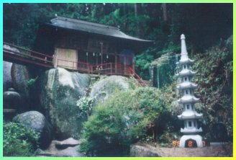
IDEAL #3: WA
INTERPERSONAL HARMONY
Nature has no agenda. It simply
exists as a harmonious ideal.

Slide 42
LIVING IN THE TRIANGLE OF HARMONY
Internal harmony
External harmony Interpersonal harmony

Slide 43
1. The work environment is more
important than the work itself,
because the environment
determines what work can be
accomplished.
2. The underlying foundation
of the Japanese work
environment is harmony vs.
conflict in Western companies.

Slide 44
BEHAVIOR IN JAPANESE BUSINESS DEPENDS ON:
The context: the occasion, the people involved, the purpose
The behavioral model of the employee’s boss--the “geisha” (depository) of workplace ideals

Slide 45
3. Avoiding (2-way) social embarrassment by anticipating the consequences of your behavior on the community you are part of

Slide 46
A good leader doesn’t have to work hard to get others to work hard.

Slide 47
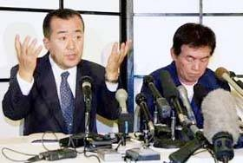
Shimatsu sho
I’m sorry, sorry, sorry
Why do the Japanese apologize in advance?

Slide 48
“I apologize in advance in case I fail to reach the ideal we are all striving to attain. If I do fall short of attaining this ideal, it certainly wasn’t due to my lack of commitment.”
“Even if I succeed, I apologize if I unintentionally broke interpersonal harmony in the process.”

Slide 49
Accepting personal blame for causing your group to fail (lose face)
Ceremonial redemption—settling accounts through ritualistic personal sacrifice (via resignation, or merely being the scapegoat)
What’s the correct way to deal with a traffic ticket in Japan? (Write a note of profuse apology to the local police department.)

Slide 50
TELEPATHIC
COMMUNICATION
HARMONY

Slide 51

Tatemae/Honne
Façade vs. reality
Communicating reality through a
screen of polite harmony.

Slide 52
1. “Safe” business meeting agendas
2. Criticism protocol via
intermediators
3. “Barbarians” within the business
delegation: Don’t speak before
your boss does; don’t disagree
with your team publicly.
4. Vague communication during
negotiations to avoid steamrolling
others

Slide 53
“We will give your generous offer a great deal of thinking.” (“No”)
“We are surprised that your product costs so little to make.” (“Your product’s cost estimates seem unreasonably low.”)
“We know that your company will be very successful in the future.” (“We do not want to work with you in a joint venture.”)

Slide 54
EXAMPLES OF SCREENED HARMONY
Telling people what they want to hear, expecting them to politely “drag” the truth out of you.
Making comments that require “reading between the lines”: “That project is very difficult to complete” (Translation: “We’ve run into some problems”)
Using third parties to communicate areas of disagreement or misunderstandings

Slide 55
What is reality in a restaurant: the nice décor, or the hot, messy kitchen in back?

Slide 56
BUSINESS
JAPANESE
STYLE

Slide 57
THE WORKPLACE AS COMMUNITY
1. Japanese companies are viewed as a community of members committed to one another and to the company’s long-run competitive success. The sense of community is greatly enhanced by the high rate of employee stock ownership: ”Since this is our company for a lifetime, let’s sacrifice together to make it a success.”
2. The Japanese government works to guide & stabilize companies, which are viewed as living organisms.

Slide 58
CEREMONIES FOR
BUILDING
RELATIONSHIPS

Slide 59

Does Donald Trump worry much about the feelings of employees?

Slide 60
Empathetic communication isn’t possible without relationship-building
based on formal/informal interactions.

Slide 61
Japanese companies are looking for a “marriage,” not a “date.” What would most girls say if you asked them to marry you after the first date?
If she actually considered your proposal, how would her parents probably react? Do you think they just might want a lot of information about you?

Slide 62
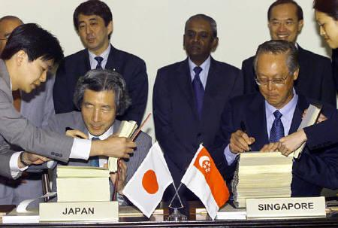
Madoguchi The relationship window into a Japanese “balloon”

Slide 63
Most Japanese companies are like a “balloon” because there are no openings in a balloon—no openings for foreigners to become part of the company. Foreigners who wish to do business with a Japanese company must have an insider “champion” (madoguchi) to “import” the outsider into the company, thus giving them face (a legitimate status to interact with insiders).

Slide 64
Japanese companies are also like a
ringed target: executives occupy
the bulls-eye; middle managers
occupy the middle circles;
foreign business partners occupy
the outer ring. Anyone the
company doesn’t do business with
is outside the circle (lacking
status, or face, completely).

Slide 65
GETTING TO HOME BASE WITH THE JAPANESE
1. Getting to first base: Getting a champion in the Japanese company
2. Getting to second base: Hierarchical networking of executives in both companies
3. Getting to third base: Interpersonal bonding via karaoke, communal baths, etc.
4. Scoring a run: Suspending etiquette (honest, straight forward business negotiations with no ceremony)

Slide 66
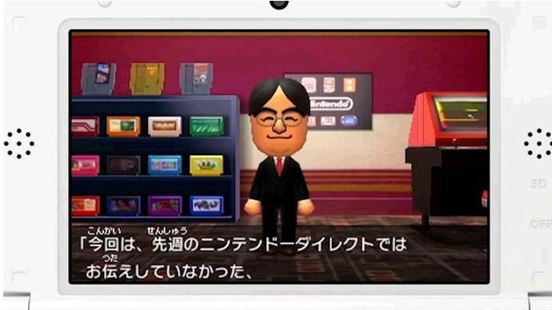
Third party representatives

Slide 67
Expect it to take a solid year
before your company “gets to first base” with a Japanese
Company.
They don’t want to work with a foreign company that is “in lust” rather than “in love.”

Slide 68
DURING THE “DATING GAME”…
Be psychologically prepared for “circular” (communal consensus) Japanese business practices.
Why do the Japanese generally ask for more and more and more information about your company? (making sure everyone saves face by knowing a lot about who they are about to do business with)

Slide 69
3. Waiting patiently for
the right introductory ceremonial occasion (You can’t celebrate Christmas
in April.)
4. The Japanese reluctance to take on new friendship obligations—sense of duty always run ahead of emotions.

Slide 70
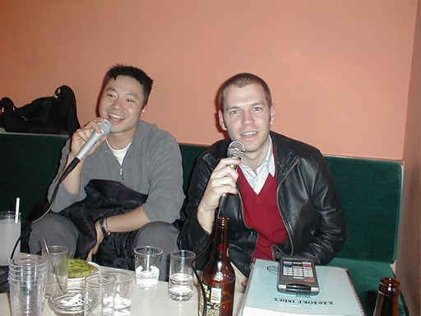
Karaoke (“empty orchestra”)

Slide 71
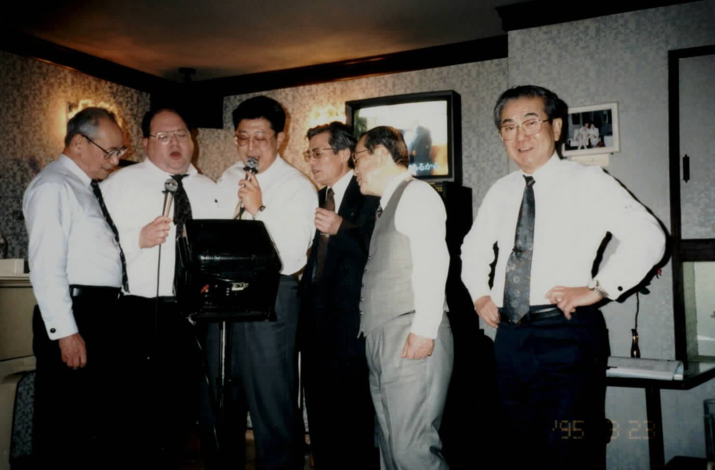
Karaoke

Slide 72
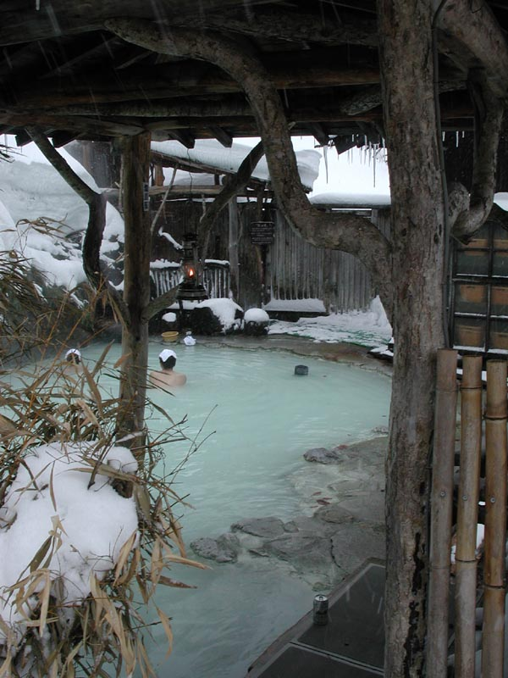
Kon’yoku Communal bathing

Slide 73
Nightlife is a cultural necessity in Japan because negotiations require safe ceremonial settings where people can be open & honest without breaking harmony—such as drinking in a bar where you can claim you were drunk & thus not aware of what blunt/honest things you may have said.

Slide 74
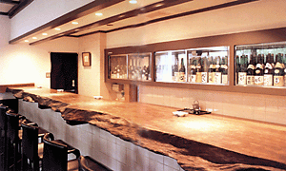
Burei Ko Abandoning etiquette

Slide 75
How does drinking in a bar make it OK for the Japanese to be blunt, honest, & even rude?

Slide 76
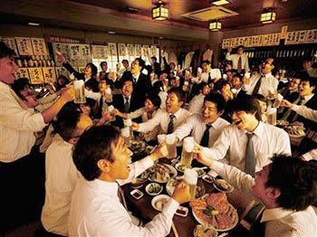
Getting drunk etiquette

Slide 77

Getting drunk etiquette: The Japanese use drinking in a bar as a excuse for engaging in socially unacceptable behavior (like blunt honesty or complaining), since “they didn’t know what they were doing” (because they were drunk).

Slide 78
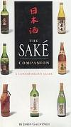
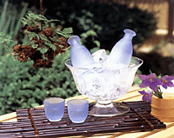
Rice Wine

Slide 79
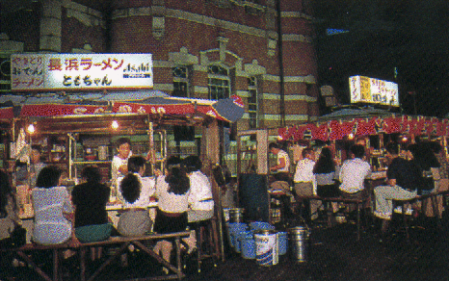
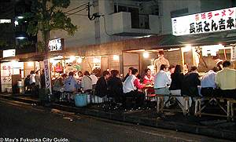
Entertaining in inexpensive Yatai stalls (Japanese “fast food” stands, which are a much cheaper entertaining venue than downtown bars and night clubs). Popular food includes ramen noodles, yakatori barbeque, & tempura (fried fish & veggies).

Slide 80
GAIATSU: USING OUTSIDE PRESSURE FOR HARMONIOUS, FACE-SAVING, CHANGE

Slide 81

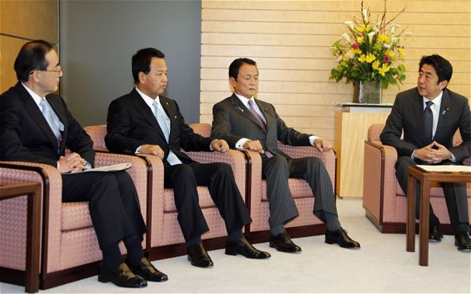
Face change (gaitsu)

Slide 82
In face-conscious Japan, change may be viewed as an admission of failure or lack of dedication.
Do you really want a change you made to imply that your boss or work team didn’t work hard enough, or weren’t competent enough, or that you have higher standards than they do?

Slide 83
The Japanese government recently began to encourage foreign (“gaijin”) companies to step up their operations in Japan as a face-saving/gaiatsu way of lighting a fire under Japanese companies to become more innovative, competitive, & efficient. “Japan hopes foreigners can shake up old & staid Japanese structures in ways that domestic firms can’t.”
In its successful turn-around of almost bankrupt Nissan, Renault showed Japanese car companies how to use their suppliers more efficiently.

Slide 84
Foreign insurance firms have introduced a number of new services copied by their Japanese counterparts.
Starbucks has forced traditional Japanese coffee-shop chains to improve.
As long ago as 1853, America’s Commodore Perry forced Japan at gunpoint to open its markets to American exports, leading to the breakdown of Japan’s ancient feudal social structure and ushering in the modernization of Japanese commercial practices.

Slide 85
Rationalizing making corporate changes on the grounds that you have to fit into other cultures where you do business:
Role of women in American factories
Making large, inefficient SUVs
3. Cleaning up the Japanese
banking system

Slide 86
IDEAL #4:
MUGA
THE ART OF
ACHIEVING PERFECTION

Slide 87
Is striving to achieve a 3.2
cumulative GPA
an ambitious goal?
Why not
strive for 4.0?

Slide 88
Do you assume that you had to earn the 4.0 GPA by yourself?
Would the scenario be any different if you could team up with 3 other BU students and count the highest grades any of you 4 make?
Perfection is too important to leave to just one person working alone.

Slide 89
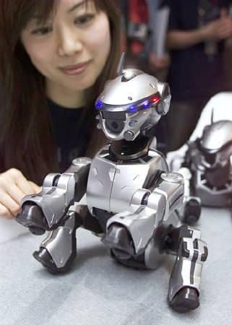
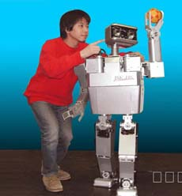
Yugo Ka Fusion of ideas & technology (high tech Zen)

Slide 90
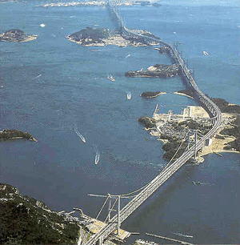
Seto Ohashi 7-mile bridge connecting Honshu with Shikoku:
The ultimate technology nation

Slide 91
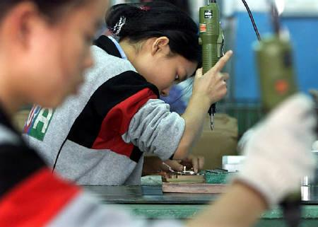
Dami Oshi
Making doubly sure

Slide 92
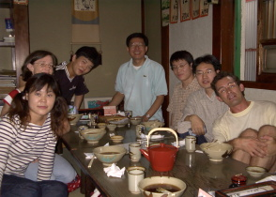
Perfection = Internal commitment + Group pressure

Slide 93
Not workaholics, but rather:
Duty-aholics
Perfection-aholics
Ideal-aholics

Slide 94
Japanese “Triangulation”
Internalized ideals
Team
oversight Statistics
PERFECTION

Slide 95
The Japanese set up a mutual accountability system to drive workers toward more perfect performance. Individual workers dedicate themselves to numerous ideals relating to performance excellence (head work, customer-orientation, sweating the details, etc.); their individual work is closely monitored/coordinated by the work team; performance statistics are used as an objective measure of everyone’s overall success. Performance is seen as too important to leave in the hands of employees working alone.

Slide 96

Transactional Management
(mutually beneficial career-enhancing exchanges) vs.
IDEAL #5: Transformational Management
(gradual transformation by ideals)

Slide 97
JAPANESE MANAGEMENT STYLE

Slide 98
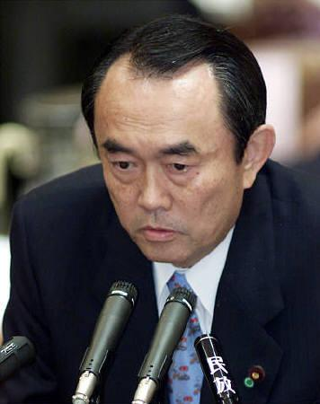
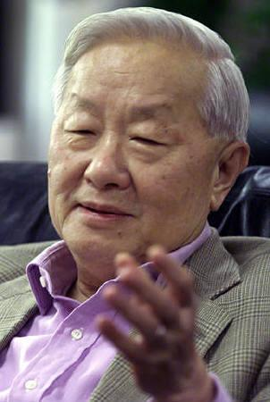
Sempai (“honorable boss”)

Slide 99
Japanese managers are practically invisible in their quest to maintain workplace ideals of harmony, loyalty, humility, & consensus.
There is no room in Japan for the hard-charging individualistic manager of the West. “The nail that sticks up gets hammered down.” “The smart hawk hides its talons.”
Managerial decisions are almost always by consensus (nemawashi) & Japanese business is a group effort.

Slide 100
4. Bosses hesitate to speak out or “rock the boat” for fear of conveying disrespect to others or disrupting harmony in some way. Likewise, their subordinates seldom challenge the status quo fearing that change might cause someone to lose face.
2. Japanese decision-making is a slow, evolutionary process since so many people must be pleased.
3. Lower level employees must pay their dues over a long period of time given the Japanese preference for experienced, middle-age leaders. And changing employment in mid-career can result in loss of retirement benefits.

Slide 101
“Japanese middle mangers are pushed into early retirement for daring to question the boss in a meeting; workers do not see their families for weeks as they are often forced to remain at the office; managers are so wedded to their jobs that their wives divorce them; nasty office politics abound.”

Slide 102
TRANSACTIONAL
vs. TRANSFORMATIONAL MANAGEMENT

Slide 103

Transactional vs. Transformational leadership

Slide 104
Transactional management, characteristic of the individualistic West, is the “quid-pro-quo” approach to work of “I’ll do this for you if you do this for me.” Managers in Western companies are expected to motivate & lead workers into pursuing organizational interests in return for providing competitive wages & benefits, possible merit pay & promotions, & agreeable work conditions. The organization looks after its interests & employees look out for their interests.

Slide 105
Japanese transformational management requires that employees motivate themselves on behalf of the organization by internalizing the workplace ideals of this boss (sempai). Managers serve as role models of organizational ideals for employees to sacrificially emulate. Employees aren’t promotable until they rise above self-interest, doing what the organization wants, the way it wants.

Slide 106
In order to be transformed by the boss, subordinates must be adept reading the boss’s mind & copying his behavior (to show that corporate traditions & ideals have been internalized).
Employees cater to the hierarchy to show loyalty & complete commitment to the cause.
The most important responsibility of subordinates is maintaining the face & honor of their boss.

Slide 107
Vague goals,
Clear ideals

Slide 108
Goals are a cheap substitute for ideals.
American employees are saturated with goals because few American companies have any ideals to offer.
With goals you seldom get more than you asked for—with ideals you often do. Goals limit; ideals stretch.

Slide 109
Japanese managers value ideals above goals, because ideals require internal/voluntary commitment on the subordinate’s part; they reflect an employee transformed by corporate ideals.
Goals set by a boss are a form of external (transactional) motivation. The Japanese want employees to be internally motivated by internalized ideals.
The Japanese want employees to motivate themselves (be transformed) by internalized ideals. Goals thrust on employees autocratically by the boss creates an “us versus them” work environment.

Slide 110
External motivators like $$$ do motivate many people, but money can’t buy loyalty or promote teamwork. Money-oriented employees are gone as soon as they can find more money elsewhere.

Slide 111
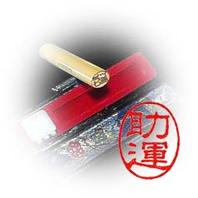


Ringi Seido
What’s the Japanese purpose of putting it in writing?

Slide 112
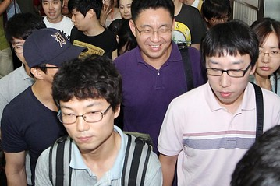
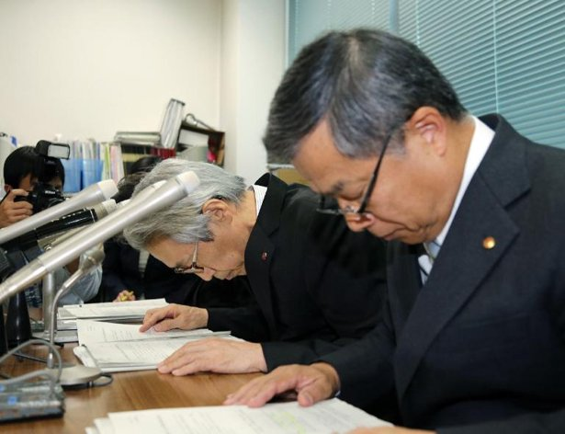
Ringi Seido

Slide 113
Managers downwardly communicate (vague) goals that they want employee teams to deliver on: “We hope the new marketing efforts will capture the true essence of our company.”
Teams send “trial balloon” scenarios upward to management to indicate alternative ways in which the expressed goal (“the essence of our company”) might be fulfilled & to build harmony.
This two-way communication process percolates until management circulates the ringi seido (ideal transformed scenario) among its ranks and then to employees for endorsement via their written seal (“pledge of allegiance”).

Slide 114
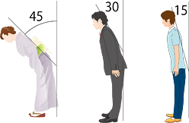

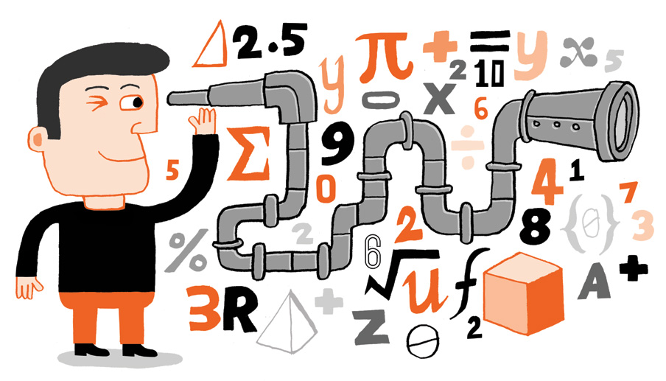

Slide 115
Percolated decision-making gives face to everyone involved: managers don‘t have to order employees to be transformed by ideals; employee needs are responded to by management.
The decision can then be implemented without political game-playing & coercion.
This careful consensus-building approach naturally slows down the Japanese decision-making process, much to the frustration of many Western companies accustomed to getting things done decisively via authoritarian, unilateral executives.

Slide 116
Mutual face
Submission > domination
+ reinforcement > negative
Ideals by osmosis

Slide 117
ASIAN
COMMUNALISM
MEETS WESTERN
INDIVIDUALISM

Slide 118
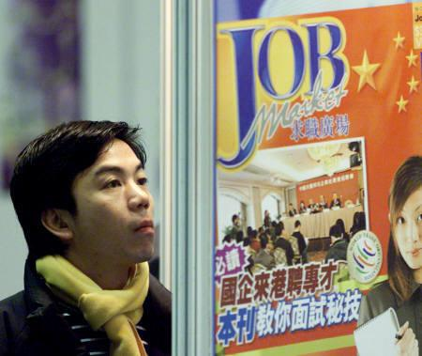
Giri
Would you like to live with unending obligations?

Slide 119
The younger generation have a Westernized mindset that expects companies to provide a “comfort environment” (“give”—not just “take”).
Endless sacrifice is a thing of the past.
Communalism meets individualism

Slide 120
Japan’s prolonged 1990s recession & breakdown of lifetime employment has taken its toll on Japanese morale & pride:
“Thumb culture”: Recent college grads don’t want to sacrifice their lives to a corporation, “hiding” at home passing the time with digital technology (video games, chat grouping, etc.).
Rising divorce & suicide , declining birth rates, lack of purpose in life

Slide 121
SOCIAL TENSIONS
1. “The Japanese company, or kaisha, still plays a more paternal part in employees’ lives than in any other well-off society, shaping not just work but also their social life. With long hours in the office as well as punishing sessions in bars with colleagues afterwards, the two are often indistinguishable. “

Slide 122
2. Twenty percent of Japanese are now elderly and the average lifespan has increased from 50 years old in 1947 to 82 today.
3. In large part, the population has been rapidly graying because small families are under work-related stress. After a Japanese couple have their first child, the husband often doesn’t have enough time to help around the home, making the wife think twice about having any more children.

