Slide 1
CHAPTER 3
GERMAN
CULTURE
The Saxon in Anglo-Saxon

Slide 2
German Culture PRISMs
To what extent are cultural differences really biological differences?
Is performance all that counts?
To what extent can we control organizations vs. organizations control us?
Why is German culture the model for business professionalism?
To what extent should business professionals be expected to serve their organizations ahead of their families?

Slide 3
Individualism
Extended family
Community
Monochronic
Poychronic
Low Context
High Context
Social Ambiguity
Social Certainty
Low Power Distance
High power Distance
Mastery
Adaptation
Emotionally Neutral
Emotionally Expressive
Quantity of Life
Quality of life

Slide 4
THE SAXON FOUNDATION OF
WESTERN TEMPERAMENT
Science, technology, engineering (environmental control)
2. German culture is “heavy/weighty” (theology, philosophy, classical music, theoretical science, etc.)
in comparison to “lite” U.S. culture
(pop music, sitcoms, fast food, blue jeans, etc.)

Slide 5
THE EFFECT OF CLIMATE ON CULTURE
Northern frigid climates demand seriousness of purpose (long hard winters can kill!), lots of planning (dressing properly, winterizing houses, etc.), and high energy (to keep warm).
Frigid climates also promote solitary living since social interaction is limited by the ice, snow, and long periods of darkness.
Anglo-Saxons are typically privacy-oriented, perhaps due to lengthy indoor living in a hostile climate.

Slide 6
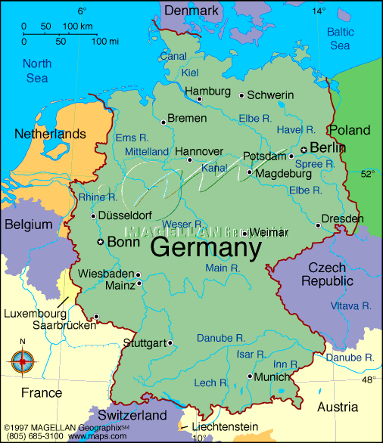

Slide 7
Does the previous map suggest anything
about why Germany was so
imperialistic in the first half
of the 20th century?

Slide 8
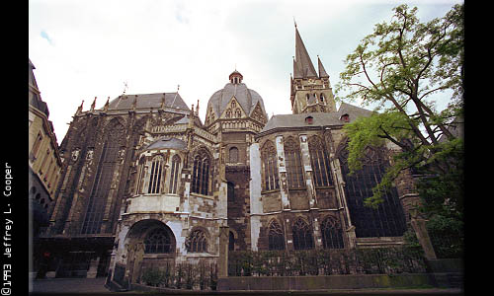
Aachen, Germany (formerly of the Netherlands):
Original home of the Van Aukens, which translates, “from Aachen”

Slide 9
GERMAN ABSTRACT THINKING & MASTERY CULTURE

Slide 10
WHAT GERMAN COMPOSERS, PHILOSOPHERS, THEOLOGIANS, & SCIENTISTS SHARE IN COMMON
Abstract thinking
Systemic thinking
Conceptual thinking

Slide 11
DEUTSCHE KOMPONISTEN
Johann Sebastian Bach
Joseph Haydn
Wolfgang Mozart
Ludwig van Beethoven (revolutionary)
Franz Schubert
Robert Schumann
Johannes Brahms
Richard Wagner (revolutionary)
Gustav Mahler
Arnold Schoenberg (revolutionary)
Anton Webern

Slide 12
DEUTSCHE THEOLOGIANS
Karl Barth
(revolutionary)
Dietrich Bonhoeffer
Emil Brunner
Martin Buber
Rudolf Bultmann
Meister Eckhart
Adolf Harnack
Martin Heidegger
Karl Jaspers
Martin Luther (revolutionary)
Karl Rahner
Walter Rauschenbusch
Friedrich Schleirmacher
Paul Tillich

Slide 13

In the “Protestant Reformation” of 1521, Martin Luther sought to reform the Roman Catholic church.

Slide 14
DEUTSCHE PHILOSOPHEN
Friedrich Schelling
Karl Marx
Baruch Spinoza
Gottfried Leibniz
Arthur Schopenhauer
Gustav Fichner
Johann Fichte
G. F. W. Hegel
Immanuel Kant
Edmond Hesserl
Ludwig Wittgenstein

Slide 15
DEUTSCHE WISSENSCHAFTLER: WISSENSCHAFT
Albert Einstein
Gabriel Fahrenheit
Alexander von Humboldt
Johannes Kepler
Ernst Mach
Theory of relativity
Temperature measurement
Botany
Laws of planetary motion
Measuring sound speed

Slide 16
DEUTSCHE WISSENSCHAFTLER: WISSENSCHAFT
Laws of electric current
Theory of alternating current
Radio & TV waves
Quantum mechanics & the uncertainty principle
Georg Olm
Charles Steinmetz
Heinrich Hertz
Werner Heisenberg

Slide 17
DEUTSCHE WISSENSCHAFTLER: MEDIZIN
August Wassermann
Robert Koch
Wilhelm Rontgen
Cure for syphilis
Cure for TB
Discovery of X-Rays

Slide 18
DEUTSCHE WISSENSCHAFTLER: PSYCHOLOGIE
Sigmund Freud
Carl Jung
Franz Mesmer
Psychotherapy
Theory of dreams
Hypnotism

Slide 19
Deutsche Wissenschaftler: ingenieurwesen
Linotype printing
Aeronautical design
Nuclear reactor
Hydrogen dirigibles
Binoculars & optics
Binary computer
Ottmar Mergenthaler
Otto Lillienthal
Lise Meitner
Ferdinand von Zeppelin
Carl Zeiss
Konrad Zuse

Slide 20
DEUTSCHE WISSENSCHAFTLER:
INGENIEURWESEN
Karl Benz
Gottfried Daimler
Werner von Braun
Johann Roebling
Edward Teller
Johannes Gutenberg
Internal combustion engine
Internal combustion engine
Rockets
Suspension bridges
Hydrogen bomb
Printing press

Slide 21

The Mercedes (designed to cruise for long distances over 100 MPH) & bullet train are icons of German engineering excellence & craftsmanship.

Slide 22
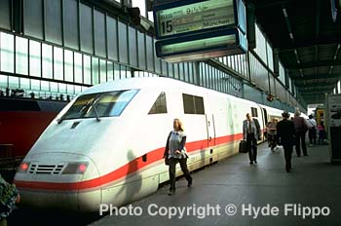

Slide 23
GOLF: THE SPORT WITH THE GERMAN MINDSET
Emotional control
Planning ahead
Technique & precision
Micro-management
Focus & concentration
Measurable performance
Course management

Slide 24
GERMAN
BUSINESS
CULTURE

Slide 25
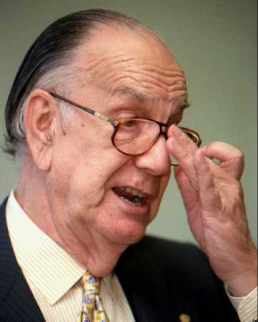
Geschäft (Business) Kultur in Deutschland

Slide 26
THE SAXON FOUNDATION OF
WESTERN PROFESSIONALISM
1. Low context
2. Monochronic
3. Emotionally
neutral

Slide 27
4. Institutions (Bureaucracy)
5. Organizational
systems
6. Impersonal professionalism

Slide 28
SPECIFIC BUSINESS ARTIFACTS OF GERMAN CULTURE
3-piece suits + briefcase
Resumes
Formatted business letters
R&D labs
Performance evaluations
MBAs (“Mighty Business Attitude”)
Organization charts
Accounting audits
Codes of ethics

Slide 29
THE GERMAN INFLUENCE ON BUSINESS SCHOOL EDUCATION
1. Strong stress on abstract analytical systems (accounting, formulas, statistics, technical writing, computer programming) more than on “people” skills
2. Assignments that stress accuracy & “right answers” rather than creativity or innovation
3. Learning via following the system more than individual discovery

Slide 30
Germanic-influenced American business schools prepare students to live their future lives around the needs of “conform and perform” corporations.
B-schools program students to conform via analytical courses; routinized instruction that emphasizes right answers & heavy memorization; & strict attention to technical accuracy (accounting problem sets, finance formulas, statistical analysis, perfect resumes, etc.).
B-students with high grades (especially in accounting and finance) have already demonstrated their capacity to “score” for profit-driven conform/perform corporations.

Slide 31
THE
GERMAN
ORGANIZATIONAL
MINDSET

Slide 32
THE GERMAN ORGANIZATIONAL MINDSET
1. Performance is all that counts
2. Micromanaging the workplace: job descriptions, systems & procedures, deadlines, etc.
3. Technical communication: Formal letters, resumes, memos, analysis reports, statistical reports, etc.
4. Formality: Chain of command, professional dress, punctuality, Use of surnames & titles

Slide 33
5. “All business” work environment: focus, concentration, efficiency, etc.
6. Compartmentalism: Separation of private life and professional life
7. Strong centralized authority
8. “The system is the solution”: All employees & activities must plug into formal plans and procedures. “Plan your work and work your plan.”

Slide 34
What is the organization
culture of the German corporation?
Serious
Formal
Bureaucratic
Analytical

Slide 35
Germans want organizations to be like a machine: so carefully designed & crafted that they almost run themselves (via systems & procedures, chain of command, job descriptions, etc.)
Germans emphasize the system over the people in the system, because people are “messy” (emotional, unpredictable,
hard to control, etc.).

Slide 36
HOW PROFESSIONALIZED ORGANIZATIONS LIMIT OUR FREEDOM & MASTER US:
We must run our lives around the interests of the org: work hours, dress code, job descriptions, geographical transfers, etc.
Separation from family & friends
Required college education & professional certifications
Internalizing org goals & mission
Conforming to the org culture
A professional is someone who devotes his/her life to helping an organization succeed.

Slide 37
PERFORMANCE
CULTURE

Slide 38
THE PERFORMANCE CULTURE
Goals, competition, promotions
LSAT & GMAT exams
Commission sales
Football coaches
Job interviews
Continuoulsy-updated resumes
Companies hire college graduates because college life (controlled and performance-oriented) “programs” students for similar corporate environments—learning to do what an organization wants you to do

Slide 39
HOW AMERICANS “CHEAT” TO BEAT GERMANS IN PRODUCTIVITY
Due to German compartmentalizing (separating professional life from personal life), German employees expect to work a fairly rigid 8:00-5:00 schedule & then go home. More informal, less regimented, American workers are happy to work anytime, anyplace, this boosting their productivity & organizational flexibility & $$$. Germans say live by the system, while Americans say beat the system.

Slide 40
THE BU
PERFORMANCE CULTURE
Performance organizational culture demands that the national culture shapes people to fit into performance cultures. Baylor says that being a tier 1 institution means it does a better job of preparing students for high performance careers. Hence, BU has greatly upped its performance culture via tougher grading, escalating classroom workloads, competition between students, & administration strong power centralization.

Slide 41
THE MALE BIAS OF GERMAN BUSINESS CULTURE
The traditional male bias in Anglo-Saxon business culture was strongly influenced by the German bias for emotional control/neutrality in interpersonal relationships & analytical decision-making (impersonal
professionalism).

Slide 42
GERMAN
COMMUNICATION
&
PRIVACY

Slide 43
COMMUNICATION GERMAN STYLE
Clear communication is blunt communication—preferably written. German employees prefer written instructions over verbal because of their increased accuracy & they back-up employee accountability.
Criticism doesn’t have to be sugar-coated to be constructive
Accuracy is too important to keep quiet about mistakes
Formality maintains professionalism

Slide 44
Departments in
German companies
are so wedded
to privacy that “silo” departments share little information with employees & between departments.

Slide 45
Privacy is essential for neutralizing nervous stress in in emotionally neutral cultures.

Slide 46
GERMAN
COMMUNITARIANISM

Slide 47
Similar to Scandinavians, Germans have a strong sense of social justice based on equality of outcomes and protection against insecurity.
The German government uses a complex legalistic regulatory system to promote equality of hours retailers can be open, cartels (restricting how many new companies may move into an established industry), & bailing out bankrupt companies to avoid unemployment & layoffs.

Slide 48
3. German companies often work in alliances, even between competitors, to promote stability.
4. Companies are slow to change, since their quest for security and social justice promotes consensus decision-making among wide networks of cooperating alliances.
5. However, the German workplace is serious business, “low on compassion, high on performance. Error-free, competent performance is the standard against which employees will be judged. Performance issues are taken up directly and bluntly.”

Slide 49
THE GERMAN
CO-DETERMINATION SYSTEM
By law, German workers are heavily represented on German boards (in companies with 2,000 or more employees), giving them a pivotal role in shaping corporate policies & strategies
This has greatly lowered the number of strikes & lost work days in the German economy as well as union conflict in an emotionally neutral culture that dislikes the disorder of organizational conflict.

