Slide 1
CHAPTER 9
FRENCH CULTURE

Slide 2
French Culture PRISMs
Is it OK for a culture to be “arrogant”?
Is it possible for any culture today to escape the pull of secular modernism?
Is existentialism a fount of human freedom or a cultural disease?
Is materialism the ultimate priority for nations to pursue?
Are there other “split personality” cultures in the world besides the French?

Slide 3
Individualism
Extended family
Community
Monochronic
Poychronic
Low Context
High Context
Social Ambiguity
Social Certainty
Low Power Distance
High power Distance
Mastery
Adaptation
Emotionally Neutral
Emotionally Expressive
Quantity of Life
Quality of life

Slide 4
FRENCH
SOPHISTICATION

Slide 5
“Culture, the source of Europe’s ascendancy, is France’s greatest treasure.”

Slide 6
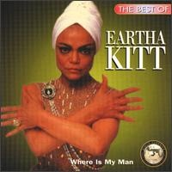
C’est Si Bon!

Slide 7
France is the lifestyle culture (the outward “worldliness” of sumptuous cuisine, high fashion, & intellectual sophistication) within post-Enlightenment Western culture.
French cultural tradition is “fancy”: mellifluous language, escargot, snuff boxes, the Moulin Rouge, existentialism, Impressionistic painting, fine wines & cuisine, et. al.

Slide 8
COMMENT LA CULTURE FRANÇAISE EST-ELLE
SOPHISTIQUÉE?
(HOW IS FRENCH SOPHISTICATED?)
Moustache wax High heel shoes
Lingerie Parfume Garters
Snuff boxes French cuffs Waist coats
Cravats (neckties) Hoop skirts
Brassieres Hair nets
Pioneered porno photos

Slide 9
Why is French so difficult to pronounce? (to make it sophisticated)
The French government’s language commission monitors public TV to make sure the French language remains “pure” (especially from American technical terms & slang)

Slide 10
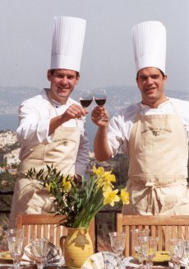
Deux chefs de Cordon Bleu

Slide 11
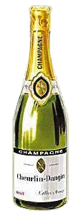
La champagne francais

Slide 12
FAMOUS FRENCH WINE REGIONS:
Burgundy
Bordeaux
Beaujolais
Champagne
Chablis

Slide 13
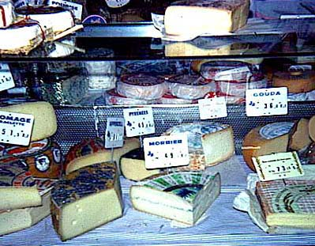
Le France est celebre pour son fromage

Slide 14
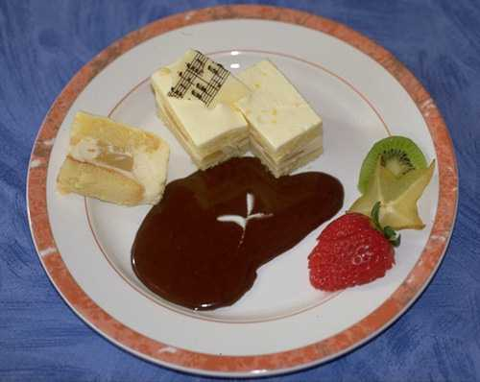
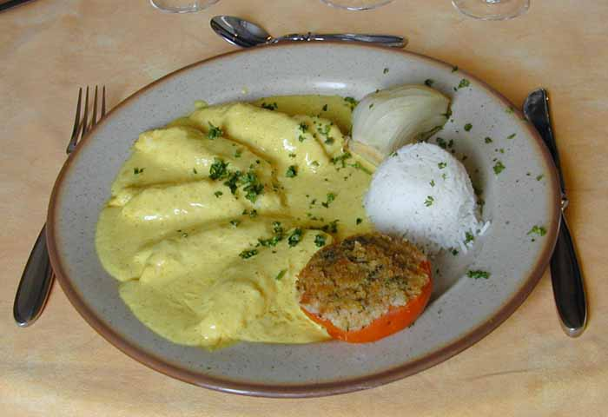
Sauce lourde et pâtisserie française riche

Slide 15
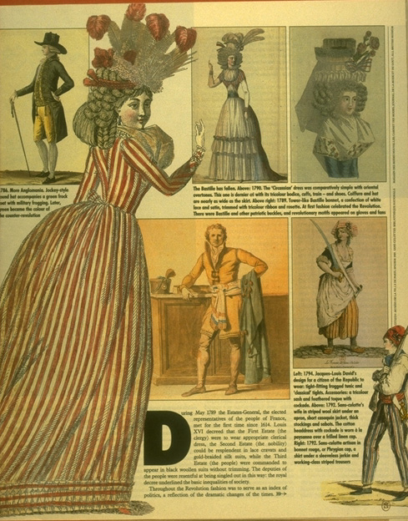
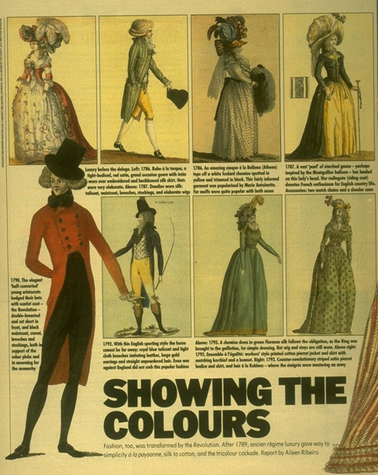
La France est célèbre pour quel genre de mode?

Slide 16
CÉLÈBRES ARTISTES FRANÇAIS
Boucher
Braque (cubism)
Cezanne
Corot
Courbet
David
Degas
Delacroix
Toulouse-Lautrec (Moulin Rouge)
Gauguin (a cutting earful)
Matisse (fauvism)
Millet
Monet
Pissarro
Poussin
Renoir (impressionism)
Seurat (pointillism)

Slide 17
THE
FRENCH
DUAL
PERSONALITIES

Slide 18
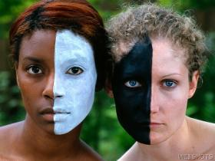
Française fendue (split) la personnalité: LIBERTARIANISM VS. BUREAUCRACY
(Latin + Anglo-Saxon mixture)

Slide 19
A CULTURAL LEGACY OF TWO INCOMPATIBLE CULTURES
The French have a dual personality culturally with a volatile Anglo-Saxon/Latin blend—libertarianism + elitism.

Slide 20
Personality 1:
THE FRENCH LIBERTINE
  1. Liberal lifestyles & uninhibited licentiousness (La Moulin Rouge & the infamous “Can-Can” dance & LA FEÉ VERTE (absinthe)
  2. Mardi Gras (vs. Lent)
  3. Self-indulgent sophistication
  4. Political activism, strikes, unionism

Slide 21
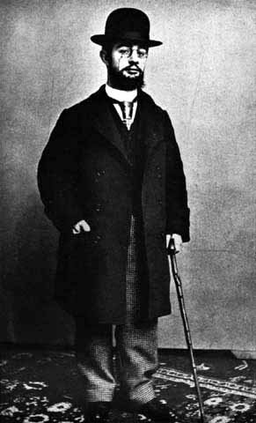
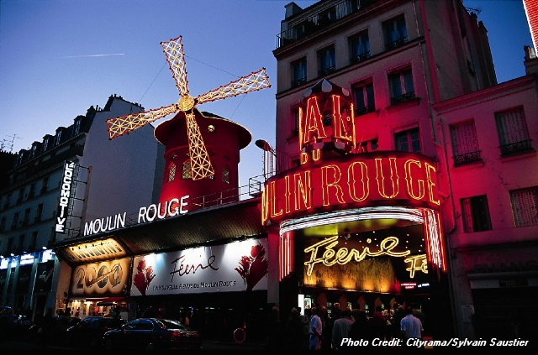
HENRI TOULOUSE-LAUTREC who painted the habitués of the Moulin Rouge (“red windmill”)

Slide 22
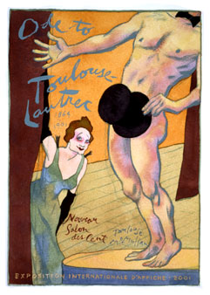
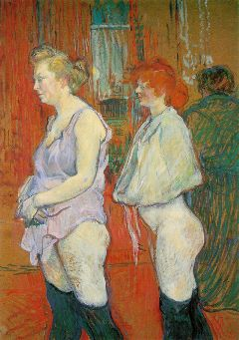
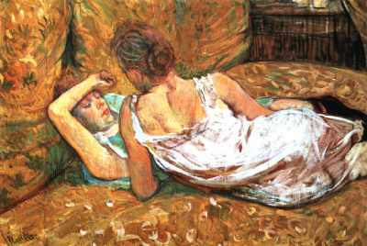

Slide 23
Personality 2:
FRANÇAIS LE BUREAUCRATE
Code Napoleon & a pervasive “Civil Service” system of professional employment
Competitive examinations
Rules for hiring, promotions, raises, etc.
The discipline of impersonal organization structure (the strange Anglo Saxon transplant)

Slide 24
The French show the bureaucratic/control side of their character today in their tough zero-tolerance anti-terrorism policies, often in tension with human rights.
All religious symbols are banned from public forums.
Unrestrained surveillance of Muslim activity within France.
“Offensive harassment” of the Muslin community via unannounced raids on suspected gathering places for terrorists
Limited human rights privileges for those under arrest or interrogation.

Slide 25
Under the French legal system, the Napoleonic Code, those arrested are “guilty until proven innocent,” & judges serve as rubber stamps for state prosecutors rather than advocates for impartial jurisprudence.

Slide 26
“The French have no problem of identity. They know who they are and can’t imagine wanting to be anybody else. They are determined to remain a presence on the world scene. But the material means are lacking, and the world has become negligent in paying what France considers its due deference to moral and intellectual weight. It lives with its contradictions and never stops seeking to make its mark.”

Slide 27
“Everyone considers the French to be the most nationalistic people in Europe. The Gallic rooster--proud, independent, self-assured, and mocking--symbolizes France. Other nations choose an eagle, a lion, a unicorn, and elephant, a serpent as their national symbol. The French enshrined a barnyard fowl, but the scrappiest, noisiest, most brilliant. They relish both the bravura and the satire. “

Slide 28
A
SCHIZOPHRENIC
HISTORY

Slide 29
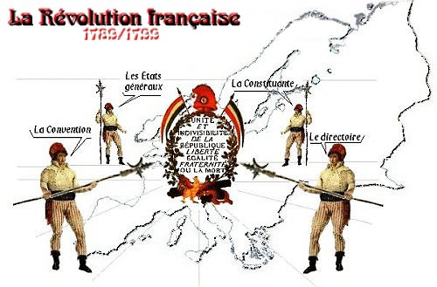

Slide 30
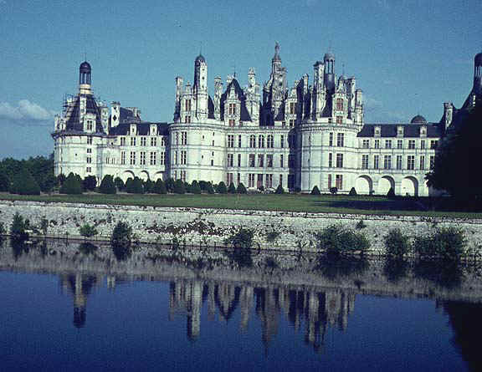
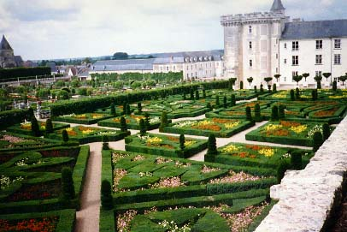
Versailles: Le palais royal
French élitisme

Slide 31
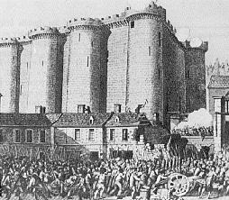
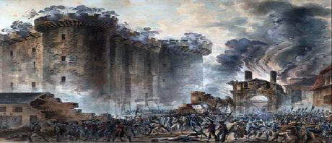
July 14, 1789: Storming of the Bastille (political prison) by the rebelling “commoners”

Slide 32
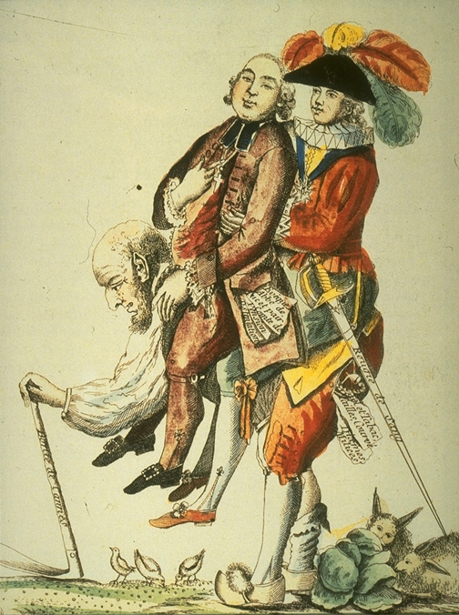
Qu'a causé la révolution française?
King Louis XVI

Slide 33
Poor grain harvests in 1787-88
Exorbitant taxation
Royal frivolousness

Slide 34
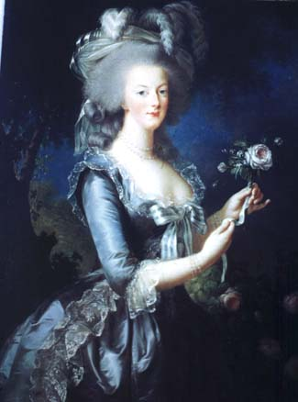
De Reine Marie Antoinette
(“Let them eat cake if they have no bread.”)

Slide 35
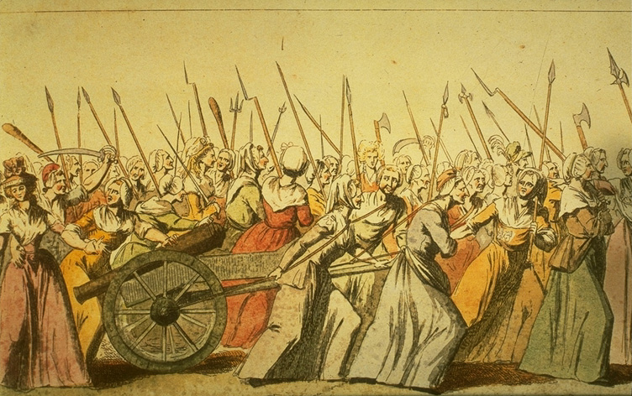
Sur le guerre des Classes
(to the class warfare)

Slide 36

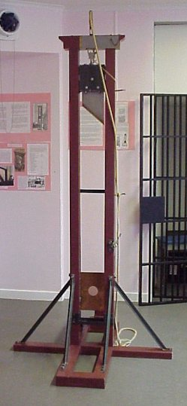

Le massicot (la Guillotine) hier et aujourd‘hui

Slide 37
“The National Razor”
40,000 executed (many set up politically) in the “Reign of Terror”
Dr. Guillotine didn’t invent the guillotine but championed its use in the revolution on the grounds that it was “quick and painless” (in contrast to manual beheading with an ax)
88 lb. beveled blade
A half second to behead, but is the head still conscious for the next 30 seconds?

Slide 38
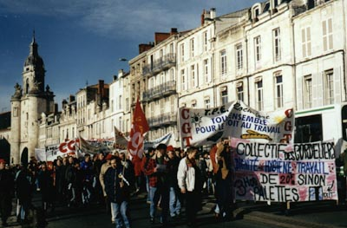
The French still love to protest, but without the rolling of heads!

Slide 39
“Only the Russian Bolshevik Revolution and the Spanish Civil War tore their countries apart in so great a rage as the French Revolution. Yet only 15 years after the fall of the French Bastille (prison) Napoleon crowned himself emperor.” So why was the revolution even fought?

Slide 40
NAPOLEON
SPLITAPART

Slide 41
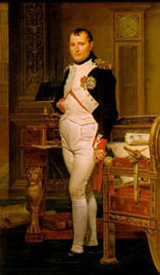
D'empereur Napoleon:
Domocrat ou dictateur?

Slide 42
THE NAPOLEONIC CODE
Napoleon wanted to create a uniform code of law for France, which historically had a patchwork legal system based on local customs, special charters applying to only a few, & non-uniform laws across various geographical locales.
The resulting Napoleonic Code, completed in 1804 under Napoleon's direction, soon became the 19th century prototype legal system for another 24 nations (& has heavily influenced the laws of Louisiana & Quebec to this day).
The Napoleonic Code differs from British common law primarily in the great amount of latitude under the Code extended to judges in interpreting the spirit of the law (vs. the letter of the law under the British system).

Slide 43
General over French army at age 28
(“Little Emperor”)
Conquered Italy, Holland, Spain, Austria
Peaked militarily in 1812
& then defeated by the Russians & exiled to the island of Elba
Make a military comeback but defeated by the British at Waterloo, Belgium
Exiled to the African island of St. Helena & died (by poisoning?)

Slide 44
SPLIT (BON)APARTE
“Liberator vs. “The Little Emperor”
2. Popular with soldiers but contempt for the common man (who kissed the severed heads during the revolution)
3. Dictator sets up impersonal Anglo-Saxon bureaucracy via the Code Napoleon
4. The French bureaucracy favored the socially elite through guaranteeing entrance to universities that turned out virtually all government & business leaders.

Slide 45

What do you get when a bomb
explodes in a French kitchen?
(Linoleum Blownapart)

Slide 46
FRENCH
SOCIAL
DUALITY

Slide 47
SIGNS THAT FRENCH CULTURE CAN’T ADAPT TO THE MODERN WORLD
Rioting in 2006 throughout France by Muslim minorities who have been excluded from the French economic system.
Three-fourth of young French want to become state employees because it ensures lifetime security.
French unemployment has remained at high levels (around 10%) because companies hesitate to create new jobs because legally-mandated employee benefits are so high.

Slide 48
Just 36% of the French agree that capitalism is the world's best economic system.
Modern French government has been unwilling to admit that French socialism (reflected by an average tax rate of 44%) has sapped national economic growth.
“The French seem to no longer know what they want.”

Slide 49
“The decline of French as a world language, especially as the lingua franca of the world elite, is a source of pain and recrimination to the French. A substantial government budget is dedicated to countering this trend.” As one elderly French patriot puts it: “A thousand years, we have a thousand years of culture to support us. That’s what France represents. That’s why we are so sturdy and so rich in spirit.”

Slide 50
FRENCH
BUSINESS
DUALITY

Slide 51
France is the 5th largest economy in the world & 5th largest exporter.
Famous French companies include Renault, Peugeot, & L’Oreal
The French work fewer hours per week (35) than any other developed nation.

Slide 52
The French in general have a negative attitude towards business & corporations & tend to use business as a convenient scapegoat for France’s economic problems.
In reality, France’s rigid labor laws (35 hour legal workweek, strong union powers, generous guaranteed worker benefits) are behind the nation’s high unemployment & slow growth
The French voted down the proposed new EU constitution in 2005 in large part because of fear that their employment “comfort zone” would be compromised by stricter constitutional provisions toward labor.

Slide 53
A sarcastic French media commentator summed up France’s future in the 21st century: “France will soon be made up of the old, the Arab, and the creatician,” a slang word he created to refer to computer-driven professionals who are “taking over the world.” Legal and illegal Muslim immigration into France is significantly changing the nation’s population and ethnic profile and becoming a new source of social instability in France (of both religious and ethnic origin).

Slide 54

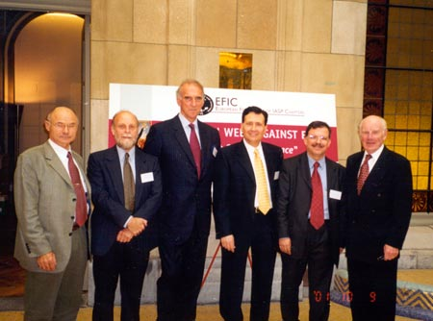
Ils ont le de pure race
They have the “pedigree” (to be executives)

Slide 55
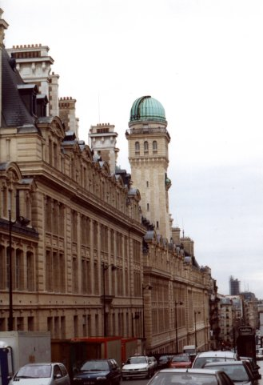
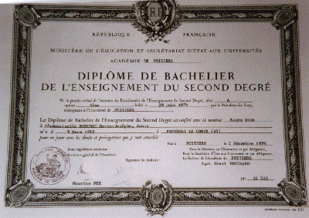
Un diplome de la haute ecole:
National School for Administration & the Paris Institute of Political Studies
The professional graduate school the French
elite have to attend in order to qualify
for an executive business career.

Slide 56
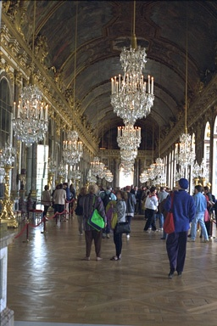
How are French government &
business leaders different from most
other Western leaders?

Slide 57
Socially elite--college connections into their executive position
Not accountable to the rest of the organization (managerial elites)
Formal & ceremonial
Outwardly sophisticated

Slide 58
FRENCH
LIFESTYLE &
PHILOSOPHY

Slide 59
SECULARISM

Slide 60
Under French law, France is a non-religious, secular culture (which bars religious symbols in public venues)

Slide 61
“For many Euro secularists, America’s religiosity is its least attractive characteristic. They can’t believe that any modern person can be religious unless they are either stupid (Britain’s Private Eye dubs George Bush the leader of the “Latter Day Morons”) or insane (a former German chancellor was known to accuse Bush of ‘hearing voices—namely God’s’).”
Recent European polls found that most French & Dutch, & a large number of Brits & Germans think Americans are way too religious.

Slide 62
“The French have always been objects of admiration, hatred, pity, or terror, but never indifference.”

Slide 63
MODERNES PHILOSOPHIE FRANÇAISE

Slide 64
FRENCH PHILOSOPHERS
Bergson
Comte
Descartes
Husser;
Pascal
Poincare
Rousseau
Voltaire
Beaudrillard
Bergson
Derrida
Foucault
Lyotard
Marcel
Saussure
Sartre

Slide 65
“ The real political counterpoint in France is held by the intellectuals. They form a vocal class, creating a tension between the great man who claims to embody the nation and the stubborn individuality of the French. The French think of themselves as the most lucid of peoples, their language the true tongue of clarity. The French educational system gives great importance to the capacity to develop abstractions and to present them with elegance. Nowhere else do intellectuals rule so supreme. No other society bows before them so unquestioningly.”

Slide 66
SKEPTICISM

Slide 67
“Cuisine details matter enormously to the French, and they go to great efforts to make sure they are just right, whether it’s a swirl of cream on a pastry, the color of cloth on an old chair, or the seam of a dress. Parisians are not often hospitable, not because they don’t like inviting people into their homes, but because its takes so much trouble and expense to assure a perfect menu, with just the right wine, that few can manage very often. They would rather not have guests than entertain in a mediocre style.”

Slide 68
THE SKEPTICAL MINDSET
“Prove it” via science
“Reject more than you accept” (focus on reasons not to believe)
“Stick a pin in the balloon”
Satirize & belittle
Intellectualize

Slide 69
Skepticism lies behind why the French love to debate & argue, especially with Americans, whom they perceive as “plastic” and unsophisticated.
Skeptics love to point out where you are uninformed, misinformed, or idealistic.
If pressed to profess what they believe in, skeptics will proudly answer, “I believe in nothing” (nihilism), since there is no absolute “truth”.

Slide 70
EXISTENTIALISM

Slide 71
It’s no accident that the skeptical French popularized the 20th century philosophy of Existentialism which holds that you must define truth for yourself to find some (subjective) meaning in life. Religion or philosophy won’t do because they claim to be based on absolute truth.
For most Existentialists, meaning in life stems from secular lifestyles, social causes, Internet activism, or in just plain partying (“eat, drink, and be merry”—French libertinism)

Slide 72
“Waiting for Godot,” a play by Samuel Beckett, is the quintessential expression of existentialism: a man waits on a street corner for “Godot” (a symbol of absolute truth) to arrive, but he never does.
If life has no meaning (if “Godot” never arrives), what should we do? French existentialists say we must find something meaningful in life that becomes our own (subjective) truth: a political cause, a lifestyle, “wine, women, & song,” etc.

Slide 73
In the minds of many, modern corporate consumerism lies at the heart of post-modern illusion. “Consumerism is the myth that the individual will be gratified and integrated by consuming. Self-worth is gauged by buying power. The public substitutes consumer ideals for the lost cultural traditions of family, religion, and art. The commercial exploitation of culture and duplicity in media and advertising have become threats to the consciousness of objective reality.”

Slide 74
Consciously crafting your own subjective world
POSTMODERNISM
(POMO)
Medieval → Enlightenment →Modernism →
Post-modernism

Slide 75
“There’s no such thing as absolute truth. What you see varies according to what you are looking for. The story depends on who is listening and watching, as well as who is acting and talking.”

Slide 76
Post-modernism (“after the modern era” of science) is the reigning mindset of the UGEN because of its emphasis on individualized, subjective truth. “Truth” is shaped by your lifestyle, tribal memberships, & opinions.
Truth is what you say it is based on the subjective world you live in. Other people hold different “truths” because they live in different subjective worlds.
There are as many truths as there are people. You’re on your own, which is why tribal support is needed.

Slide 77
“Postmodernism reduces all significant truth to matters of personal preference and ends in nihilism” (no values at all).
“In the post-modern world, where we ask the self to be the sole source of meaning, value and purpose, survival of the self has become problematic. The self has become increasingly insubstantial and vulnerable.” UGENs need tribes to have a sense of self, so picking personal tribes is as important to UGENs as picking a career.

Slide 78
MODERNISM says there is no absolute truth.
POST-MODERNISM holds that there is no objective truth—that I have to (existentially) define what is “truth” for me based on my subjective feelings, tribal groups, & way of seeing reality.
Asked to define truth, high profile postmodern philosopher Richard Rorty replied simply: It’s what my friends let me get away with saying.

