Slide 1
CHAPTER 10
CHINESE
CULTURE

Slide 2
Chinese Culture PRISMs
Are human needs best satisfied in individualism or community cultures?
In the 21st century, can people truly be isolated?
Is individualism a human ideal?
Which is more important: Why something is done, or how it’s done?
Is doing your duty more important than “fulfillment” in life?
Is it OK to tell “little white lies”?

Slide 3
Individualism
Extended family
Community
Monochronic
Poychronic
Low Context
High Context
Social Ambiguity
Social Certainty
Low Power Distance
High power Distance
Mastery
Adaptation
Emotionally Neutral
Emotionally Expressive
Quantity of Life
Quality of life

Slide 4
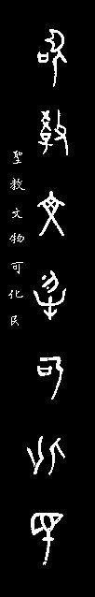

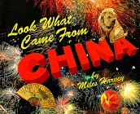

Slide 5
Paper
Printing
Gunpowder
Matches
Rudder
Parachute
Hot air balloon
Umbrellas
Chess
Seismograph
Brandy & whiskey
Iron plow
Mechanical clock
Planting crops in rows
Dynamite
Natural gas drilling
Wheelbarrow
Rockets
Major contributions to astronomy, physics, chemistry,engineering

Slide 6
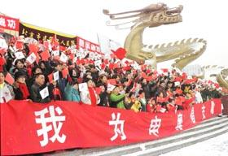
Does this century belong to the dragon?

Slide 7
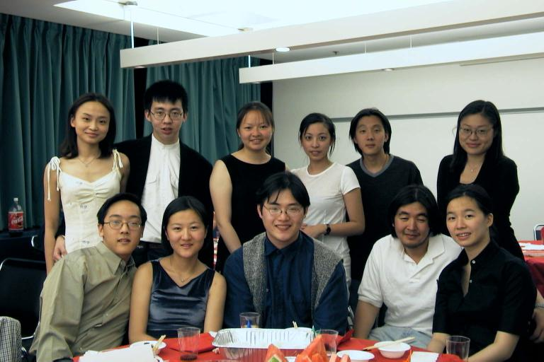
Future MBAs?

Slide 8
CONFUCIANISM:
THE ROOTS OF
CHINESE CULTURE

Slide 9
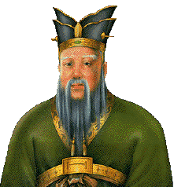
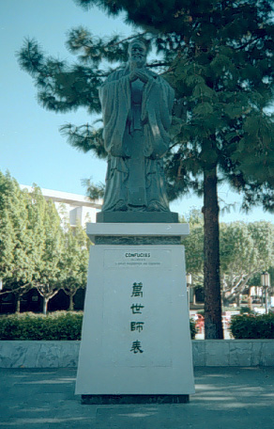
Confucius
Kung (Master) Fu-tse

Slide 10
551- 479 BC
At age 50 became a very successful city magistrate
Achieved unprecedented
administrative success for local
Chinese civic leaders
Was the first organizational
theorist
5. Died at age 72

Slide 11
THE BASICS OF CONFUCIAN PHILOSOPHY
Confucianism is not a “religion.”
Addresses the IDEAL
(community-enhancing) social structure—the ideal model of society

Slide 12
CONFUCIAN VIRTUES
The eight traditional Confucian virtues are: zhong (loyalty), xiao (piety), ren (benevolence), ai (love), zin (trust), yi (justice), he (harmony), and ping (peace). Li is the ideal of courtesy & ceremonial harmony.

Slide 13
Confucianism developed into a paternalistic social system of taking care of community members in return for their obedience to the status hierarchy (based largely on age, seniority, and educational attainment.) Being just one year older than someone or graduating from college a semester earlier can determine whether you’re hired or promoted. The tight sense of community promoted by Confucianism produces consensus-based decision-making and a team mindset.

Slide 14
CONFUCIUS MAKES A COMEBACK
Mid-20th century Chinese Communist leaders sought to erase the age-old legacy of Confucian in favor of secular statism. But more progressive, pro-capitalist 21st century leaders look to the Confucian emphasis on order, harmony, & balance as a potent means for developing new respect among the masses for the modern government--& something to fill the current ideological gap left by the fall of Maoism.

Slide 15
COMMUNITY
COMMUNITY
COMMUNITY

Slide 16
Community = the network of people you and your family depend on most and who depend on you.
Something is an IDEAL if it enhances the community (but not necessarily individual members of the community, who are expected to sacrifice for the good of the community).

Slide 17
Forest (community) or trees (individuals)?
Are people part of their community
or separate from it?

Slide 18
ECOSYSTEM:
1. Life exists interdependently within
the nurturing community, but
never independently.
2. Community is interdependency.

Slide 19
REJECTING THEIR NICHE
The blades of grass want to be bushes;
the bushes want to be cedar trees; the cedars want to be Redwoods.
The steam is threatening to prosecute the grass for soaking up too much water.
The flowers are going on strike to demand their fair share of the bee’s honey profits.
The deer & squirrels are suing the trees for hiding hunters.
The environmentalists want to ban people from the forest.

Slide 20
THE WESTERN CULTURE OF INDIVIDUALISM
About the only community most Westerners ever belong to is the nuclear family.
Westerners are culturally “programmed” for PERSONAL success, which requires putting self before community.
Western culture does not have a tradition of ideals (which are community enhancers).

Slide 21
THE PRICE PAID FOR INDIVIDUALISM STEPPING ON COMMUNITY
Crime
Divorce
Litigation
Militant special interest groups
Pollution
War

Slide 22
COMMUNITY IS:
Others-before-self ritual etiquette
We > me
Occupying your social niche to maintain community stability
Cooperation > conflict
Ideals > pragmatism

Slide 23
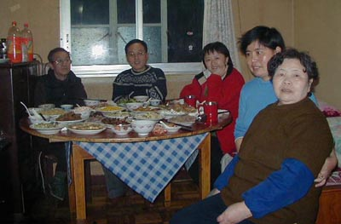
SOCIAL NICHES START HERE

Slide 24
SOCIAL NICHES
Occupying your social niche is
mandatory because niches hold
society together., but they vary in importance (status) depending on how dependent the community is on them.
2. “The prince should rule, the laborer should work, and the servant should be obedient.”

Slide 25
You’re born into a community (extended family & clans) and have a niche in that community (“#1 son,” family patriarch or matriarch, founder of the family business, etc.)

Slide 26
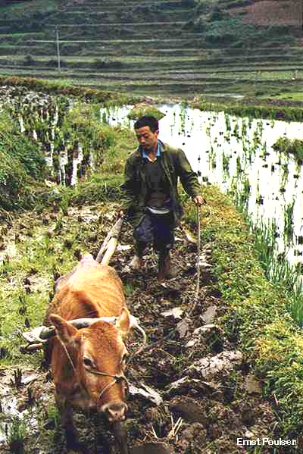
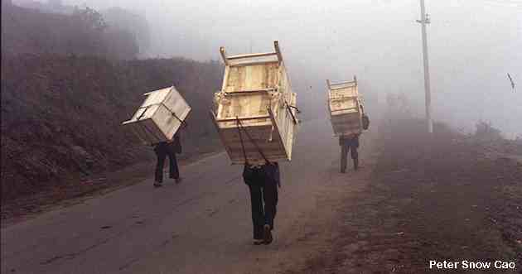
Would you like to be in their shoes?
Rich in their niche

Slide 27
1. View yourself as a member of the community, not an isolated individual.
2. Derive your identity from your community niche.
3. Realize how important you are to the community.

Slide 28
COMMUNALISM

Slide 29
Asians are as self-centered as Westerners (because that’s human nature), but Asian interpersonal etiquette/expectations force Asians to put the community first.

Slide 30
Most behavior in Western culture is governed by laws vs. peer pressure in Asian cultures. Peer pressure is a more powerful human influence than laws because we internalize the etiquette reinforced by our peers (friends, work associates, etc.), while laws remain largely external to our daily lives. Laws motivate us through fear, while peer pressure motivates us through the much stronger human desire to be accepted and respected.

Slide 31
WHAT IS COMMUNITY CONSCIOUSNESS?
Sensitivity toward what
others expect you to do + What
traditional social
etiquette says you must do =
Built-in etiquette for putting the
community first

Slide 32
ETIQUETTE BUILDS COMMUNITY
& CHECKS SELFISH HUMAN NATURE
Surface harmony sustains peaceful interactions (vs. conflict).
Putting others first creates cooperation and teamwork (vs. self-serving competitiveness).
Accepting your niche and duties promotes social stability (vs. revolution).
Sacrifice brings out the best
in others (while selfishness unleashes coarseness).

Slide 33
French culture is the most sophisticated in an outward way. Asian culture is the most inwardly sophisticated due to the many nuances of Asian etiquette built upon community ideals.

Slide 34
ETIQUETTE
IN ACTION

Slide 35
1. When receiving a business card from an Asian, never put it away in their presence. Treat the card as if it were the person who gave it to you. Neither should you write on the card in their presence (which ruins the formal status of the card).
2. Avoid body contact when meeting
most Asians. Use verbal greetings only.
3. Koreans are very protective of their boss’s mental harmony and avoid delivering bad news until late in the day.

Slide 36
When doing business in a Korean executive’s office, never put anything on his desk (violation of personal space).
Many Asians are very uncomfortable receiving personal praise or public notice for fear of showing up others, altering social relationships, or because they wonder if you’re trying to manipulate them.
Compliment the group rather than the individual.

Slide 37
When meeting Chinese, always recognize the oldest person first and inquire about his health.
Don’t “clean your plate” at a Chinese banquet, since this may be interpreted to mean that you were not served enough food.

Slide 38
To promote harmonious relationships with the Japanese, send negotiating questions well in advance of the meeting and don’t be surprised if executives engage in long pauses of silence before answering questions. The Japanese don’t like surprises in social situations.
“Yes, but” means “no” in most
Asian cultures.
11.In Asia , don’t open gifts in the presence of the giver. Receive and present gifts with both hands.

Slide 39
If you are applauded in China,
you should applaud back.
13.Seating arrangements are important, whether for business meetings or for dining. The principal guest sits next to the host when dining. The Chinese host will lose face is this protocol is not followed.
14.The Japanese may ask you a lot of personal questions. Don’t be upset, they’re merely trying to determine your social standing so they can address you with proper respect.

Slide 40
Westerners are individualistic, independent (of community), isolated, & separated. This reflects the Western deterministic scientific mindset of analyzing discrete (separate) objects in isolation of one another (such as the zoological classifications of life).
Asians are communal, interdependent & connected, reflecting the new scientific tradition of quantum physics ( a “spider web” universe).

Slide 41
ASIAN COMMUNITY vs.
WESTERN INDIVIDUALISM

Slide 42
Community
Community
(Separation)
Submissive
individualism
Egocentric
Individualism

Slide 43
1. In individualistic Western culture,
WHAT you do is more important than
HOW you do it or WHY you do it: “Just
do it!” This is because pragmatic
Westerners usually act on the basis of what
is best for them as individuals rather than
what may be in the best interests of the
community. Hence, how you achieve self
interest is not important, as long as you
achieve it. Why you do something is also a
given most of the time: to benefit yourself.

Slide 44
2. Asians feel HOW & WHY you do something is more important than what you do, because the interests of others (the community) come first. Since how you do things affects others around you, behavioral etiquette is followed in a way that looks out for the interests of others as well as your own interests. Why you do something is also important because things must be done to benefit the community in addition to self.

Slide 45
Asians have no personal identity apart from the communities they have interdependencies in—like a street person in the West who is separated from “polite society” & therefore “persona non grata. ”

Slide 46
ASIAN SUBMISSIVE INDIVIDUALISM
Meet the expectations of your community.
Humbly submit to your
social niche.
3. Give face (to receive face).
4. Maintain the etiquette of harmony.

Slide 47
Asians aren’t “robot” conformists—community etiquette is built around maintaining a set of idealistic behaviors, such as showing respect for the niche of others, communicating harmoniously even with people you don’t like, etc.

Slide 48
WESTERN VS. ASIAN SELF-IDENTITY
“Do your own thing.”
vs.
Do your duty in the community.

Slide 49
ASIAN vs. WESTERN
VIEWS OF COMMUNITY
Westerners tend to self-define their own identities based on their lifestyle & profession. Asians draw on the outside community for self-definition, such as family niche & their interdependencies within the larger community .
Thus, Asians are programmed to look for how they can serve the larger community, while Westerners look for how the community can serve them individually.

Slide 50
AT ONE WITH THE PERFECT
IDEALS OF NATURE
Nature has no agenda, no goal, no purpose, except to exist as community.

Slide 51
COMMUNAL
HARMONY

Slide 52
Asian etiquette is like traffic laws: detailed rules everyone must follow to ensure a safe community.
Behavioral etiquette ensures harmony within the community, making it a better place for everyone to live.

Slide 53
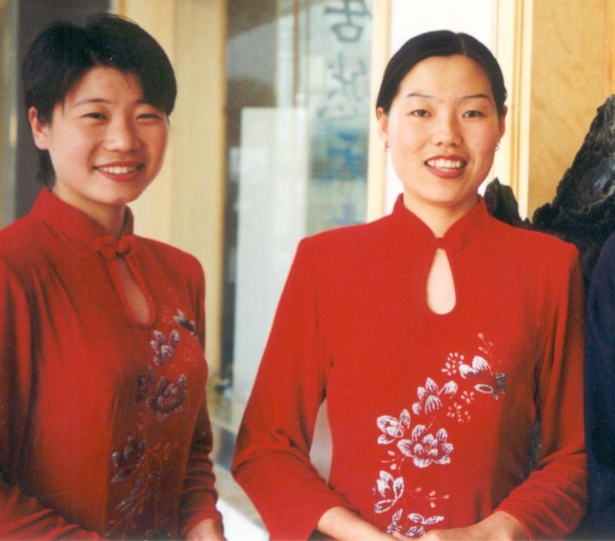
  Behavioral etiquette starts with surface harmony

Slide 54
Interacting with others in a way that produces positive feelings for everyone.
Telling others what they want to hear (to avoid disturbing interpersonal harmony).
3. Treating others the way they expect to be treated.
4. Read-between-the-lines subtle messages.

Slide 55
“Your daughter is such a
committed piano student.
Last night I could hear her
practicing until midnight!”
Positive feelings?
Hear what they wanted to hear?
Treated the way they wanted?
Between-the-lines message?

Slide 56
EASTERN
vs.
WESTERN
PERCEPTION

Slide 57
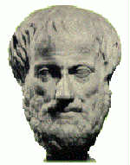
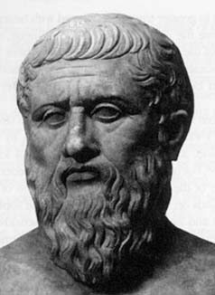
Aristotelian (materialistic) Perception
vs.
Platonic ideal-ism (Confucianism)

Slide 58
1. Ancient Greek philosophers Plato &
Aristotle represent the difference between Western perception of reality (materialism) & the Asian perspective (ideals).
2. Aristotle believed ultimate reality consists of the physical presence of things (such as a chair). Plato believed the concept (ideal) of something (the concept of a chair as being something you sit on) is its ultimate reality.

Slide 59
WESTERN SEPARATENESS vs. EASTERN COMMUNAL INCLUSIVENSS
Western science views the world as a series of isolated, separate objects that must be examined apart from their natural environment (like a butterfly pinned to a display case) in order to “objectively” understand/control them--hence the scientist’s façade of “emotional detachment.”
Eastern communal inclusiveness holds that life can be understood only in its natural community (hence, zoos are no substitute for nature).

Slide 60
Western separateness portrays God as an independent deity in a unknown place called heaven.
Eastern communal inclusiveness says God is everywhere and in everything (so man can unite with an impersonal force).

Slide 61
Westerners tend to see the world as “either/or” (Catholic or Protestant; capitalist or Communist, etc.).
The Chinese perceive reality as “both/and” (blended religions, blended economic systems, etc.).

Slide 62
The Western musical scale of separate half tones vs. the Chinese continuous tone scale
Western segmented food vs. Chinese blended food

Slide 63
Physicists no longer possess a unified theory that can explain how the universe works, as was thought to be true from the time of Isaac Newton until the late 19th century, when the world was viewed as a mechanical clock (“either/or” scientific logic) that worked on its own pre-determined course.
“We are now certain that the world is not a deterministic mechanism, but what the world is we cannot truly say. We don’t know how the world ultimately operates.”

Slide 64
11. Quantum physics (the study of unpredictable atomic & subatomic systems) has shown that the universe isn’t mechanistic—it’s unpredictable/unknowable: matter (being) & energy (becoming) at the same time (both/and) = consistent with the Asian model of reality, & baffling to the traditional Western mechanistic mind set.

Slide 65
EAST & WEST SEE
REALITY DIFFERENTLY
WEST: Focus on separate objects in the environment
EAST: Focus on the total environment
WEST: The individual shapes society
EAST: Society shapes the individual
WEST: I am always the same person
EAST: I am a different person in different social situations

Slide 66
WEST: I strive to be unique in the group
EAST: I strive to fit into the group harmoniously
WEST: I transmit information & must send it clearly
EAST: I receive information & must interpret it situationally

Slide 67
ASIAN IDEALISM
(Using ideals to
transform us & our communities)

Slide 68
HOW IS THE HUMAN MIND STRUCTURED?
Frances Bacon & the Western enlightenment's tabla rasa (blank tablet) vs.
Asian transcendental idealism
(ideals > materialism)

Slide 69
Western science has traditionally assumed that the mind is like a computer—that it knows only the facts that are fed into it. When we’re born, the mind is a “blank tablet” that contains nothing.
In contrast, the Asian tradition holds that the mind comes “pre-programmed” with the whole set of human ideals (our “conscience”) and thus we don’t have to learn what beauty, love, & justice are—we instantly know them when we experience them.

Slide 70
Asian culture holds that ideals are innate in the human mind—built into us from birth. The totality of all these ideals constitute our conscience.
The Western scientific tradition doesn’t reject the Asian idealistic model of the mind—it simply ignores it on the grounds that it lies beyond the purview of materialistic science. For the most part, Western culture has traditionally ignored Asian culture because of its non-scientific, non-materialistic bent.

Slide 71
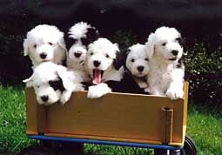
EASTERN METAPHYSICS & WESTERN POST-MODERN PHILOSOPHY

Slide 72
Where did you learn that these puppies are “cute”? In grade school did you have to memorize a list of everything in the universe that is “cute” so you would know are to accurately respond this picture?
Did you also memorize a list of everything that is beautiful in the universe?

Slide 73
Do we have to be taught what
beauty is?
2. Can we recognize justice & injustice when we encounter them?
3. Don’t we naturally favor health over disease & peace over war?
4. Do we have to go to school to learn what love is?

Slide 74
If someone suffers brain damage from a stroke, do they no longer have any thoughts?
If someone has a heart attack, do they lose all of their emotions?
Your conscience bothers
you when you violate certain
community ideals—where is
your conscience located?

Slide 75
Ideals are universal and permanent, unlike material objects (including people!) that deteriorate over time.
Ideals like beauty, love, and perfection can’t be rationally understood. They can only be experienced via communal living
The more they are experienced, the more they transform you & your community into that ideal state.
You can merge into the Ideal Mind via meditation in which the false reality of your separated self is dissolved (Hindu Nirvana)

Slide 76
How could you explain to someone what an orange tastes like if they’ve never eaten any fruit?
Some things are better experienced than explained, such as:
  What is community?
  What is harmony?
  What is duty?
  What is beauty?

Slide 77
IDEALS THAT BUILD COMMUNITY
Love (vs. hate)
Brotherhood (vs. discrimination)
Unity (vs. chaos)
Health (vs. disease)
Balance (vs. perversion)
Peace (vs. war)
Justice (vs. unfairness)
Beauty (vs. ugliness)

Slide 78
COMMUNITY
is the supreme ideal because it is the combination of all ideals: cooperation, harmony, sacrifice, teamwork, justice, human dignity, etc.

Slide 79
IDEALISM IN ASIAN
ETIQUETTE:
The means are just as important
as the ends.
HOW you
do something is as much of an ideal as what you do (because how you do things determines whether or not interpersonal harmony is achieved).

Slide 80
How gifts are wrapped
How food is served
How respect is shown to authority
Self-discipline as a sign of total commitment to a cause
Personal sacrifice as a sign of atonement for group failure

Slide 81
Asian culture is built around human ideals based on the logic that if ideals are so important that the human mind if pre-programmed with them, people should give ideals prominence in the way they live and interact with others—hence a community-based society.

Slide 82
THE
TAO
“The universe is not just stranger than you think, it is also stranger than you can imagine.”

Slide 83
THE TAO:
(Lao Tsu, 600 BC)
A life-enhancing energy generated by the presence of community ideals
(Tao means “the way”—the right mix of tradition & situational etiquette.)

Slide 84
“The point of Taoism is not to create an ideal society, but to achieve oneness with the Tao (the way), which is understood as a natural principle. The person who is able to blend in the “the way,” who can detach himself from the worries of society, will be happy and healthy and live for a long time.” To stay on “the way,” we-wei (receptivity, acceptance, spontaneity) is required. “To abide by the wu-wei is to accept things as they come, go with the flow, and try not to assert yourself or change the natural course of things.”

Slide 85
“A Taoist would consider that, in the grand scheme of things, it really doesn’t matter whether you achieve your goals or not. The important thing is just being part of the process of life. For this reason, Taoists love nature, which works spontaneously. Whatever happens in nature always works out right. Taoist believe that everything that exists is always in a state of becoming its opposite. Life is turning into death, and death is becoming life. Wet things are becoming dry and dry things wet. Summer and winter keep changing places.”

Slide 86
THE TAO IS AN INVISIBLE FORCE THAT WORKS HARMONIOUSLY LIKE NATURE:
Gravity &
centrifugal force
2. Your nervous system
3. Re-channeling nerve flows in acupuncture

Slide 87
“A new study indicates that acupuncture is twice as effective as conventional treatment for back pain. Researchers at Germany’s University of Regensburg published their work in the Archives of Internal Medicine. The researchers conducted trials on 1,162 people. One third were treated with genuine acupuncture. Another third got fake acupuncture. The final group received traditional treatment with drugs and physiotherapy. After six months, the patients receiving acupuncture — even the fake acupuncture —reported improvement significantly higher than the traditionally treated group. One thing is certain: The drug companies did not pay for this study.”

Slide 88
The Tao (“dow”) works by combining balanced complements
that build community.

Slide 89
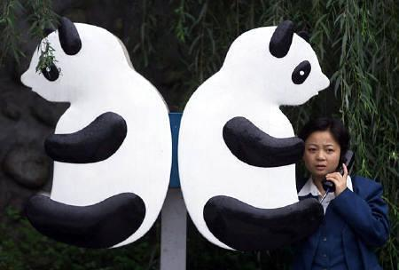
Yin & Yang are opposite ideals that produce a positive new ideal when combined.

Slide 90
COMMUNITY-BUILDING OPPOSITES
  1. Masculine + Feminine
  FAMILY
  (Single parent households don’t constitute family because yin/yang aren’t united)
  2. Passive emotional control +
  Active physical control
  (martial arts) SELF DISCIPLINE

Slide 91
1. Complementary opposites generate qi (“chee”)– the Tao's positive energy flow: cooperation,
teamwork, health, etc.
2. These build community.
3. Social niches provide complements to opposites.

Slide 92
Absence of complementary opposites produces sha qi, negative Taoist energy: conflict, selfishness, broken relationships, disease, loneliness, etc.
Sha qi damages a society via crime, broken families, militancy, exploitation
of others, etc.

Slide 93
The Taoist concept of qi means several things: (1) Rejection of calculated, restless, goal-oriented effort; (2) Trusting in the benefits of effortless, spontaneous action free of human striving; (3) Emphasis on the importance of balance between earth, heaven, and human events. Taoism (“dowism”) places heavy emphasis on the human principles of non-control and non-interference. To pursue the Tao means to abandon all restless struggling, no matter what form it may take.

Slide 94
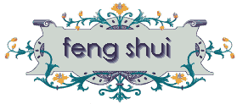


Interior & exterior decorating harmony generates healthful surroundings & living conditions.

Slide 95
WESTERNIZED TAOISM
Christian Science (Mary Baker Eddy)
Norman Vincent Peale & “positive thinking”
Mary Kay Cosmetics, AMWAY sales rallies, & motivational speakers in business & sports
Jack Nicklaus “Zen golf”
Star Wars (the “Force” & Yoda)
Environmentalists & Wicans (Gaians)

Slide 96
Modern quantum (sub-atomic) physics shows that nature’s fundamental laws are based on probability, not certainty. Atomic particles can be in two or more states of motion at the same time. The same particle can interfere with its own path of movement. Two widely separated particles can be entangled. Such mysterious phenomena have led many physicists to conclude that we don’t really understand the universe very well, contrary to the sometimes naïve, dogmatic assumptions of historical science.

Slide 97
“Physics is not about smaller and smaller billiard balls (electrons, quarks, & neutrinos), it’s about relationships between those objects, which derive their identity from these relations. Since the relationship between two objects is fundamental, it isn’t surprising that a change in that relationship can affect both more than one object at once, even at extreme distances. The universe is rational because it is relational. This interconnectedness disclosed by modern quantum mechanics physics reveals the universe as holistic. “

Slide 98
“Electrically, earth is so finely balanced in positive & negative charge that even if you get yourself charged up by shuffling across a rug on a dry day, you will feel no appreciable electric force pulling you to the ground. If all the negative charge could be magically stripped away from the earth, you would be instantly crushed to death by the enormous electric pull. If all the positive charge were stripped away, you would be propelled into space faster than a rocket. This same fine balancing—an almost perfect cancellation of attractive & repulsive forces—prevails throughout the universe.”

Slide 99
BUDDHISM & ASIAN METAPHYSICS

Slide 100
UNDERSTANDING BUDDHISM
Zen Buddhism says, “be nothing, think nothing.” Zen involves meditation with an empty mind, achieved by freeing the mind of earthly thoughts and attachments. This is often achieved by mediating on an object such as a rock, pool, or flower. Zen teaches nothing and believes that only one essence exists (monism—one mind). Zen uses meditation as the means of attaining salvation by virtue of inner power. Zen stresses mental discipline, personal sacrifice, and disregard of physical pain.

Slide 101
Buddhism seeks to eliminate false belief in individualism expressed as, “I am,” “I have,” “mine,” and “self.” Buddhism utilizes different mental ways of dissolving individual identity as a means of uniting with the one universal life force (dharma). The process by which life forces combine and cooperate creates the illusion of a coherent self. Buddhism, like Hinduism, believes in the process of rebirth (reincarnation). The death of the enlightened person reincarnates into a different human life or a non-human life form. A better rebirth can be brought about by good deeds, or a worse one by evil deeds (the Hindu concept of karma).

Slide 102
Those who attain Buddhahood (enlightened freedom from the illusion of the physical world) will entertain only pure thoughts and be indifferent to wealth, pain, and pleasure. Buddhism teaches that man is at the center of the universe, and we should strive to be “a lamp unto ourselves.” Buddhists believe that suffering comes from man’s desire to seek pleasure, which produces grief from constant cravings in life. Buddhism thus has three major premises: existence is suffering; desire causes suffering; getting rid of all desire ends suffering.

Slide 103
The ideal Taoist personal situation is attainable only through prolonged observation and meditation, resulting in simplicity of life, strong faith in natural processes, and overcoming human cravings. Taoism teaches that when human events and material objects are allowed to exist in natural harmony with the Tao, peace & harmony result. Thus, enlightened people will order their lives according to the Tao, living passively in tune with an interconnected universe. The Tao may thus be thought of as “the way the universe works.” It could also be understood as the universal law or will of “god.”

Slide 104
ANCESTOR WORSHIP
Asian society historically revolved around ancestor worship, where the oldest male in each family performed ceremonies to honor dead relatives. Asian shamanism teaches that the spirits or souls of individuals survive death and continue to influence the welfare of the living, therefore making it necessary to treat the departed with reverence.

Slide 105
Everything in the
universe is connected,
forming an
interdependent
community (“spider web” of relationships)

Slide 106
EASTERN (HINDU + BUDDHIST) METAPHYSICS
We absorb communal ideals by staying on the “spider web” (rather than striving to live independent lives).

Slide 107
THE GENIUS OF COMMUNAL CULTURE
You become (embody) the community ideals you absorb (Zen Buddhism).
Community is the ultimate ideal because it results from all the ideals.

Slide 108
THE BOTTOM LINE ON ASIAN METAPHYSICS:
Reality (like love) is more experienced than understood.
You can’t “fall” into
love by analyzing it.

Slide 109
“Don’t just
do something.
Stand there!”
Community ideals are
absorbed more through quiet meditation
& stillness than through a noisy
environment of restless busyness.

Slide 110
Western culture focuses on understanding reality, while Asian culture seeks to experience reality.

Slide 111
FACE

Slide 112
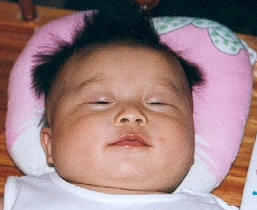
Face?

Slide 113
FACE IS:
Respect visibly received from the community
Community importance (niche)
Fulfilling duty
Two-way loyalty
Interpersonal etiquette

Slide 114
FACE COMES FROM:
Relationship building within
your community of personal,
long-run relationships
2. Mutual dependencies within your community
3. Accountability for your personal actions & those of your family
4. Exchanging favors only with those who equal you in face (or via a intermediary with connections)

Slide 115
What’s the best way to know if you have face?
By how others treat you and seek to
exchange favors with you.

Slide 116
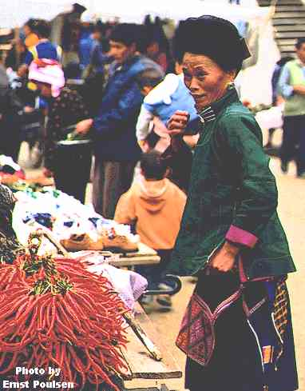
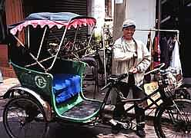
“I am somebody” face

Slide 117
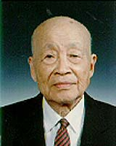
The face of age (wisdom)

Slide 118
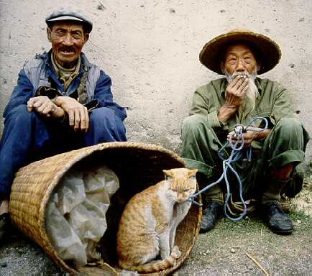
How can you get face from a cat?
Selling the cat gives them
a legitimate “business”
position in the community.

Slide 119
THE
CHINESE
FAMILY
BUSINESS

Slide 120
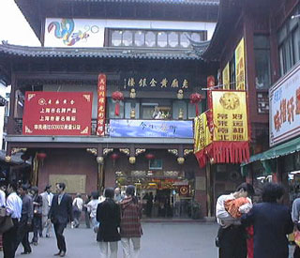
No Wal-Mart in sight.

Slide 121
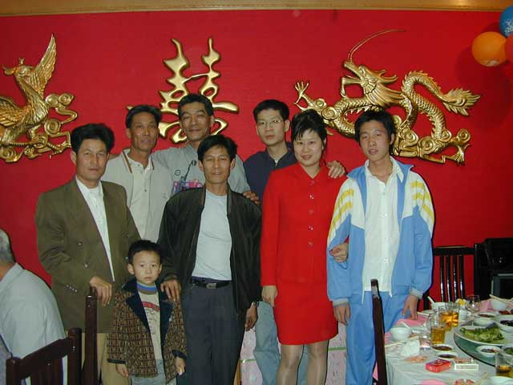
The company chain of command

Slide 122
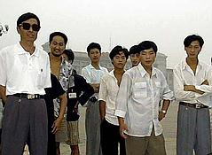
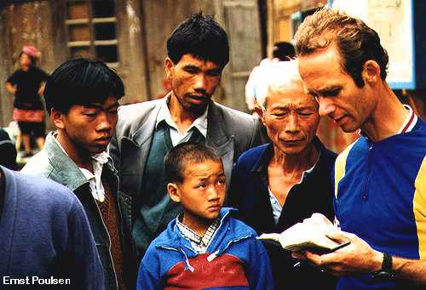
Networking to become an insider

Slide 123
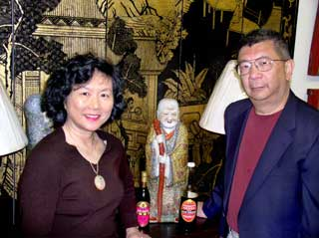
Chinese family businesses work exclusively with insiders who cooperate in a common business network called a quanxiwang. They exchange business favors & stay loyal to one another so that business is conducted in a high-trust personalized manner.

Slide 124
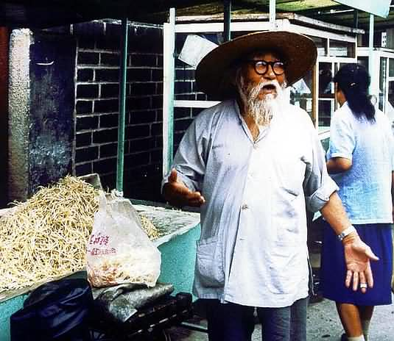
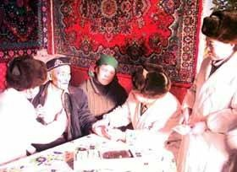
Influence & face in their guanxiwang (non-institutional grass-roots relationships business network).

Slide 125
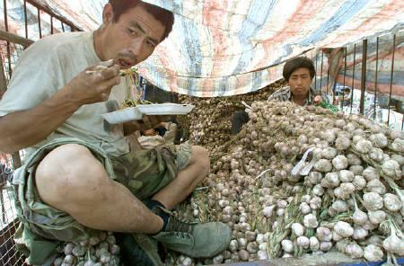
Work life without a guanxiwang

Slide 126
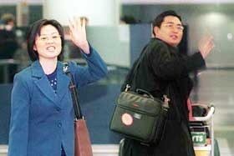
Using guanxi (“connections”) to expand their deal-making network

Slide 127
Guanxi is your capacity to leverage the resources and power of others for mutual gain.

Slide 128
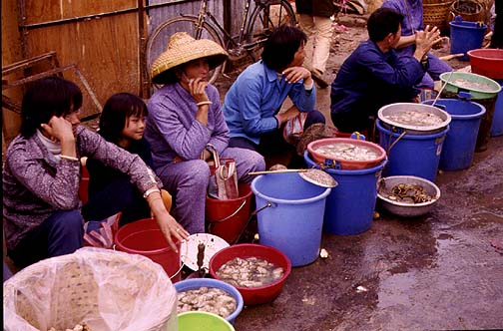
What do “IOU?”

Slide 129
GUANXI WESTERN
(INSTITUTIONAL) STYLE
Politicians, lawyers, bankers
Lobbyists
Boards of directors
Country clubs
Golf
Chambers of commerce

Slide 130
THE KEYS TO POWER NETWORKING
1. WHO you know
2. WHAT you can do for others & what they can do for you
3. How much FACE you have in your guanxiwang (your group of personal relationships)

Slide 131
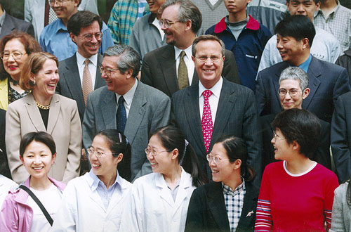
Chinese relationships are nurtured slowly because of the many demands placed on mutual loyalty, exchange of favors, & maintaining face.

Slide 132
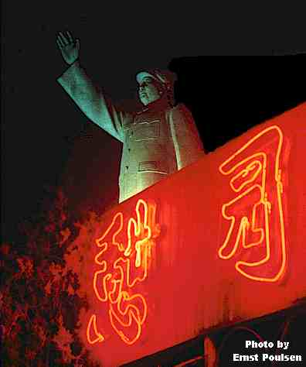
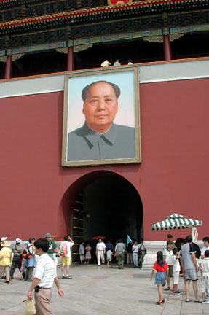
Mao’s attempts to restructure Chinese society failed because he couldn’t break up the informal grass roots guanxiwang networks.

Slide 133
RENGING
The communal ethic for
conducting business in your
guanxiwang.

Slide 134
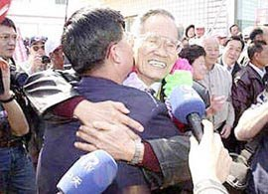
#1. FAVORS MUST BE RETURNED

Slide 135
The grassroots nature of Chinese business (exchanging favors in guanxiwangs) makes it difficult to determine who is powerful—guanxi is a process, not a title.

Slide 136
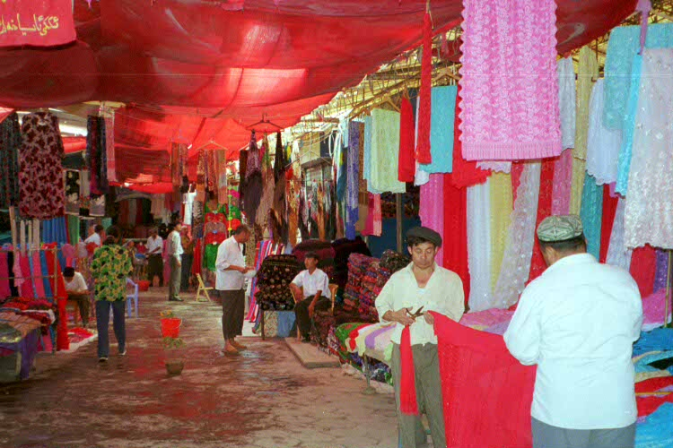
#2. You must do business only with your guanxiwang.

Slide 137
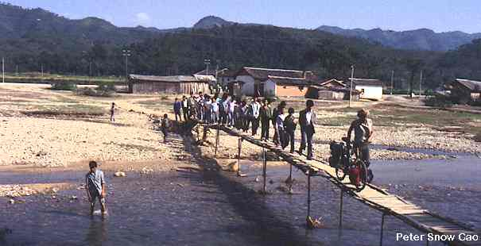
#3. Mutual trust is mandatory.

Slide 138
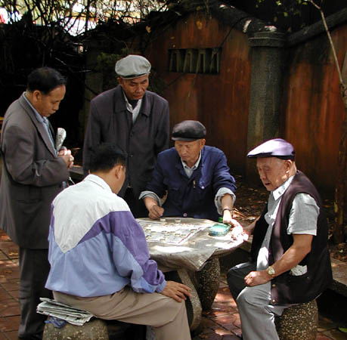
#4. You must be available to your guanxiwang.

Slide 139
THE CULTURAL PROGRAMMING OF CHINESE MANGERS
The nation, ethnic ties, & family
have priority over profit maximizatio.n
2. Leaders are chosen more on the basis of commitment to the community than professional competence.
3. Redistributing wealth to the community is more important than accumulating individual wealth.
4. Credit & rewards for performance belong to the group, not the individual.

Slide 140
5. All business decisions must factor in nationalism, corporate success, and work teams.
6. Assets should be used to benefit the community more than the capitalist.
7. Personal duty to the bigger cause is the core of employee motivation.

Slide 141
CHINESE NEGOTIATING TACTICS
Using friendships to gain concessions
Overwhelming you with hospitality to win your favor
Closely studying your behavior when you’re not aware in order to predict your decisions & political moves
Asking you to reveal your position on issues first in order to gain an advantage
Changing the deal unexpectedly to pressure you to make last minute concessions

Slide 142
NEW
SOCIAL
TRENDS
IN
CHINA

Slide 143
FROM RACHEL DEWOSKIN, AUTHOR OF FOREIGN BABES IN CHINA
“Consumerism became a religion, with companies arriving like missionaries, converting employees, testing advertising strategies, and seducing the average Zhou Schmoe with products he had never known he needed.”
“New soap operas were offering up previous forbidden products: hard currency, the freedom to travel, liberated sex, international careers, & air-conditioned condominiums.”

Slide 144
3. “Privilege and its trappings had long been closely associated with Western imports, illicit movies, fancy cars, and frivolities in general. Once considered banes of Western civilization, they have became the new playthings of the politically advantaged Chinese class. Urban China sparkled; while rural citizens remained poor, its cities were getting rich. Chinese women stalked through China’s cities in miniskirts and heels, cell phones & pagers attached to their leather purses. They dyed their hair blond and had eyelid lifts to westernize their eyes.”

Slide 145
“The overall divorce rate in China soared during the 1990’s, beset by the problems of modern love. There was one divorce in every 9 marriages, 4 times higher than ten years earlier.”
“Deng Xiaoping’s famous statement, “to get rich is glorious,” took effect, resonating everywhere. But some would get wealth a lot sooner than others. This was a jarring shift for Chinese of all ages who had been deeply versed in the virtues of a communal society, where advantage and class distinction were largely erased.”

Slide 146
“Chinglish,” a hybrid of English and Chinese, is the new lingo used by hip Western foreigners in China today. Pinyin (“spell sound”) uses Western letters to decode how the speak and understand Chinglish.
There are 77,000 known characters in traditional written Chinese.
Chinese small talk is not about weather; it simply acknowledges what has already occurred, such as “You’ve arrived” as you enter the office.

Slide 147
THE LITTLE
EMPEROR
GENERATION

Slide 148
China’s one-child policy over the last generation prevented 300M births & unbalanced the gender ratio from a normal 105 males to 100 females to 118 males for every 100 females.
Boys are valued more than girls because they pass on the family lineage & brides must be paid a large dowry.
The “little emperor” generation (of spoiled single children) is producing a new wave of materialistic consumerism in China.

Slide 149
Fertility rate dropped from 2.29 children in 1980 to 1.69 today (2.1 is replacement rate)—300M fewer births in the last 30 years
118 males born for every 100 females via selective abortion (vs. the global norm of 105 male births to 100 female)
Permitted exceptions to the policy: in rural areas, couples can have a second child is the first is female; in urban areas parents who are only children are allowed 2 children

Slide 150
Richer Chinese sometimes circumvent the policy by paying assessed fines; using in vitro fertilization as a means of multiple births; having children abroad.
Penalties for breaking the policy: fines 3-10X annual income; state employees can be demoted of fired; children not allowed into better schools; forced abortion in some rural areas
The “4-2-1” pending future problem: 4 grandparents + 2 parents must be supported by 1 child
Other social problems: shortage of brides for men; “incest villages”; the ration of working age people to retirees will fall from 6 today to 2 by 2040

Slide 151
PRACTICAL ADVICE FOR
DOING BUSINESS
IN CHINA
From One Billion Customers, by James McGregor

Slide 152
The Chinese government uses competition from foreign companies to reform its own companies and economic system.
Although China is confident about becoming a world-class competitor, it is also paranoid and insecure about the outside world.
China is modernizing, not Westernizing.
China has lots of slogans but no prominent ideology other than to become rich and powerful through international trade and business.
Chinese negotiators are masters of making you feel that you need them more than they need you.
The Chinese will ask you for anything because you just may be stupid enough to agree to it.

Slide 153
The most important thing in conducting business with the Chinese is to know who you are dealing with and what they really want and need.
The Chinese always strive to get concessions from you.
Don’t take what Chinese negotiators tell you to be the actual truth. They often site nonexistent regulations or rules simply to put you in a negotiating bind or box.
Contracts in China are not a guarantee of anything. It is the relationship built in negotiating the contract that you build your future on.

Slide 154
Contract details matter less than personal relationships.
Treat Chinese partners with great respect and equality, because insults and slights are never forgotten, and retribution is certain.
Chinese employees want leaders and mentors, not dictators or risk-avoiding bureaucrats.
Chinese employees and officials are ethically confused due to the culture’s rapid conversion from community wealth to individualized capitalized wealth.
Officials clear the way for business; business paves the way for Chinese officials to accumulate assets. Senior Chinese officials seldom engage in direct corruption, preferring instead to use nepotism as the means of building family wealth. For the ruling elite, gathering family assets quietly is quietly accepted.

Slide 155
Choose legitimate business agents and consultants to obtain corporate licenses and approvals, and seek as little information as possible about how they are obtained.
Don’t attempt to bribe the Chinese. Nobody stays bought and the Chinese know bribery is against American laws. Instead, build long-term, win-win relationships with your customers through training them, offering them opportunities to travel and engage in recreation.
At its core, today’s China is all about self-interest. It is very strong on competition but week on cooperation.
Never put your business in the position where you are dependent on one individual for access to government officials.
Inform your suppliers that they will be dropped if they try to bribe your employees. Suppliers will appreciate being let off the hook.

Slide 156
Be tough in negotiating. The Chinese respect it.
Frame your negotiation arguments to show how your company is good for China, and don’t emphasize what is wrong with the Chinese system or government. Don’t make the Chinese look bad.
Enlist the help of your home government in negotiating, as well as relevant international organizations and trade associations.
Cultivate relationships with Chinese officials but spend more time with the customer than with politicians.

Slide 157
You don’t win in China by getting only to the top guy. You win by enlisting supporters at all levels. The most talented business professionals in China are keen human observers who know what makes people tick. Lawyers in the West look for legal loopholes; the Chinese find people who can nudge their business interests this way or that way.
You can’t ignore Chinese government officials but don’t sit and wait for their approval. The best strategy is to avoid forcing a government decision.
China is not one market, but rather a collection of many local markets, each with its own practices, traditions, and methods of local protectionism. The most carefully constructed legal contracts will quickly die when politics or relationships go against them.

Slide 158
When forced to share your technology in China, isolate any parts of the technology that are not immediately crucial.
Deep scars from the Cultural Revolution and the sudden upheavals of capitalism have created a get-rich atmosphere in which nobody trusts anybody. In China business, expect to be cheated.
The Chinese appear to be a collective society. They eat together, travel together, and recreate together. But below that collective surface a dog-eat-dog competitive drive make the Chinese among the most individualistic and selfish people.
China’s rush to get rich is accompanied by deep distrust of the system, and anyone outside the circle of close acquaintances. This has created a business environment steeped in dishonesty and lack of transparency.

