Slide 1
CHAPTER 1
CROSS-CULTURE
INTERACTION

Slide 2
Cross-Culture Interaction PRISMs
Are some cultures “better” than others?
Do you have to dislike other cultures in order to like your own culture?
To what extent do most people accurately understand their own culture?
Why are cultures rapidly disappearing?

Slide 3
CULTURES
COMPLETE
HUMANITY

Slide 4
WHAT DO CULTURES CONTRIBUTE TO HUMANITY?
Every culture in the world contributes something unique to humanity—a certain “section” in the circle of humanity and life.
Put all cultures together and you have all 360 degrees in the human circle. Without every culture, humanity would be worse off.
The more you understand and appreciate cultures, the more you know and appreciate about human beings—and being alive.

Slide 5
INTERESTED IN HUMAN DIVERSITY?
For a look at the amazing depth & breadth of human diversity, check out the following web sites:
http://en.wikipedia.org/wiki/Ethnicity
http://en.wikipedia.org/wiki/List_of_ethnic_groups

Slide 6
The only way to really understand your culture is to get outside it.

Slide 7
ETHNOCENTRISM

Slide 8
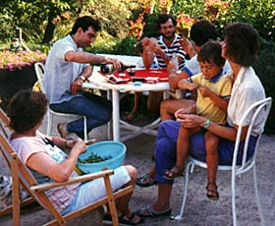
Why do parents always think
their children are good looking?
Because we favor what we are most familiar with.

Slide 9
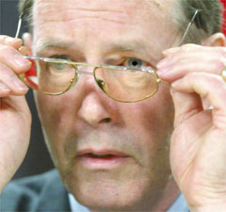
Ethnocentrism: Wearing the wrong pair of cultural glasses

Slide 10
“Americans are artificially isolated from the rest of the world. Our media simply do not let accurate images of anyone else’s culture in. The challenge for humanity is figuring out how to live together now that the world is one completely intermeshed culture.”

Slide 11
I see where local firefighters and police are learning to speak Spanish because of calls they get from families that can’t speak English. Whatever nationality you are, if you want to live in the United States you should learn English. If we go anywhere else in the world, they will expect us to speak their language. Why shouldn’t they have to speak ours?
(Letter to the Waco newspaper)

Slide 12
“If we were at war with Mexico, could we stop its citizens from crossing our border? Of course we could. So why don’t we do it now? These illegals are crippling our economy. Often they pay no taxes. Yet they get services for free.”
(Letter to the Waco newspaper)

Slide 13
America is becoming besieged by the hyphenated American syndrome. Whereas we used to be the melting pot of nations, there exists a conspiracy to “unmelt” the pot and separate Americans from one another by some distinctive and decisive hyphen. A hyphenated American seems to be a self-serving individual who wants to distinguish himself as one who has special needs or wants special consideration. No matter how politically correct some of these terms seem to be, I will never accept them nor use them. It would shame me to use some other country to distinguish myself from my fellow Americans.

Slide 14
TEMPORARY CULTURAL INSANITY
Assuming everyone sees the world the way you do
Assuming everyone works the way you do
Assuming your way is best
Assuming everyone wants what you want
Assuming everyone wants to be like you

Slide 15
THE SUBTLETIES OF CULTURAL BEHAVIOR
Reading emotions accurately
Catering to social status differences
Insiders vs. outsiders
Power vested in your job title vs. who you know

Slide 16
CULTURAL BRIDGE-BUILDING
1.Try to speak their language & eat their food.
2. Don’t judge/evaluate people in the host culture by the standards of your own culture.
3. Don’t refer to others as “aliens” or “foreigners.”
4. Resist the urge to “go native” in dress & manners, losing your genuineness in the process.

Slide 17
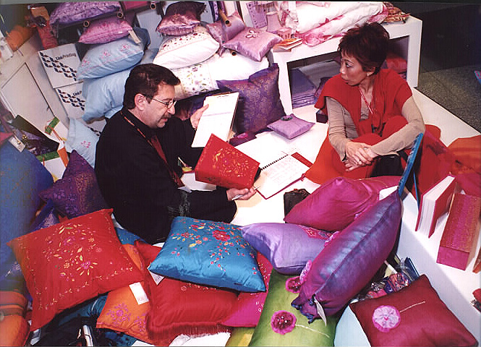
Cross-cultural deals often start slowly because most cultures do business in a personalized manner, which requires relationship-building.

Slide 18
GUESS WHO?
The vast majority of the nation’s public school students never study a foreign language at any grade level.
Less than 8% of undergrad college students are taking a foreign language in a given year & only 2% are studying aboard.
Business, engineering & science majors never have to take a foreign language.

Slide 19
“Without speaking a second language, it’s not possible to have any sophisticated understanding of another culture.”
“Many students in other nations begin learning another language before the age of 10. They will have an edge over monolingual Americans in developing business relationships & connections outside their home turf.”
A special commission of the U.S. Department of Education has called for a sweeping overhaul of the core curriculum of all public schools & in higher education to prepare American students for the global world of the 21st century.

Slide 20
One of the most humbling experiences in life is learning another nation’s language while living in that nation. The inability to communicate clearly and competently can play havoc with ones confidence and sense of sophistication. Enduring this experience is often the ideal “cure” for ethnocentric people.

Slide 21
MACRO FACTORS THAT SHAPE CULTURES

Slide 22
The nation’s culture
Its governmental system
Its institutions
Whether business practices are personal or impersonal

Slide 23
YOU KNOW YOU ARE IN AN INSTITUTIONALIZED CULTURE WHEN:
There are numerous laws, regulations, & lawyers.
People depend on institutions (public schools, hospitals, banks, etc.) more than family.
Most things are organized & efficient.
The main building blocks of society are singles & small nuclear families.
People are independent & self-sufficient.
Power is widely shared.

Slide 24
Many people are high achievers, are at work more than with family, & have career-centered identifies.
Life is fast-paced, competitive, & often stressful.
Governments are relatively stable.
Status is earned & based in large part on money/material wealth.
People are agenda-driven.
Big business dominates.

Slide 25
YOU KNOW YOU ARE IN A PERSONALIZED CULTURE WHEN:
Large extended families are the main source of power & personal identity.
Most people have jobs rather than careers.
Relationships are more important than personal productivity.
Organizations aren’t efficient & reliable.
“Bribes” are a way of life, since people control assets more than institutions.
People exchange favors & network to get ahead.

Slide 26
7. People enjoy the free things of life (relationships, leisure, religion, celebrations, etc.) more than the bought things.
8. Most businesses are small & family-operated.
9. Women have a different social role than men.
10.Govenments & politics are unstable.
11. Who you know is more important than what you know.

Slide 27
Why do business operations on the grass roots level make or break foreign joint ventures?
Because most cultures (especially those with a modern colonial history = Africa, Latin, America, SE Asia, & Middle East) aren’t equipped with a strong institutional infrastructure.

Slide 28
GRASS ROOTS BUSINESS THRIVES ON:
Personal relationships vs. contracting (“savoir faire” skills)
Hospitality (bonding)
Exchanging favors to build a resource base

Slide 29
THE PERSONALIZED APPROACH TO DOING BUSINESS
Doing business more on the basis of who you know rather than what you know
Continuing networking & relationship-building
Associational power—based on your boss, family members, & others you are closely networked with
Hospitality (bonding)
Patience (people accommodated over performance)

Slide 30
THE FOOTPRINTS OF
IMPERSONAL BUSINESS
Legalization of business deals via contracts rather than friendships
Professionalism: no favoritism, anti-nepotism policies, bidding for contracts, etc.
Accountability via codes of professional ethics, performance reviews, financial audits, & govt. regulation.

Slide 31
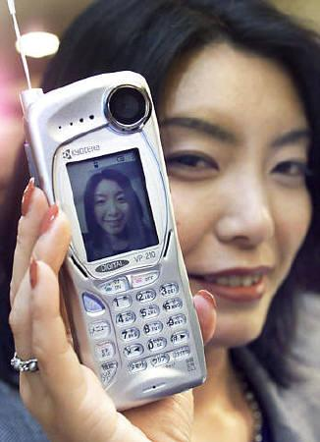
In most cultures, it’s smart for women to pursue career success via cutting-edge technical jobs because they are so much in demand that’s it’s hard for companies to bypass women.

Slide 32
In most male-dominated cultures, foreign professional women are treated as a “third gender” (neither male nor female). They are not treated as a culturally-traditional woman is treated in that culture, nor as a man is treated.
Instead, women professionals are treated with a special code of etiquette that takes males “off the hook” for complying with traditional cultural expectations for treating women.
Thus, traditional (paternalistic) cultures need 3 genders for conducting business, while unisex cultures need only one.

Slide 33
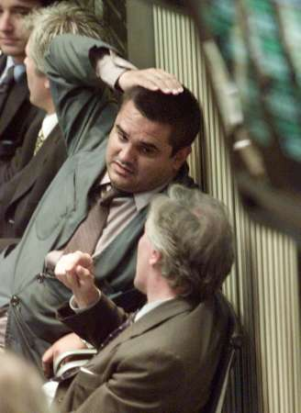
Cross-cultural business relationships should be more cooperative than competitive:
Win-win
Give & take
Personalized rather than bureaucratic

Slide 34
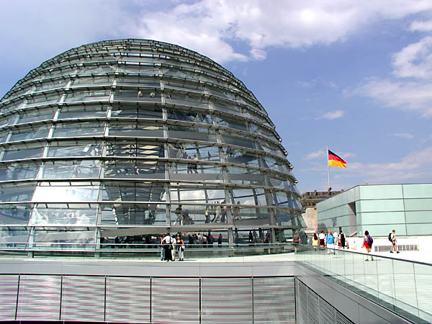
Why are there multiple bottom lines in global business?
Because most cultures expect more out
of business than profit: jobs,
community service, health care, etc.

Slide 35
SEEING
A NEW
REALITY

Slide 36
UNDERSTANDING vs.
EXPERIENCING REALITY
Ultimately you can’t understand a culture by studying it, but only through experiencing it, first as an outsider, then as an insider.
Ironically, it is only as you experience other cultures inside out that you begin to understand your own home culture.
You can tell you’ve been assimilated into another culture when you dream in their language & start seeing a “stranger” everytime you look in the mirror!

Slide 37
CHANGE THE EYES THAT SEE REALITY
1. "Profit is the bottom line of business." (What about market share? Stable employment? Loyalty to business partners?)
2. "Time is money." (Time might be viewed as competitive advantage or as as a matter of fate.)
3. "The way to get ahead is through hard work." (Maybe success comes through contacts, or personal characteristics, or family background).
4. "Plan your work and work your plan." (What if God wills otherwise? What if your low social position denies you economic opportunity?)
5. "We're an equal opportunity employer." (Not in hierachical societies).
6. "Let's be practical and come up with a compromise." (What--and sell out your values and ideals?!)
7. "We hire on the basis of competence." (We hire on the basis of who you know, who you're related to, or based on your ethnic background).
8. "Professionals are punctual." (Not if they are at the top of the hierarchy or in a relational culture).

Slide 38
CONCLUSIONS
Ethnocentrism is the toughest problem to deal with in cross-cultural interaction.
The best way to overcome ethnocentrism is to avoid evaluating others by the standards of your own culture.
The capacity to read others is the key to mastering cross-cultural interaction.
In most of the world, business in conducted on a personal basis.

Slide 39
THE EROSION OF
NON-INSTITUTIONAL
CULTURES

Slide 40
As explained in chapter 2, there are 3 basic families of cultures in the world: individualistic cultures based on capitalist institutions; extended family cultures based on multi-generation relationships; & community cultures based on placing the interests of the larger community (family, company, neighborhood, etc.) ahead of personal interests.
With the phenomenal rise & spread of capitalism around the world since the second half of the 20th century, extended family & community cultures have been transitioning toward institutionalism with its ideal infrastructure for efficient, profit-maximizing business activity.

Slide 41
Corporate careers demand individualism so business professionals can work when & where they are needed by corporations. Careerists are wedded to their corporate institution, spending more time at work than with the family unit or within the larger social community.
Thus, loyalty to the corporation, rather than to the family or community, is generating increased cultural institutionalism & producing a new universal culture (the “UGEN” culture (discussed in chapter 14) of bi-cultural professionals at home in both their traditional home culture as well as corporate culture. Over time, the institutional pull of capitalism spawns a greater degree of individualism in all industrialized cultures.

Slide 42
The U.S. had to go through a cataclysmic civil war to establish that institutions would rule America. Until mid-19th century, American culture was divided over: (1) The pull of agrarian, extended family, states-rights ideal of Thomas Jefferson, and: (2) The institutional federalism (big government + big business) espoused by Alexander Hamilton.
By mid-20th century, America’s institution-driven culture dominated the world commercially to such an extent that extended family & communal cultures were forced to Westernize (institutionalize) to keep pace in economic growth.

Slide 43
Muslim cultures are an exception to the trend towards capitalistic institutionalism/individualism because of Islam’s historical emphasis on theocratic law over secular law.
Capitalist cultures tend to marginalize the cultural role of religion, making it a compartmentalized private matter that doesn’t interfere with corporate professionalism. Muslims practice a public religion & historically have favored a non-secularized social system that is in tension with the capitalist culture of corporations—hence the recent “culture wars” between Westernized secular cultures & many Muslim cultures.

Slide 44
21C HYBRID CULTURES
Illegal immigrants with a permanent, though unofficial, role in local economies around the world.
People of multilingual, multicultural backgrounds who are at home in more than one culture.
Professional working mothers who split their time between professional & family cultural responsibilities

Slide 45
THE 21st CENTURY MUSEUM OF CULTURES

Slide 46
As highlighted in chapter 14 (the universal generation), cultural differences are rapidly eroding in the 21st century as the emerging “universal” generation develops a culture of its own. Cultural differences have been in decline for a long time due to the unavoidable & pervasive influence of the digital revolution (Internet, pop culture icons, etc.) In the 21st century, cultural differences are most pronounced among middle-age people , but their 20th century influence is fast disappearing.

Slide 47
CULTURAL ASPECTS OF GLOBALIZATION
Global consumerism spurred by the spread of capitalism and the advertising of global brand names
Emergence of middle class social structure in a growing number of developing nations
Greater international tourism & immigration
The emergence of a universal generation of young people who share more cultural similarities than differences

Slide 48
INDIVIDUALISM CULTURE SPREAD BY CAPITALISM
Capitalism, the pursuit of wealth via private companies, thrives on individualism (pursuit of self-gain): entrepreneurs; investors; advertisers and public relations professionals; financial brokers, etc.
Capitalism erodes community via job mobility; employee layoffs; foreign off-shoring; mergers/acquisitions; economic swings; dual-career marriages.

Slide 49
EXAMPLES OF CAPITALISM-BASED CULTURAL CHANGE
China, ancient bastion of community culture, is currently undergoing a jarring shift to individualism spawned by its rapid shift to capitalism.
Exporting to individualist cultures in the West has long been Japan’s national economic strategy.
India’s thousands of call-center workers must learn English & use English first names while working.

Slide 50
English is the international language because capitalism is the international economic system.
To a large extent, global consumerism thrives on promoting self-identity consumerism and individualistic lifestyles: fashion; women professionals; pop culture & entertainment icons; social websites; birth control; target marketing, etc.

