Slide 1
CHAPTER 4
BRITISH
CULTURE
The Anglo in Anglo/Saxon

Slide 2
British Culture PRISMs
Is cultural imperialism justifiable?
Is personalized or impersonal power best for a culture?
Why is privacy so important in Anglo-Saxon cultures?
On what basis does British culture claim its superiority?

Slide 3
Individualism
Extended family
Community
Monochronic
Poychronic
Low Context
High Context
Social Ambiguity
Social Certainty
Low Power Distance
High power Distance
Mastery
Adaptation
Emotionally Neutral
Emotionally Expressive
Quantity of Life
Quality of life

Slide 4
THE UNRIVALED BRITISH LITERARY GENIUS
William Shakespeare
William Blake
Elizabeth Barrett Browning
Robert Burns
Lord Byron
S.T. Coleridge
Lewis Carroll
Chaucer
John Donne
Percy Shelley
Alfred Lord Tennyson
William Wordsworth
William Butler Yeats
Charles Dickens
John Keats
John Milton

Slide 5
THE BRITISH
INSTITUTIONAL
LEGACY

Slide 6
SIX KEY ANGLO-SAXON CULTURAL CONTRIBUTIONS
Rule of law & institutions
Capitalism (free markets)
Science & technology
Education
Meritocracy (rewarding the best achievers)

Slide 7
INSTITUTIONAL CONTRIBUTIONS
British common law: innocent until proven guilty; jury system; representative legal counsel; bail; impartial justice. Under the Napoleonic Code of France, most judges serve as rubber stamps for prosecutors--“guilty until proven innocent.”
Checks & balances on government power (the democratic institutional model)
Institutional/cultural imperialism (USA, India, Hong Kong, Singapore, Canada, Australia, New Zealand, South Africa)

Slide 8
The British used their perceived cultural superiority (ethnocentrism) to justify their 3-century worldwide imperialism & empire building via transplanting democratic institutions & government to a record number (over 60) of nations. Cultural imperialism can both direct (military subjugation) & indirect (economic & cultural systems, such as capitalism, language, religion, “pop culture, ideologies, etc.).

Slide 9
THE MAGNA CARTA
1. English foundation of modern
constitutional law in 1215 which limited
the power of English kings
2. Required kings to be bound by laws & guaranteed certain political liberties for commoners; separated church and state; & reformed the legal system
3. “No man shall be arrested, or imprisoned, or deprived of his property, or outlawed, or exiled, or in any way destroyed, nor shall we go against him, unless by legal judgment of his peers, or by the law of the land.”

Slide 10
THEY
ONCE
WERE
BRITISH

Slide 11
Afganistán
America
Araba
Austria
Bahrain
Belize
Belize
Bermuda
Bhutan
Botswana
Brunei
Canada
Caymans
Cyprus
Egypt
Falklands
Fiji
Gambia
Ghana
Gibraltar
Haiti
Hawaii
Hong Kong
India
Iraq
Ireland
Italy
Jamaica
Kenya
Kuwait
South Africa
Sudan
Syria
Tanzania
Tobago
Trinidad
Uganda
Zanzíbar
Zimbabwe
Lebanon Madagascar
Malawi
Malaysia
Malta
Montserrat
Namibia
New Zealand
Nigeria
Pakistan
Qatar
Scotland
Sierra Leone

Slide 12
THE
BRITISH
CHARACTER

Slide 13
A CULTURE OF CONSERVATIVE, PRINCIPLED BEHAVIOR
Non-compromising on principle
Steadfast, stable, and stalwart
Stick with the system

Slide 14
BEDROCK BRITISH PRINCIPLES
Rule of law
Power of institutions over men
Patriotism
Duty
Steadfastness

Slide 15
It was the sea-going British that established the tradition that the captain goes down with his ship—sacrificing your life is the ultimate rule of duty.
Duty is a paramount principle to the British mind. The British believe that doing your duty determines what kind of a person you are and what kind of nation Britain is.

Slide 16
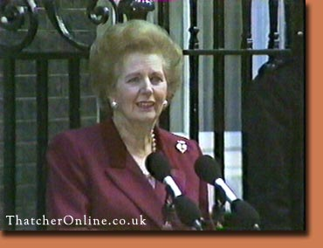
Margaret Thatcher:
The “Iron Lady”

Slide 17
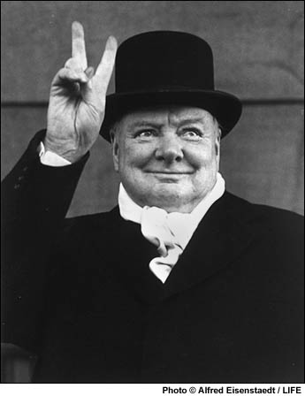
Sir Winston, the stalwart

Slide 18
CHURCHILL QUOTE UNQUOTE
We have not journeyed across the centuries, across the oceans, across the mountains, across the prairies, because we are made of sugar candy.
I have nothing to offer but blood, toil, tears and sweat.
We shall fight on the beaches. We shall fight on the landing grounds. We shall fight in the fields, and in the streets, we shall fight in the hills. We shall never surrender!

Slide 19
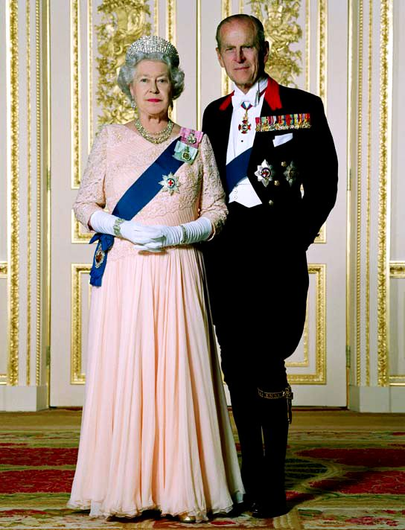
The formal British believe that they should act a a role model for their nation’s heritage through all circumstances—hence formal dress, proper grammar, & diligence in duty.

Slide 20
THE
BRITISH
GENTLEMAN

Slide 21
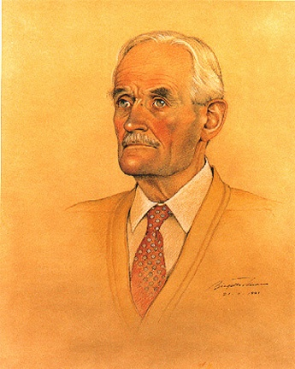
The Proverbial British Gentleman
(principle over pragmatism)

Slide 22
MANNERED INDIVIDUALISM
The people of London are the most civilized in the world. Their civilization is based on the recognition that all people are imperfect, and due allowances should be made for their imperfections. I have never experienced quite such a sense of balance elsewhere. What is acceptable and what is not acceptable is very well understood by everybody. (American jazz genius, Duke Ellington)

Slide 23
CODE OF THE GENTLEMAN
Principled behavior (based on higher standards than self-centeredness)
Personal integrity
Tactful & understated
Well grounded in the finer things of life
Well mannered and groomed
A good host

Slide 24
EVERYDAY BRITISH FORMALITY
Children expected to behave like “little adults” (example: Harry Potter characters)
“Proper” grammar even for the lower classes
Dress to fit the occasion
Good posture
Impeccable table manners
“Sir” & “ma’am”

Slide 25
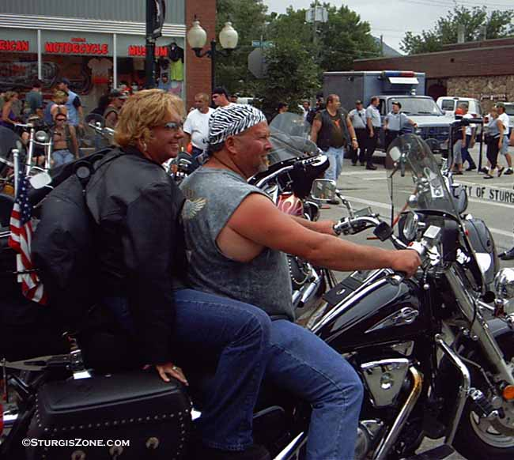
“Cheeky” (uncivilized) Americans

Slide 26
BRITISH
BUSINESS
CULTURE

Slide 27
THE BRITISH BUSINESS CULTURE
1. Sophisticated wit & off-the-wall verbal humor (in contrast to the Germans)
2. Avoid the hard sell & marketing glitz (emphasize substance over “sizzle”)
3. “Don’t take business too seriously--it’s not really a profession”
4. The good-ole-boy “kitchen cabinet” (Reflecting British class structure, key executive decisions are often made in a “good ole boy” network of long-time friends who might not even work for the company)

Slide 28
THE BRITISH VIEW BUSINESS THE WAY AMERICANS VIEW:
Used car salesmen
Pawn shops
Tele-marketers
Casinos
Garage sales
AM radio

Slide 29
WHY STICK WITH THE STATUS QUO?
“Because our system is the best! Change compromises perfection.”

Slide 30
THE BRITISH CULTURAL LEGACY
Institutional imperialism
Moral fiber & toughness
Nationalistic willpower & tenacity
Playing by the rules
Interpersonal formality & reserve

