Slide 1
MEXICAN CULTURE
CHAPTER 7

Slide 2
Mexican Culture PRISMS
Who’s responsible for authoritarian rule?
The economic inefficiency of polychronic, relationships-oriented cultures
The conditional-acceptance mindset of capitalism
How should people be held accountable in external locus of control cultures?
Unisex culture: Should women be treated differently than men?

Slide 3
Should cultures emphasize work & productivity over family & relationships?
To what extent should employees in external locus of control cultures be held accountable for their work?
Should “private capitalism” companies practice “communal capitalism” in developing nations?
Should organizations expect employees to separate their personal & professional lives?
Which should be more important in the workplace: productivity or people?

Slide 4
Individualism
Extended family
Community
Monochronic
Polychronic
Low Context
High Context
Social Ambiguity
Social Certainty
Low Power Distance
High power Distance
Mastery
Adaptation
Emotionally Neutral
Emotionally Expressive
Quantity of Life
Quality of life

Slide 5
In most respects, Latin cultures are 180 degrees opposite of Anglo/Saxon cultures.

Slide 6
UNA HISTORIA DE LA DOMINACIÓN AUTORITARIA

Slide 7
Una historia revolucionaria

Slide 8
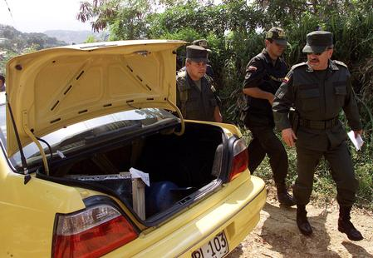
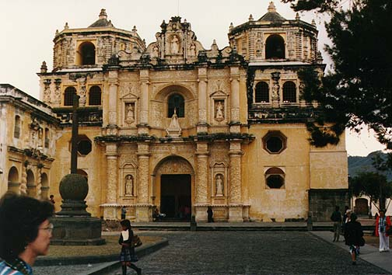
Una historia de la gente dominada (dominated people)

Slide 9
THE DOMINATORS
Spanish
French
“Texicans” & the Republic of Texas
Dictators: Villa, Carranza, Diaz, etc.
The one-party PRI government 1929-1999
Roman Catholicism
Drug lords
NAFTA?

Slide 10
VIOLENCE AS USUAL IN MEXICAN HISTORY
Conquistadors bringing superior weaponry & exotic diseases to the Americas (1550s)
The Spanish Inquisition (late 1550s)
Mexican War of Independence against Spain (1810-21)
America’s “manifest destiny” (the “God-given” right to acquire massive Mexican territory) war (1846-48)
Civil War of Reform over curtailing the Catholic Church’s political power in MX (1857-61)
Battle of Puebla (1862) to expel French colonial rule in MX
The era of MX revolutionaries (1910-1917)

Slide 11
How was domination involved in the genesis of the Mexican people?
(Intermarriage of the Spanish with the Amerindians of Central America.)

Slide 12
THE INFLUENCE OF AUTHORITARIANISM ON LATIN CULTURE
Security & identity via the extended family
to compensate for the absence of democratic
institutions
2. Emphasis on the free things of life which
can’t be taken away from you by authoritarian
governments
3. Personal dignity (“face”) to compensate for
the lack of social status opportunities in
authoritarian cultures
4. The Roman Catholic church has always been
the backbone of authority in Latin cultures

Slide 13
LATIN EXTENDED FAMILY CULTURE

Slide 14
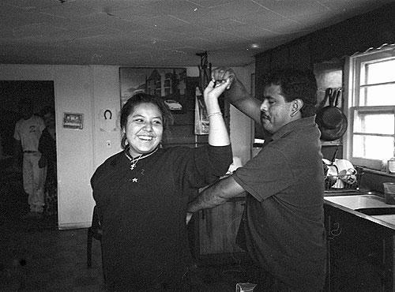
La Familia

Slide 15
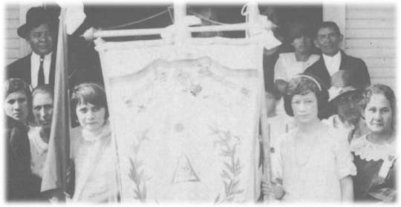
El genio (genius) de la cultura latina es la familia extendida

Slide 16
La familia extendida es psicologicamente saludable
(The extended family is psychologically healthy)

Slide 17
LAS VENTAJAS (advantages) DE LA FAMILIA EXTENDIDA
Personalized, non-institutional child care
Unconditional acceptance (love doesn’t have to be earned)
Constant companionship
Traditions
Growing up with biological parents
Connections between generations
High touch culture (hugging, touching, breast feeding, etc.)

Slide 18
CONDITIONAL
vs.
UNCONDITIONAL
ACCEPTANCE

Slide 19
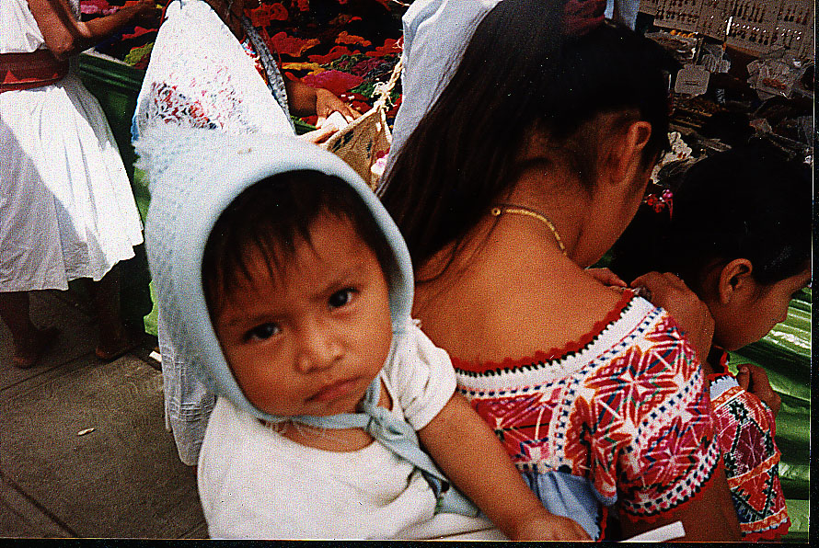
Aceptación condicional contra incondicional

Slide 20
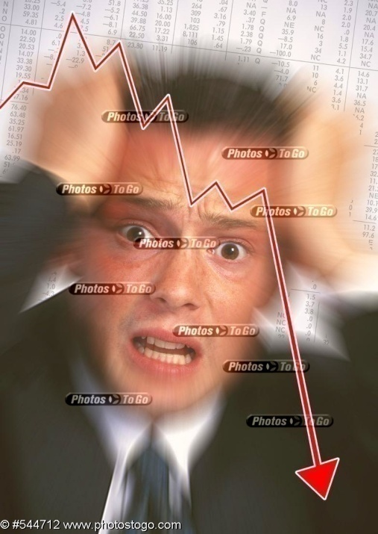
Performance-centered dysfunctions (workaholism, alcoholism, depression, anorexia, loneliness, non-intimacy, etc.) are much less common in Latin cultures than in Anglo-Saxon.

Slide 21
THE ROOT CAUSES OF PSYCHOLOGICAL DYSFUNCTIONS IN ANGLO CULTURE
Self-manufactured personal identity in life
Pressure to perform beginning in early childhood
Significant number of people reared in blended (divorced & remarried) families & single parent families
Lack of community in Anglo culture & isolation of individuals
High emphasis on materialism (quantity of life > quality of life)

Slide 22
Adultery takes a lesser toil on families in most Latin cultures because it rarely leads to divorce. The family unit is viewed as more important than the husband or wife. Many well-to-do Latin males maintain mistresses, who are culturally viewed as inferior because they lack the legitimate social status of a wife/mother with a family.
Divorce is more commonplace in Anglo cultures because women are more likely to be economically independent and hence less dependent on marriage than most Latin women. Also, “stay-home” mothers hold a relatively low status in career-oriented Anglo culture.

Slide 23
EL TEMPERAMENT LATINO

Slide 24
Given the tough realities of Latin history, why are Latins typically happy?

Slide 25
Latin culture reflects the Latin climate: warm, colorful (just as Anglo culture reflects the more austere climate of the north)

Slide 26
A HIGH TOUCH CULTURE
Being around family
24-hour weddings
Nursing babies
Funeral “wakes”
Latin dancing
Hugs, kisses, & togetherness

Slide 27
Una pasión para la vida

Slide 28
THE 7 F’s OF LIFE
Latins emphasize the free things of life (quality of life):
Family
Friends
Fun
Fiestas
Food
Faith
Freedom

Slide 29
WHAT IS THE PURPOSE OF LATIN MUSIC?
Bolero
Rumba
Cha Cha
Salsa
Merengue
Pasa doble

Slide 30
Una vida colorida

Slide 31
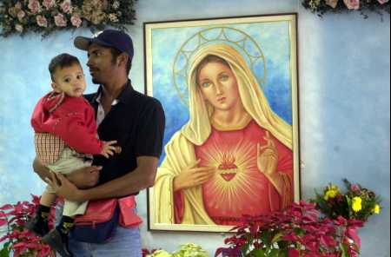
Los rituales estables de la vida (the stable rituals of life)

Slide 32
RELIGIOUS RITUALS:
Solidify life’s priorities
Provide comfort & security
Help people cope with this life & look forward to a better life after death

Slide 33
Latins believe that the best way to live life is to accept it as it comes rather than try to control it.
Latins have an external locus of control—seeing life as controlled by forces outside yourself. Anglos tend to have an internal locus of control (“calling your own shots”).
Anglos are more likely than Latins to practice birth control, illustrating the cultural difference of controlling life (to maximize personal freedom & independence) vs. “letting life happen to you.”

Slide 34
THE PROTESTANT WORK ETHIC VS. CATHOLICISM:
Earning God’s blessings
(“Protestant work ethic”) vs. simply receiving them through church sacraments

Slide 35
Anglos live to work & hence are career-driven
Latins work to live & hence emphasize jobs over careers
Anglos are less community minded because career-pursuits usually rule out settling down, which limits professional opportunities.

Slide 36
Why do Anglos usually find visiting in Mexico to be so relaxing?

Slide 37
When Mexicans say they want you to “understand” them, they mean to see things in light of the totality of their relationships, responsibilities, & limitations in life.
The common Mexican attitude of “no culpa” (“I’m not at fault”) stems from their external locus of control (“Forces beyond my control run my life”). This attitude makes it very difficult to hold Mexicans accountable for their behavior and its consequences.
Mexicans place a very high value on “alma” (one’s inner spirit & spiritual essence) & hence look down on people who strive for meaning in life through material wealth or other superficial values. Alma is what’s left over after the achievement drive has been satisfied.

Slide 38
LATIN
CORRUPTION

Slide 39
Because authoritarian cultures place power in the hands of individuals rather than institutions, the opportunity for corruption runs high.
Mexicans tend to be suspicious of institutions because they are run by the power elites on behalf of the elites. “Institutions aren’t your friend, so smart people avoid them.”

Slide 40
Several top Mexican government officials recently admitted that the Mexican justice system is “broken” (due to weak & corrupt institutions & rule by powerful officials who are not held accountable) & in need of drastic & immediate reform.
About 80% of crime in Mexico goes unreported because citizens know it wouldn’t do any good. Only 5% of reported crimes are actually investigated & ¾ of these are never resolved.

Slide 41
THE 3 LATIN ACCEPTS
Accept authority
Accept the status quo
Accept corruption

Slide 42
LATIN
PRIDE &
DIGNITY

Slide 43
Latin male “machismo” (hyper-masculinity) reflects the Latin’s strong sense of personal dignity & desire to be treated with respect.
Since many Latin cultures were politically dominated historically, males often over-compensated for their lack of institutional power by demanding others to treat them with the upmost respect—otherwise, trouble was sure to follow.

Slide 44
“You can take away my political freedom & deny me opportunities, but you can’t take away my personal dignity.”

Slide 45
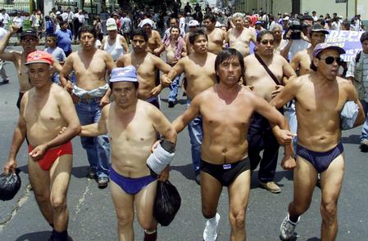
LATIN PRIDE: Protesting the indignity of a new government tax on beer: “You’ve stripped us of our male dignity!”

Slide 46
SHOWING RESPECT ON THE GRASS ROOTS LEVEL
1. Spend time with people
2. Accept their hospitality
3. Don’t make critical comments about their nation
4. Try to speak a little of their language
5. Laugh at yourself a little bit
6. Give them a heartfelt gift (especially for the family)

Slide 47
THE
LATIN
FASCINATION
WITH
DEATH

Slide 48
Latins deal with death by accepting it as a natural part of life—it adds mystery to life and tests character.

Slide 49
Dia de los Muertos Oct. 31- Nov. 2

Slide 50
During Mexico’s version of Halloween, people “stick out their tongue” at death to show their lack of fear. Picnics are held in cemeteries, stores sell cheap sugar candy shaped like skulls, rosary beads are placed on makeshift altars in roadways where loved ones perished in traffic accidents, & parties & midnight vigils are held to make light of evil spirits & demons.

Slide 51
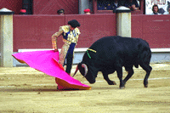
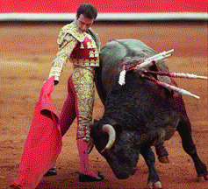
LA CORRIDA: A RITUAL OF MACHISMO, HONOR …

Slide 52
& DEATH

Slide 53
SIMPATICO
&
SAVOIR FAIRE

Slide 54
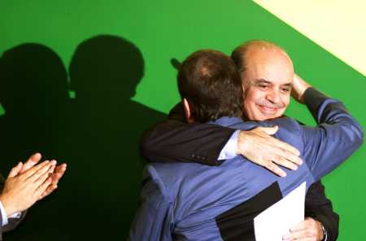
Simpatico Latino (friends instead of institutions)

Slide 55
SAVOIR FAIRE (the “street smart” Latin)
“To know how to do” is the Latin art of networking and building relationships.
Exchanging favors
Cultivating “personalismo” (a strong, colorful personality)
“Worldliness”

Slide 56
In grass-roots relationships cultures, people tend to stay loyal to those they do business with & are often viewed as part of the “extended family.” When you’re an insider, you may receive better service, special deals, or even insider influence.

Slide 57
THE POLYCHRONIC LATIN WORKPLACE

Slide 58
Anglo-Saxons design organizations to be machines. Latins want an organization to be like a family.

Slide 59
The polychronic workplace
Recent research estimates that the GDP of
Ecuador is lowered 4.3% ($724M) annually
due to the lifestyle of lateness

Slide 60
Integration of professional & personal life
Lower short-term productivity
Tolerance of workplace distractions, interruptions, inefficiencies
Communal sharing of property
Less workaholism & worker isolation (& hence less organizational politics)
Office celebrations

Slide 61
When Mexicans say “mañana, ” they don’t necessarily mean they will do it tomorrow, but rather when “life isn’t happening”—when no friends or relatives are around; when the weather isn’t nice; when the fiesta is over, etc. Much of the time, life is dull, menial, or unpleasant, so don’t put off enjoying life when the opportunity is present. “Smell the roses while they bloom.”

Slide 62
EL
JEFE

Slide 63
Latin organizations are glued together by personalismo (personalized authority) more than by performance or professionalism. Workers are more committed to their boss than to the organization.

Slide 64
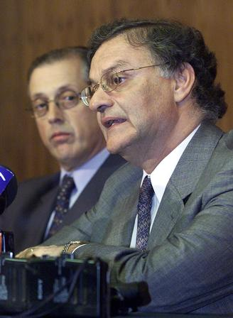
Paternalistic El Jefe (father figure)

Slide 65
El Jefe is expected to be fully in charge: make decisions autocratically, solve problems, give out all assignments, etc. Mexican workers want to be told what to do..”
Subordinates seldom take initiative for fear of “showing up” the boss or making mistakes that would disappoint the boss (father figure).

Slide 66
MEXICAN AUTOCRATIC MANAGEMENT
In Mexican culture there is no tradition of delegating authority from boss to subordinate, because the boss is an autocratic father figure. Subordinates don’t feel it is their place to act like the boss, so they prefer to be told what to do by the boss. Subordinates are expected to accept unconditionally what their boss says, even through they might sometimes disagree. “The Mexican does as he is told.” Mexican workers are thus unaccustomed to solving problems, which are left to the boss. The subordinates responsibility is limited to carrying out instructions, but not for achieving final results.

Slide 67
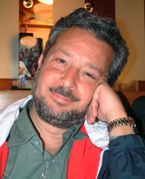
Buena Gente (“Good person” boss)

Slide 68
Anglo-Saxon managers feel it is unprofessional to cater employees in a personalized manner.
Latins expect to be treated as unique members of the work family by a boss who is buena gente.
Latins won’t bond with impersonal mala gente (“bad” persons). They will be obedient but not committed.

Slide 69
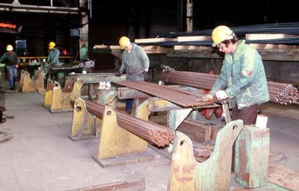
Anglo unemotional scientific management alienates Latin workers because personal circumstances are not taken into consideration

Slide 70
Latin workers take professional matters personally, especially workplace problems. They don’t like the impersonal scientific approach to problem-solving, because it pays no attention to uncontrollable circumstances & employee dignity.

Slide 71
ANGLO IMPERSONAL MANAGEMENT
Latins don’t like impersonal ways of doing business and resent valuing employees solely for their productivity. Latins respond well to nurturing behavior and are uncomfortable with competitive power plays and aggressiveness in the workplace or between companies. Anglo-Saxon managers typically believe that all employees should be treated in the same uniform manner; otherwise the manager can be accused of discrimination.

Slide 72
This management style is poorly suited to Latin culture, where employees want to be treated in an individualized manner consistent with their unique personal needs. Anglo managers are culturally conditioned to look for and isolate workplace problems rather than successes, which Latin employees are apt to view as critical and judgmental.

Slide 73
LATIN CAREER BARRIERS
Most Latins don’t want a higher material standard of living if it means pursuing a traditional career in which organizational demands (8:00 to 5:00 work, career related geographical mobility, isolation from the family during the day, etc.) break up the extended family. The extended family is not compatible with modern industrial society, because female members of the extended family must be at home during the day. The stay-at-home Latin female is revered, in contrast to the housewives’ low status in career-oriented Anglo cultures.

Slide 74
IMMIGRATION

Slide 75
LETTER TO THE EDITOR
Our southern border is as imaginary as the equator. Our politicians cannot see it any more than those who are crossing it illegally. Politicians wring their hands on this issue as though they are being asked to police the equator. If they cannot do the job then they should turn it over to the private sector. There are companies in America that would do an excellent job of taking care of our immigration problem on the southern border. Policymakers tell us that fences will not work. Yet the White House still has a fence around it. An estimated 12 million illegals are in our country. How is it that we can send men to the moon but we can’t send these illegals home?

Slide 76
Immigrant labor (10M strong) is the largest international industry in the Southwest USA

Slide 77
THE IMPACT OF ILLEGAL IMMIGRATION ON THE U.S. ECONOMY
8.1 million: illegal immigrants
$1.8 trillion: annual spending, U.S.
$220.7 billion: annual spending, Texas
$652 billion : annual contribution to U.S. GDP
$27 billion or more: the costs of education, health care and incarceration in six states, including Texas

Slide 78
A 2007 report by the federation said the costs of education, health care and incarceration of undocumented immigrants in six states, including Texas, exceeds $27 billion annually.
"We need comprehensive reform that looks at our needs and addresses those needs," said the president of the group that examined data for 500 sectors of the economy.

Slide 79
PROFILE OF ILLEGAL IMMIGRANTS IN THE USA
Estimated 9.3M illegal aliens in 2002; 50% Mexican and 23% other Latin American; 23% in California, 12% in Texas (approx. 1.1M), 10% in Florida
6M of the 9.3M are believed to be employed, making up 5% of the total U.S. labor force.
Growth of the illegal alien population in America: 13M in 1994; 16M in 1997; 17.4M in 2000; 19.7M in 2003

Slide 80
4. Median weekly earnings of full-time illegal immigrants in America: $489 versus $643 for legal Americans
5. Twenty thousand new H-1B visas were approved by Congress in 2004 to bring in skilled specialty immigrant workers (computer programmers, nurses) to the American economy
6. 75% of day laborers in the U.S. (including 2/3 of all workers in construction & agriculture) are illegal.
7. 2/3 of the 20M foreign-born workers in the Texas workforce are non-citizens.

Slide 81
RECENT GLOBAL LABOR TRENDS
1. The overall % of immigrants in the European & American workforces is rising. Immigrants comprise approx. 15% of the American workforce today.
2. China & developing nations have doubled the amount of manufacturing they do for Western nations since the early 1990s.
3. The IMF estimates that the global labor supply has increased 4-fold since 1980.
4. In a recent study of 18 nations, the average real pay of workers has increased 0.24%, raising questions about how much workers have benefited from the world’s recent growth.

Slide 82
ESTIMATED % OF IMMIGRANT EMPLOYMENT IN U.S. INDUSTRIES
Agriculture: 61%
Domestic housekeeping: 36%
Drywall installers: 27%
Landscaping: 26%
Maintenance: 26%
Meat handlers: 25%
Hand packers: 22%
Cement finishers: 22%
Roofers: 21%
Animal slaughter: 20%
Cleaning: 19%
Laundry: 17%
Apparel: 16%
Hospitality: 14%
Restaurants: 11%
Construction: 10%

Slide 83
“Recent efforts to heavily fine U.S. companies who employ illegal Mexicans have already caused serious disruptions in the operations of many American businesses, especially in agriculture. Many farmers have will produce only half of their normal crops due to growing labor shortages & many farmers have chosen not to plant at all.”

Slide 84
SHOULD AMERICA CLOSE ITS BORDERS?
“Those who simply want to deport all unauthorized immigrants might be surprised at the economic result. I don’t think they would be very happy. It would cause a lot of dislocation in terms of trying to maintain industries such as agriculture, construction, and hospitality.”
“Curbing the use of immigrant labor would cause the Central Texas building boom to fall flat on its back.”
“There’s just not enough raw bodies in the construction trades. I don’t think that Congress recognizes the full impact of a closed border system.”

Slide 85
There’s an absolute numerical decline of Anglos in the labor force nationwide and in Texas. Without people from other cultures and origins coming here, we’d actually see a decline in the American labor force.”
“The jobs immigrants take are not the jobs Americans won’t do. Immigrants are doing the jobs at the prices that are offered. Roofers and cement mixers who used top make $15 an hour aren’t going to work for $8.”
“We’re not just workers. We’re not murders or criminals. We do important work. We work faster, for less money, and we do good work.”

Slide 86
“The U.S. has 12-15M undocumented workers employed primarily in agriculture, construction, food services, & tourism. With the low unemployment rate below 5%, where do we think we can realistically find people to fill unskilled or semi-skilled jobs? If every illegal immigrant was sent back to his country of origin, America would have a worker shortage across the board, not just in a few industries. Prices would skyrocket and it would take longer to get work done—if you could find people to do the work at all.”

Slide 87
“Looked at from a Christian point of view, nationalism is a very dangerous principle. The Christian understanding of who is our neighbor is not limited to those who look like us or who have the same citizenship papers.”

