Slide 1
CHAPTER 8
ITALIAN
CULTURE

Slide 2
Italian Culture PRISMs
To what extent should we allow organizations to control our lives?
Should the customer be king?
Does MBA stand for Mighty Business Attitude?
What degree of obedience & loyalty do citizens owe to corrupt a government?
Is profit more important than family?

Slide 3
Individualism
Extended family
Community
Monochronic
Poychronic
Low Context
High Context
Social Ambiguity
Social Certainty
Low Power Distance
High power Distance
Mastery
Adaptation
Emotionally Neutral
Emotionally Expressive
Quantity of Life
Quality of life

Slide 4
Italy is unique as a Latin culture in 2 ways: (1) It has achieved middle class affluence & (2) has a web of institutions

Slide 5
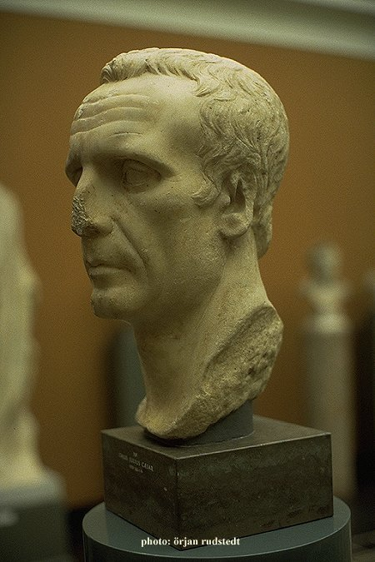
Yesterday’s imperialism

Slide 6
Is the Roman Empire making a comeback?
(The European Union)

Slide 7
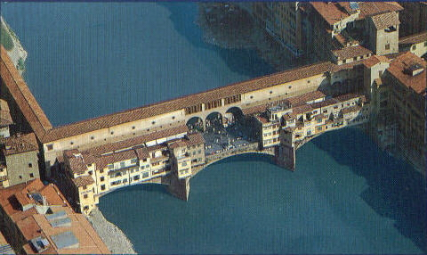
Florence, the Renaissance City

Slide 8
The Enlightenment:
The age of science
& humanism (man, not the church, is the center of the universe)

Slide 9
Giuseppe Garibaldi
Leonardo DaVinci
Galileo Galilei
Alexandro Volta
Guglielmo Marconi
Caesar
Dante
Cicero
Giorgio Armani
St. Francis of Assisi
Andrea Bocelli
Enrico Caruso
Christopher Columbus
Federico Fellini
Sophia Loren
Michelangelo
Maria Montessori
Luciano Pavarotti
Giacomo Puccini
Raphael
Giuseppi Verdi
Nicolo Machiavelli

Slide 10
Machiavelli’s classic, The Prince: How to manipulate people in organizations for power & self-gain. Manipulative Machiavellianism is alive & well throughout Italian & Western cultures:
POLITICS: negative campaigning; fund raising; spin; lobbying
CORPORATIONS: advertising/PR; lobbying; accounting fraud; telemarketing
MEDIA: political bias; political campaign advertising; talking heads (ideology struggles).

Slide 11
THE
JADED
ITALIAN
CULTURE

Slide 12
Italians are big on dietrologia (conspiracy theories)

Slide 13
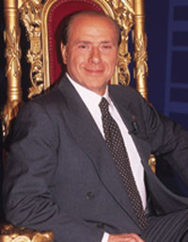
Il politicain si serve
(Politicians serve themselves)

Slide 14
“Italy is a nation where nepotism, corruption, & dishonesty are incarnate in the political leader.”
(For example, building & safety codes are seldom enforced in Italy due to collusion between builders & politicians.)

Slide 15
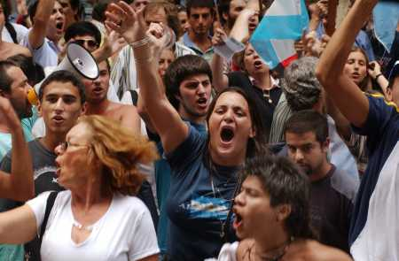
Paralizzato governo
The government is so paralyzed that
national referendums must be held
in order to pass most laws.

Slide 16
CAUSES OF ITALIAN & WESTERN GOVERNMENTAL PARALYSIS
Numerous splintered political factions that won’t compromise (“Red” vs. “Blue” states in America & Republican-Democratic paralysis)
Self-seeking politicians & lobbyists
Continuously re-elected incumbents
Voter apathy & cynicism

Slide 17
5. Power is based on (elite) people, not institutions
6. The corrupt know each other well
7. Special interest groups
know they can court Italian officials
“Pork barrel“ political projects (“earmarks” in America)
9. Organized corruption (the Mafia)
10. Good-ole-boy “justice” networks of lawyers, DAs, judges, police

Slide 18
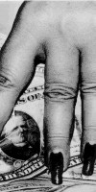
La società li serve
Most Italians liken their country
to a whore—used, but not loved

Slide 19
“Italians are strikingly un-private. They argue in public, pour out romantic secrets on television, and talk so loudly and incessantly on their cell telephones that it can be hard not to listen in.”
The Italian government has cashed in on the cell phone craze to tap the calls of suspected mobsters—eavesdropping has become an Italian way of life.

Slide 20
WHY DO ITALIANS BELIEVE IN HANDLING
PERSONAL BUSINESS STRICTLY IN CASH?
Because Italy is the wealthiest classic
Latin culture, Italians stand to
lose more to corrupt institutions
than Latins in other nations.
Italy’s “underground economy”
(hidden, non-taxed business income)
is enormous.

Slide 21
WHY JUSTICE IS HARD TO COME BY IN ITALY
It takes an average of 8 years for Italian courts to finish most major crime trials because they aren’t prosecuted on a continuous basis.
Lawyers often go on strike.
Italy’s recently passed statue of limitation for white collar crimes is so short that it is nearly impossible to prosecute white collar criminals before time runs out. A recent Italian government report predicts that 90% of white collar crimes currently under investigation will likely have to be dropped.

Slide 22
ITALIAN
CULTURE
TODAY

Slide 23
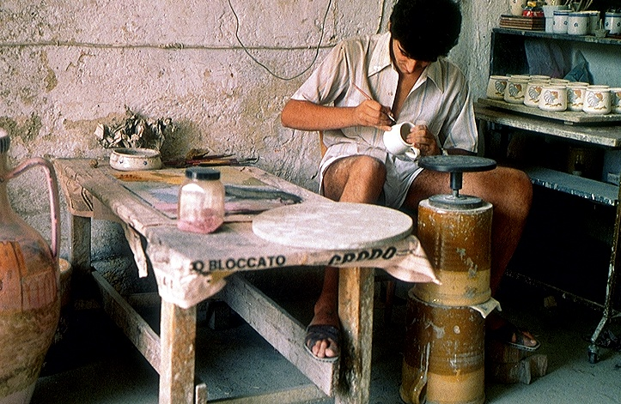
Commercio della famiglia

Slide 24
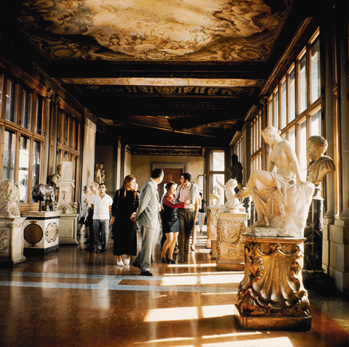
Commercio della famiglia oggi e domani (The family business today & tomorrow)

Slide 25
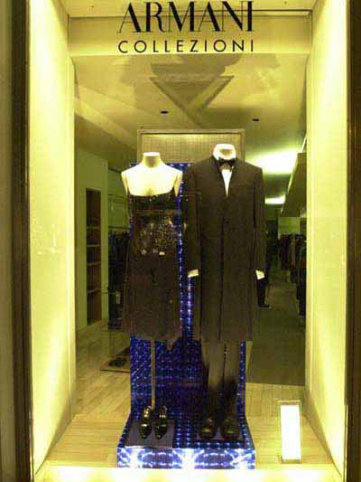
L' industria italiana di modo (Italian Fashion Industry)

Slide 26
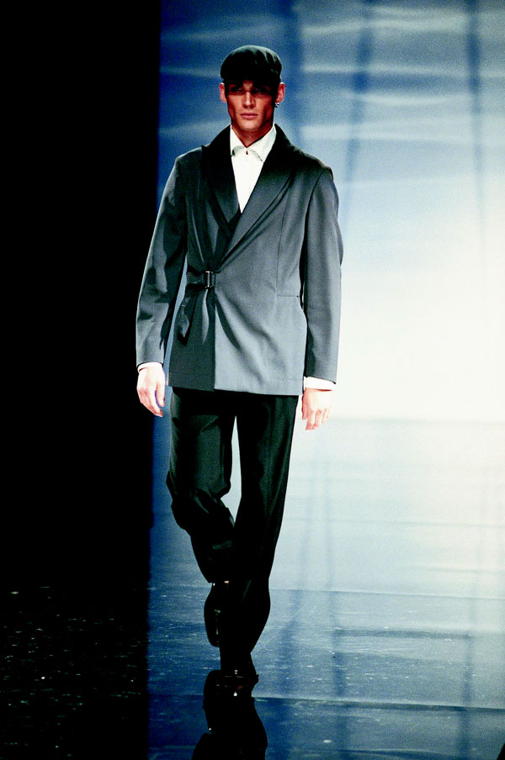
Alla moda italiano il signore (Men’s Fashion)

Slide 27
Ugliness or lack of style is a bigger sin in Italy than immorality.

Slide 28
WHY THE FASHION INDUSTRY MAKES SENSE FOR ITALIAN CULTURE
1. Family-owned & run: the ideal form of business in Latin cultures
2. Requires little start-up capital
3. Non-institutional: hard for corrupt government officials to touch
4. Artistic: Being artistic is valued above simply making money

Slide 29
Italian family business owners practice community capitalism (multiple stakeholders): family comes before customers & quality of life before profit maximization. The family is king, not customers.

Slide 30
The customer is not king in Italy—the family firm runs things around the needs of the family (hours open, days off, speed of service, etc.)

Slide 31
YOU HAVE TO BE AN INSIDER
Want good service? Want to bargain? Want people who treat you in a genuine way? Then you’d better be an insider in Latin cultures: a member of the extended family, a long-time loyal customer or supplier, a member of the community, or least a trusted acquaintance of an insider. Latins place relationships ahead of money & top notch performance. They feel that who you do things for is more important than what you do. Working only for the $$$ makes you a professional “prostitute.”

Slide 32
Italians consider their family
business to be a commercial
work of art, not just a “golden egg”
to be exploited

Slide 33
STREET-WISE ITALIANO ADVICE:
Don’t invest your own money in a “rented house”—own your own business
Organizations are an abstraction; people are concrete
Profit maximization is strictly for those who don’t have an extended family
Business is artistic self-expression. Don’t sell your soul to an impersonal publicly-owned company that cares only about what you produce, not who you are.

Slide 34
NEGATIVE
MBA
VIBES

Slide 35
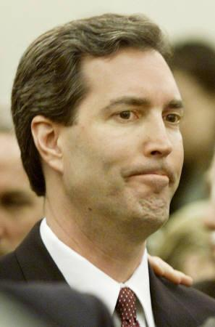
Un MBA:Non è prabably italiano (This MBA is probably not Italian)

Slide 36
Most Italians believe that MBAs care more about their careers than the company they work for—they are in it strictly for $$$ & career-building
MBAs got no style or sophistication
because the only thing they value is profit
3. MBAs don’t care what they sell as long as it makes them $$$
4. MBAs pass nothing on to the next generation except their workaholism

Slide 37
Why devote all of your time, energy, & talents to helping somebody you don’t even know (a corporation’s stockholders) get rich?
Why not give your family members your quality time (on the job with you)?

Slide 38
Most Italians & Latins would feel a massive loss of freedom in Anglo-Saxon institutional/organizational culture, with its obsession for control, analysis, punctuality, conformity, & performance, performance, performance.
Latins don’t want to eat in robot franchises, work for mercenary profit maximizers, cater to rude customers, or separate themselves from family 50-60 hours a week.

Slide 39
THE CORDATA:
GODFATHER
ORGANIZATIONS

Slide 40
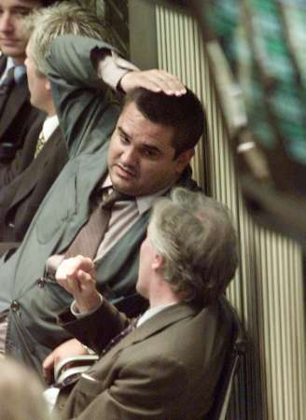
The cordata at work: A way to turn the scorned corporation into a family network

Slide 41
Semi-independent “godfather” bosses run their part of the company as if it were a family business. They hire their own employees who work for the “godfather” exclusively. Strong mutual loyalty is maintained. The various godfathers meet periodically to cut deals between them which shapes how the company operates.

