Slide 1
Coming together is a beginning. Keeping together is progress. Working together is success.
--Henry Ford

Slide 2
Module 6
Application of OD for Retention and Utilization

Slide 3
Model for Organizational Development and Change
Stage 1 – Establish the Need for Change
Stage 2 – Disseminate a Vision
Stage 3 – Diagnosis/Analyze
Stage 4 – Recommendations
        Stage 5 – Implementation of Strategies
        Stage 6 – Measure, Reinforce, & Refine

Slide 4

First Break All The Rules – Ch 6
Find the right fit
Peter Principle
Create heroes in every role
Critical role of self-discovery
Managing and the new career
        Importance of getting to know your employees.

Slide 5
First Break All The Rules – Ch 7
4 Keys
  Select for Talent
  Define the Right Outcomes
  Focus on Strengths
  Find the Right Fit
Interviewing for talent
Performance Management routine
        Turning the keys

Slide 6

Strengths / Talents
Know your Strengths/Talents

Slide 7
Strengths – 34 Themes
Relating: harmony, includer, empathy, individualization, relator, communication, responsibility
Impacting: command, competition, developer, positivity, maximizer, woo
Striving: achiever, activator, belief, significance, self-assurance, adaptability, restorative, discipline, focus
            Thinking: analytical, arranger, connectedness, deliberative, futuristic, context, strategic, consistency, ideation, input, intellection, learner

Slide 8

Skill Development
What are your Strengths?

Slide 9
Strengths / Talents
Know your Strengths/Talents
Develop your Strengths/Talents
Use your strengths/Talents
  Teams
  Motivation
  Selection
  Leadership
  Career Planning

Slide 10
Team
group of individuals who depend upon one another to accomplish a common objective

Slide 11
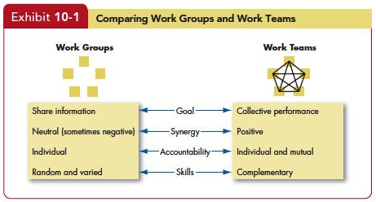
Contrast Groups and Teams
Y

Slide 12
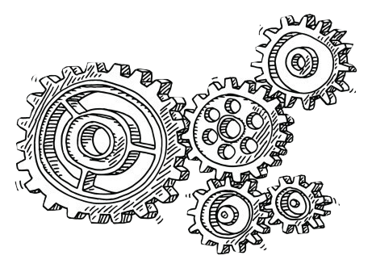
Advantages of Teams
Accomplish difficult task
Combine skills and talents/ diversity of views
Effective decision making/more accurate
Increase organization stability
Increased legitimacy/ acceptance of solution

Slide 13
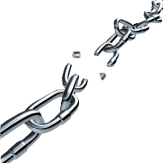
Disadvantages of Teams
Disadvantages of Teams
Time consuming
Pressures to conform
Dominated by the few
Ambiguous responsibility

Slide 14
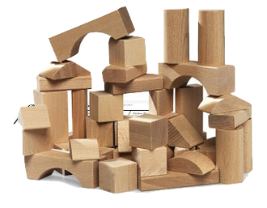
Support Systems
Selection of Team Members
Rewards/Motivation (effective measurement)
Leadership
Technology
        Training

Slide 15

TEAMS
Why Teams Don’t Work
  Teams must be real
  Teams need a compelling direction
  Teams need enabling structures
  Teams need a supportive organization
  Teams need expert coaching
How to Reward Your Stellar Team
  Clear objectives
  Check in on progress
  Use a variety of rewards
  Know the team
        Discuss Collective Efforts
        Evaluate Team Performance
Coutu, D. (2009). Why Teams Don’t Work. Harvard Business Review, 99-105.
How to Reward Your Stellar Team (2013) HBR Blog

Slide 16
Team Development
Integrate the goals of the individual and the group with the goals of the organization.

Slide 17

Critical Skills for Effective Teams
Goal-setting skills
Conflict resolution skills
Problem solving skills
        Interpersonal skills (communication, supportiveness, trust, cohesion)
        Role clarification skills

Slide 18

Team Development Interventions
Role Clarification
  Role Negotiation
  Role Analysis
Interpersonal Skills
  Outdoor Experiential Laboratory Learning
      Problem Solving
        Group Think
        Abilene Paradox

Slide 19

Role Negotiation – New Groups
Contract setting
Issue Diagnosis
Role Negotiation
        Written Role Negotiation
        Agreement

Slide 20
Role Analysis – Existing Groups
Role analysis
Role incumbent expectation of others
Role expectations by others
        Role profile

Slide 21
Outdoor Experiential Laboratory Training
Outdoor setting of experiential exercises
Focus
  Leadership
  Team work
        Interpersonal relationships

Slide 22
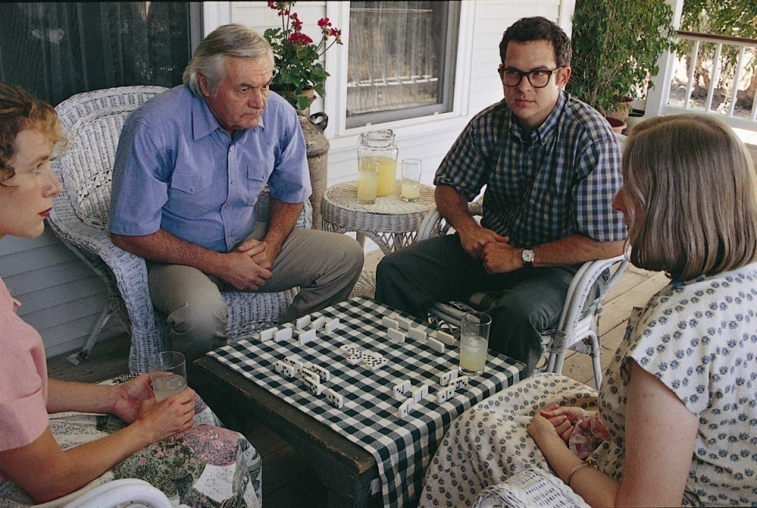
Problem Solving
Group Think –Group tries to reach decision without critical evaluation.
Abilene Paradox – group decides on action that is counter to the preference of many of the individuals in the group.
Turner, M. E.; Pratkanis, A. R. (1998). "Twenty-five years of groupthink theory and research: lessons from the evaluation of a theory".
Organizational Behavior and Human Decision Processes 73: 105–115. doi:10.1006/obhd.1998.2756

Slide 24
"An empowered organization is one in which individuals have the knowledge, skill, desire, and opportunity to personally succeed in a way that leads to collective organizational success."
--Stephen Covey

Slide 25
Talent Management in Times of Change

Slide 26

Empowerment
Empowerment gives people in organizations the ability to get things done, often at levels of the hierarchy where the power can be most directly and effectively applied.

Slide 27
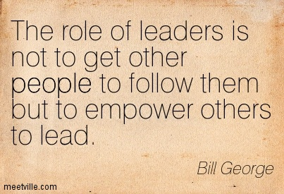
Leaders Everywhere
How is empowerment important in organizations today?

Slide 28
Stages of the Empowerment Process
Stage 1
Conditions Leading to Powerless- ness
Empower- ing Leadership practices
Stage 3
Providing Self-Efficacy Information
Stage 2
Stage 4
Stage 5
Empower-ing Experience
Behavioral Outcomes

Slide 29
Stage 1: Some Conditions Leading to Powerlessness
Organizational factors such as bureaucratic climate
Autocratic supervision
Rewards that aren’t tied to performance
Routine, simplified jobs
        Remove barriers

Slide 30
Stage 2: Some Empowering Managerial Practices
Participation in decision making.
Control over work processes
Tie rewards to performance.
Express confidence, encouragement, and support.
        Retrain managers

Slide 31

Stage 3: Sources of Self-Efficacy Information
Training
Vicarious experience
Emotional support
Feedback
        Success Stories

Slide 32
Stages of the Empowerment Process
Stage 1
Conditions Leading to Powerless- ness
Empower- ing Leadership practices
Stage 3
Providing Self-Efficacy Information
Stage 2
Stage 4
Stage 5
Empower-ing Experience
Behavioral Outcomes

Slide 33

Stage 5: Behavioral Outcomes
Improved commitment
Improved coordination
Improved motivation
        Improved satisfaction

Slide 34

Top 10 Ways to Make Employee Empowerment Fail
Heathfield, S. (2014). Top Ten Ways to Make Employee Empowerment Fail. About Money

Slide 35
Skill Development
Empowering Employees

