Slide 1

Module 3
Change Management Process

Slide 2

Diagnosis
“If you don’t ask the right questions, you don’t get the right answers.
A question asked in the right way often points to its own answer.
Asking questions is the A-B-C of diagnosis.
Only the inquiring mind solves problems.”
Edward Hodnett (American Poet 1841-1920)

Slide 3
Model for Organizational
Development and Change
Stage 1
Stage 2
Stage 3
Stage 4
Stage 5
Stage 6
Establish the Need for Change
Disseminate a Vision
Diagnosis/Analyze
Recommendations
Implementation of Strategies
Measure, Reinforce, & Refine

Slide 4
DIAGNOSIS
a systematic approach to understanding and describing the present state of the organization

Slide 5

Diagnostic Articles
The Parable of Diagnostics
What can we learn?
Diagnosing Business Problems
What do we need to be careful not to do?
Wolf, W. (1994). The Parable of Diagnostics. Journal of Organizational Change Management, 6-7.
MacLennan, A. (2009) Diagnosing Business Problems, HR Network, p. 30-34.

Slide 6
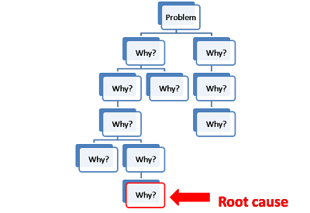
Five Why’s
Write down a problem
Ask Why the problem happened
If it doesn’t get the root cause ask why again!
http://www.isixsigma.com/tools-templates/cause-effect/determine-root-cause-5-whys/

Slide 7
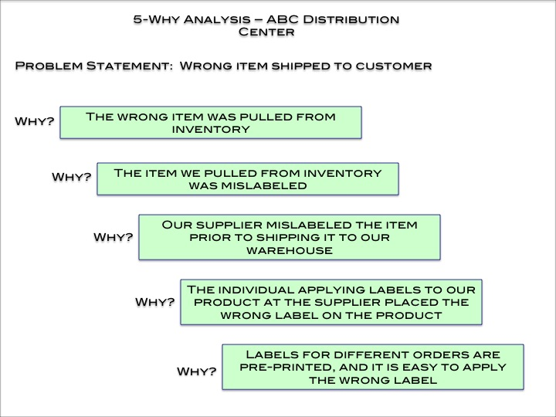

Slide 8

Gather Data
Data Collection
  Define objectives
  Identify central variables
  Selection of methods of gathering data
Methods
  Secondary sources
  Questionnaires
  Direct observation
  Interviews
  Other

Slide 9
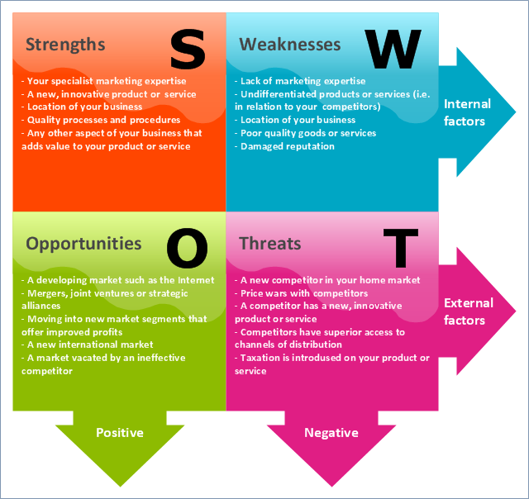
SWOT Analysis
Analysis not just lists
All parts are important
Prioritize factors in each category
Multiple sources of data across the organization
http://articles.bplans.com/how-to-perform-swot-analysis/

Slide 10
Social Network Analysis: Sociogram
A
B
# = 3
# = 0
Isolate
Clique
C
E
# = 2
D
# = 1
# = 5
F
# = 1
http://www.durlandconsulting.com/images/pdfs/Understanding_maps_11_03a.pdf

Slide 11
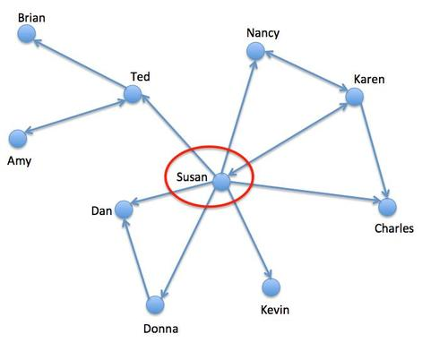

Slide 12
Kevin
Sonya
Sam
Lisa
Julia
Helen
John
Paul
Lee
David
Carl
Sue
Bill
Ali
Alex
Marketing
Finance
Manufacturing

Slide 13
Force-Field Analysis
-4
-3
-2
-1
RESTRAINING FORCES
(Estimated Strength)
Higher
Current
Equilibrium
Equilibrium
+1
+2
+3
+4
Lower
DRIVING FORCES
(Estimated Strength)

Slide 14
Force-Field Analysis
Lower Absentee Rate
Desired Rate
Present Rate
Higher Absentee Rate
FORCES TENDING TO RESTRAIN (INCREASE) ABSENTEE RATE
0% 1% 2% 3% 4% 5% 6% 7% 8% 9% 10% 11% 12%
First-line supervisors
Inclement weather and cold climate
Below standard vacation days
No monetary ownership in company
No personal leave policy
Interest in Work
Promotion Policy
Pay scale
Present sick leave policy
Fear of losing Job
FORCES TENDING TO IMPROVE (DECREASE) ABSENTEE RATE

Slide 15
IMPLEMENTATION OF CHANGE STRATEGY
Set of planned change activities intended to help an organization increase its effectiveness

Slide 16


WHY DOES CHANGE MANAGEMENT NEED TO CHANGE?
HBR Blog (2013) – Change Management Needs to Change

Slide 17

Selecting an Intervention for Organizational Change
Root cause
Time frame
Financial resources
Client support
Change agent skill
Energy level

Slide 18
An Integrated Approach to Change
Change
Leader
Behavioral
Strategy
Structural
Strategy
Technological
Strategy
Change Attitudes & Values
Change Structures & Design
Change Production & Methods
New Behaviors
New Relationships
New Processes
Improved
Performance

Slide 19

Major OD Intervention Techniques
Individual level
Group Level
Intergroup level
Total organizational system

Slide 20
OD Interventions: An Overview
Types of Interventions
Category | Individual | Group | Intergroup | Total Organization System
Behavioral | Transactional Analysis | Team Building | Intergroup Development | Goal Setting
 | Career Planning | Process Consultation | Third-Party Intervention | Survey Feedback
 | Quality of Work Life | Quality Control | Organization Mirror | Quality of Work Life
 | Stress management | Role Negotiation | Process Consultation | Action Research
 | Empowerment | Role Analysis | Total Quality Management | Total Quality Management
 | Management by Objective | Goal Setting
 | Goal Setting | Third-Party Intervention
Structural | Job Enrichment | Job Enrichment | Job Enrichment | Restructuring
 | Stress Management | Team Building | Goal Setting | Survey Feedback
 | Quality of work life | Quality Circles | Total Quality Management | Total Quality Management
 | Management by Objective | Role Negotiation
 |  | Role Analysis
Technical | Job Design | Job Design | Job Design | Total Quality Management
 |  | Quality control | Total Quality Management | Survey Feedback
 |  |  |  | Reengineering

Slide 21

Stream Analysis
Key factors that need to be altered
Interventions plotted over time
Shows the relationship of one intervention to another
Total organizational system
https://www.changeanalytix.com

Slide 22
Stream Analysis Chart
Month Behavioral Structural Technical
0
1
2
3
4
5
6
7
8
9
10
11
12
B1
Team
Building
T1
Install
Robotics
S1
Chain of
Command
B2
Intergroup
Team
Building
B3
Team
Building
S2
Self-
Managed
Work
Teams

Slide 23
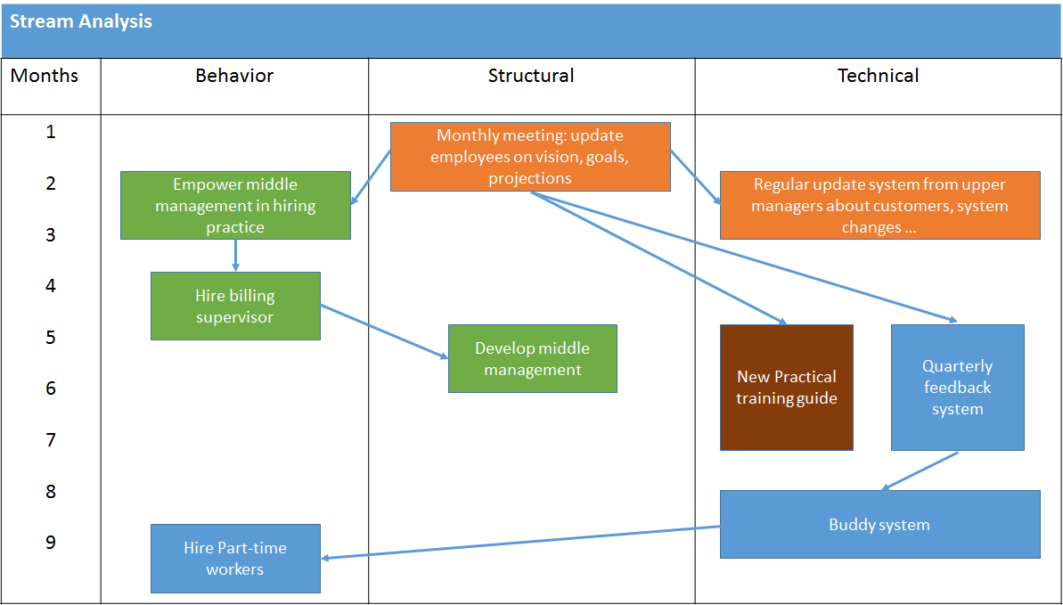
Stream Analysis

Slide 24

SKILLS DEVELOPMENT
Energy International

Slide 25

Learning Points
Decision Process
Information Strategy
Leadership

Slide 27
“The thing I have learned at IBM is that culture is everything.”
– Louis V. Gerstner, Jr. former CEO IBM

Slide 28
ORGANZATIONAL CULTURE
A common perception by the organization’s members; a system of shared meaning.

Slide 29
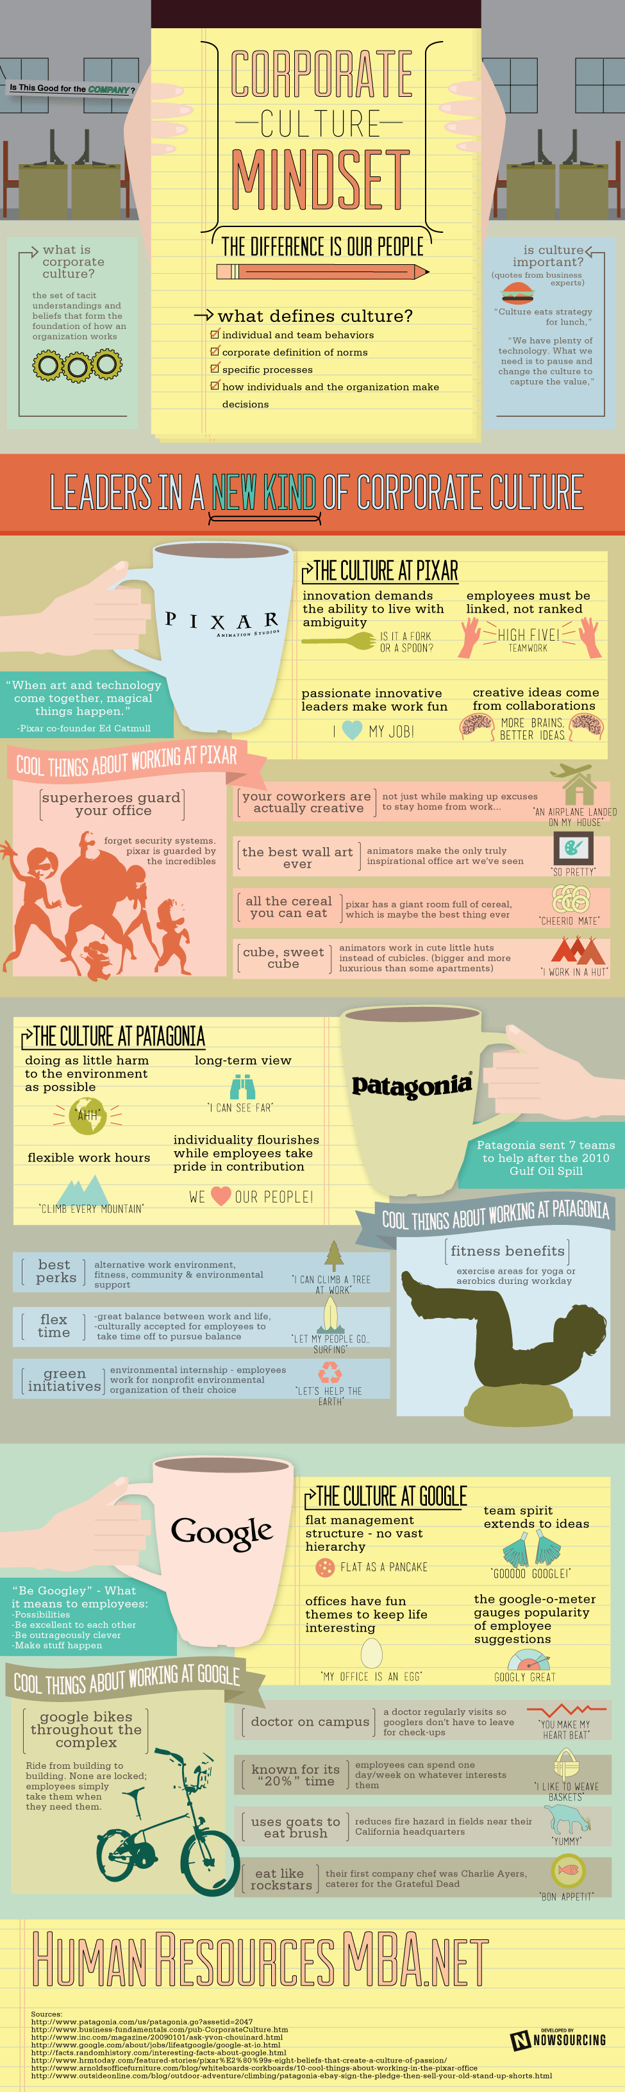

Slide 30
Functions of Organizational Culture: Why it is Important!
JUSTIFICATION
OF BEHAVIOR
ENCOURAGE
SHARED
PERCEPTIONS
ENHANCED
COOPERATION
CULTURE
ENHANCED
COMMITMENT
IMPROVED
DECISION
MAKING
IMPROVED
COMMUNICATION
ENHANCED
CONTROL

Slide 31
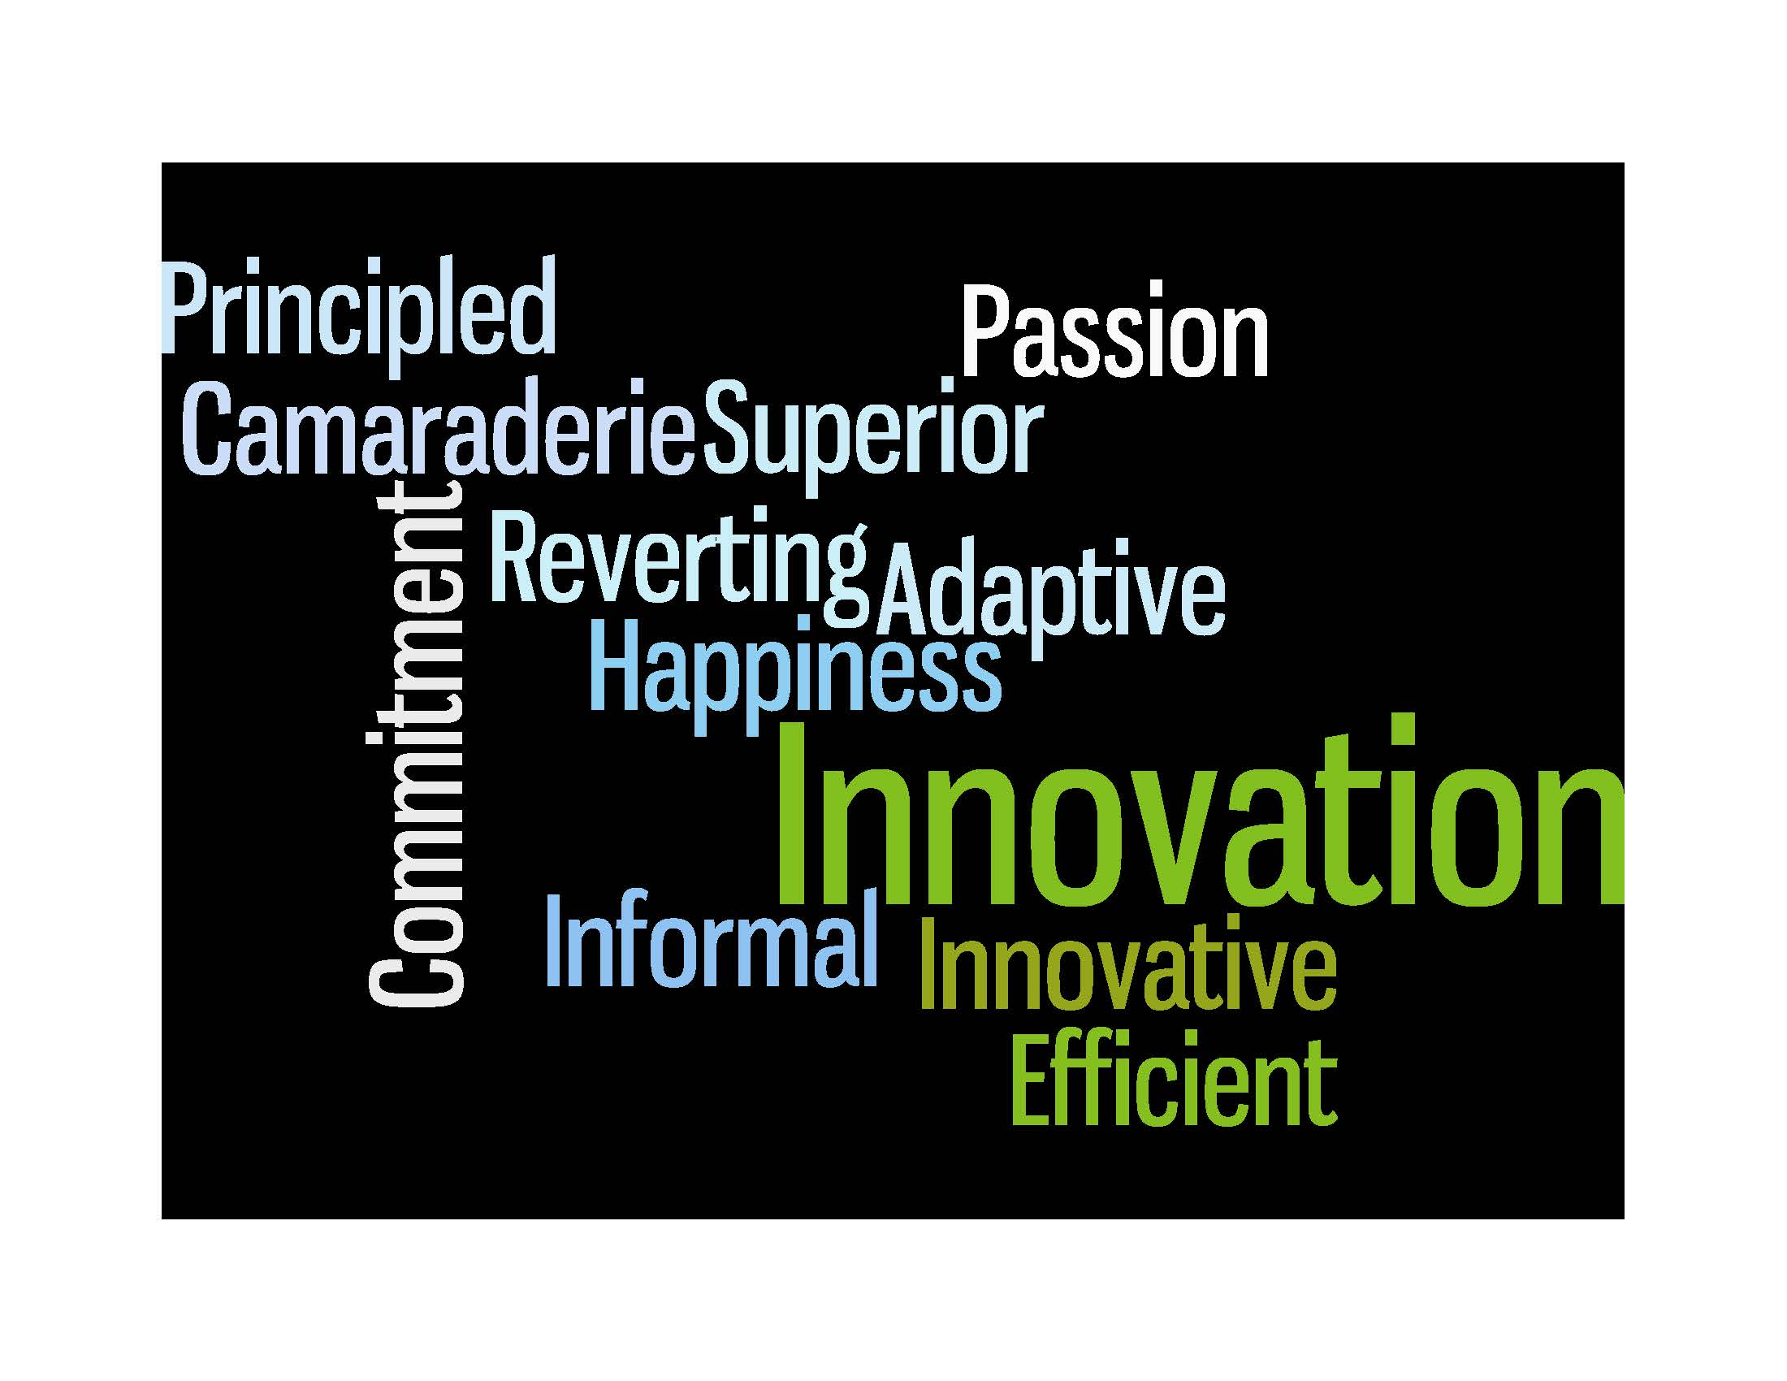
Notes:
Wordle.net

Slide 32

Notes:
www.wordle.net

Slide 33
Elements of Organizational Culture
Rituals
Rites
Values
Organizational
Culture
Symbols
Heroes
Narratives

Slide 34
Elements of Organizational Culture
Values
Organizational
Culture

Slide 35

Values at The Dwyer Group
LIVE RICH
Respect
Leadership
Customer focus
Having fun in the process
Recite values at the beginning and ending of meeting!!

Slide 36

New Belgium Brewing
Remembering that we are incredibly lucky to create something fine that enhances people's lives while surpassing our consumers' expectations.
Producing world-class beers.
Promoting beer culture and the responsible enjoyment of beer.
Kindling social, environmental and cultural change as a business role model.
Environmental stewardship: Honoring nature at every turn of the business.
Cultivating potential through learning, high involvement culture, and the pursuit of opportunities.
Balancing the myriad needs of the company, our coworkers and their families.
Trusting each other and committing to authentic relationships and communications.
Continuous, innovative quality and efficiency improvements.
Having Fun.

Slide 37
Elements of Organizational Culture
Organizational
Culture
Symbols

Slide 38





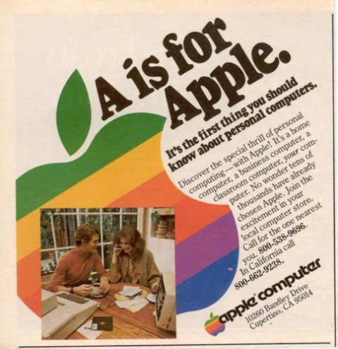


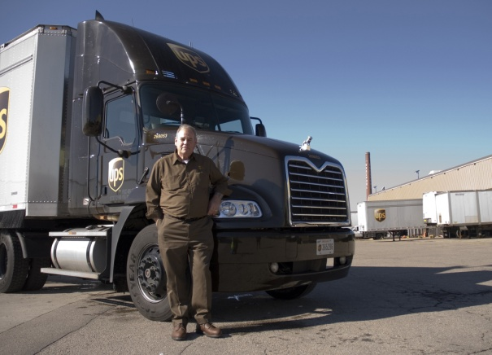



Symbols

Slide 39
Elements of Organizational Culture
Organizational
Culture
Narratives

Slide 40
Forms of Narratives
Stories dramatize relatively ordinary, everyday events within organizations in order to convey important cultural meanings.
Legends are more uplifting than stories and portray events that defy explanation by ordinary circumstances.
Myths are dramatic, unquestioned narratives about imagined events.
Sagas describe heroic exploits performed in the face of adversity.
Recurring story themes: equality, loyalty, security, control.

Slide 41
Elements of Organizational Culture
Organizational
Culture
Heroes

Slide 42
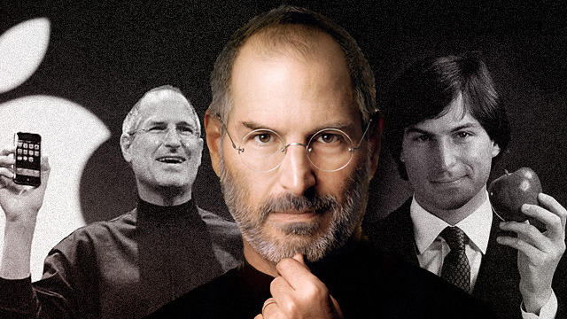
Heroes
Heroes are company role models. In their performance of deeds, embodiment of character, and support of the existing organizational culture, they highlight the values a company wishes to reinforce.
Heroes are the main characters in the stories relayed throughout an organization.

Slide 43

Herb Kelleher of Southwest Airlines
Herb Kelleher is cofounder, chairman of the board, and was CEO of Southwest Airlines.
Under Kelleher’s guidance, Southwest has been remarkably successful. It has been profitable every year since 1973 yet maintains the lowest fares.
Fortune magazine named it the most admired airline and best place to work in the United States.
Kelleher has created a unique culture at Southwest Airlines through a mix of humor, altruism, concern for others, and straight talk.

Slide 44
Elements of Organization Culture
Rites
Organizational
Culture

Slide 45
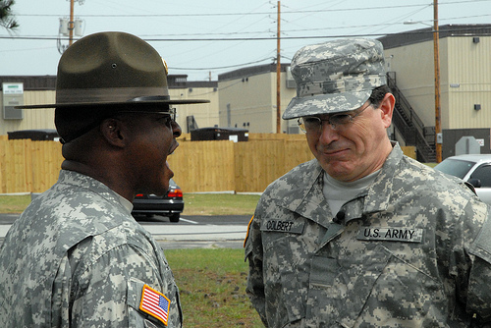
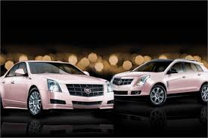

Rites (formal)
Rites combine cultural forms into a public performance.
Some forms of rites include:
  Rites of Passage (completion
  of Army basic training)
  Rites of Enhancement (awards ceremony)
  Rites of Integration (company Christmas party)

Slide 46
Elements of Organization Culture
Rituals
Organizational
Culture

Slide 47
Rituals (informal)
Rituals are relatively simple combinations of repetitive behaviors, often carried out without much thought, and often brief in duration.
For example:
  how members greet one another
  how birthdays are celebrated
  who eats where and with whom
  how a phone conversation should proceed
Rituals are often more important for their expressive, emotional consequences than for more practical reasons

Slide 49
SKILLS DEVELOPMENT
Culture Fit

Slide 50
CULTURE AND CHANGE
Cultural Change that Sticks
What do we start with when thinking about cultural change?
Orange is the New Culture
What is unique about this culture?
Trader Joe’s Remarkable Journey
How has their culture played a role in their success?
Katzenbach, H., Steffen, I., & Kronley, C. (July-Aug 2012). Cultural Change that Sticks. Harvard Business Review, 2-9.
Orange is the New Culture (2013) Fast Company.
Gustafson, M. (2008) Trader Joe’s Remarkable Journey. Retailer Extra.

Slide 51
SKILLS DEVELOPMENT
Transforming Organizational Cultures

Slide 53

“In most organizational change efforts, it is much easier to draw on the strengths of the culture than to overcome the constraints by changing the culture.”
Edgar Schein, professor MIT Sloan School of Management

Slide 54
Model for Organizational
Development and Change
Stage 1
Stage 2
Stage 3
Stage 4
Stage 5
Stage 6
Establish the Need for Change
Disseminate a Vision
Diagnosis/Analyze
Recommendations
Implementation of Strategies
Measure, Reinforce, & Refine

Slide 55
CHANGING CULTURE

Slide 56
Tools for Change
Strategic Planning
Information Sharing/Communication
Leadership
Vision/Core Values
Support
Resources
Motivation/Rewards

Slide 57
Implementation of Culture Change
Communicate the New Culture
Have a leader that emulates the new Culture
Realign the Organizational Policies and Practices to Support the New Culture
Define the Elements of the New Culture
Use Elements to Reinforce and Transmit the New Culture
Replace Managers and Employees who do NOT embrace the New Culture
Evaluate the Culture in Relation to the Organization’s Mission

Slide 58

EDS
What was the existing culture at EDS?
How did the new CEO go about changing culture?
Why did they choose a change leader from outside of the organization?
What is the new culture of EDS?
Breen, B. (2001). How EDS Got Its Groove Back. Fast Company, 51: 10p.

Slide 59

Zappos
Customer Service
Company Culture
Employee Training & Development
Hsieh, T. (2010). Zappos’s CEO on Going to Extremes for Customers. Harvard Business Review, 41-45.

Slide 60

What makes a great leader?
Behaviors / Actions
Encourages employees to be themselves.
“A lot of people [act] different on the weekends versus the office. It's like they leave a big part of themselves. We want them to be the same person at home and the office.”
Engages his employees.
“Only with your feedback can we improve, and build something that has never existed before: a well-known brand, accessible to everyone, that promises nothing less than a WOW experience.”
Traits / Qualities
What can we learn from Tony Hsieh?
Curiosity
Open-minded
Transparent
Self-Improver
Passionate
Adaptive
Making a personal emotional connection is important not only with the customer, but also with the people you work with.
Coming to work should be about “hanging with your friends”. This type of relationship is good for the company because productivity increases when there are higher levels of trust.
Notes:
Sources:
Delivering Happiness by Tony Hsieh
http://www.entrepreneur.com/article/219449
http://www.businessinsider.com/email-inspired-zappos-company-culture-2014-8
http://www.inc.com/magazine/20090501/the-zappos-way-of-managing.html
http://www.businessinsider.com/tony-hsieh-work-from-home-zappos-2013-3

Slide 61

HCL
What is unique about their culture?
How did they go about transformation?
When did they start?
Nayar, V. (2010). A Maverick CEO Explains How He Persuaded His Team to Leap into the Future. Harvard Business Review, 110-113.

Slide 62
SKILLS DEVELOPMENT
Downsizing
Stay in your role
Come to a consensus of ranking
You don’t know how many people will be fired

Slide 63

Learning Points
Decision Making
Culture Sources: Values, Norms, etc.
Leadership

