Slide 1
Stream Analysis EXAMPLES
Organizational Analysis Project
MGT 5310
Below are examples of stream analysis from student projects in previous years. PLEASE read the notes for each one to get some tips on a successful stream analysis.

Slide 2
Structural
Behavioral
Technical
Month
0
1
2
3
4
5
6
7
8
9
10
11
12
Configure Intranet/Email Groups
Initial Mgmt Meeting
Newsletter/Town Hall
Employee Feedback
Workshop
Decision M/CV
Training
1st Q Meeting
Implementation
Banners
Bus Cards
Informal, Constant
Reviews
2nd Q Meeting
3rd Q Meeting
Notes:
Note: Different Colors represent different recommendations which makes it easy for the audience to see and follow

Slide 3
Behavioral
Structural
Technical
0
1
2
3
4
5
6
Increase Communications Awareness Internally
Disseminate need for quarterly procedures
Identify individuals to head newsletter
Create departmental teams
Build Newsletter & E- letters
Build Appraisal Form
1st quarterly appraisal
Establish Need for Feedback Regularly
Weekly Recognition Awards
Review appraisals
Provide one on one feedback
Document feedback
Empowerment Rewards
Notes:
3
Note: Arrow must be used to link boxes and show if there is any flow/integration between boxes

Slide 4
Implementation
Month Behavioral Structural Process
Marcus takes abstractors to lunch
Employee of the week recognition at meetings
Begin weekly company update meetings
Begin one-on-one training sessions
Develop formal evaluations system
0
1
2
3
4
5
Install electronic board displaying law changes
Feedback on leadership given by employees during evaluations
Implement pilot programs for new technology
Implement formal evaluations system
Expand office; separate abstractors and escrow
6 mos. – 1 year
Notes:
Notice these arrows are all going across time but do not integrate with one another. The arrows should sow the integration of the different elements of the recommendation.

Slide 5
Stream Analysis
Behavioral
Structural
Process
0
1
2
3
4
5
6
7
8
9
10
11
12
Develop Vision/Mission Stmt
Appoint Training Coordinator
Develop ST Incentive Prgm
Define
SMART goals
Identify
next leaders
Communicate Vision/Mission Statement
Monitor Performance / Behavior / Feedback
Develop Trainings, Policies and Procedures
MONTH
Review: Performance, SMART goals, Incentive
Self-assessment
Publish Vision/Mission Statement on web
Core Competency Training
Review: Performance, SMART goals, Incentive
Self-assessment
Survey
Core Competency Training
Review: Performance, SMART goals, Incentive
Self-assessment
Core Competency Training
Annual Review
Self-assessment
Survey
Notes:
This group failed to use arrows to connect which is wrong. Also notice their third heading is process which is not correct. It should be technical.

Slide 6
STREAM ANALYSIS
BEHAVIORAL STRUCTURAL PROCESS
0
1
2
3
4
5
6
7
8
9
10
11
12
Partner meeting addressing top-down communication
Monthly partner/ manager meeting
MONTH
Communicate vision to all employees
New evaluation system
Conduct 1st performance evaluation
Employees: 0 – 1 yr.
Social activity policy
Announce and implement new social initiatives
Conduct annual performance evaluation
All Employees
Conduct survey
Notes:
Note: All stream analyses must have time down the vertical axis and behavior, structural, and technical (NOT PROCESS) on the horizontal axis. I will give leeway on interpreting these categories. Basically behavioral is how the behaviors change (things you want people to do different), structure is the underlying framework for the way things are done, and technical is the implementation of new processes.

Slide 7
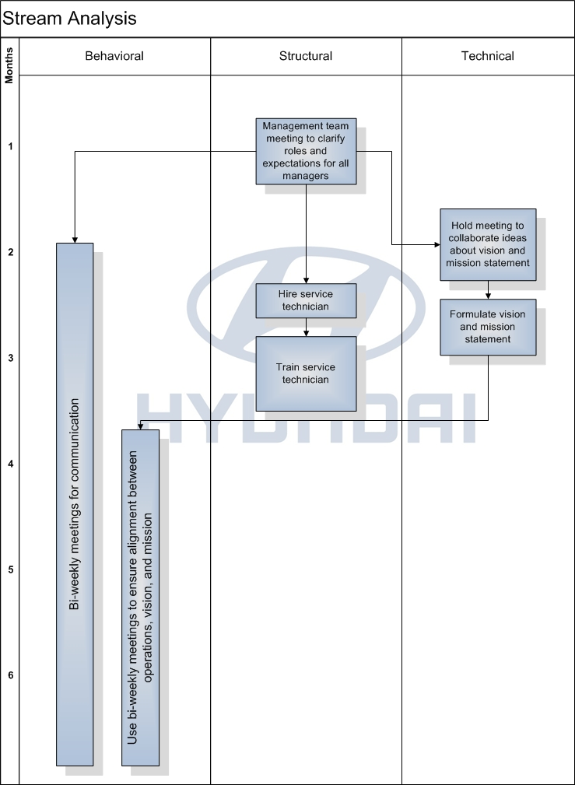
Notes:
Note: Remember that the stream analysis lays out your recommendations it does not say what your results will be obtained. This is a common mistake. Be sure to show what you are going to do but do NOT include what outcome you expect (high satisfaction, lower turnover, better performance, improved communication, etc.)

Slide 8
Behavioral
Stream Analysis Chart
GYM
X
Structural
Technical
Month
1
2
3
4
5
6
7
8
9
10
11
12
Define Company Values
Hire HR Director
Promote Sense of Belonging
Establish
Individual
Meetings
Establish
Group
Meetings
Implement Rights and Rituals
Visual
Communication:
Goal Charts
Clearly define roles
and expectations
of employees
Training Program:
Lower Level
Managers
Front Desk
Personnel
Foster Open Communication and Relationship Building
Implement 360 Feedback Evaluation
Create and
Implement
Rewards
system
Notes:
Note: While some recommendations are ongoing like this “foster open communications” in blue on the left be careful not to have too many of these in your final stream analysis. The stream analysis should be a visual that someone outside your group could look at and easily understand.

Slide 9
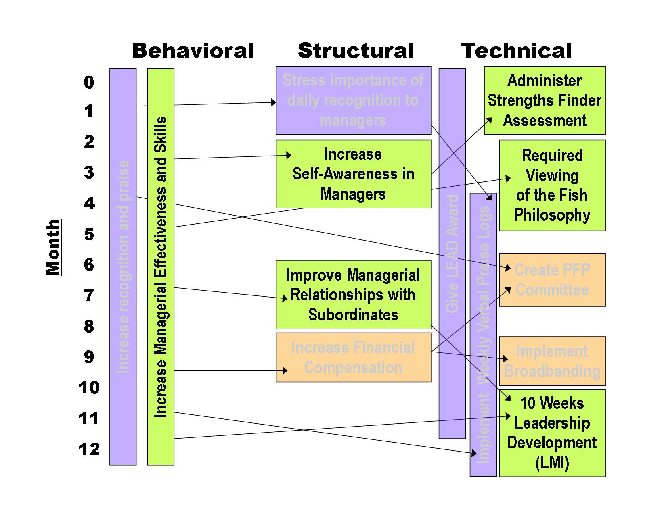
Stream Analysis
Overview
Data
Analysis
Recognition
Training
Q & A
Notes:
Note: DO NOT have arrows going back in time!

Slide 10
Jan
Feb
Mar
Apr
May
June
July
Aug
Sep
Oct
Nov
Dec
Expansion Governance (EG)
Multiple stage process: Collection-Assess-Teaming-Time (CATT)
Collection
Information on employees’ duties and growth-related changes
Continue EG
Keep teams updated with necessary information to alleviate bottlenecks and other growth-related problems
Assess
Evaluation of problem areas and bottlenecks caused by rapid growth
Reassess teams and goals
Teaming
Team creation to offset workloads; teams to streamline deliverables
Time (continual stage)
Lifecycle standard for certain procedures and processes to assist with adaptation
Notification Phase
Lifecycle shift 25% of procedures
Lifecycle shift 50% of procedures
Lifecycle shift 75% of procedures
Feedback System
Monthly meetings, notifying about growth-related
Notification of change specificity (CS) program
Initial CS Implementation
(CSI)
CSI
CSI
CSI
CSI
CSI
CSI
CSI
CSI
CSI
Employee
Feedback & Executive assessment
Employee
Feedback & Executive assessment
Employee
Feedback & Executive assessment
Employee
Feedback & Executive assessment
Notes:
Note: While this is very nice looking it is NOT a stream analysis. You must have a stream analysis!

Slide 11
Friendships: Stream Analysis
Notes:
Note: This stream analysis with the next two were all part of one project. While often initially presented separately as part of the presentation it is imperative that they are combined into one stream analysis at the end. The stream analysis is the integrated culmination of the recommendations. If the combined stream analysis is too busy then you likely have too much detail in the stream analysis.

Slide 12
On-the-Clock Fitness: Stream Analysis
Behavioral
Structural
Technical
0
1
2
3
4
5
6
7
8
9
10
11
12
Management meeting to outline wellness program structure and policies
Document wellness program logistics and policies
GM hosts meeting to explain wellness program to employees
Create wellness program employee pamphlet handout
Open understanding of importance to personal commitment to health
Commence and implement wellness program
Document and monitor wellness program activity and hours logged
Notes:
Part of previous slide

Slide 13
Gold’s Scramble: Stream Analysis
Notes:
Part of previous slide

Slide 14
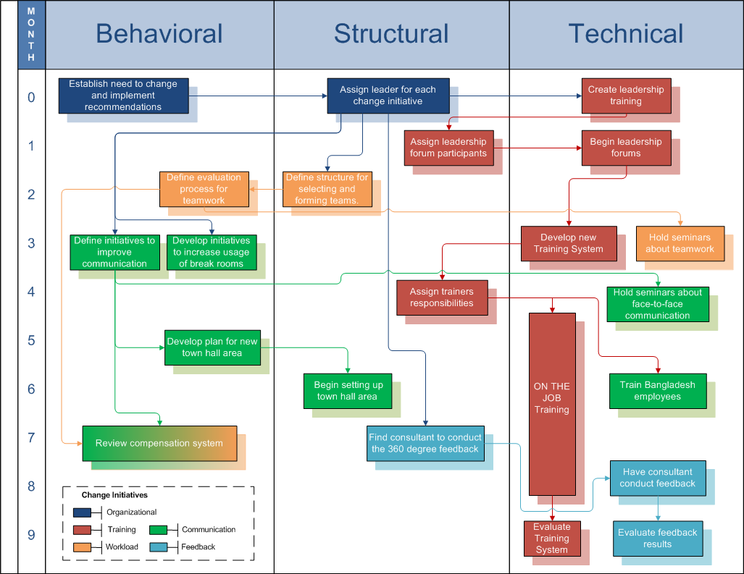
STREAM ANALYSIS
Notes:
If an action encompasses two recommendations you could do something like was done here with different colors.

