Slide 1








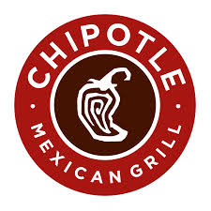





Organizations in Action
Anisha - Microsoft
Aude - IKEA
Cami - Marriott
Tina - Zappos
Spencer - Hewlett-Packard
David - Container Store
Mike E. – Apple
Terrance - Proctor & Gamble
Kevin - Goldman Sachs
Jay - Ralph Lauren
Quinn - Delta
Mike S. - Chipotle
Osamma – Under Armour
Bo - Qualcomm

Slide 2















Organizations in Action
Funmi – General Mills
Wesley - Columbia
Jared - Twitter
Benjamin - Disney
Dalton – Southwest Airlines
Emmie – Johnson & Johnson
Margie - Lego
Paul - Nike
Lauren – Black Diamond Equipment
Akin - Caterpillar
Elizabeth - Nordstrom
Kate - Starbucks
Jessica – University of Phoenix
John - Google
Kaci - Memorial Sloan Kettering Cancer Center

