Slide 1

text the word “info” to ebs@baylor.edu to get more information
european business seminar
European Business Seminar
Summer 2012
EBS

Slide 2
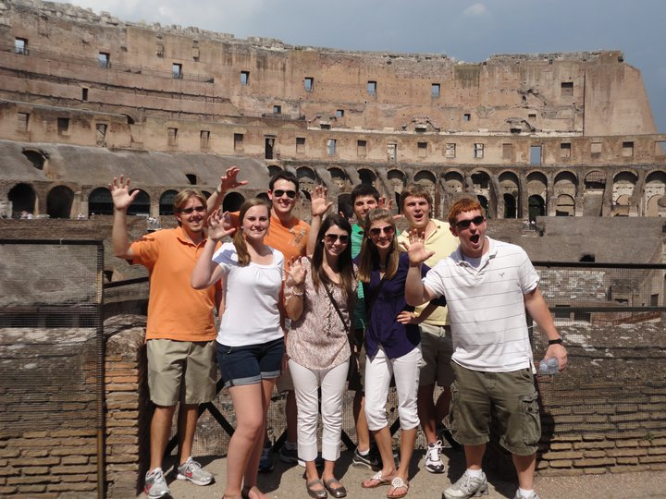
Study Abroad in Europe Summer 2012
EBS
text the word “info” to ebs@baylor.edu
to get more information

Slide 3
Austria
Study Abroad in Europe Summer 2012
EBS
text the word “info” to ebs@baylor.edu
to get more information

Slide 4
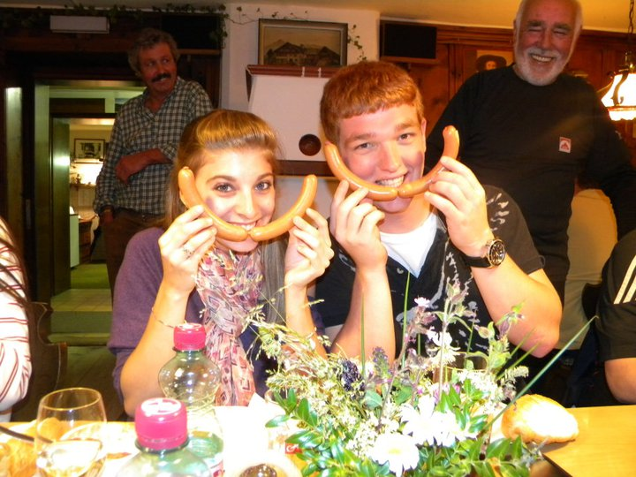
text the word “info” to ebs@baylor.edu to get more information
Study Abroad in Europe Summer 2012
EBS

Slide 5
Study Abroad in Europe Summer 2012
MUNICH, GERMANY
EBS
text the word “info” to ebs@baylor.edu
to get more information

Slide 6
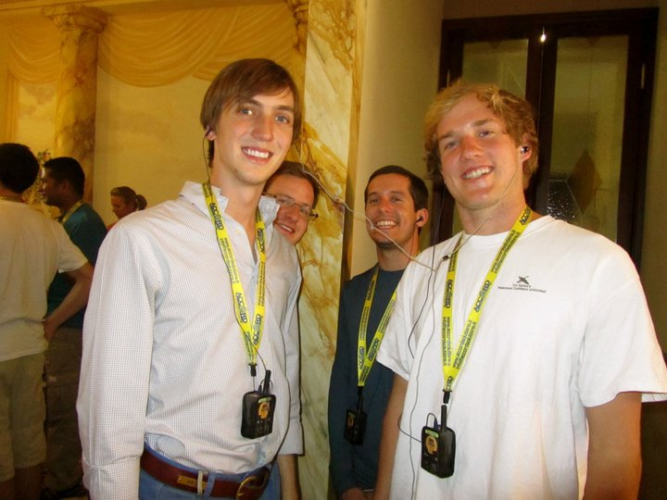
text the word “info” to ebs@baylor.edu to get more information
Study Abroad in Europe Summer 2012
EBS

Slide 7
Rome
Study Abroad in Europe Summer 2012
EBS
text the word “info” to ebs@baylor.edu
to get more information

Slide 8
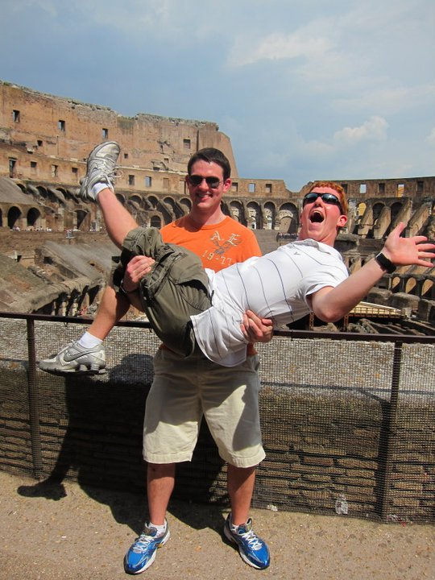
text the word “info” to ebs@baylor.edu to get more information
Study Abroad in Europe Summer 2012
EBS

Slide 9
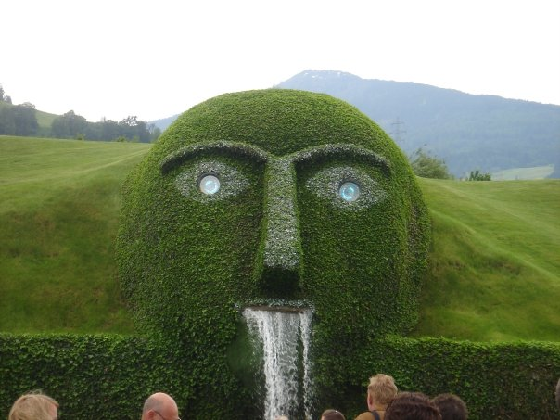
Study Abroad in Europe Summer 2012
EBS
text the word “info” to ebs@baylor.edu
to get more information

Slide 10
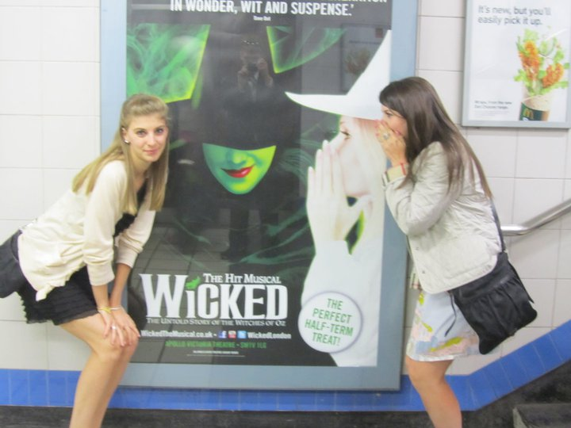
Study Abroad in Europe Summer 2012
EBS
text the word “info” to ebs@baylor.edu
to get more information

Slide 11

Study Abroad in Europe Summer 2012
EBS
text the word “info” to ebs@baylor.edu
to get more information

Slide 12
Study Abroad in Europe Summer 2012
Siena, Italy
EBS
text the word “info” to ebs@baylor.edu
to get more information

Slide 13
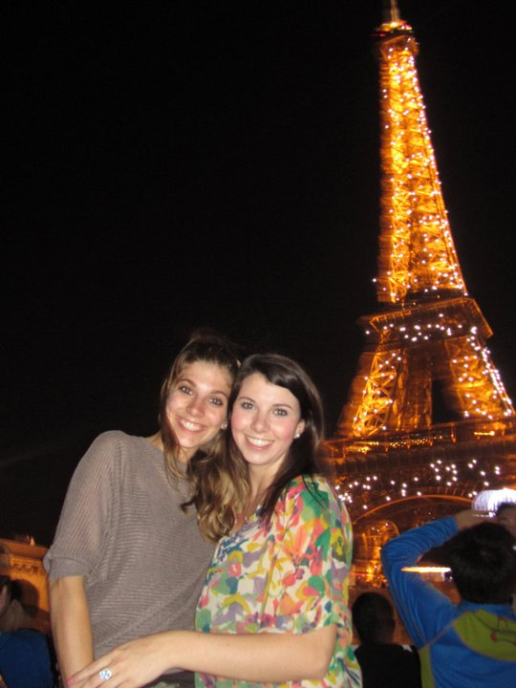
Study Abroad in Europe Summer 2012
EBS
text the word “info” to ebs@baylor.edu
to get more information

Slide 14

Study Abroad in Europe Summer 2012
EBS
text the word “info” to ebs@baylor.edu
to get more information

Slide 15
Paris
Study Abroad in Europe Summer 2012
EBS
text the word “info” to ebs@baylor.edu
to get more information

Slide 16
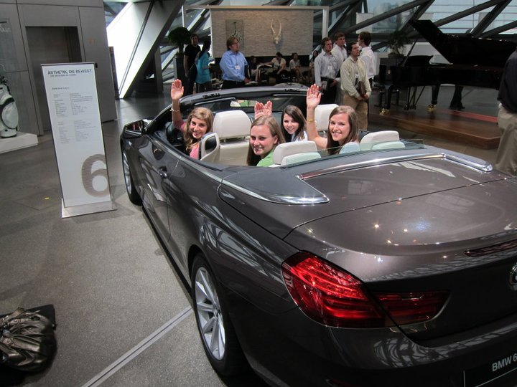
Study Abroad in Europe Summer 2012
EBS
text the word “info” to ebs@baylor.edu
to get more information

Slide 17
London
Study Abroad in Europe Summer 2012
EBS
text the word “info” to ebs@baylor.edu
to get more information

Slide 18
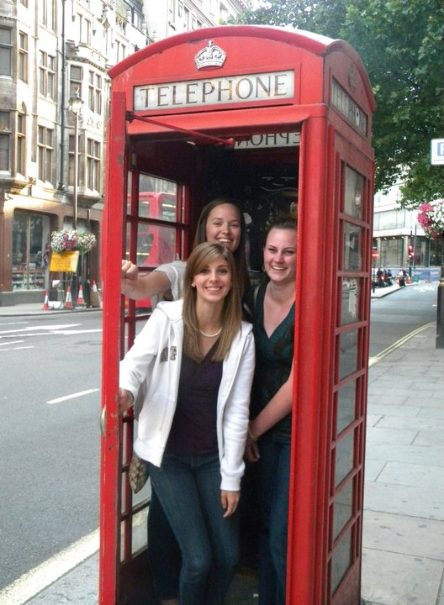
Study Abroad in Europe Summer 2012
EBS
text the word “info” to ebs@baylor.edu
to get more information

Slide 19
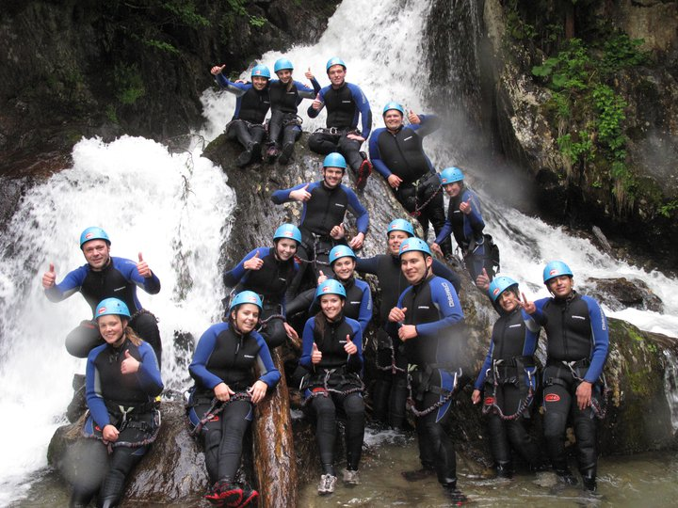
Study Abroad in Europe Summer 2012
EBS
text the word “info” to ebs@baylor.edu
to get more information

Slide 20
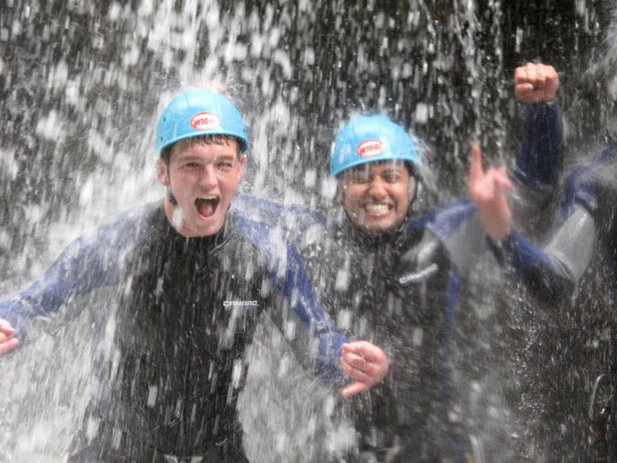
Study Abroad in Europe Summer 2012
EBS
text the word “info” to ebs@baylor.edu
to get more information

Slide 21
text the word “info” to ebs@baylor.edu to get more information
Study Abroad in Europe Summer 2012
FLORENCE, Italy
EBS

Slide 22
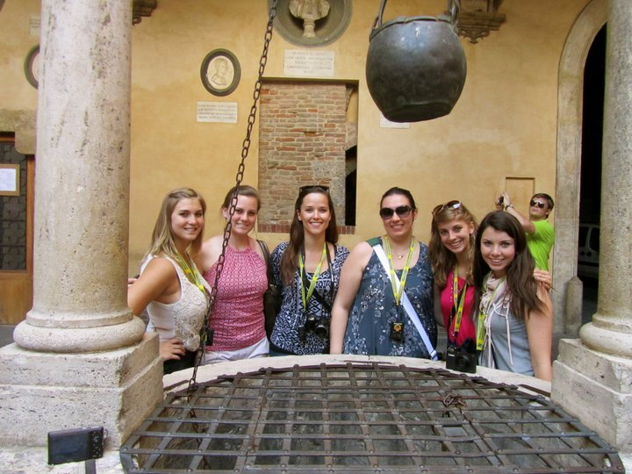
Study Abroad in Europe Summer 2012
EBS
text the word “info” to ebs@baylor.edu
to get more information

Slide 23
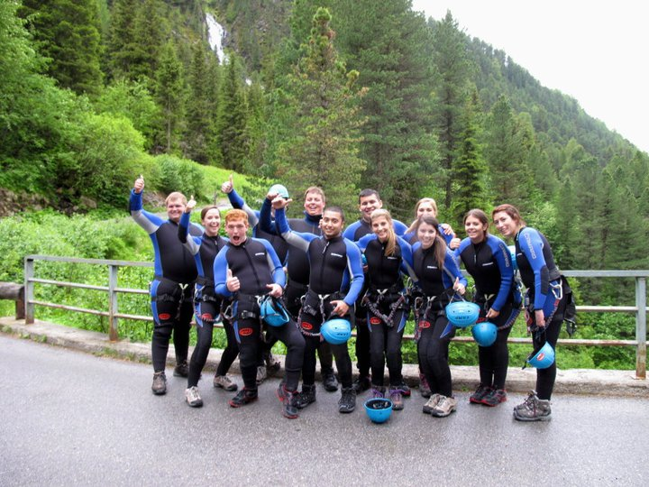
Study Abroad in Europe Summer 2012
EBS
text the word “info” to ebs@baylor.edu
to get more information

Slide 24
Study Abroad in Europe Summer 2012
Maranello, Italy
EBS
text the word “info” to ebs@baylor.edu
to get more information

Slide 25
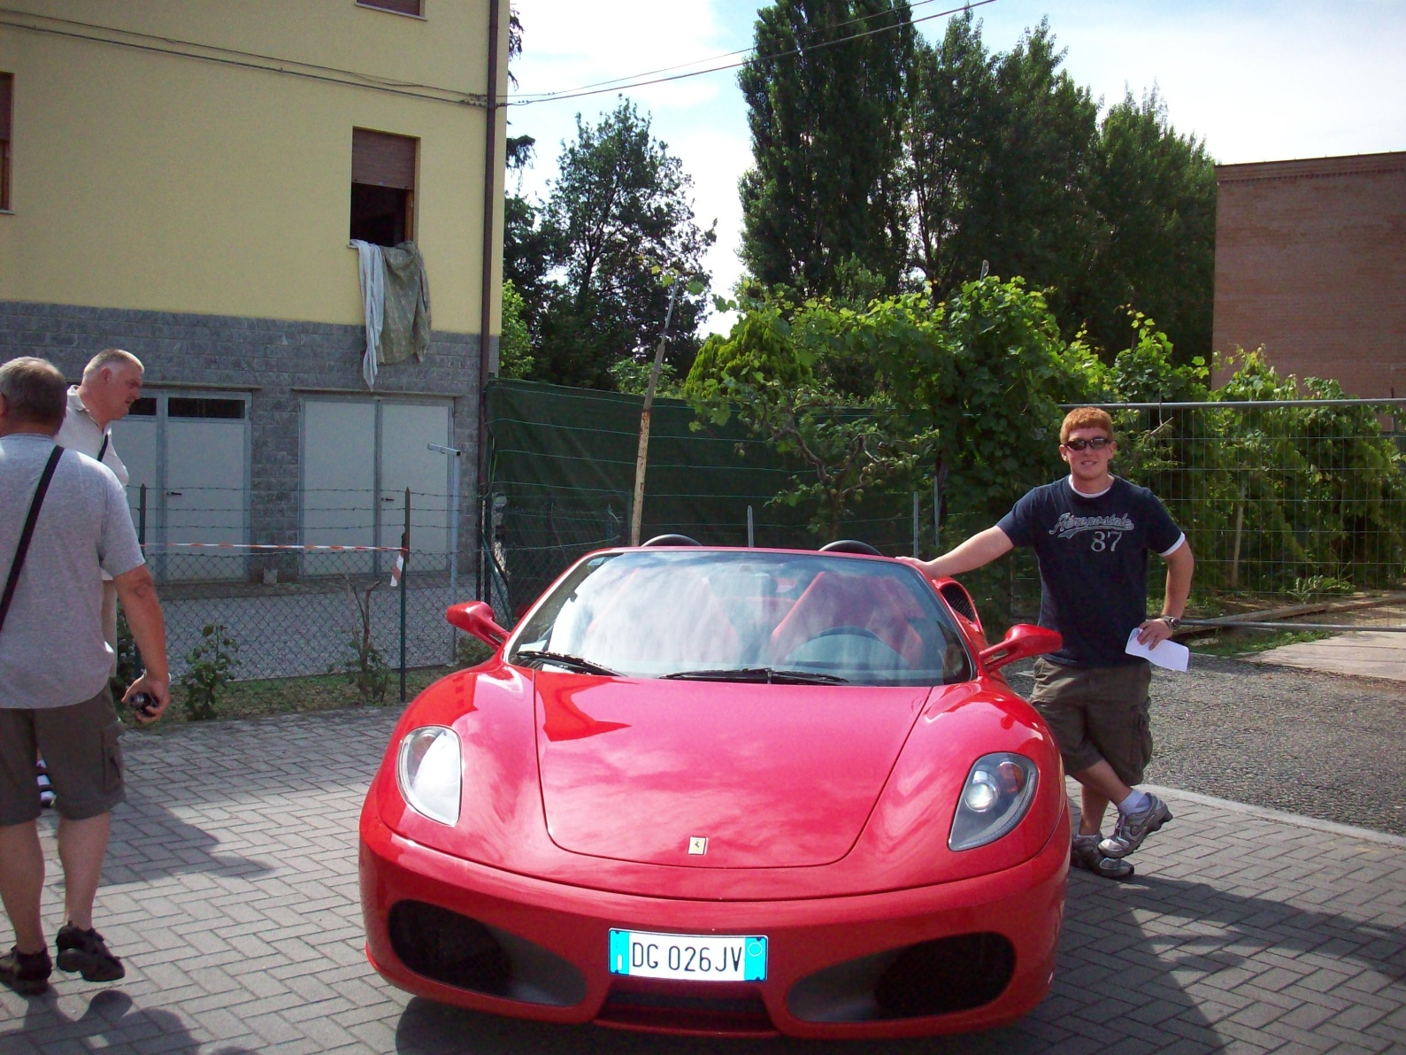
Study Abroad in Europe Summer 2012
EBS
text the word “info” to ebs@baylor.edu
to get more information

Slide 26
european business seminar
Study Abroad in Europe Summer 2012
EBS
text the word “info” to ebs@baylor.edu
to get more information

Slide 27
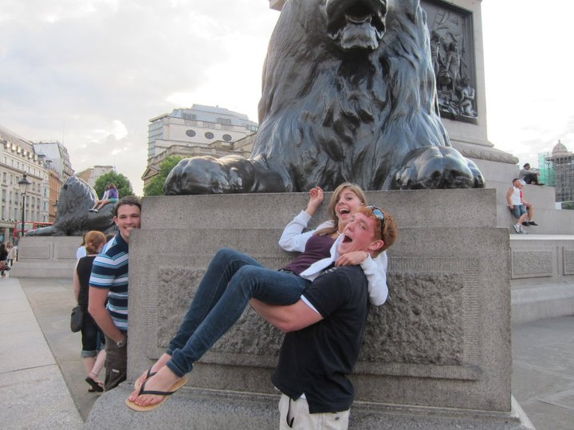
Study Abroad in Europe Summer 2012
EBS
text the word “info” to ebs@baylor.edu
to get more information

Slide 28
8
cities
Study Abroad in Europe Summer 2012
EBS
text the word “info” to ebs@baylor.edu
to get more information

Slide 29
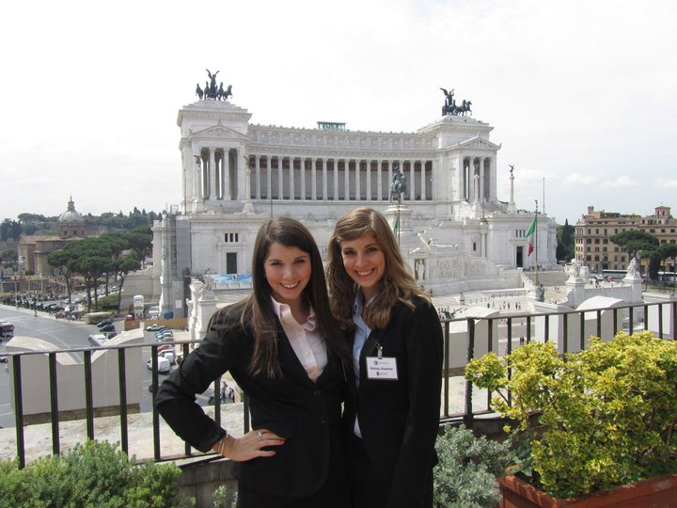
Study Abroad in Europe Summer 2012
EBS
text the word “info” to ebs@baylor.edu
to get more information

Slide 30
5
countries
Study Abroad in Europe Summer 2012
EBS
text the word “info” to ebs@baylor.edu
to get more information

Slide 31
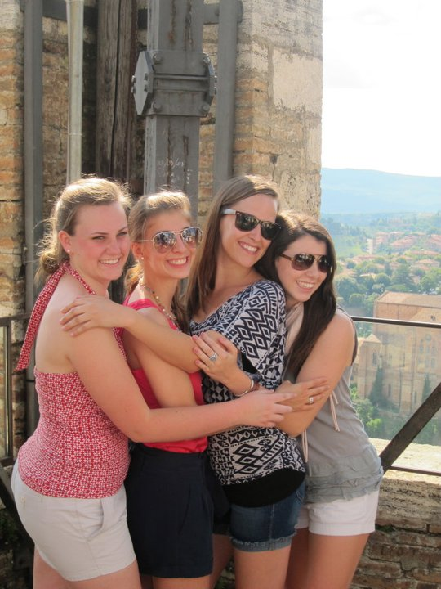
Study Abroad in Europe Summer 2012
EBS
text the word “info” to ebs@baylor.edu
to get more information

Slide 32
Study Abroad in Europe Summer 2012
EBS
text the word “info” to ebs@baylor.edu
to get more information

Slide 33
unlimited memories!
Study Abroad in Europe Summer 2012
EBS
text the word “info” to ebs@baylor.edu
to get more information

Slide 34
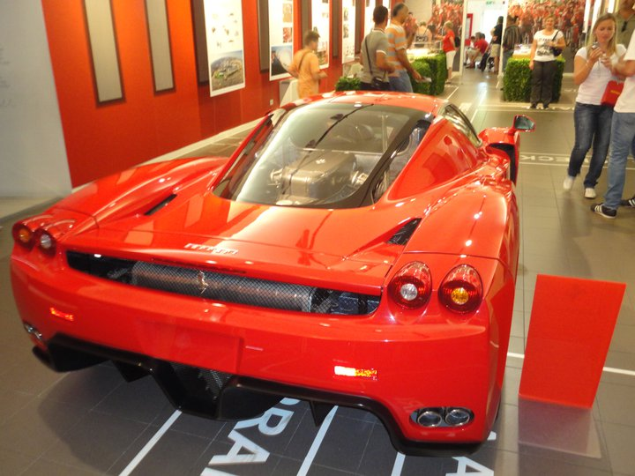
Study Abroad in Europe Summer 2012
EBS
text the word “info” to ebs@baylor.edu
to get more information

Slide 35
european business seminar
Study Abroad in Europe Summer 2012
EBS
text the word “info” to ebs@baylor.edu
to get more information

Slide 36
Study Abroad in Europe Summer 2012
EBS
text the word “info” to ebs@baylor.edu
to get more information

Slide 37
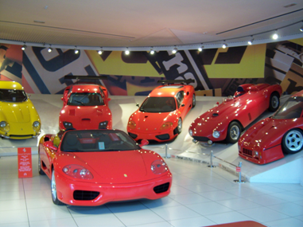
Study Abroad in Europe Summer 2012
EBS
text the word “info” to ebs@baylor.edu
to get more information

Slide 38
ITALY
Study Abroad in Europe Summer 2012
EBS
text the word “info” to ebs@baylor.edu
to get more information

Slide 39
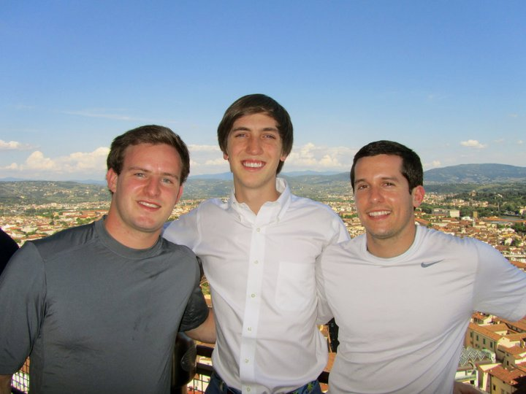
Study Abroad in Europe Summer 2012
EBS
text the word “info” to ebs@baylor.edu
to get more information

Slide 40
Germany
Study Abroad in Europe Summer 2012
EBS
text the word “info” to ebs@baylor.edu
to get more information

Slide 41
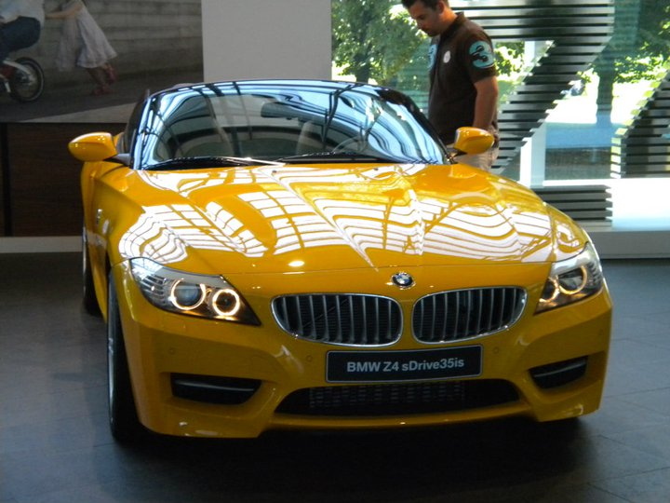
Study Abroad in Europe Summer 2012
EBS
text the word “info” to ebs@baylor.edu
to get more information

Slide 42
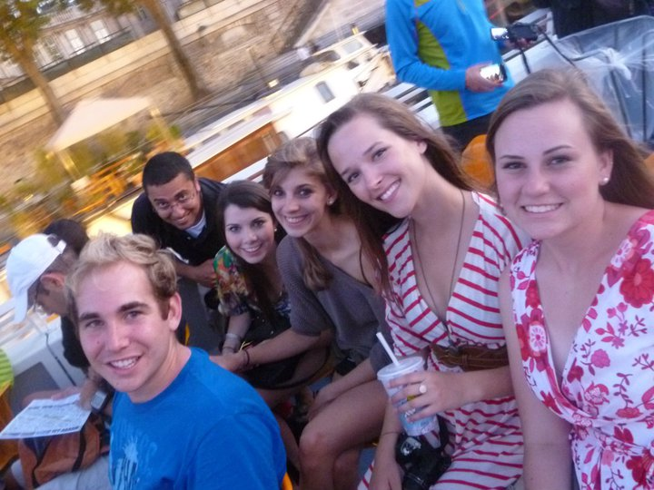
Study Abroad in Europe Summer 2012
EBS
text the word “info” to ebs@baylor.edu
to get more information

Slide 43
France
Study Abroad in Europe Summer 2012
EBS
text the word “info” to ebs@baylor.edu
to get more information

Slide 44
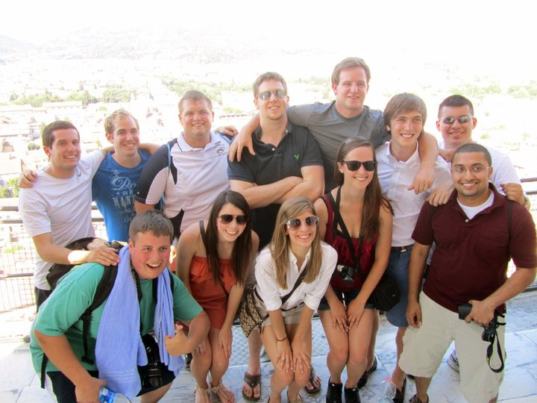
Study Abroad in Europe Summer 2012
EBS
text the word “info” to ebs@baylor.edu
to get more information

Slide 45
United
Kingdom
Study Abroad in Europe Summer 2012
EBS
text the word “info” to ebs@baylor.edu
to get more information

Slide 46
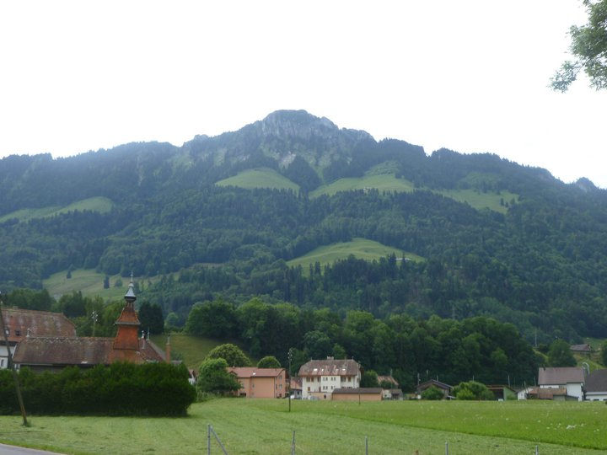
Study Abroad in Europe Summer 2012
EBS
text the word “info” to ebs@baylor.edu
to get more information

Slide 47
Study Abroad in Europe Summer 2012
EBS
text the word “info” to ebs@baylor.edu
to get more information

Slide 48
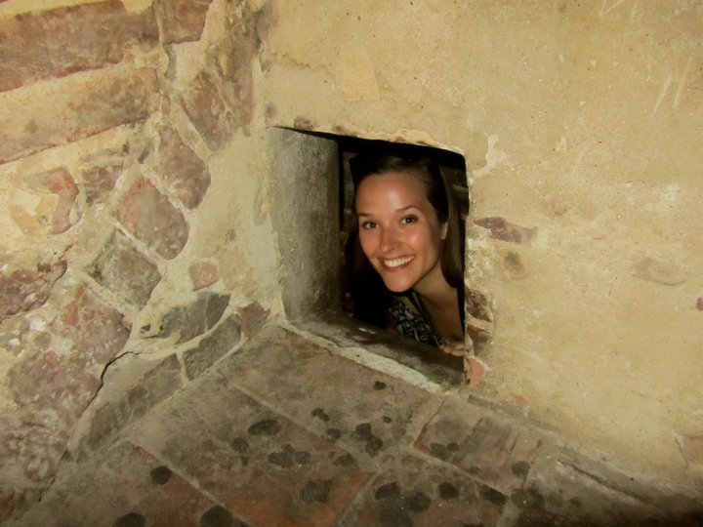
Study Abroad in Europe Summer 2012
EBS
text the word “info” to ebs@baylor.edu
to get more information

Slide 49
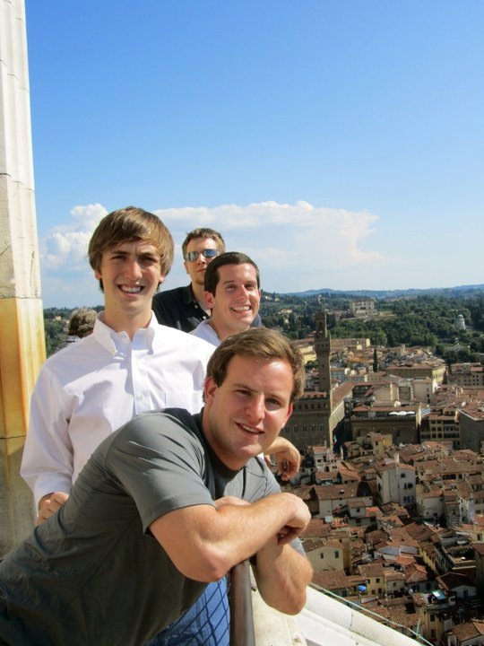
Study Abroad in Europe Summer 2012
EBS
text the word “info” to ebs@baylor.edu
to get more information

Slide 50
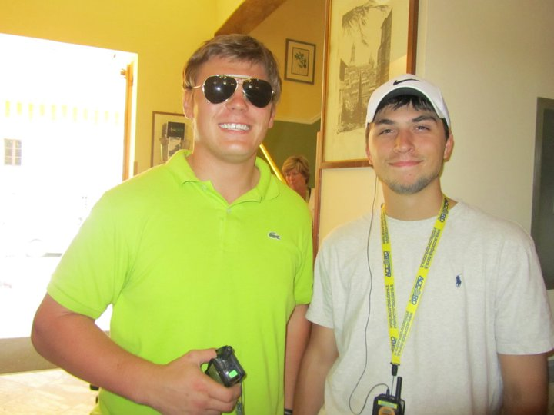
Study Abroad in Europe Summer 2012
EBS
text the word “info” to ebs@baylor.edu
to get more information

Slide 51
european business seminar
Study Abroad in Europe Summer 2012
EBS
text the word “info” to ebs@baylor.edu
to get more information

Slide 52
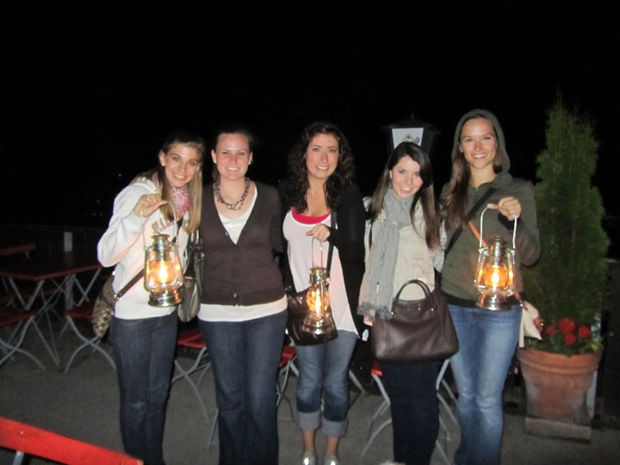
Study Abroad in Europe Summer 2012
EBS
text the word “info” to ebs@baylor.edu
to get more information

Slide 53
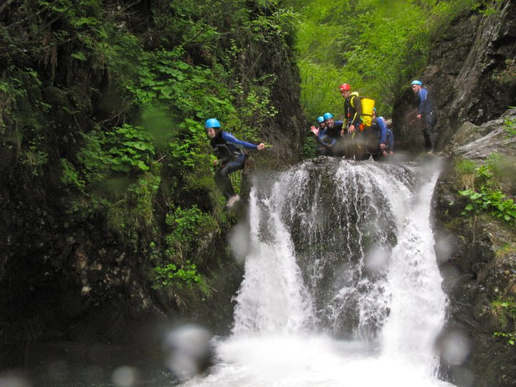
Study Abroad in Europe Summer 2012
EBS
text the word “info” to ebs@baylor.edu
to get more information

Slide 54
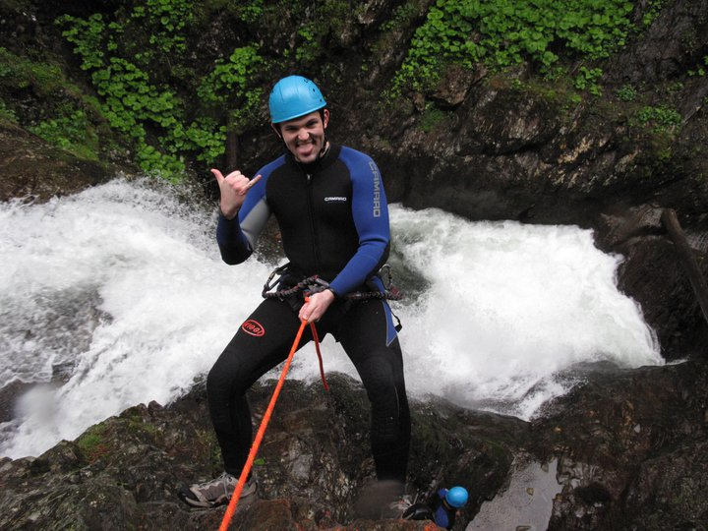
Study Abroad in Europe Summer 2012
EBS
text the word “info” to ebs@baylor.edu
to get more information

Slide 55
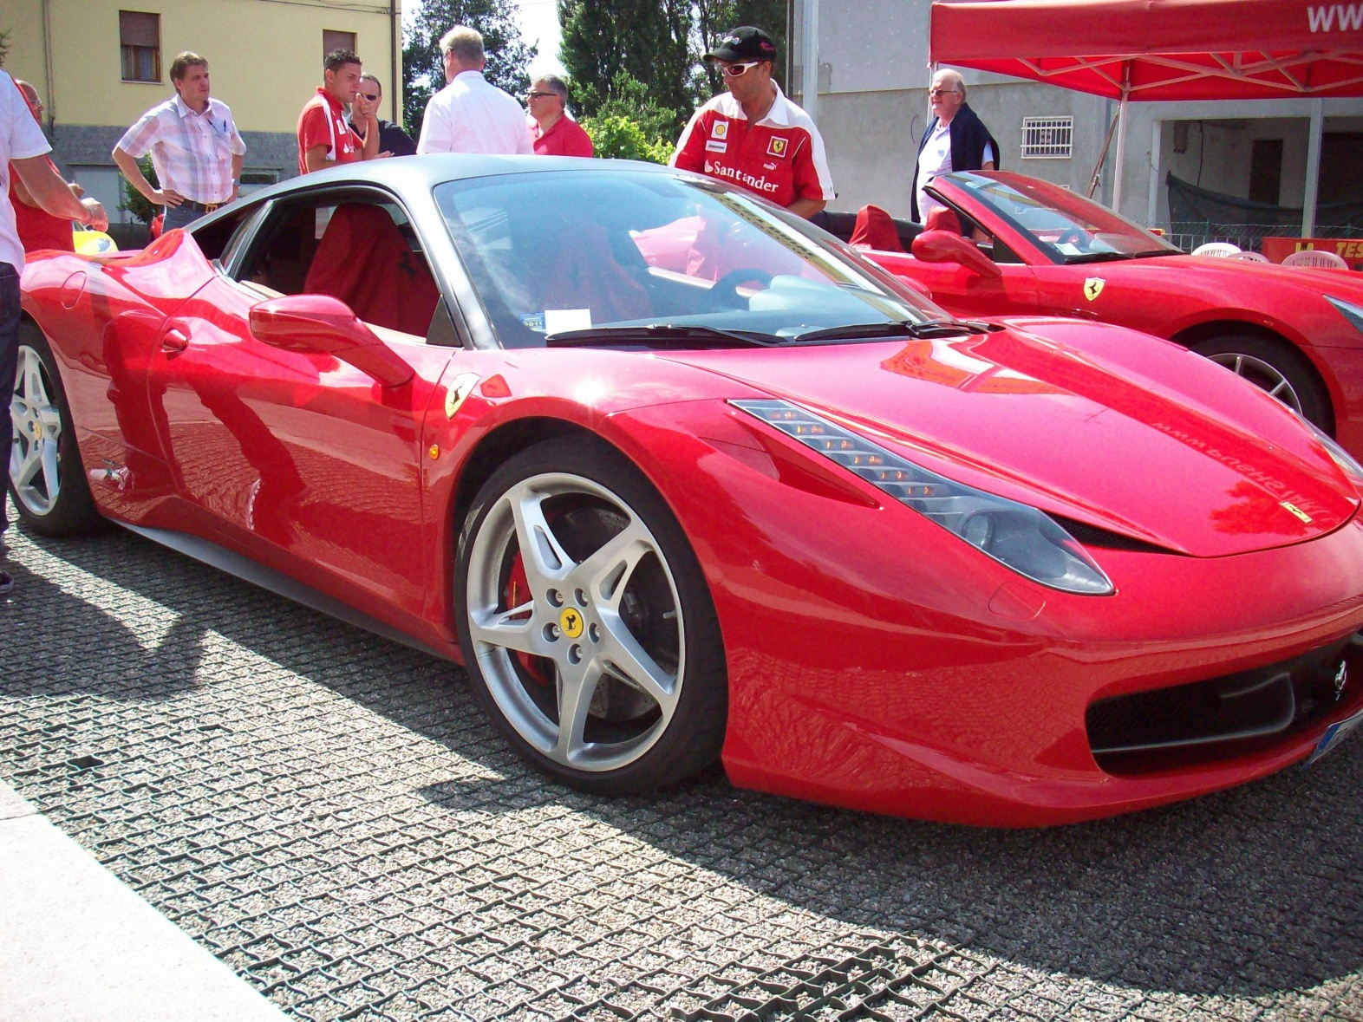
Study Abroad in Europe Summer 2012
EBS
text the word “info” to ebs@baylor.edu
to get more information

Slide 56
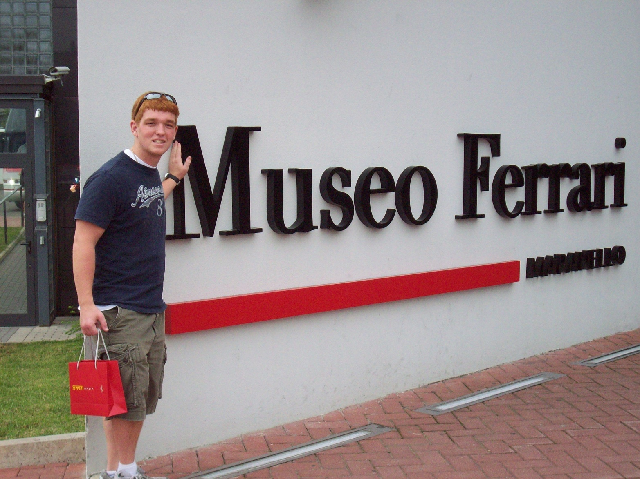
Study Abroad in Europe Summer 2012
EBS
text the word “info” to ebs@baylor.edu
to get more information

Slide 57

Study Abroad in Europe Summer 2012
EBS
text the word “info” to ebs@baylor.edu
to get more information

Slide 58
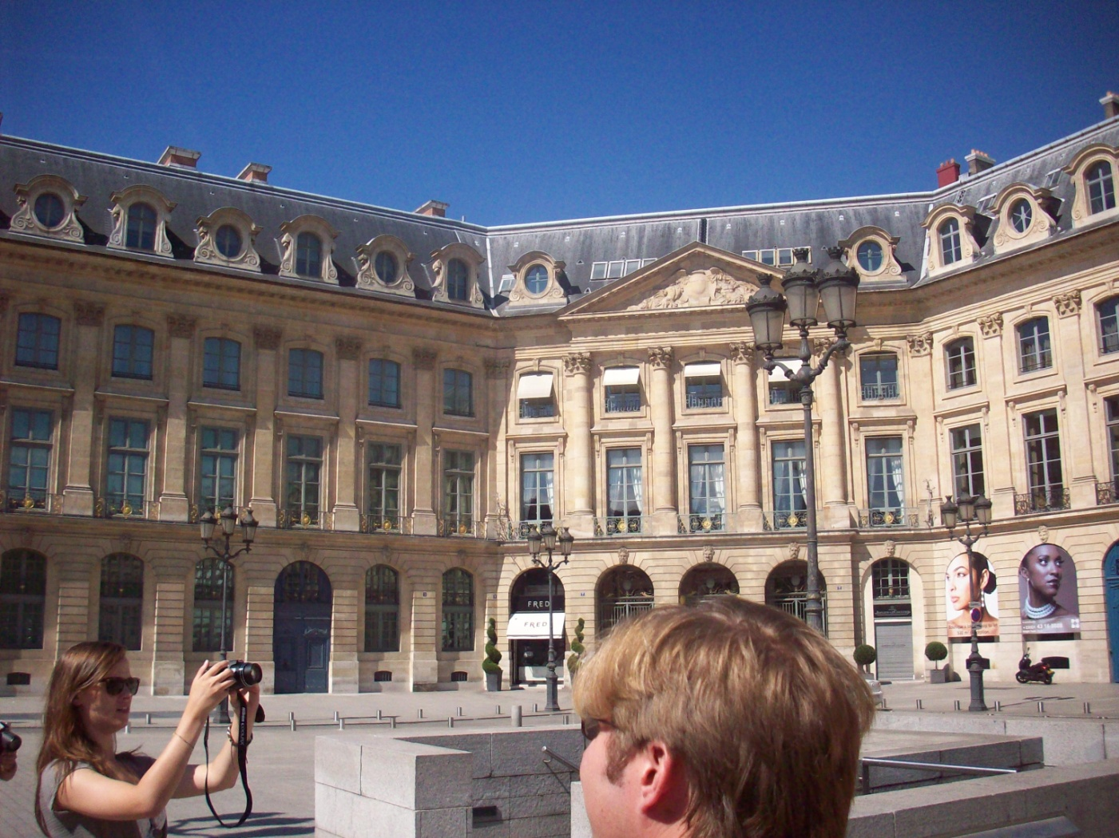
Study Abroad in Europe Summer 2012
EBS
text the word “info” to ebs@baylor.edu
to get more information

Slide 59
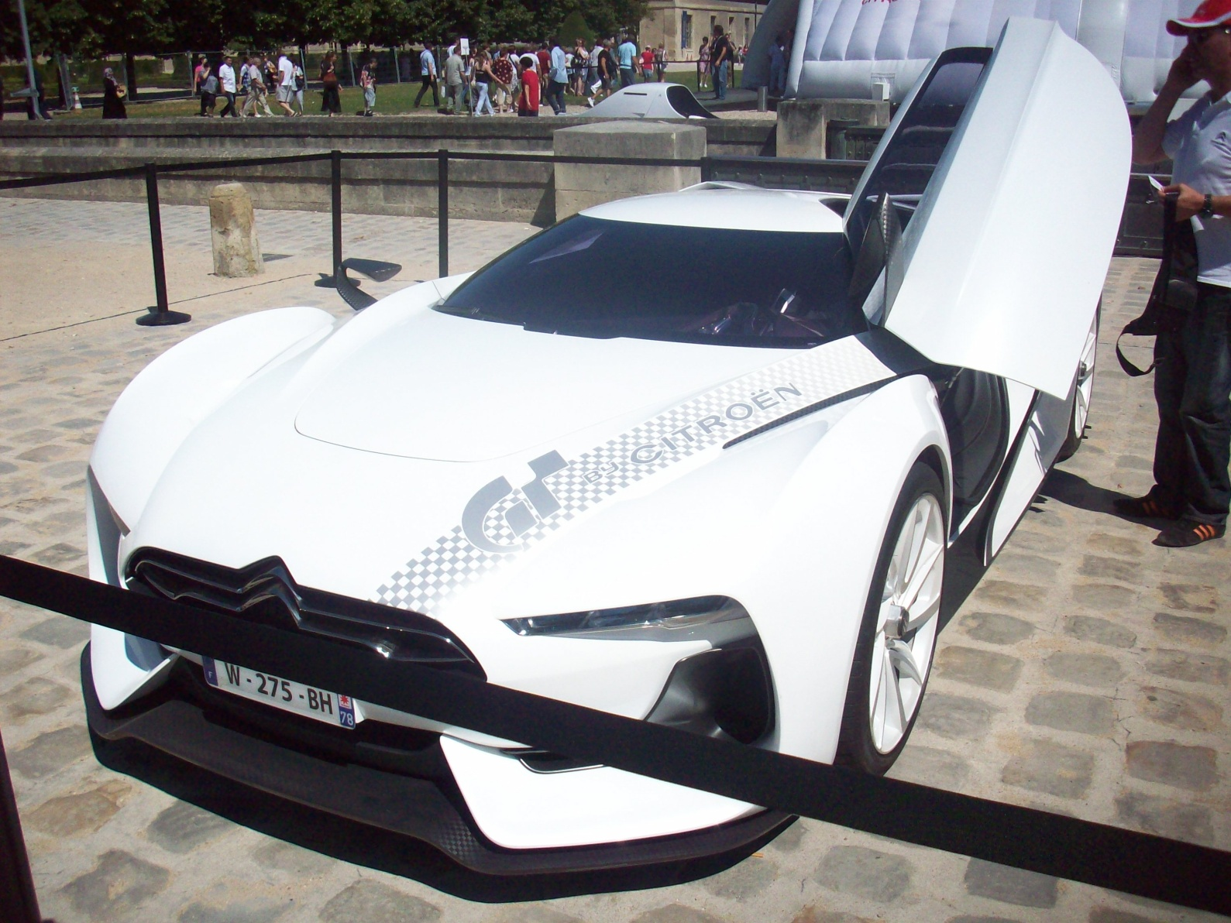
Study Abroad in Europe Summer 2012
EBS
text the word “info” to ebs@baylor.edu
to get more information

Slide 60
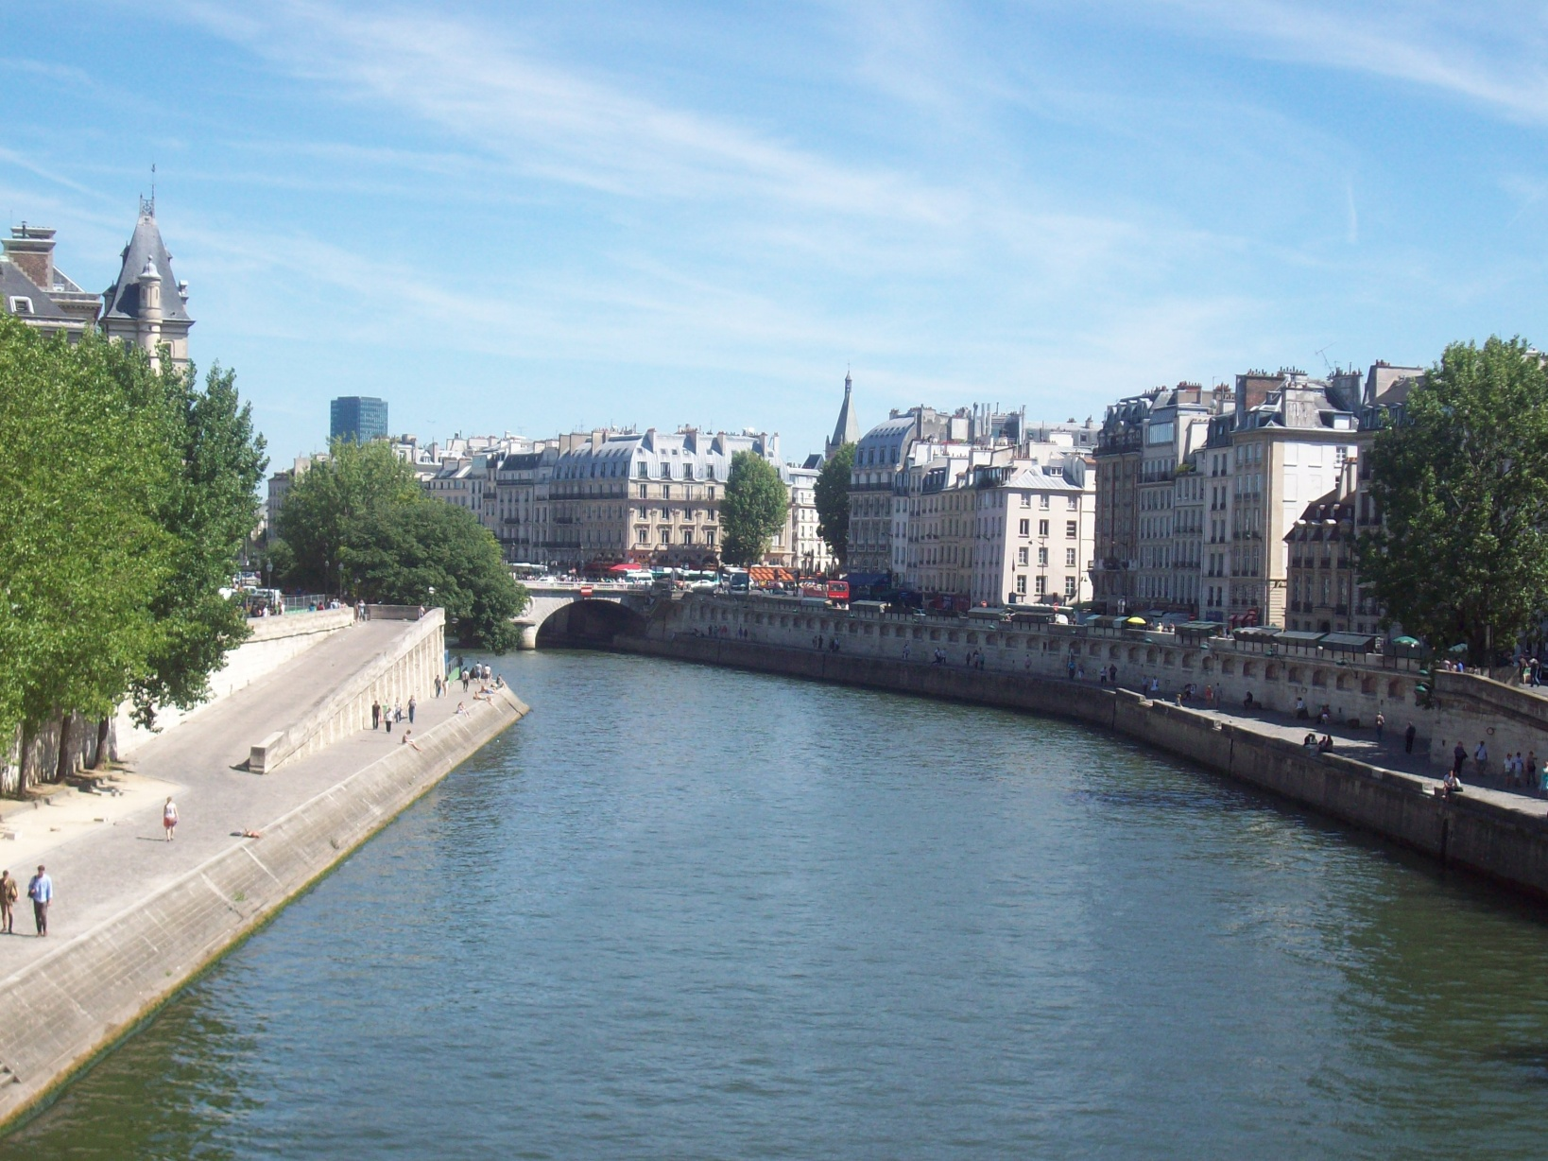
Study Abroad in Europe Summer 2012
EBS
text the word “info” to ebs@baylor.edu
to get more information

Slide 61
european business seminar
Study Abroad in Europe Summer 2012
EBS
text the word “info” to ebs@baylor.edu
to get more information

Slide 62
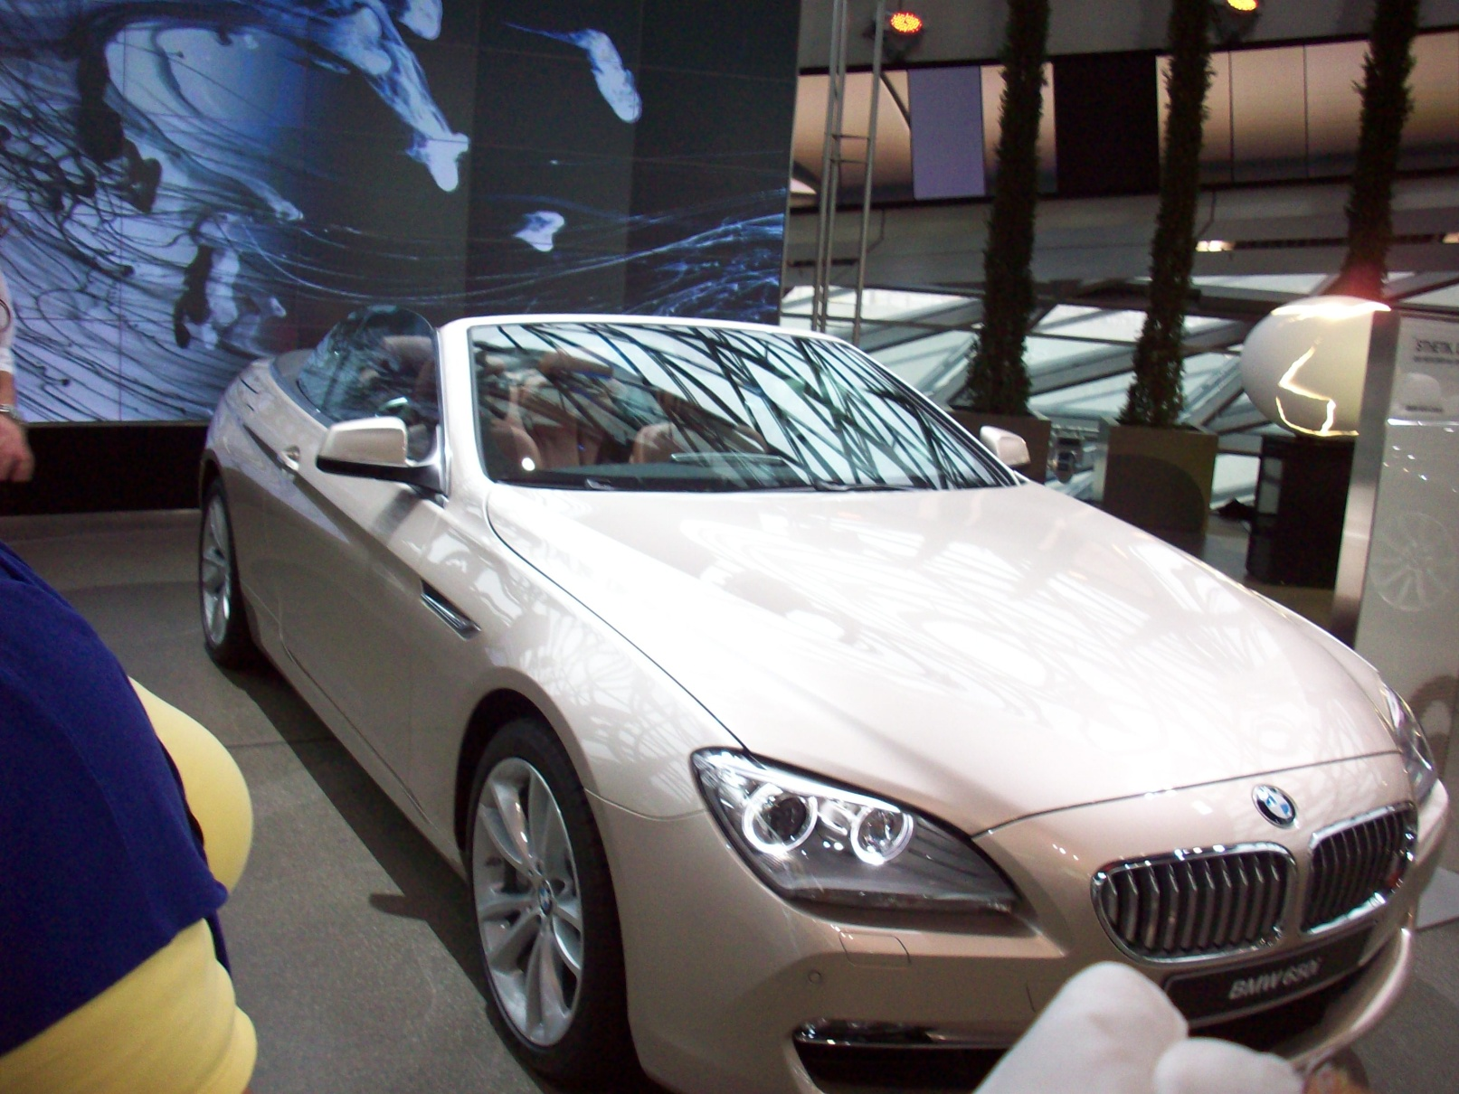
Study Abroad in Europe Summer 2012
EBS
text the word “info” to ebs@baylor.edu
to get more information

Slide 63
european business seminar
Study Abroad in Europe Summer 2012
EBS
text the word “info” to ebs@baylor.edu
to get more information

Slide 64
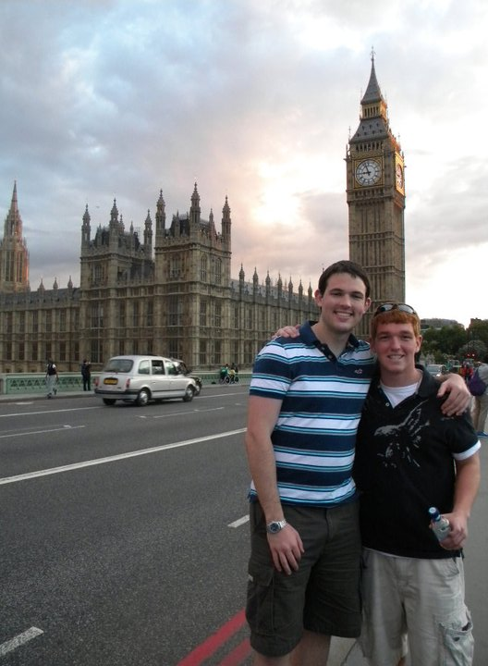
Study Abroad in Europe Summer 2012
EBS
text the word “info” to ebs@baylor.edu
to get more information

Slide 65
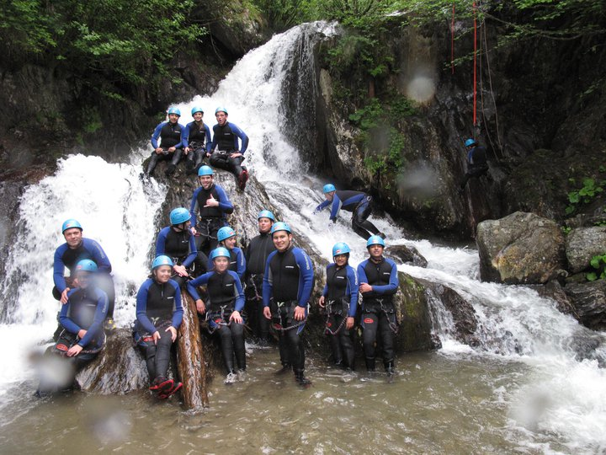
Study Abroad in Europe Summer 2012
EBS
text the word “info” to ebs@baylor.edu
to get more information

Slide 66
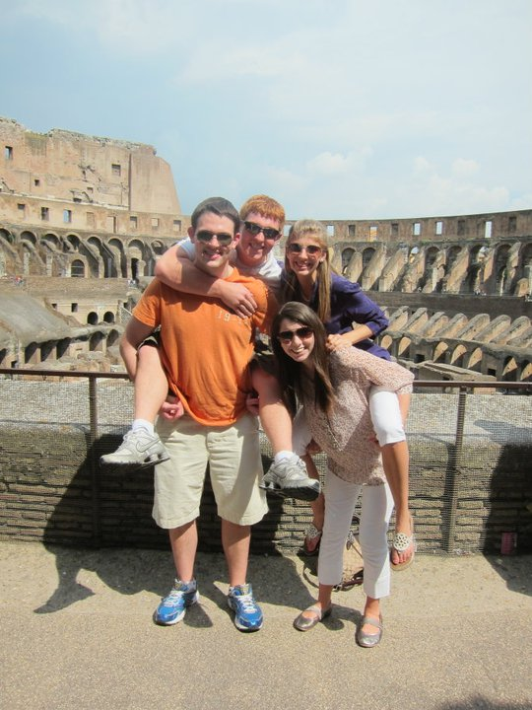
Study Abroad in Europe Summer 2012
EBS
text the word “info” to ebs@baylor.edu
to get more information

Slide 67
Study Abroad in Europe Summer 2012
EBS
text the word “info” to ebs@baylor.edu
to get more information

Slide 68
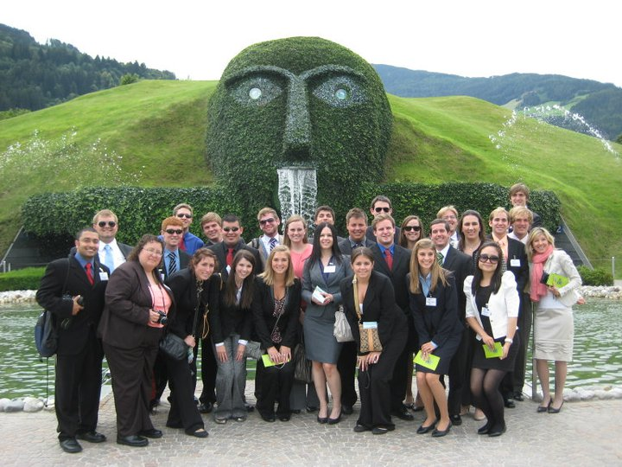
Study Abroad in Europe Summer 2012
EBS
text the word “info” to ebs@baylor.edu
to get more information

Slide 69
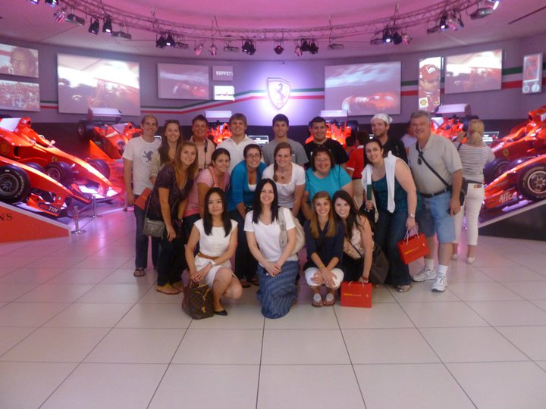
Study Abroad in Europe Summer 2012
EBS
text the word “info” to ebs@baylor.edu
to get more information

