Slide 1
What is Information Systems?

Slide 2
What is an Information System?
Data
Collects, processes, stores, analyzes, and disseminates information to support operational and managerial decision-making
Integrates functional areas
Consists of:
  Hardware
  Software
  Data
  Network
  Procedures
  People
Hardware
Software
Network
People
Procedures
More than hardware and software!

Slide 3
What is an Information System, cont…
Collects data
(input)
Processing
Produces information (output)
Transactional Data
Internal Data
External Data
Request for Info
Reports
Display of Information
System Feedback
MIS Programs
  Summarize
  Compile
  Categorize

Slide 4
Example ISs: Distribution System
Order Fulfillment
Stock Replenishment


Customer
Sales
Order
Purchase
Order
Supplier
Order
Entry
Purchasing
data
Accepted
order
Purchasing
P
a
y
m
e
n
t
S
t
a
t
e
m
e
n
t
Invoice
P
a
y
m
e
n
t
P.O.
copy
Inventory
Receiving
goods
Filled
Order
P.O.
copy
Receipt
Notification
Billing
Inventory
data
A/P
A/R
Billed Order
General
Ledger
Receivables data
Payables data

Slide 5
Other Examples…

Slide 6
What is the MIS field?
“MIS is the application of people, technologies, and procedures used by decision-makers to solve business problems.”

Slide 7
What is the MIS field?...cont
Systems
  Design
  Development
  Deployment
  Management
For BUSINESS VALUE!
ORGANIZATIONS
TECHNOLOGY
MIS
PROCESSES

Slide 8
What do MIS majors do?
Initiate and lead technology enabled change
Analyze and design innovative digital products and services
Apply IT to automate and improve business processes
Transform a business function with IT
Analyze clients, specify needs, integrate apps, and manage projects
Source: Mandviwalla, Munir, Temple University, 2011.

Slide 9
How does MIS differ from other tech-related fields?
MIS
EE
CE
CS
SE
Focus on Hardware
Innovations
Focus on Software
Innovations
Focus on Application to Business
EE- electrical engineering: CE- computer engineering: CS- computer science:
SE- software engineering: MIS- information systems

Slide 10
System Development
How does it all begin?
  Need
  Problem
  Opportunity
Project Request
  Formal request for new/modified information systems
  May go through steering committee

Slide 11
System Development, cont…
SDLC
  Phased approach to designing and implementing information systems
Phases
  Planning
  *Analysis
  Design
  Implementation
  Maintenance

Slide 12
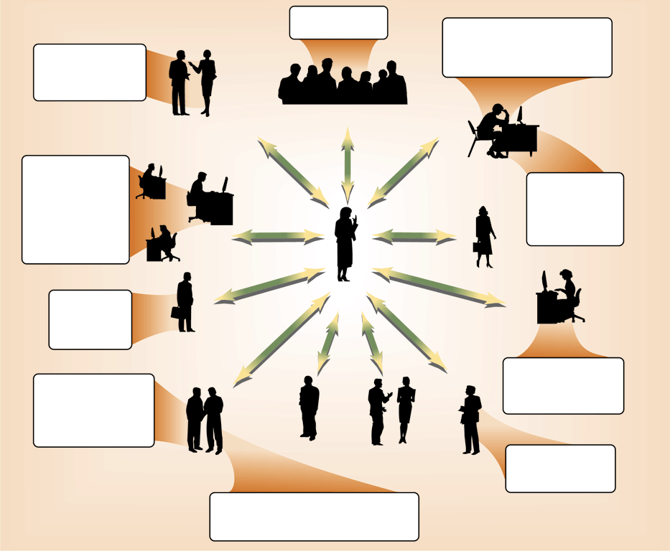
System Development, cont…
Participants
  *Systems
  Analyst
  Users
  Vendors
  MANY more

Slide 13
Why Major in MIS?
Higher demand than supply of graduates
Competitive salary
Can work in any industry-sports, health, fashion, etc…
Can work in any area-marketing, accounting, etc…
Constant learning and new projects
Travel, if desired

Slide 14
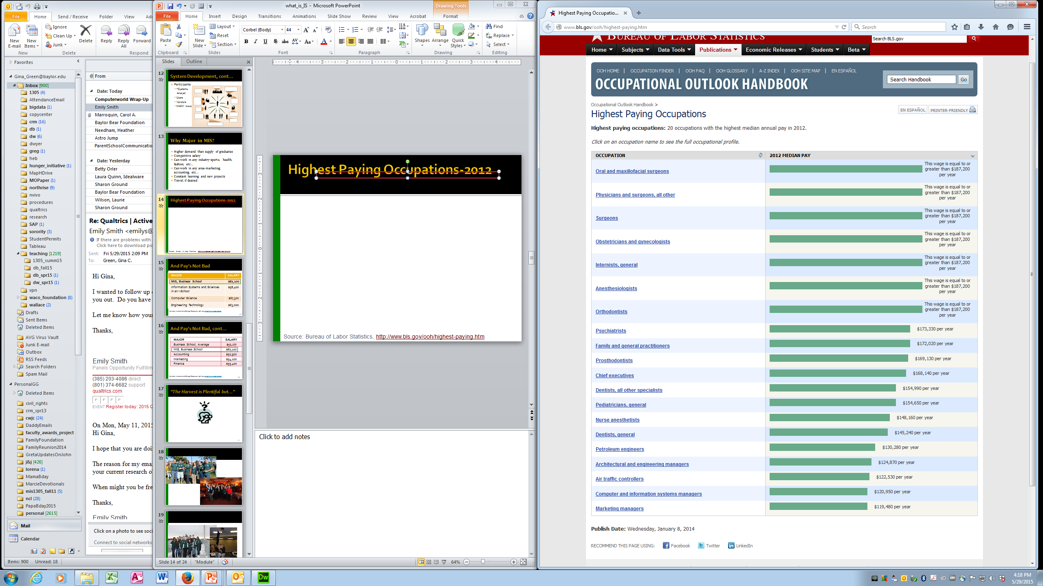
Highest Paying Occupations-2012
Source: Bureau of Labor Statistics, http://www.bls.gov/ooh/highest-paying.htm

Slide 15
And Pay’s Not Bad
MAJOR | SALARY
MIS, Business School | $62,100
Information Systems and Sciences in an I-School | $58,400
Computer Science | $67,300
Engineering Technology | $63,000
National Association of College Employers, April 2014 http://www.naceweb.org
I
L

Slide 16
And Pay's Not Bad, cont…
MAJOR | SALARY
Business School, Average | $52,277
MIS, Business School | $62,100
Accounting | $52,900
Marketing | $54,100
Finance | $55,400
c
National Association of College Employers, April 2014 http://www.naceweb.org/

Slide 17

Typical Jobs
  Business Process Analyst
  Programmer / Web Developer
  Technical Training / Writing
  Cyber Security
  Project Management
  Systems Analyst
  Data Analyst
  Systems Integrator
  IT (Risk) Consultant
  Business Intelligence
  Network Administration
  Accounting and Controls Systems Specialist
  ….
P

Slide 18
What skills are needed?
Where do you get these skills?
Technical IS knowledge
Core business knowledge
Teamwork, communication,
critical thinking, and
project management skills
An interest in making
organizations and the people
in them function more
effectively
MIS Program - database design, programming, networking and security, project management, systems analysis and design
Business Core Classes - accounting, business law, economics, finance, management, and marketing
The four year Baylor experience combined with student organization and local and outside internship(s)
You!

Slide 19
“The Harvest is Plentiful but…”

Slide 20
What types of companies do MIS grads work for?
Corp. Internal IT Groups
  USAA
  ExxonMobil
  Applied Materials
  Royal Bank of Canada
  CitiBank
  McLane
  ConocoPhillips
  Phillips 66
  General Motors
  Toyota
  BNSF
  Halliburton
  Lockheed Martin
  Caterpillar
  Southwest Airlines
Public Accounting Firms
  Ernst & Young
  KPMG
  PWC
  Deloitte
Finance
  Fidelity Investments
Consulting Firms
  Protiviti
  SunGard Consulting
  Accenture
  Sendero
  Aprimo
  Avanade
Sports
  Houston Astros
  ESPN

Slide 21
What types of companies do MIS grads work for?
Entrepreneurs, etc…
Technology Companies
  IBM
  Hewlett-Packard
  Microsoft
  AT&T
Federal Government
  FBI
  CIA
  IRS
  Navy
  Army
Non Profits
  Cooperative Baptist Fellowship
Academic IT Groups
  Baylor, MCC, …
  Crawford, Midway, Rapoport, …

Slide 22
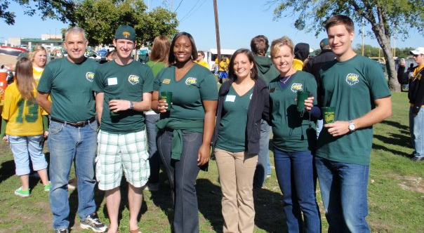


P

Slide 23

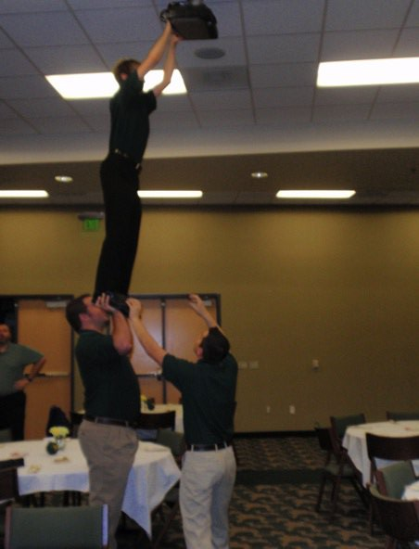
P

Slide 24





