Slide 1
Database Concepts & Introduction to MS Access

Slide 2
Outline
Database Overview
Database Management System Concepts
Database Structures
Database, tables, records, fields
MS Access Overview
Creating a Database
Database Objects
Creating a Table
Using a Database

Slide 3
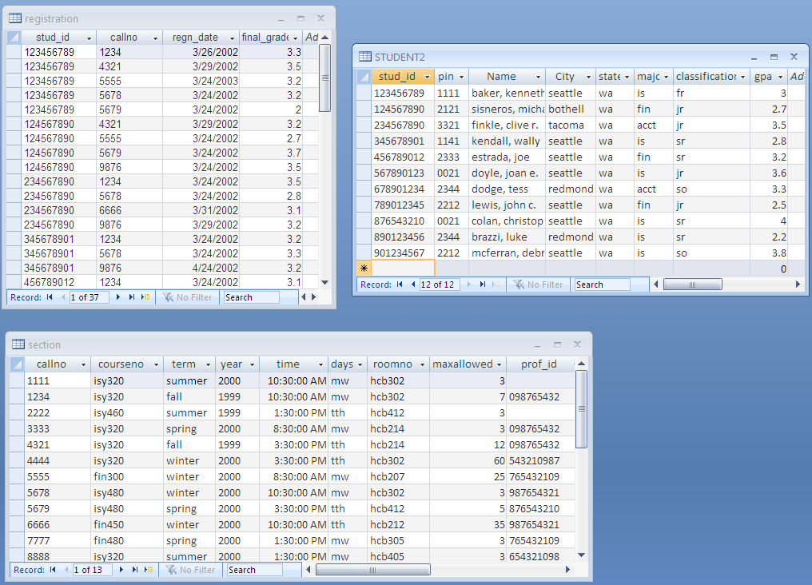
Converting Data to Information

Slide 4
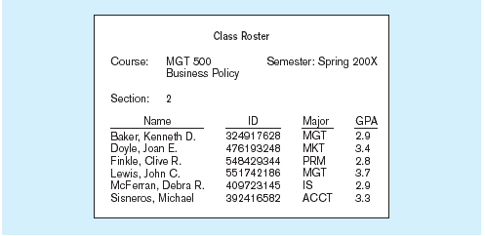
Converting Data to Information,…
2011

Slide 5
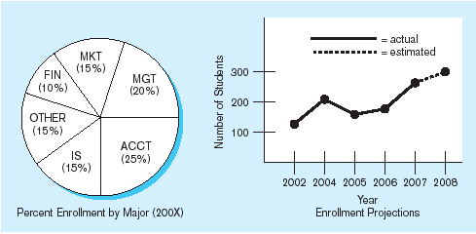
Converting Data to Information, …
10

Slide 6
Relational Database Management System (RDBMS) Components
DBMS
the software that permits an organization to centralize data, manage them efficiently, and provide access to the stored data

Slide 7
RDBMS Components, cont…
Database
a collection of data organized in storage centrally to serve many applications efficiently
SSN:
Name:
Position:
Database
SAVE
User
Employee DB NFL DB Orders DB
Student Registration DB etc…

Slide 8
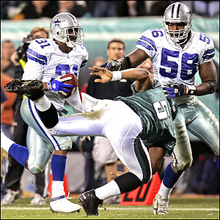
RDBMS Components, cont…
Relational Model
a collection of related tables
NFL Database
Player
Team
Owner

Slide 9
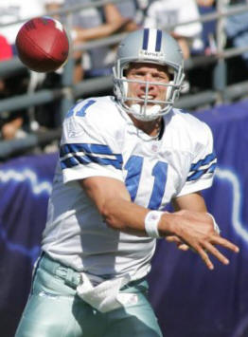
What info would we need to store about NFL players?
NFL Database
Player
Team
Game
Statistics
Owner

Slide 10
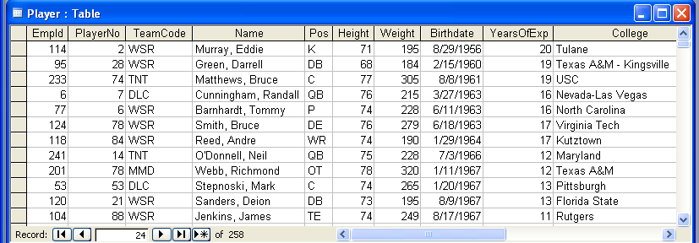
Tables
NFL DB
Players
Teams
Games
Owners
Statistics
Table - a collection of related records
Record - a group of related fields
Represents all information about one object
Field - a characteristic or attribute of interest

Slide 11
Primary Key
Field that uniquely identifies each record in a table.
Concatenated/Compound/Composite

Slide 12
Field Data Types (in MS Access)
Text (short or long)
Number
Date/Time
Currency
AutoNumber
Yes/No
OLE Object
Attachment
Hyperlink…

Slide 13
Example Table
Title | Type | Rating | Stars | MovieId | Co. | Year
The Untouchables | Action | PG13 | 3.5 | 1011 | MGM | 1991
Far and Away | Drama | PG | 3 | 1212 | PMT | 1991
Lion King | Family | G | 2.75 | 1411 | DIS | 1993
Twister | Action | PG | 3.5 | 2321 | PMT | 1995
Table Name: _______________
____ Records: each record represents one movie
____ Fields: each field stores a fact (characteristic) about a movie
____ Primary Key: which field uniquely identifies a record? (i.e no Duplicates…ever!)
What data types would you use for each field above?

Slide 14
MS Access
Desktop RDBMS
Graphical User Interface
Part of Office 2013 Professional
Can also "access" data in other RDBMS systems:
MS SQL Server, Oracle, MySQL, …
Can also "access" data in other non-RDBMS systems:
Excel

Slide 15
MS Access Common Database Objects
Tables
Forms
Queries
Reports

Slide 16
Creating a new Access Database
Click here to create a new database
Previously-opened db's will be listed here

Slide 17
Creating a new Access Database, cont…
Change file name to mis1305.accdb
Click on folder; Save db to mis1305_
access folder on desktop (folder
not shown here)
Click here to create the db

Slide 18
MS Access 2013 Interface

Slide 19
Creating a Table
Create the Movies table on previous slide
Create Table
Define field names and data types
Identify primary key
SAVE
Enter data
Filter data
Sort data
Formatting table

Slide 20
Printing Tables
2 options
File (ie, Office Button) | Print
Select All | Copy | Paste into Word

Slide 21
Using a Database
Open & Use Existing Database with data
Create New Database
Import existing data
Excel
Access
Link to existing data
Excel
Oracle

