Slide 1
MIS 1305
Intro to Information Technology & Processing
Dr. Gina Green
Gina_Green@baylor.edu
254.710.6210

Slide 2
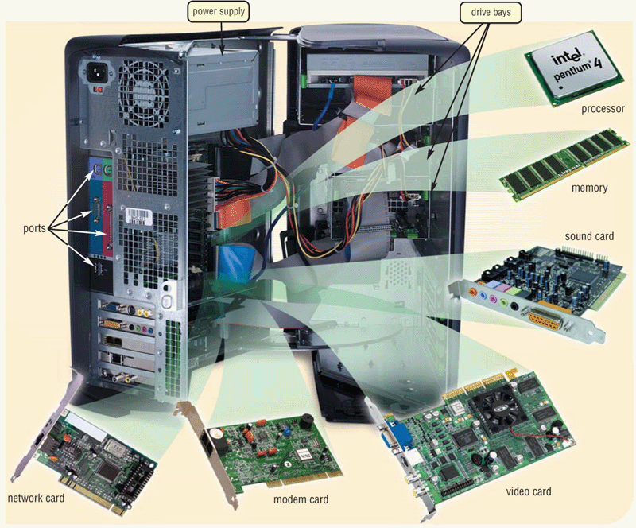
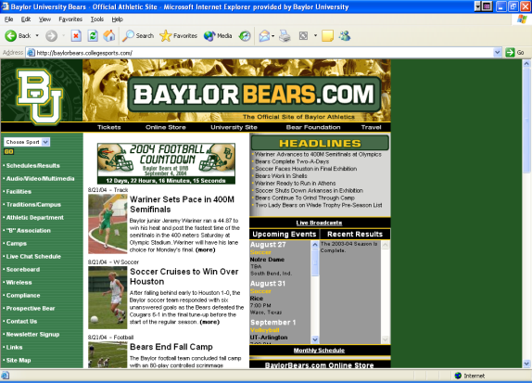
Topics
Concepts:
IS Overview
Software:
Excel
Access
Development:
Web Development

Slide 3
Testing
Testing out
Contact Prof. Karen Leskoven (ext. 4242)
$200-$400* non-refundable
If pass, receive credit but not letter grade
*contact Prof. Leskoven for accurate price

Slide 4
Textbooks/Software
New Perspectives Microsoft Excel 2013 - Comprehensive
New Perspectives Microsoft Access 2013 - Introductory
SAM 2013 for Microsoft Office Assessment, Training, & Projects V1.0 – Access Code

Slide 5
Class Deliverables
3 Individual Projects
Excel
Access
Website
3 exams (includes Comprehensive Final)
ALL deliverables weighted (see syllabus)

Slide 6
My Expectations (also see class syllabus)
Classroom Conduct
Actively listen & participate
Turn off cell phones
Limit personal conversations during class
Use computers for class activities only
Do not leave during lecture unless it’s an emergency
Let me know before class if you will have to leave early
Take plenty of notes in class
Assignments & Exams
Do quality work on all assignments/exams
Do work individually; don’t share work with others
Absences & Tardiness
Be on time
Attend all lectures
Show Documentation for Excused Absences
Preparation
Print lecture slides & bring to class
Read chapters
Check email for announcements regularly
Check online course schedule regularly

Slide 7
Canvas
Canvas Website: http://www.baylor.edu/canvas
Login with bearID & password
Course is MIS1305 F1 (9:45a section)
MIS1305 F2 (11:30a section)
Canvas used for:
Grades
Attendance

Slide 8
Baylor File Storage
Box (optional)
http://baylor.box.com
Accessible from any computer connected to Internet
Login with bearID & password
Box Help:
http://www.baylor.edu/its/index.php?id=94642
P-Drive (optional)
Accessible from any Baylor computer
My Computer → P-Drive
--OR--
Start → Run → type in \\casey2\stu\Your_Bear_Id

Slide 9
Syllabus…

Slide 10
For Now…
Take online survey
http://baylor.qualtrics.com/SE?SID=SV_8q6PkNfw0nLr8G0&SVID=Prod

Slide 11
For next time…
Purchase Books & SAM Access Code

