Slide 1
PRINCIPLES OF MACROECONOMICS 2e
Chapter 12 The Keynesian Perspective
PowerPoint Image Slideshow

Slide 2
CH.12 OUTLINE
12.0 Who was J.M. Keynes?
12.1: Aggregate Demand in Keynesian Analysis
12.2: The Building Blocks of Keynesian Analysis
12.3: The Phillips Curve
12.4: The Keynesian Perspective on Market
Forces

Slide 3
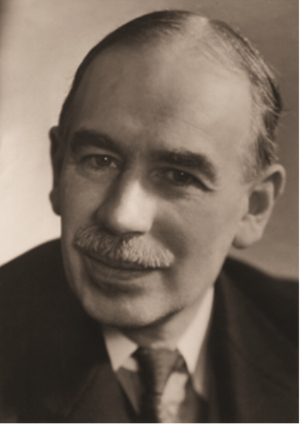
12.0 Who Was J.M. Keynes?
John Maynard Keynes (1883-1946) was the son of a Cambridge economist, and had a huge social and public life as a member of the Bloomsbury Group of prominent intellectuals and artists. He studied economics formally for only 8 weeks under Marshall, and never completed his degree. He moved quickly into public service at the India Office (in London), the Treasury, and the Bank of England. He eventually returned to academia to teach at Cambridge and to serve as editor of the Economic Journal (the premier British journal). He was among the leaders of the Bretton Woods Conference after World War II that created the IMF and established a system of fixed exchange rates. He wrote several books, but is best known for the ideas presented in The General Theory of Employment, Interest and Money, published in 1936

Slide 4
12.0 Who Was J.M. Keynes?
From the preface of The General Theory:
This book is chiefly addressed to my fellow economists. I hope that it will be intelligible to others…
A monetary economy, we shall find, is essentially one in which changing views about the future are capable of influencing the quantity of employment and not merely its direction... We are thus led to a more general theory, which includes the classical theory with which we are familiar, as a special case...
The composition of this book has been for the author a long struggle of escape, and so must the reading of it be for most readers if the author’s assault upon them is to be successful,— a struggle of escape from habitual modes of thought and expression. The ideas which are here expressed so laboriously are extremely simple and should be obvious. The difficulty lies, not in the new ideas, but in escaping from the old ones, which ramify, for those brought up as most of us have been, into every corner of our minds.

Slide 5
12.0 Who Was J.M. Keynes?
From the Conclusions of The General Theory:
The outstanding faults of the economic society in which we live are its failure to provide for full employment and its arbitrary and inequitable distribution of wealth and incomes…
Since the end of the nineteenth century significant progress towards the removal of very great disparities of wealth and income has been achieved through the instrument of direct taxation … Many people would wish to see this process carried much further, but they are deterred by … the belief that the growth of capital depends upon the strength of the motive towards individual saving and that for a large proportion of this growth we are dependent on the savings of the rich out of their superfluity… We have seen that, up to the point where full employment prevails, the growth of capital depends not at all on a low propensity to consume but is, on the contrary, held back by it; and only in conditions of full employment is a low propensity to consume conducive to the growth of capital. One of the chief social justifications of great inequality of wealth is, therefore, removed.

Slide 6
12.0 Who Was J.M. Keynes?
From the Conclusions of The General Theory:
The State will have to exercise a guiding influence on the propensity to consume partly through its scheme of taxation, partly by fixing the rate of interest, and partly, perhaps, in other ways. Furthermore, it seems unlikely that the influence of banking policy on the rate of interest will be sufficient by itself to determine an optimum rate of investment. I conceive, therefore, that a somewhat comprehensive socialisation of investment will prove the only means of securing an approximation to full employment; though this need not exclude all manner of compromises and of devices by which public authority will co-operate with private initiative. But beyond this no obvious case is made out for a system of State Socialism which would embrace most of the economic life of the community. It is not the ownership of the instruments of production which it is important for the State to assume. If the State is able to determine the aggregate amount of resources devoted to augmenting the instruments and the basic rate of reward to those who own them, it will have accomplished all that is necessary. Moreover, the necessary measures of socialisation can be introduced gradually and without a break in the general traditions of society...

Slide 7
12.0 Who Was J.M. Keynes?
From the Conclusions of The General Theory:
[I]f our central controls succeed in establishing an aggregate volume of output corresponding to full employment as nearly as is practicable, the classical theory comes into its own again from this point onwards. If we suppose the volume of output to be given, i.e. to be determined by forces outside the classical scheme of thought, then there is no objection to be raised against the classical analysis of the manner in which private self-interest will determine what in particular is produced, in what proportions the factors of production will be combined to produce it, and how the value of the final product will be distributed between them... Thus, apart from the necessity of central controls to bring about an adjustment between the propensity to consume and the inducement to invest, there is no more reason to socialise economic life than there was before...

Slide 8
12.0 Who Was J.M. Keynes?
From the Conclusions of The General Theory:
There will still remain a wide field for the exercise of private initiative and responsibility. Within this field the traditional advantages of individualism will still hold good.
Let us stop for a moment to remind ourselves what these advantages are. They are partly advantages of efficiency — the advantages of decentralisation and of the play of self-interest. The advantage to efficiency of the decentralisation of decisions and of individual responsibility is even greater, perhaps, than the nineteenth century supposed; and the reaction against the appeal to self-interest may have gone too far. But, above all, individualism, if it can be purged of its defects and its abuses, is the best safeguard of personal liberty in the sense that, compared with any other system, it greatly widens the field for the exercise of personal choice. It is also the best safeguard of the variety of life, which emerges precisely from this extended field of personal choice, and the loss of which is the greatest of all the losses of the homogeneous or totalitarian state.

Slide 9
12.0 Who Was J.M. Keynes?
From the Conclusions of The General Theory:
The authoritarian state systems of today seem to solve the problem of unemployment at the expense of efficiency and of freedom. It is certain that the world will not much longer tolerate the unemployment which, apart from brief intervals of excitement, is associated and in my opinion, inevitably associated with present-day capitalistic individualism. But it may be possible by a right analysis of the problem to cure the disease whilst preserving efficiency and freedom.

Slide 10
12.0 Who Was J.M. Keynes?
From the Conclusions of The General Theory:
The ideas of economists and political philosophers, both when they are right and when they are wrong, are more powerful than is commonly understood. Indeed the world is ruled by little else. Practical men, who believe themselves to be quite exempt from any intellectual influences, are usually the slaves of some defunct economist. Madmen in authority, who hear voices in the air, are distilling their frenzy from some academic scribbler of a few years back. I am sure that the power of vested interests is vastly exaggerated compared with the gradual encroachment of ideas. Not, indeed, immediately, but after a certain interval; for in the field of economic and political philosophy there are not many who are influenced by new theories after they are twenty-five or thirty years of age, so that the ideas which civil servants and politicians and even agitators apply to current events are not likely to be the newest. But, soon or late, it is ideas, not vested interests, which are dangerous for good or evil.

Slide 11
12.1 Aggregate Demand in Keynesian
Analysis
The Keynesian perspective focuses on the idea that firms produce output only if they expect it to sell.
Real GDP - the amount of goods and services actually sold in a nation.
Keynes argued that aggregate demand is not stable - that it can change unexpectedly.
Recessionary gap - equilibrium at a level of output below potential GDP.
Inflationary gap - equilibrium at a level of output above potential GDP.

Slide 12
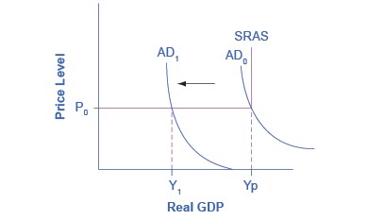
The Keynesian AD/AS Model
The Keynesian View of the AD/AS Model uses an SRAS curve, which is horizontal at levels of output below potential and vertical at potential output.
Thus, when beginning from potential output, any decrease in AD affects only output, but not prices.
Any increase in AD affects only prices, not output.

Slide 13
What Determines Consumption
Expenditure?
Consumption expenditure is spending by households and individuals on durable goods, nondurable goods, and services.
Keynes identified three factors that affect consumption:
Disposable income - income after taxes.
Expected future income
Wealth or credit

Slide 14
What Determines Investment
Expenditure?
Spending on new capital goods is called investment expenditure.
These fall into four categories:
producer’s durable equipment and software
nonresidential structures (such as factories, offices, and retail locations)
changes in inventories
residential structures (such as single-family homes, townhouses, and apartment buildings)
When a business decides to make an investment in physical or intangible assets, the firm considers both:
the expected investment benefits (future profit expectations)
the investment costs (interest rates)

Slide 15
What Determines Government Spending?
Federal, state, and local government spending provides important public services such as national defense, transportation infrastructure, and education.
Keynes recognized that the government budget offered a powerful tool for influencing aggregate demand.
More government spending could stimulate AD (or less government spending reduce it).
Lowering or raising tax rates could influence consumption and investment spending.
Keynes concluded that during extreme times like deep recessions, only the government had the power and resources to move aggregate demand.

Slide 16
What Determines Net Exports?
Since we define aggregate demand as spending on domestic goods and services, export expenditures add to AD, while import expenditures subtract from AD.
Two sets of factors can cause shifts in export and import demand:
changes in relative growth rates between countries
changes in relative prices (including exchange rates) between countries

Slide 17
12.2 The Building Blocks of Keynesian Analysis
Keynesian economics focuses on explaining why recessions and depressions occur and offering a policy prescription for minimizing their effects.
The Keynesian view of recession is based on two key building blocks.
Aggregate demand is not always automatically high enough to provide firms with an incentive to hire enough workers to reach full employment.
The macroeconomy may adjust only slowly to shifts in aggregate demand because of sticky wages and prices.
Sticky wages and prices - a situation where wages and prices do not fall in response to a decrease in demand, or do not rise in response to an increase in demand.

Slide 18
Wage and Price Stickiness
Keynes pointed out that although AD fluctuated, prices and wages did not immediately respond as economists often expected.
Instead, prices and wages are “sticky,” making it difficult to restore the economy to full employment and potential GDP.
Keynes emphasized one particular reason why wages were sticky: the coordination argument.
Coordination argument - downward wage and price flexibility requires perfect information about the level of lower compensation acceptable to other laborers and market participants.

Slide 19
Wage and Price Stickiness, Continued
Some modern economists have argued that along with wages, other prices may be sticky too.
When a firm considers changing prices, it must consider two sets of costs.
changing prices uses company resources
frequent price changes may leave customers confused or angry
Menu costs - costs firms face in changing prices.

Slide 20
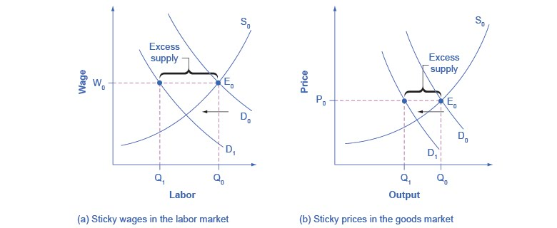
Sticky Prices and Falling Demand in the
Labor and Goods Market
In both (a) and (b), demand shifts left from D₀ to D₁.
However, the wage in (a) and the price in (b) do not immediately decline.
In (a), the quantity demanded of labor at the original wage (W₀) is Q₀, but with the new demand curve for labor (D₁), it will be Q₁.
Similarly, in (b), the quantity demanded of goods at the original price (P₀) is Q₀, but at the new demand curve (D₁) it will be Q₁.

Slide 21
Sticky Prices and Falling Demand in the
Labor and Goods Market, Continued
An excess supply of labor will exist, which we call unemployment.
An excess supply of goods will also exist, where the quantity demanded is substantially less than the quantity supplied.
Thus, sticky wages and sticky prices, combined with a drop in demand, bring about unemployment and recession.

Slide 22
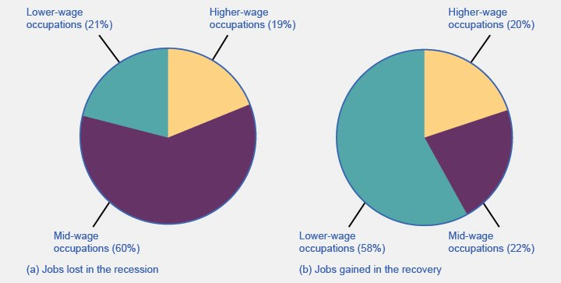
Jobs Lost/Gained in the
Recession/Recovery
Discussion Questions:
Why is the pace of wage adjustments slow?
What does the data in the charts above suggest about jobs lost and gained since the Great Recession in the U.S.

Slide 23
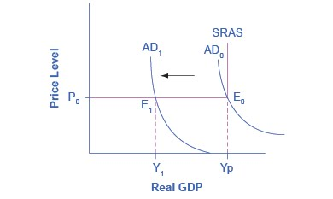
A Keynesian Perspective of Recession
The figure illustrates the two key assumptions behind Keynesian economics.
A recession begins when aggregate demand declines from AD₀ to AD₁.

Slide 24
A Keynesian Perspective of Recession, Continued
The recession persists because of the assumption of fixed wages and prices, which makes the SRAS flat below potential GDP.
If that were not the case, the price level would fall also, raising GDP and limiting the recession.
Instead the intersection E₁ occurs in the flat portion of the SRAS curve where GDP is less than potential.

Slide 25
The Expenditure Multiplier
Macroeconomic externality - occurs when what happens at the macro level is different from and inferior to what happens at the micro level.
Expenditure multiplier - Keynesian concept that asserts that a change in autonomous spending causes a more than proportionate change in real GDP.
The idea that not only does spending affect the equilibrium level of GDP, but that spending is powerful.
Δ Y > 1
Δ Spending
The reason for the expenditure multiplier is that one person’s spending becomes another person’s income, which leads to additional spending and additional income
The cumulative impact on GDP is larger than the initial increase in spending.

Slide 26
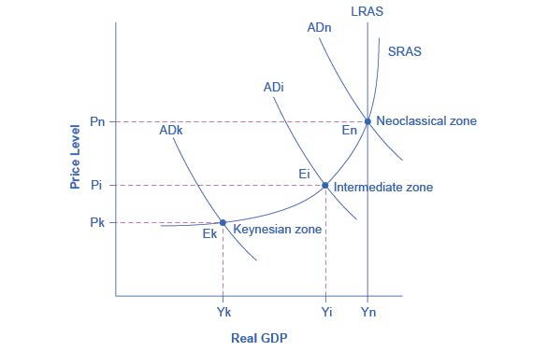
12.3 The Phillips Curve
Recall the different zones in the AS curve.
Phillips curve - the tradeoff between unemployment and inflation.

Slide 27
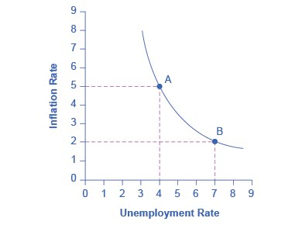
A Keynesian Phillips Curve Tradeoff
between Unemployment and Inflation
A Phillips curve illustrates a tradeoff between the unemployment rate and the inflation rate.
If one is higher, the other must be lower.
For example, point A illustrates a 5% inflation rate and a 4% unemployment.
If the government attempts to reduce inflation to 2%, then it will experience a rise in unemployment to 7%, as point B shows.

Slide 28
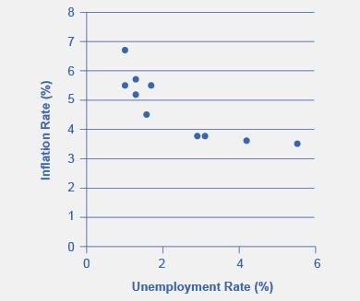
The Phillips Curve from 1960–1969
This chart shows the negative relationship between unemployment and inflation.

Slide 29
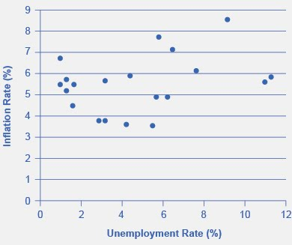
U.S. Phillips Curve, 1960–1979
The tradeoff between unemployment and inflation appeared to break down during the 1970s as the Phillips Curve shifted out to the right.

Slide 30
Keynesian Policy for Fighting
Unemployment and Inflation
Keynesian macroeconomics argues that the solution to a recession is expansionary fiscal policy.
Expansionary fiscal policy - tax cuts or increases in government spending designed to stimulate aggregate demand and move the economy out of recession.
When the economy is operating above potential GDP, unemployment is low, but inflationary rises in the price level are a concern.
The Keynesian response would be contractionary fiscal policy, using tax increases or government spending cuts to shift AD to the left.
The result would be downward pressure on the price level, but very little reduction in output or very little rise in unemployment.
Contractionary fiscal policy - tax increases or cuts in government spending designed to decrease aggregate demand and reduce inflationary pressures

Slide 31
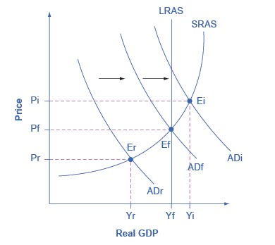
Fighting Recession and Inflation with Keynesian Policy
If an economy is in recession, with an equilibrium at E_{r}, then the Keynesian response would be to enact a policy to shift aggregate demand to the right from AD_{r} toward AD_{f}.
If an economy is experiencing inflationary pressures with an equilibrium at E_{i}, then the Keynesian response would be to enact a policy response to shift aggregate demand to the left, from AD_{i} toward AD_{f}.

Slide 32
12.4 The Keynesian Perspective on
Market Forces
Controversy has simmered over the extent to which government should play an active role in managing the economy.
Some supporters of Keynesian economics advocated a high degree of government planning in all parts of the economy.
However, Keynes was careful to separate the issue of aggregate demand from the issue of how well individual markets worked.

Slide 33
The Keynesian Perspective on
Market Forces, Continued
He argued that individual markets for goods and services were appropriate and useful, but that sometimes that level of aggregate demand was just too low.
He also believed that, while government should ensure that overall level of aggregate demand is sufficient for an economy to reach full employment, this task did not imply that the government should attempt to set prices and wages, nor to take over and manage large corporations or entire industries directly.

Slide 34
This OpenStax ancillary resource is © Rice University under a CC-BY 4.0 International license; it may be reproduced or modified but must be attributed to OpenStax, Rice University and any changes must be noted.

