Slide 1
PRINCIPLES OF MACROECONOMICS 2e
Chapter 8 Unemployment
PowerPoint Image Slideshow

Slide 2
CH.8 OUTLINE
8.0: Why is Unemployment a Problem?
8.1: How the Unemployment Rate is Defined and
Computed
8.2: Patterns of Unemployment
8.3: What Causes Changes in Unemployment
Over the Short Run
8.4: What Causes Changes in Unemployment
Over the Long Run

Slide 3
8.1 Why is Unemployment a Problem?
Individual and Family Issues
Insufficient income
Loss of self esteem
In long run – loss of skills
Physical and emotional health – possible addiction
Broader Economic Costs
Loss of output, demand, and skills
Payment of unemployment benefits and other support
Social Issues
Inequality, violence, and other crime
Policy Implications
Rise of populism, protectionism

Slide 4
8.1 How the Unemployment Rate is
Defined and Computed
The adult (over 16) population consists of:
Employed - currently working for pay.
More specifically: “Persons who did any work for pay or profit during the survey reference week; persons who did at least 15 hours of unpaid work in a family-operated enterprise; and persons who were temporarily absent from their regular jobs because of illness, vacation, bad weather, industrial dispute, or personal reasons.”
Unemployed - out of work and actively looking for a job.
Out of the labor force - those who are not working and not looking for work, whether they want employment or not.
also termed “not in the labor force”
Labor force - the number of employed plus the unemployed.
Unemployment rate - the percentage of adults who are in the labor force and thus seeking jobs, but who do not have jobs.
Unemployment rate = Unemployed people x 100
Total labor force

Slide 5
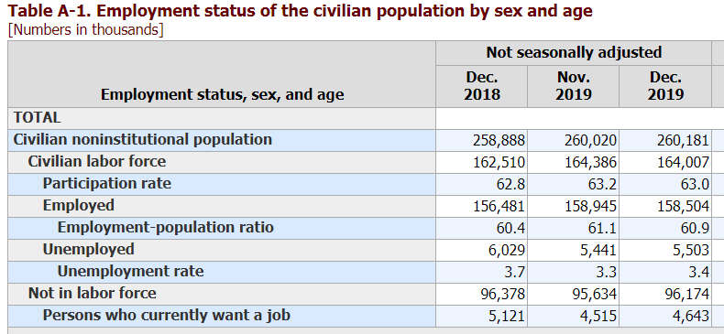
8.1 How the Unemployment Rate is
Defined and Computed
https://www.bls.gov/news.release/empsit.t01.htm

Slide 6
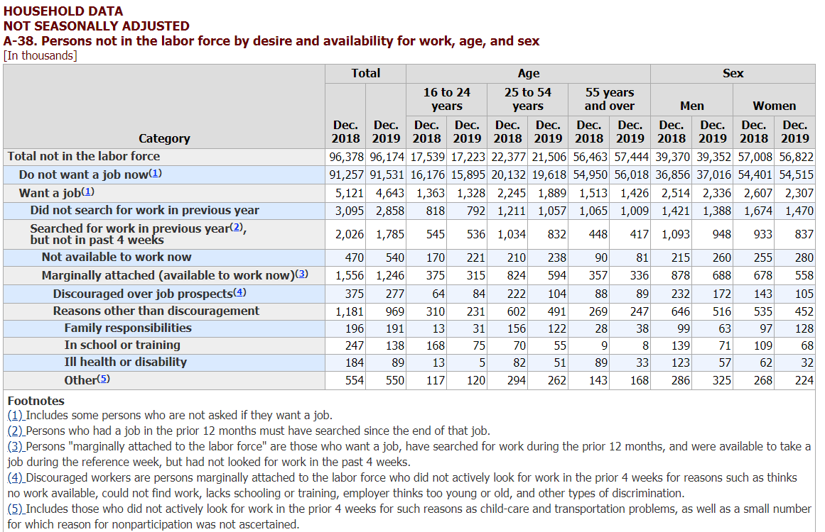
8.1 How the Unemployment Rate is
Defined and Computed
https://www.bls.gov/web/empsit/cpseea38.htm

Slide 7
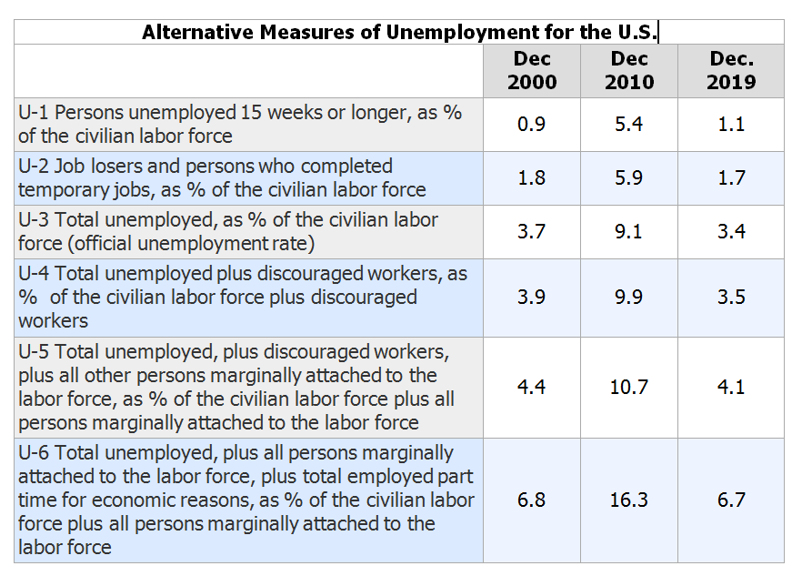
https://www.bls.gov/news.release/empsit.t15.htm

Slide 8
Hidden Unemployment
“Hidden unemployment” - people who are mislabeled in the categorization of employed, unemployed, or out of the labor force.
Part-time or temporary workers looking for full-time or permanent work.
Underemployed - individuals who are employed in a job that is below their skills.
Discouraged workers - those who have stopped looking for employment due to the lack of suitable positions available.

Slide 9
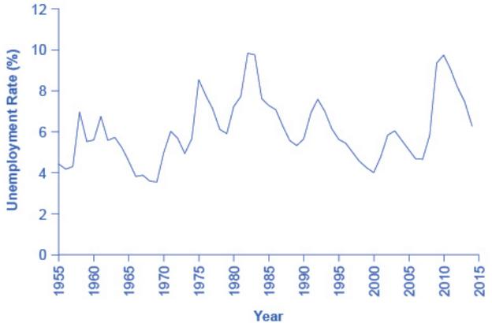
8.2 Patterns of Unemployment
The U.S. unemployment rate moves up and down as the economy moves in and out of recessions.
However, over time, the unemployment rate seems to return to a range of 4% to 6%.
There does not seem to be a long-term trend toward the rate moving generally higher or generally lower. (Source: Federal Reserve Economic Data (FRED) https://research.stlouisfed.org/fred2/series/LRUN64TTUSA156S0)

Slide 10
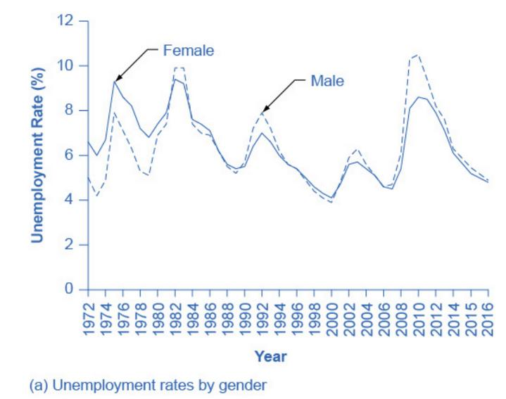
Unemployment Rates by Group - Gender
Unemployment rates for men used to be lower than unemployment rates for women.
In recent decades, the two rates have been very close, often with the unemployment rate for men somewhat higher. (Source: www.bls.gov)

Slide 11
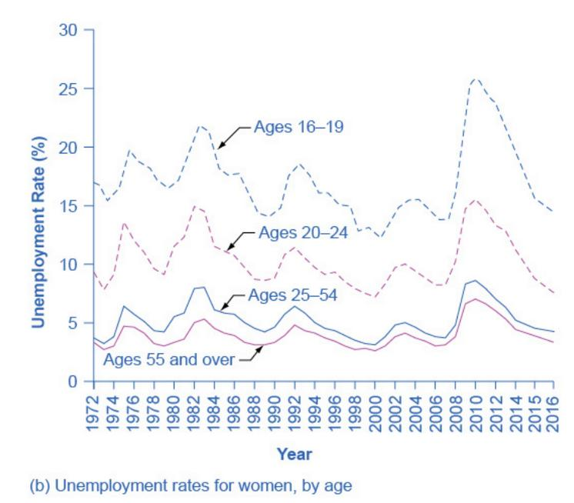
Unemployment Rates by Group - Age
Unemployment rates are highest for the very young and become lower with age. (Source: www.bls.gov)

Slide 12
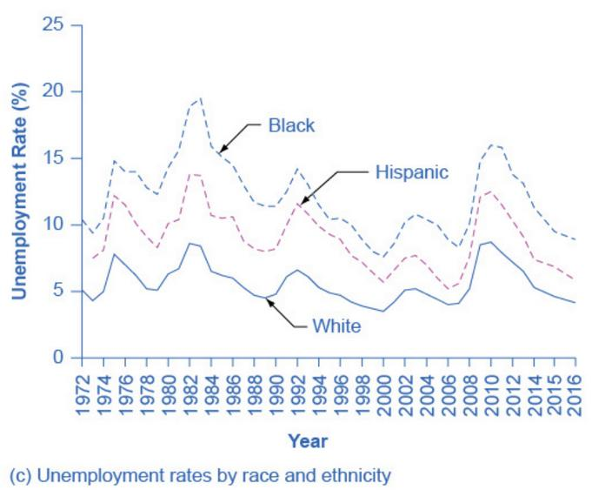
Unemployment Rates by Group - Race and Ethnicity
Although unemployment rates for all groups tend to rise and fall together, the unemployment rate for whites has been lower than the unemployment rate for blacks and Hispanics in recent decades. (Source: www.bls.gov)

Slide 13
International Unemployment Comparisons
From an international perspective, the U.S. unemployment rate typically has looked a little better than average.
Caution when comparing cross-country unemployment rates due to:
Different definitions of unemployment
Survey tools for measuring unemployment
Poorer countries lack resources and technical capabilities in their statistical agencies.
Different labor markets
In low-income countries, workers are not involved in the labor market through an employer who pays them regularly, but in short-term work, subsistence activities, and barter.

Slide 14
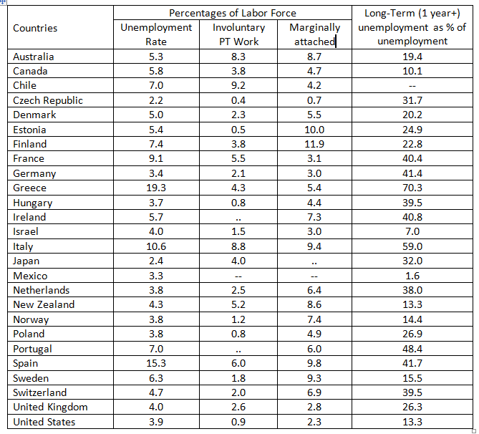
International Unemployment Comparisons
OECD Labor Force Statistics for 2018

Slide 15
8.3 What Causes Changes in Unemployment over the Short Run
Cyclical unemployment - unemployment closely tied to the business cycle, like higher unemployment during a recession.
From the standpoint of the supply-and-demand model of competitive and flexible labor markets, unemployment represents something of a puzzle.

Slide 16
8.2.5 Categories of Unemployment
Frictional unemployment - unemployment that occurs as workers move between jobs. Not necessarily a problem. May just be a sign of a dynamic economy.
Policy interventions – Probably none
Cyclical unemployment - unemployment closely tied to the business cycle, like higher unemployment during a recession.
Policy interventions – fiscal & monetary policy to moderate the business cycle and short-term unemployment assistance.
Structural Unemployment - unemployment that occurs because the structure of the economy is changing (perhaps driven by technology and/or globalization), and individuals lack skills valued by employers or live in the wrong locations.
Policy interventions – worker retraining and relocation. Possible shifts in trade and industrial policy to create more jobs.

Slide 17
8.2.6 Unemployment Benefits
Eligibility requirements vary from state to state, but with similarities. Here are the requirements in Texas:
You must have earned wages in at least two of the four previous calendar quarters that make up your “base period” (earliest four of the five complete calendar quarters before you filed your claim for benefits).
Your earnings during the entire base period must be at least 37 times your weekly benefit amount. Your weekly benefit amount is the total you earned in your highest paid quarter divided by 25, up to a current maximum of $454.
You must be unemployed through no fault of your own, as defined by Texas law (downsizing, layoff, etc., rather than fired for cause or quitting without something like a medical reason)
You must be available to work.
Benefits are available for up to 26 weeks. Between 2008 and 2012, Texans could apply for up to 47 weeks of additional extended benefits.

Slide 18
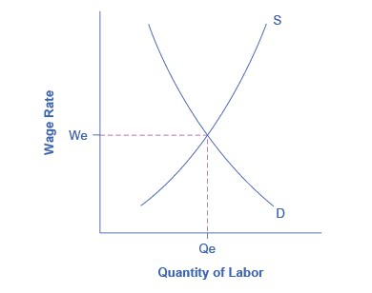
8.3 Causes of Short-Run Unemployment Equilibrium in the Labor Market
In a labor market with flexible wages, the equilibrium will occur at wage W_{e} and quantity Q_{e},
Here the number of people who want jobs (shown by S) equals the number of jobs available (shown by D).

Slide 19
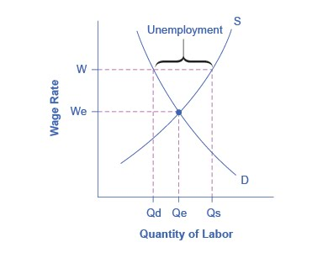
Sticky Wages in the Labor Market
Because the wage rate is stuck at W, above the equilibrium, the number of those who want jobs (Q_{s}) is greater than the number of job openings (Q_{d}).
The result is unemployment, shown by the bracket in the figure.

Slide 20
Why Wages Might Be Sticky Downward
Implicit contract - an unwritten agreement that the employer will try to keep wages from falling when the economy is, and the employee will not expect huge salary increases when the economy or the business is strong. Form of insurance.
Efficiency wage theory - the theory that the productivity of workers, either individually or as a group, will increase if the employer pays them more.
Adverse selection of wage cuts argument - if employers reduce wages for all workers, the best will leave.
Insider-outsider model - those already working for the firm are “insiders” who know the procedures; the other workers are “outsiders” who are recent or prospective hires. Similar to above.
Relative wage coordination argument - across-the-board wage cuts are hard for an economy to implement, and workers fight against them. Especially true for real (price-adjusted) wages.

Slide 21
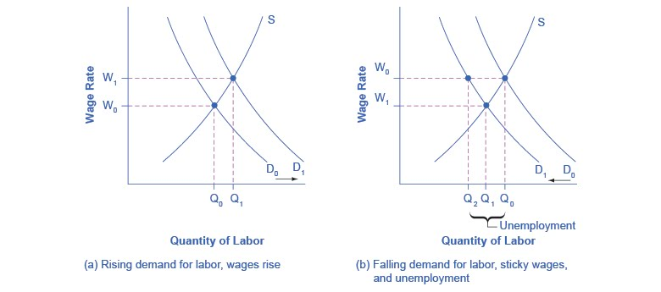
Rising Wage and Low Unemployment:
Where Is the Unemployment in Supply and Demand?
In a labor market where wages are able to rise, an increase in the demand for labor from D₀ to D₁ leads to an increase in equilibrium quantity of labor hired from Q₀ to Q₁ and a rise in the equilibrium wage from W₀ to W₁.

Slide 22
Rising Wage and Low Unemployment:
Where Is the Unemployment in Supply and Demand?
In a labor market where wages do not decline, a fall in the demand for labor from D₀ to D₁ leads to a decline in the quantity of labor demanded at the original wage (W₀) from Q₀ to Q₂. These workers will want to work at the prevailing wage (W₀), but will not be able to find jobs.

Slide 23
8.4 What Causes Changes in
Unemployment over the Long Run
Natural rate of unemployment - the unemployment rate that would exist in a growing and healthy economy from the combination of economic, social, and political factors that exist at a given time.
Economists consider the economy to be at full employment when the actual unemployment rate is equal to the natural unemployment rate.

Slide 24
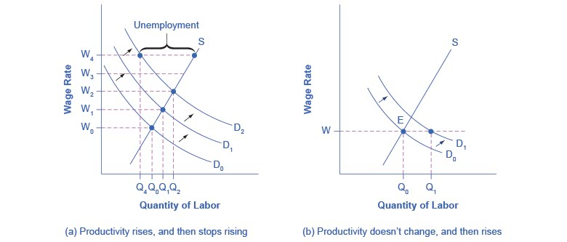
Unexpected Productivity Shifts and the Natural Rate of Unemployment
a)
Productivity is rising, increasing the demand for labor. Employers and workers become used to the pattern of wage increases.
Then productivity suddenly stops increasing.
The expectations of employers and workers for wage increases do not shift immediately, so wages keep rising as before.
However, the demand for labor has not increased, so at wage W₄, unemployment exists where the quantity supplied of labor exceeds the quantity demanded.

Slide 25
Unexpected Productivity Shifts and the Natural Rate of Unemployment
b)
The rate of productivity increase has been zero for a time, so employers and workers have come to accept the equilibrium wage level (W).
Then productivity increases unexpectedly, shifting demand for labor from D₀ to D₁.
At the wage (W), this means that the quantity demanded of labor exceeds the quantity supplied, and with job offers plentiful, the unemployment rate will be low (below its “natural” rate.

Slide 26
Public Policy and the Natural Rate of Unemployment
On the supply side of the labor market, public policies to assist the unemployed can affect how eager people are to find work.
Example: unemployment insurance, welfare benefits, food stamps, and government medical benefits may make the opportunity cost of unemployment lower -> a worker may be less eager to seek a new job.
What seems to matter most is how long the assistance lasts.
Short term benefits (weeks/months) vs. long term benefits (years)
Government assistance for job search or retraining can sometimes encourage people back to work sooner.

Slide 27
Public Policy and the Natural Rate of Unemployment, Continued
On the demand side of the labor market some public policies can affect the willingness of firms to hire:
Government rules
Social institutions
Presence of unions

Slide 28
The Natural Rate of Unemployment in
Recent Years
Underlying economic, social, and political factors that determine the natural rate of unemployment can change over time, which means that the natural rate of unemployment can change over time too.
Estimates by economists of the natural rate of unemployment in the U.S. economy are about 4.5 to 5.5% , which is a lower estimate than previously. (This is from the textbook – see next slide for an update)
Reasons for this lower rate:
Internet as a job seeking tool
Growth of the temporary worker industry
Aging of the “baby boom generation”

Slide 29
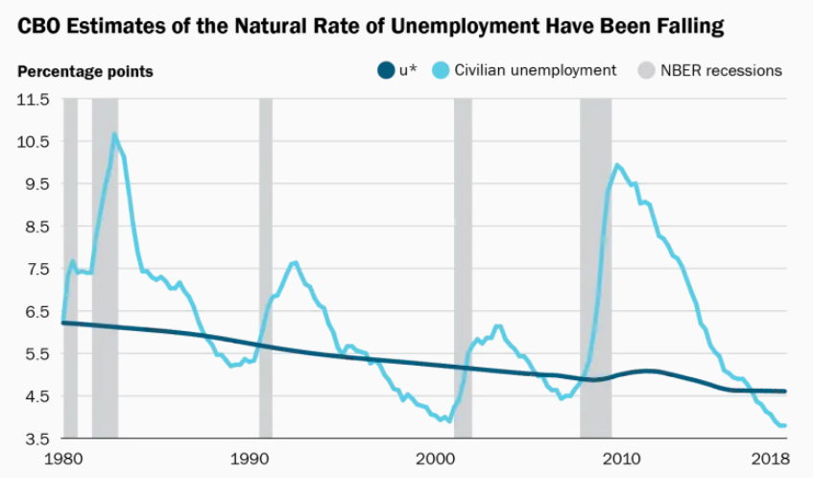
The Natural Rate of Unemployment in
Recent Years
Most estimates suggest that u* has declined since the 1980s, and is now somewhere around 4.5 percent. The Congressional Budget Office puts it at 4.6 percent. The latest projections from Federal Reserve policymakers puts it between 4.2 percent and 4.5 percent. A recent estimate by Richard Crump, a New York Fed economist, Marc Giannoni, a Federal Reserve Bank of Dallas economist, and Stefano Eusepi and Ayşegül Şahin of the University of Texas at Austin put it at 4.1 percent. (all of which are above the current rate – 3.5%)
Source: https://www.brookings.edu/blog/up-front/2019/03/06/what-is-u/

