Slide 1
PRINCIPLES OF MACROECONOMICS 2e
Appendix B The Expenditure-Output Model
PowerPoint Image Slideshow

Slide 2
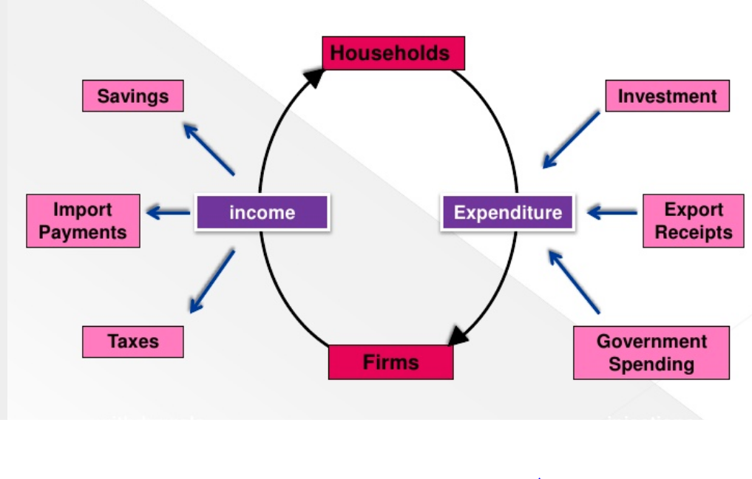
Circular Flow of Income and Expenditures
Withdrawals
Injections
How rapidly does income circulate through the economy? That depends on the effciency
of the firms and on injections to and withdrawals from the flow of income.

Slide 3
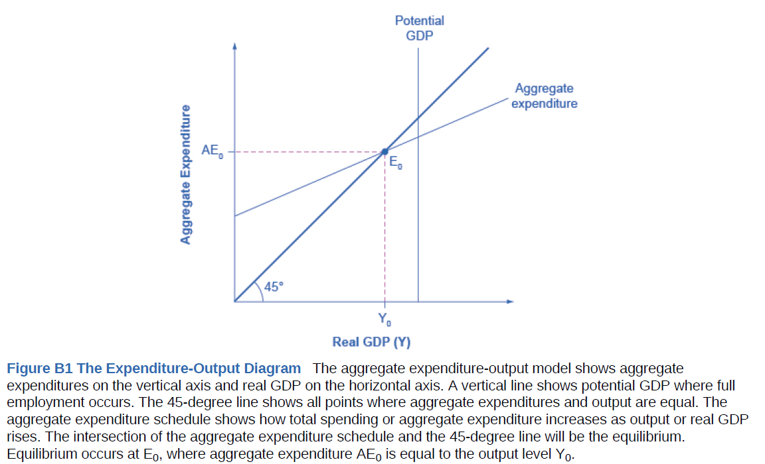
Axes of the Model

Slide 6
C
c₁-c₁t
c₀
Y

Slide 7
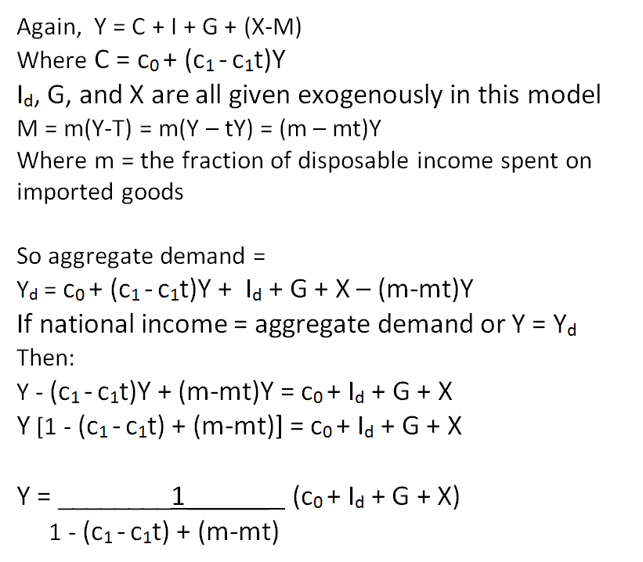

Slide 8
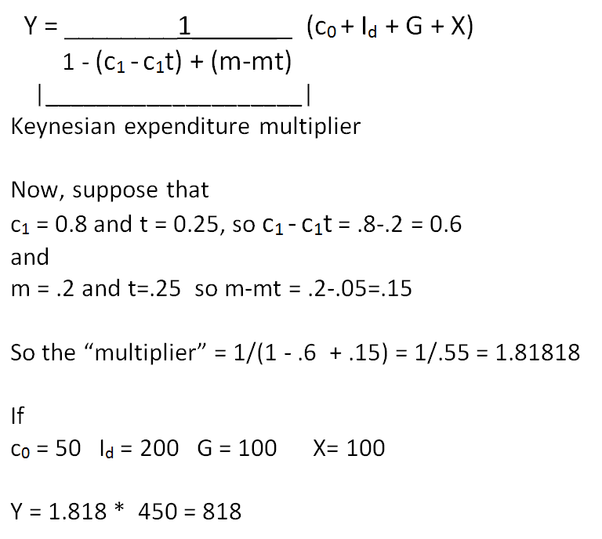

Slide 9
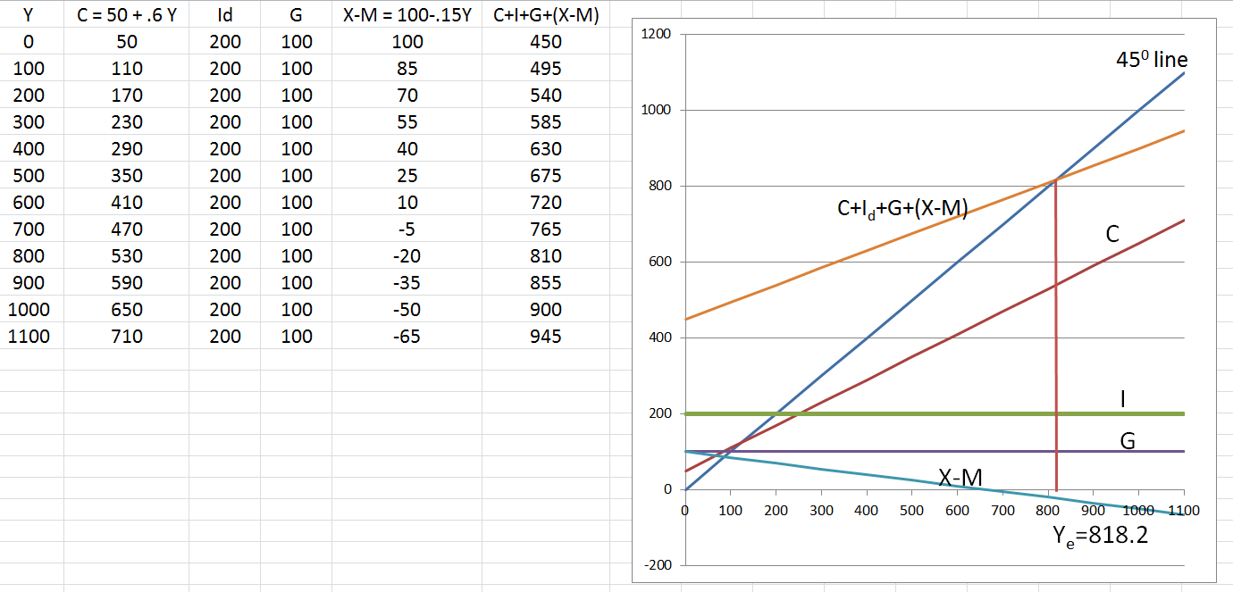
Finding the Same Answer Graphically – The “Keynesian Cross” Diagram

Slide 10
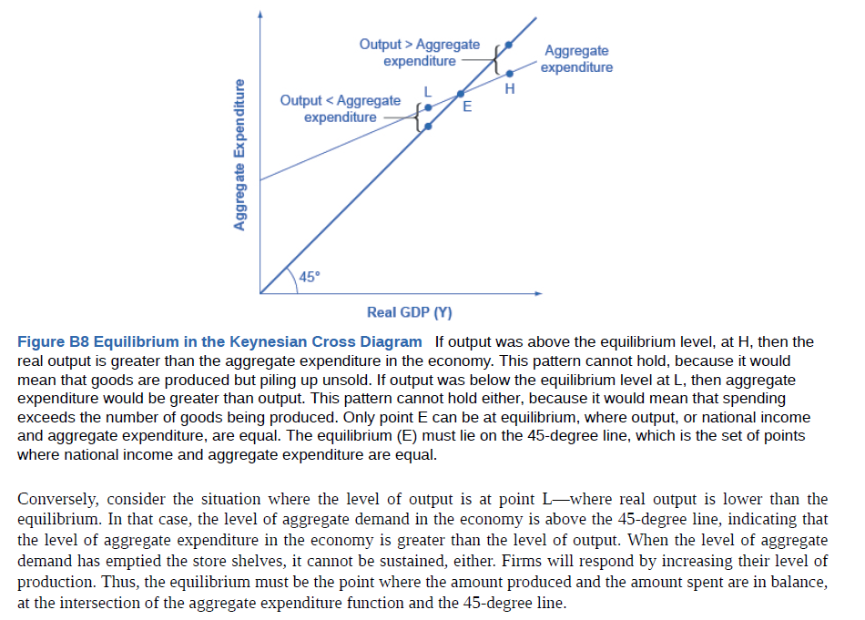

Slide 11
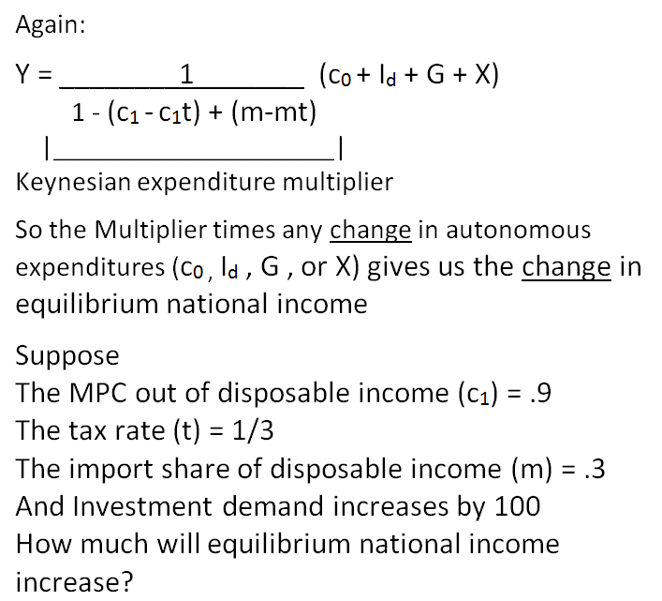
More on the Keynesian Multiplier

Slide 12
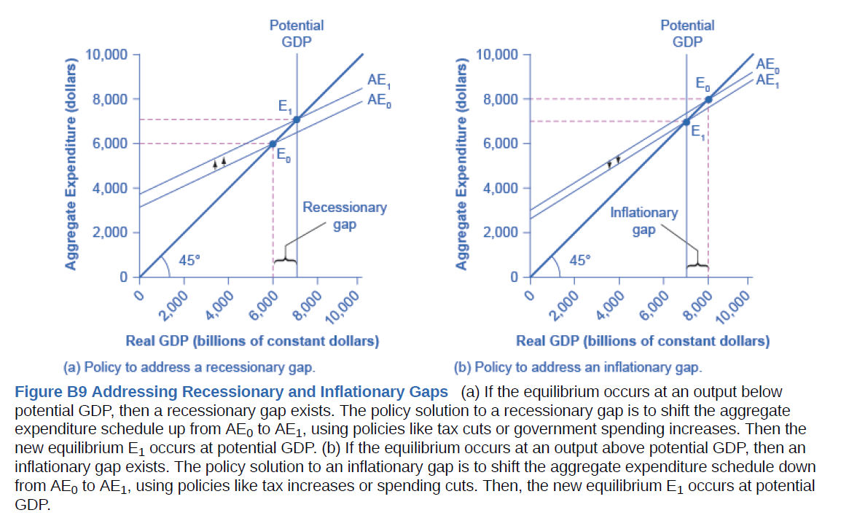
Recessionary and Inflationary Gaps

Slide 13
If the Keynesian Multiplier is 2, and we want to close an Inflationary Gap of $100 billion, we might
Increase G by $50 billion
Decrease G by $50 billion
Increase G by $200 billion
Decrease G by $200 billion

