Slide 1
CHAPTER 1
CROSS-CULTURE
INTERACTION

Slide 2
WHAT DO CULTURES CONTRIBUTE TO HUMANITY?
Every culture in the world contributes something unique to humanity—a certain “section” in the circle of humanity and life.
Put all cultures together and you have all 360 degrees in the human circle. Without every culture, humanity would be worse off.
The more you understand and appreciate cultures, the more you know and appreciate about human beings—and being alive.

Slide 3
The only way to really understand your culture is to get outside it.

Slide 4
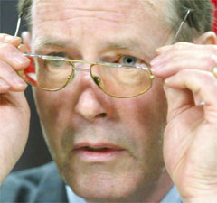
Ethnocentrism: Wearing the wrong pair of cultural glasses

Slide 5
One of the most humbling experiences in life is learning another nation’s language while living in that nation. The inability to communicate clearly and competently can play havoc with ones confidence and sense of sophistication. Enduring this experience is often the ideal “cure” for ethnocentric people.

Slide 6
YOU KNOW YOU ARE IN AN INSTITUTIONALIZED CULTURE WHEN:
There are numerous laws, regulations, & lawyers.
People depend on institutions (public schools, hospitals, banks, etc.) more than family.
Most things are organized & efficient.
The main building blocks of society are singles & small nuclear families.
People are independent & self-sufficient.
Power is widely shared.

Slide 7
Many people are high achievers, are at work more than with family, & have career-centered identifies.
Life is fast-paced, competitive, & often stressful.
Governments are relatively stable.
Status is earned & based in large part on money/material wealth.
People are agenda-driven.
Big business dominates.

Slide 8
YOU KNOW YOU ARE IN A PERSONALIZED CULTURE WHEN:
Large extended families are the main source of power & personal identity.
Most people have jobs rather than careers.
Relationships are more important than personal productivity.
Organizations aren’t efficient & reliable.
“Bribes” are a way of life, since people control assets more than institutions.
People exchange favors & network to get ahead.

Slide 9
7. People enjoy the free things of life (relationships, leisure, religion, celebrations, etc.) more than the bought things.
8. Most businesses are small & family-operated.
9. Women have a different social role than men.
10.Govenments & politics are unstable.
11. Who you know is more important than what you know.

Slide 10
GRASS ROOTS BUSINESS THRIVES ON:
Personal relationships vs. contracting (“savoir faire” skills)
Hospitality (bonding)
Exchanging favors to build a resource base

Slide 11
THE PERSONALIZED APPROACH TO DOING BUSINESS
Doing business more on the basis of who you know rather than what you know
Continuing networking & relationship-building
Associational power—based on your boss, family members, & others you are closely networked with
Hospitality (bonding)
Patience (people accommodated over performance)

Slide 12
THE FOOTPRINTS OF IMPERSONAL BUSINESS
Legalization of business deals via contracts rather than friendships
Professionalism: no favoritism, anti-nepotism policies, bidding for contracts, etc.
Accountability via codes of professional ethics, performance reviews, financial audits, & govt. regulation.

Slide 13
In most male-dominated cultures, foreign professional women are treated as a “third gender” (neither male nor female). They are not treated as a culturally-traditional woman is treated in that culture, nor as a man is treated.
Instead, women professionals are treated with a special code of etiquette that takes males “off the hook” for complying with traditional cultural expectations for treating women.
Thus, traditional (paternalistic) cultures need 3 genders for conducting business, while unisex cultures need only one.

Slide 14
Cross-cultural business relationships should be more cooperative than competitive:
Win-win
Give & take
Personalized rather than bureaucratic

Slide 15
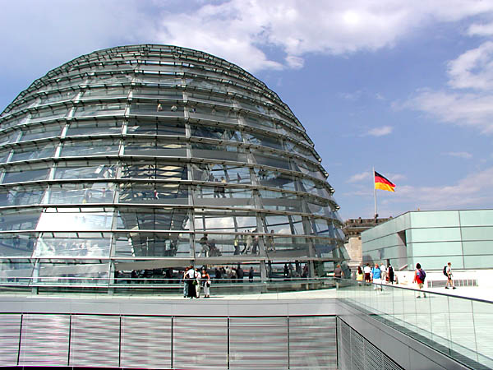
Why are there multiple bottom lines in global business?
Because most cultures expect more out
of business than profit: jobs,
community service, health care, etc.

Slide 16
UNDERSTANDING vs.
EXPERIENCING REALITY
Ultimately you can’t understand a culture by studying it, but only through experiencing it, first as an outsider, then as an insider.
Ironically, it is only as you experience other cultures inside out that you begin to understand your own home culture.
You can tell you’ve been assimilated into another culture when you dream in their language & start seeing a “stranger” everytime you look in the mirror!

Slide 17
CHANGE THE EYES THAT SEE REALITY
1. "Profit is the bottom line of business." (What about market share? Stable employment? Loyalty to business partners?)
2. "Time is money." (Time might be viewed as competitive advantage or as as a matter of fate.)
3. "The way to get ahead is through hard work." (Maybe success comes through contacts, or personal characteristics, or family background).
4. "Plan your work and work your plan." (What if God wills otherwise? What if your low social position denies you economic opportunity?)
5. "We're an equal opportunity employer." (Not in hierachical societies).
6. "Let's be practical and come up with a compromise." (What--and sell out your values and ideals?!)
7. "We hire on the basis of competence." (We hire on the basis of who you know, who you're related to, or based on your ethnic background).
8. "Professionals are punctual." (Not if they are at the top of the hierarchy or in a relational culture).

Slide 18
THE 21st CENTURY MUSEUM OF CULTURES

Slide 19
Corporate careers demand individualism so business professionals can work when & where they are needed by corporations. Careerists are wedded to their corporate institution, spending more time at work than with the family unit or within the larger social community.
Thus, loyalty to the corporation, rather than to the family or community, is generating increased cultural institutionalism & producing a new universal culture (the “UGEN” culture (discussed in chapter 14) of bi-cultural professionals at home in both their traditional home culture as well as corporate culture. Over time, the institutional pull of capitalism spawns a greater degree of individualism in all industrialized cultures.

Slide 20
As highlighted in chapter 14 (the universal generation), cultural differences are rapidly eroding in the 21st century as the emerging “universal” generation develops a culture of its own. Cultural differences have been in decline for a long time due to the unavoidable & pervasive influence of the digital revolution (Internet, pop culture icons, etc.) In the 21st century, cultural differences are most pronounced among middle-age people , but their 20th century influence is fast disappearing.

Slide 21
CULTURAL ASPECTS OF GLOBALIZATION
Global consumerism spurred by the spread of capitalism and the advertising of global brand names
Emergence of middle class social structure in a growing number of developing nations
Greater international tourism & immigration
The emergence of a universal generation of young people who share more cultural similarities than differences

Slide 22
INDIVIDUALISM CULTURE SPREAD BY CAPITALISM
Capitalism, the pursuit of wealth via private companies, thrives on individualism (pursuit of self-gain): entrepreneurs; investors; advertisers and public relations professionals; financial brokers, etc.
Capitalism erodes community via job mobility; employee layoffs; foreign off-shoring; mergers/acquisitions; economic swings; dual-career marriages.

Slide 23
EXAMPLES OF CAPITALISM-BASED CULTURAL CHANGE
China, ancient bastion of community culture, is currently undergoing a jarring shift to individualism spawned by its rapid shift to capitalism.
Exporting to individualist cultures in the West has long been Japan’s national economic strategy.
India’s thousands of call-center workers must learn English & use English first names while working.

Slide 24
English is the international language because capitalism is the international economic system.
To a large extent, global consumerism thrives on promoting self-identity consumerism and individualistic lifestyles: fashion; women professionals; pop culture & entertainment icons; social websites; birth control; target marketing, etc.

Slide 25
CHAPTER 2
CLASSIFYING
CULTURES

Slide 26
WHY DO CULTURES SEEM SO COMPLEX?
Because of the outward superficial differences between cultures:
Ethnic features
Language
Fashion
Cuisine
In reality, understanding cultures is much easier than it looks.

Slide 27
THE
BIG 3
CULTURE
CLASSIFICATIONS

Slide 28
Cul Class #1:
TRAFFIC LIGHT
MODEL

Slide 29
THE TRAFFIC LIGHT MODEL OF CULTURE
Green light: Go ahead
Yellow light: Be careful
Red light: Stop!

Slide 30
Green light cultures: Individualistic
Behavior needs little coaching and can be fairly spontaneous
Yellow light cultures: Extended family
Behavior needs some coaching and moderate training in culturally-appropriate etiquette
Red light cultures: Community/group
Behavior needs close coaching and extensive training in culturally-appropriate etiquette. Spontaneity should be avoided.

Slide 31
What kinds of behaviors require coaching?
Business protocol, negotiating, conducting meetings, rapport-building, social etiquette, giving work instructions, etc.

Slide 32
Cul Class #2:
INDIVIDUALISM
EXTENDED FAMILY
COMMUNITY

Slide 33
INDIVIDUALISM CULTURES (primarily Anglo-Saxon)
Institutions more important than family
Etiquette is optional
Individualism to accommodate capitalism
Achievement for identity & social status
Defining your own social responsibilities

Slide 34
EXTENDED FAMILY CULTURE (Latin, Middle Eastern, African)
Extended family > institutions
Unconditional acceptance > achievement
Appreciation of the free (non-materialistic) things in life
Religion & traditions > secularism & careerism

Slide 35
COMMUNITY (Asian) CULTURES
Community = your interdependency network of “insiders”
Focus on ideals, esp. harmony & “face”
Mandatory social etiquette to show respect to community members

Slide 36
Individualistic culture: I define myself (not society)

Slide 37
The I Culture
Individualism
Institutions
Independence
Internal locus of control

Slide 38
Individualistic cultures see society as a conglomeration of separate individuals rather than as interconnected people integrated into a holistic community. The concept of community is vague or missing all together. Surrogates for community are such things as bowling leagues, church attendance, social clubs, & especially online virtual communities.

Slide 39
DEFINING YOURSELF EVERYDAY
1. Individualistic cultures necessitate that people continually define & redefine themselves through career; lifestyle decisions; how money & time are spent; external appearance; hobbies; friendships, etc.
2. Your self-identity must be reinforced throughout the day as you make decisions, set priorities, & schedule your commitments.

Slide 40
INDEPENDENCE & CONTROL
Controlling your life & environment is essential in individualistic (I) cultures, because how you spend your time defines who you are. As a result, I cultures tend to be technological (Control mechanisms) Cultures:
Clocks, Cars, Chemicals, Careers, Cash, Credit Cards, Choices, Channels

Slide 41
For example, birth control has liberated (made independent) women to pursue careers as a personal alternative to full-time domestic responsibility. Birth control opens the door for women’s careers, family planning, & non-traditional self-identities.

Slide 42
American men & women in I cultures now marry at an average age of 25 & don’t have children until about 28 years of age.
American nuclear families are normally small enough to enable the mother to maintain a part-time or full-time career with the support of institutionalized child care.
The high divorce rate in I cultures & rise in single-parent families may be due in part to the greater economic independence of economically self-sufficient women.

Slide 43
What Do These Drivers Have In Common?
Both use the style of their car to
express their self-identity

Slide 44
Personal identity in individualism cultures can come not only from your career, but also from what can possibly come with it: power, social status, achievement, recognition/awards, travel, and $$$.

Slide 45
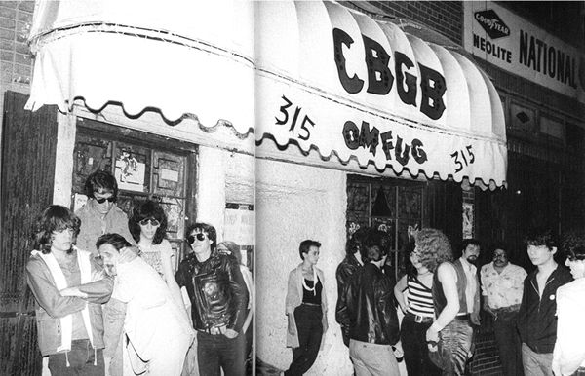
Play by the rules vs. Make your own rules to live by

Slide 46
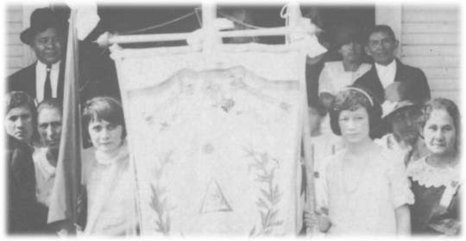
Extended Family Culture:
The family is my
identity & lifeline

Slide 47
Non-institutional cultures
Family > Organizations
People > Productivity
Quality of life (relationships & family) > Quantity of life (materialism)

Slide 48
In nuclear family (individualism) cultures, identity is largely self-determined. In extended family cultures, identity is more apt to come from outside of yourself: gender role, birth order, who you know.

Slide 49
Community Culture:
Community = interdependency networks: family hierarchies; co-workers; permanent friends; neighbors
Etiquette (“ethics”) = showing respect via rituals to those you depend on most
Ideals = behaviors that promote & sustain community harmony

Slide 50
Maintain interpersonal harmony via ritualistic
SOCIAL ETIQUETTE: Friendship bonding rituals; Bowing; Meeting/greeting rituals; Gift-giving rituals; Entertaining

Slide 51
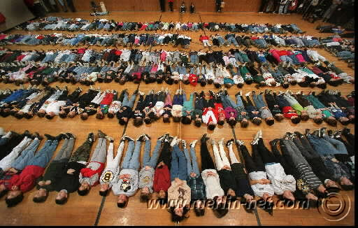
Social behavior is complex because it is dictated by situational etiquette, not by universal rules
Meditating on company success

Slide 52
CULTURE CLASH:
CAREER CULTURES
vs.
FAMILY CULTURES

Slide 53
Cultures with different profiles sometimes mesh, but not always. “Achievement” cultures (individualistic, mastery, monochronic, quantity of life) inevitably clash with “traditional” cultures (extended family, adaptive, polychronic, quality of life).
For example, American culture during the “Manifest Destiny” 19th century fatally clashed with the Native American cultures, all but exterminating them in the process. The disunited Amerindian tribes were no match for the superior military technology (the product of entrepreneurial commercial institutions) of the U.S. government with its strong institutional power.

Slide 54
One of the few times the Amerindians defeated the U.S. military was at the infamous battle of Little Big Horn (South Dakota) when a number of tribes centralized their power under Sitting Bull. But lacking the institutional infrastructure to permanently centralize power, the various Amerindian tribes were quickly wiped out by the institutional U.S.
A major cause of contemporary friction between Western & Islamic nations is cultural: secularism vs. theocracy, institutional vs. extended family, gender role differences, etc.
The USA faces a tough political challenge in seeking to install a Western-friendly form of government in the Middle East, because the region has never known strong secular institutions, but representative government necessitates strong institutions.

Slide 55
THE CULTURAL IMPACT OF QUANTITY OF LIFE & ON FAMILY STRUCTURE
1. Western culture’s strong emphasis on quantity-of-life productivity has led to a cycle of decreasing family size & prominence: Women in the workplace Delayed marriage Having children later in life + Fewer children Reliance on institutional child rearing in day care centers & public schools
2. Career emphasis has also meant a huge growth in the singles culture to accommodate the intrusiveness of institutional work on private life (long work hours, commuting, team projects, career mobility, etc.).

Slide 56
GENDER ROLE CULTURE CLASH
The traditional nurturing role of women in Western culture underwent massive change during the second half of the 20th century as many women sought personal identity in careers & greater social/economic independence.
Other women became breadwinners in order to supplement their spouse’s income to enable a higher material standard of living.
The singles & living together unmarried subcultures emerged as a new socially acceptable role for both women and men who put career & organizational life ahead of family life.

Slide 57
This redefined gender role of women led to domestic role overload for many “supermoms” who were expected to simultaneously maintain both nurturing & professional roles.
In addition, the new role of women as careerists in the workplace led to gender culture clashes in many organizations centering around sexual discrimination & harassment; the “glass ceiling” (not promoting women into executive positions); & the discomfort of many women professionals in male-dominated organization cultures built around aggressive competitiveness instead of cooperation, & authoritarian-style management instead of participative management.

Slide 58
THE SOCIAL REQUIREMENTS OF CAREERIST CULTURES
Social Darwinist culture (make it on your own)
Unisex culture (economic productivity as the primary societal role of both men & women)
Small families or childless marriages (to accommodate the time demands of institutions & organizations)
Institutional childcare (as a substitute for family care during the workday): public school systems, daycare centers, nannies, after-school programs & extracurricular activities
Widespread availability of birth control technology

Slide 59
Civil rights legislation protecting the rights of women & ethnic minorities
Geographically mobile lifestyles to accommodate career opportunities
Separation of church & state to avoid discrimination against religious minorities & the growing ranks of non-religious secularists
Secularized values to accommodate the high materialism required by a commercial culture based on the pursuit of careers.
Government socialism (unemployment & welfare benefits, medical care assistance, college loans, etc.) to provide for social welfare needs no longer met by the family.

Slide 60
THE SOCIAL REQUIREMENTS OF EXTENDED FAMILY CULTURES
A social culture of extended families, clans (extended families connected by intermarriage) & tribes (extended clans connected by intermarriage)
Gender role differences
Large families (to provide for the relative absence of social institutions)
Prominent, publicly visible religion to hold the culture together at the grassroots level in the absence of of institutions
Communal capitalism which seeks to meet the needs of multiple people, not just financial stockholders

Slide 61
Cul Class #3:
CULTURAL
DNA CODE

Slide 62
DNA #1:
MONOCHRONIC vs.
POLYCHRONIC
CULTURES

Slide 63
Monochronic—Polychronic:
Some rivers flow, others are dammed up
(Control time vs. enjoy time)

Slide 64
Monochronic cultures control time via schedules to promote personal productivity: appointments, deadlines, private offices, organization charts, etc.
Polychronic cultures put relationships before professional responsibilities & are thus less time efficient & organized.

Slide 65
Privacy is more important in monochronic cultures than polychronic, because personal productivity & stress maintenance necessitates withdrawal from the external environment.
Polychronic cultures are more open & less private to facilitate relationship-building & care-taking of the extended family.

Slide 66
5.Work stress is high in monochronic cultures due to the constant press to perform efficiently:
Work deadlines
Goals
Performance-based pay
Competitiveness
Serial busyness

Slide 67
POLYCHRONIC MARK TWAIN
Huck Finn & his friend Jim relax their way down the Mississippi River (symbolizing the flow of life), never hurrying to meet deadlines like the river boat pilots.
Every time Huck & Jim leave the river (going into monochronic civilization), they encounter problems & aren’t accepted.
Huck & Jim want to enjoy their environment, not control it.

Slide 68
DNA #2:
LOW vs. HIGH
CONTEXT
CULTURES

Slide 69
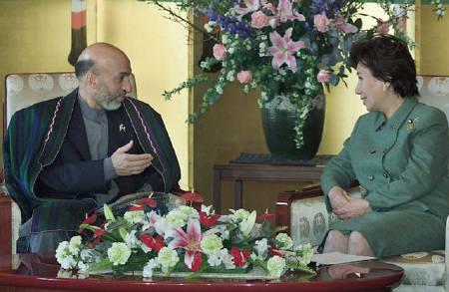
Low vs. High Context Treat everyone the same vs. cater to background characteristics

Slide 70
In high context cultures, people’s background characteristics (family name, wealth, gender, age, who they know, etc.) determine their social status more than personal achievements (which define identity in low context cultures)

Slide 71
What aspect of American history influenced Americans to
be low context? (Immigrants from all over the world had to minimize their differences in melting-pot frontier America).

Slide 72
DNA #3:
MASTERY vs.
ADAPTATION

Slide 73
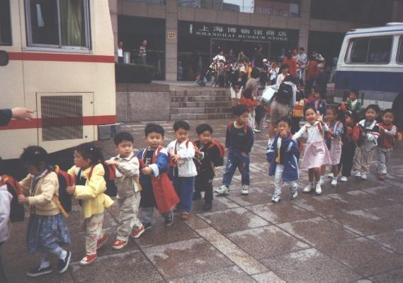
Mastery vs. Adaptation cultures (Controlling vs. adapting to the environment)

Slide 74
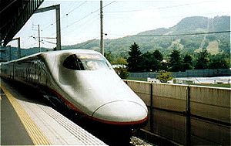
Master society via institutions, master organizations via management, & master nature via science/technology

Slide 75
Bureaucratic forms of organizational controls include job descriptions, chain of command organization charts, systems & procedures, performance reviews, etc.
Most managers in Western organizations prefer control to employee “empowerment.”
Business schools focus heavily on quantitative skills as the key to controlling organizations.
Western culture is on the brink of ultimate control via cloning, abortion, stem cell research, atomic weapons, etc.

Slide 76
HOW NON-MASTERY CULTURES ADAPT:
Heavy reliance on agriculture & self (non-institutional) employment
Dependence on the extended family rather than institutions
Central role of religion rather than career-centered secularism
Most adaptation cultures are also quality of life cultures which emphasize the “7F’s”: Free, Family, Friends, Fun, Fiestas, Food, Faith

Slide 77
THE STRENGTH OF ADAPTATION CULTURES
The capacity to absorb social change without violence & revolution
Less anxiety about what the future holds
Less violent crime
A smaller generation gap
Lasting religious traditions
Stronger families & marriages
Fewer people dispossessed by business, technology, & social change

Slide 78
DNA #4:
QUALITY
vs.
QUANTITY
OF LIFE

Slide 79
Quantity vs. Quality of life (material vs. lifestyle wealth)

Slide 80
Quantity of Life
Materialism
Wants > needs
Secularism
Singles & nuclear family
Technology
Imperialism
Workaholism
Novel experiences
Quality of Life
Extended
family
Needs-based economy
Status quo
Religion & social traditions
Jobs > careers

Slide 81
What enabled
the biggest
productivity
jump in USA
history? (Women becoming career-oriented like men)
Which is
the only
American
state that
has a
quality of
life
culture?
(Hawaii)

Slide 82
DNA #5:
TOLERANCE OF
SOCIAL
AMBIGUITY

Slide 83
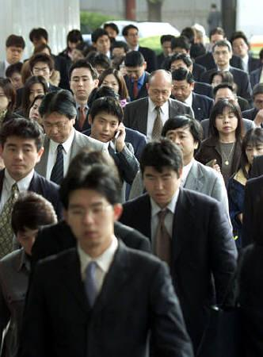
High vs. low tolerance of social ambiguity (diversity)

Slide 84
“Political correctness” & unisex culture are natural byproducts of cultures that tolerate diversity & non- conformity. Diverse lifestyles must be tolerated because there are so many of them & people derive their personal identity from them.

Slide 85
DNA #6:
POWER
DISTANCE

Slide 86
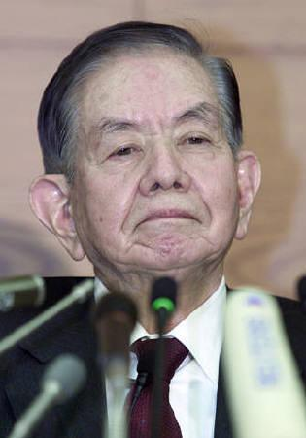
Low vs. High power distance (shared power vs. power elites)

Slide 87
Low power distance cultures decentralize power into many different organizations & job positions. Powerful people are not that much different from everyone else.
High power distance cultures centralize power into a small group of power elites who are treated with great deference.

Slide 88
LOW POWER DISTANCE
First name basis
Participative management style
Informality
People from different levels of the hierarchy interact frequently & comfortably.
Stress on personal accountability

Slide 89
HIGH POWER DISTANCE
Autocratic management style
People from different levels of the hierarchy seldom interact.
Paternalism: taking care of employees in return for loyalty & obedience
Formality

Slide 90
DNA #7:
EMOTIONAL
EXPRESSIVENESS

Slide 91
Emotionally Neutral vs. Expressive (self discipline vs. animation)

Slide 92
EMOTIONALLY NEUTRAL
Impersonal & formal
Inhibited about expressing feelings & “poker face”
High personal space; limited physical contact
Privacy (offices) & quiet
Avoiding personal style or charisma

Slide 93
EMOTIONALLY EXPRESSIVE
Uninhibited expression of feelings
High touch
Spontaneous
Opinionated & love of debate & arguing in the passionate pursuit of life

Slide 94
GOING “POSTAL”
People in emotionally neutral cultures are more likely to “lose it” emotionally than those in emotionally expressive cultures.
This can be caused not only by the tendency to “hold in” strong emotions, but also to frustrations associated with the stresses of organizational life in institutional cultures: corporate politics, deadlines, workaholism, autocratic decision-making, etc.

Slide 95
Body language
Ritual
Silence
How are emotions
expressed silently?

Slide 96
DNA #8:
LOCUS OF CONTROL

Slide 97
INTERNAL LOC
I am mainly responsible & in control of what happens to me in life.
I make myself what I am, & choose my own identity & niche in life.
I run my own life, make my own decisions, set my own goals, & deserve the success I achieve. I am the pilot of my own ship.
I make things happen in life.

Slide 98
EXTERNAL LOC
Many things control what happens to me in life. I can’t do anything about them.
I was born into a certain kind of life chosen for me by external factors: my gender, culture, family, religion, ethnicity, class status, past colonialism, etc.
There are many things in my life that I must accept.
Life happens to me. I must adjust & adapt.

Slide 99
ILOC vs. ELOC
Changing – Status quo
Leading – Following
Proacting – Reacting
Doing – Waiting
Talking – Listening
Secular – Religious

Slide 100
CHAPTER 4
BRITISH
CULTURE
The Anglo in Anglo/Saxon

Slide 101
Individualism
Extended family
Community
Monochronic
Poychronic
Low Context
High Context
Social Ambiguity
Social Certainty
Low Power Distance
High power Distance
Mastery
Adaptation
Emotionally Neutral
Emotionally Expressive
Quantity of Life
Quality of life

Slide 102
SIX KEY ANGLO-SAXON CULTURAL CONTRIBUTIONS
Rule of law & institutions
Capitalism (free markets)
Science & technology
Education
Meritocracy (rewarding the best achievers)

Slide 103
INSTITUTIONAL CONTRIBUTIONS
British common law: innocent until proven guilty; jury system; representative legal counsel; bail; impartial justice. Under the Napoleonic Code of France, most judges serve as rubber stamps for prosecutors--“guilty until proven innocent.”
Checks & balances on government power (the democratic institutional model)
Institutional/cultural imperialism (USA, India, Hong Kong, Singapore, Canada, Australia, New Zealand, South Africa)

Slide 104
The British used their perceived cultural superiority (ethnocentrism) to justify their 3-century worldwide imperialism & empire building via transplanting democratic institutions & government to a record number (over 60) of nations. Cultural imperialism can both direct (military subjugation) & indirect (economic & cultural systems, such as capitalism, language, religion, “pop culture, ideologies, etc.).

Slide 105
Afganistán
America
Araba
Austria
Bahrain
Belize
Belize
Bermuda
Bhutan
Botswana
Brunei
Canada
Caymans
Cyprus
Egypt
Falklands
Fiji
Gambia
Ghana
Gibraltar
Haiti
Hawaii
Hong Kong
India
Iraq
Ireland
Italy
Jamaica
Kenya
Kuwait
South Africa
Sudan
Syria
Tanzania
Tobago
Trinidad
Uganda
Zanzíbar
Zimbabwe
Lebanon Madagascar
Malawi
Malaysia
Malta
Montserrat
Namibia
New Zealand
Nigeria
Pakistan
Qatar
Scotland
Sierra Leone

Slide 106
A CULTURE OF CONSERVATIVE, PRINCIPLED BEHAVIOR
Non-compromising on principle
Steadfast, stable, and stalwart
Stick with the system

Slide 107
BEDROCK BRITISH PRINCIPLES
Rule of law
Power of institutions over men
Patriotism
Duty
Steadfastness

Slide 108
THE BRITISH CULTURAL LEGACY
Institutional imperialism
Moral fiber & toughness
Nationalistic willpower & tenacity
Playing by the rules
Interpersonal formality & reserve

Slide 109
The formal British believe that they should act a a role model for their nation’s heritage through all circumstances—hence formal dress, proper grammar, & diligence in duty.

Slide 110
WHY STICK WITH THE STATUS QUO?
“Because our system is the best! Change compromises perfection.”

Slide 111
The Proverbial British Gentleman (principle over pragmatism)

Slide 112
“Cheeky” (uncivilized) Americans

Slide 113
THE BRITISH VIEW BUSINESS THE WAY AMERICANS VIEW:
Used car salesmen
Pawn shops
Tele-marketers
Casinos
Garage sales
AM radio

Slide 114
CHAPTER 3
GERMAN
CULTURE
The Saxon in Anglo-Saxon

Slide 115
GERMAN
BUSINESS
CULTURE

Slide 116
THE SAXON FOUNDATION OF WESTERN PROFESSIONALISM
1. Low context
2. Monochronic
3. Emotionally
neutral

Slide 117
4. Institutions (Bureaucracy)
5. Organizational
systems
6. Impersonal professionalism

Slide 118
Germanic-influenced American business schools prepare students to live their future lives around the needs of “conform and perform” corporations.
B-schools program students to conform via analytical courses; routinized instruction that emphasizes right answers & heavy memorization; & strict attention to technical accuracy (accounting problem sets, finance formulas, statistical analysis, perfect resumes, etc.).
B-students with high grades (especially in accounting and finance) have already demonstrated their capacity to “score” for profit-driven conform/perform corporations.

Slide 119
THE
GERMAN
ORGANIZATIONAL
MINDSET

Slide 120
THE GERMAN ORGANIZATIONAL MINDSET
1. Performance is all that counts
2. Micromanaging the workplace: job descriptions, systems & procedures, deadlines, etc.
3. Technical communication: Formal letters, resumes, memos, analysis reports, statistical reports, etc.
4. Formality: Chain of command, professional dress, punctuality, Use of surnames & titles

Slide 121
5. “All business” work environment: focus, concentration, efficiency, etc.
6. Compartmentalism: Separation of private life and professional life
7. Strong centralized authority
8. “The system is the solution”: All employees & activities must plug into formal plans and procedures. “Plan your work and work your plan.”

Slide 122
Germans want organizations to be like a machine: so carefully designed & crafted that they almost run themselves (via systems & procedures, chain of command, job descriptions, etc.)
Germans emphasize the system over the people in the system, because people are “messy” (emotional, unpredictable,
hard to control, etc.).

Slide 123
HOW PROFESSIONALIZED ORGANIZATIONS LIMIT OUR FREEDOM & MASTER US:
We must run our lives around the interests of the org: work hours, dress code, job descriptions, geographical transfers, etc.
Separation from family & friends
Required college education & professional certifications
Internalizing org goals & mission
Conforming to the org culture
A professional is someone who devotes his/her life to helping an organization succeed.

Slide 124
GERMAN
COMMUNICATION
&
PRIVACY

Slide 125
COMMUNICATION GERMAN STYLE
Clear communication is blunt communication—preferably written. German employees prefer written instructions over verbal because of their increased accuracy & they back-up employee accountability.
Criticism doesn’t have to be sugar-coated to be constructive
Accuracy is too important to keep quiet about mistakes
Formality maintains professionalism

Slide 126
Departments in
German companies
are so wedded
to privacy that “silo” departments share little information with employees & between departments.

Slide 127
Privacy is essential for neutralizing nervous stress in in emotionally neutral cultures.

Slide 128
Scandinavian
Culture
CHAPTER 6

Slide 129
SCANDINAVIAN
EGALITARIANISM

Slide 130
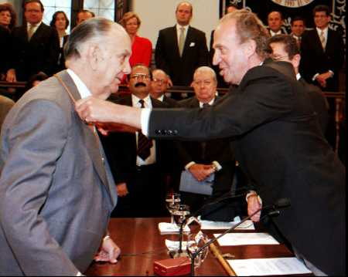
Egalitarian values: equal results, not just equal opportunity

Slide 131
“It is virtually impossible to become rich in Sweden, because the taxes are so high and the income differentials are so low. Thus there’s not much of a difference in the way people live because there isn’t much of a difference in spendable income.”
Both Swedish parents are entitled to up to a year in paternity leave. If a child has a significant illness, a parent can can take up to 60 days off at 90% pay.
Ombudsmen are readily available to represent workers in conflicts with their employer.

Slide 132
In contrast to Americans, most Scandinavians believe in
equal results rather than merely equal opportunity (because no society can truly provide equal opportunity for everyone)
A Scandinavian millionaire paid a
$174,000 speeding ticket because that
equaled the same percentage of his income
as a $200 fine for the common wage earner.

Slide 133
COMMON CAREER BARRIERS FACED BY AMERICAN WOMEN
Loss of workplace seniority when having or caring for children
Subordinating the wife’s career to the husband's career, especially when job transfers are involved
Working in a male corporate climate based on competition rather than cooperation & autocratic decision-making rather than participative

Slide 134
Equal opportunity doesn’t exist.
People aren’t equally intelligent & skilled.
Highly imperfect & rigged economic systems don’t give everyone a fair opportunity to provide for their needs.

Slide 135
How many people pay the price of your eco success?
High taxes are the foundation of economic equality & social stability.

Slide 136
You aren’t more important than anyone else. (“Jante law”)
Caring means sharing.
People’s basic needs must be met by community sacrifice.

Slide 137
SCANDINAVIAN
SECURITY

Slide 138
ORIGINS OF SECURITY CULTURE IN MODERN SCANDINAVIA
Ethnically homogeneous population (promoting a strong social conscience)
A class-free society
Geographic isolation & the hostile northern climate
Strong feminine influence within the culture

Slide 139
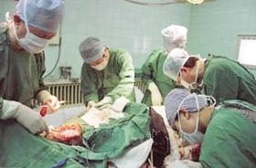
The (“cradle to grave”) welfare state
Free health care, college, pregnancy leave,
even euthanasia

Slide 140
CHILD POVERTY COMPARISONS
Scandinavian countries have the lowest child poverty rates in the world thanks to their welfare system; in Denmark just 2.4% of children live in poverty; 3.4% in Norway; 4.2% in Sweden
Mexico & the U.S. have the highest child poverty rates in the developed world: 27.7% for Mexico & 21.9% for the U.S.

Slide 141
WHY HASN’T AMERICA PURSUED “CRADLE TO GRAVE” WELFARE?
1. Opposition to & the lack of communal consciousness—perhaps due to America’s ethnic & religious diversity.
2. Higher income Americans have more ways to legally reduce their taxes than the middle class
3. Sales taxes, which America strongly relies on for tax revenue, discriminate against lower income Americans (who pay the same tax as rich Americans).

Slide 142
SCANDINAVIAN
vs.
AMERICAN
CULTURE

Slide 143
“Scandinavians have a strong sense of community responsibility. There is a willingness to make adjustments which other cultures might consider a sacrifice of individuality. “
Violent crime rates are low throughout most Scandinavian cultures. Only 6% of Swedes report being victims of violence.
“Despite high divorce rates, a high rate of unmarried parents, and shifting relationships, the number of people who live alone in isolation has not increased over time.“

Slide 144
WHERE THE AMERICAN EMOTIONAL PROFILE DIFFERS MOST FROM THE SCANDINAVIAN
Greater American propensity for risk-taking & uncertainty
American tend to be more aggressive & competitive
The American cult of personality (movie stars, rock stars, etc.)
American social status differences are based largely on money & “conspicuous consumption” (Kardashian hyper-materialism, extravagant weddings, mansions for homes, lifestyle excesses of rock stars, entertainers, & pro athletes, etc.)

Slide 145
American culture is less libertarian (no rules for “morality”) than Scandinavians because the Judeo-Christian ethic still has some influence in America & there is also a strain of religious personal piety left in America.
Americans are more Darwinian (“survival of the fittest”) than Scandinavians based on the success-orientation of Americans & rugged individualism.
Americans are more tolerant of class differences (based on wealth & standard of living) than Scandinavians.

Slide 146
America’s commercialized culture has generated an entire industry of promoters, agents, PR consultants to manufacture glamorous, larger-then-life celebrities who are icons of America wealth, success, & fame. Scandinavians prefer real people to celluloid holographs.
Swedish-born American actress Greta Garbo (famous in the 1930’s & 1940s) quit the movie business at the peak of her popularity and became a recluse because she couldn't stand being worshipped for her beauty and celebrity.

Slide 147
THE ULTIMATE UNISEX CULTURE
Scandinavian parents share household duties more than any other culture, including child-rearing.
Scandinavia leads the world in women elected to political office, sitting on boards, & holding executive corporate positions. This reflects the Scandinavian tradition of androgynous (masculine/feminine blend) organizational cultures.

Slide 148
The workplace equality of Scandinavian women is bolstered by generous paid pregnancy leave that enables women professionals not to lose their seniority level (the major reason women professionals in many other nations are paid less even when doing the same job as male counterparts).
Widespread utilization of across-the-board pay increases (vs. merit pay, which lends itself to corporate politics) also adds to Scandinavian greater workplace equality for women.

Slide 149
SCANDINVIAN LIFESTYLE PRAGMATISM
The Dutch acknowledge that morals can’t be legislated, as illustrated by the failure of Prohibition in the U.S., & don’t want to criminalize those addicted to vices.
Legalized prostitution and pornography
Government-provided drugs, abortions, and euthanasia (including babies with traumatic problems)
Highest percentage of cohabitating couples
State-sponsored euthanasia

Slide 150
MEXICAN CULTURE
CHAPTER 7

Slide 151
Individualism
Extended family
Community
Monochronic
Polychronic
Low Context
High Context
Social Ambiguity
Social Certainty
Low Power Distance
High power Distance
Mastery
Adaptation
Emotionally Neutral
Emotionally Expressive
Quantity of Life
Quality of life

Slide 152
In most respects, Latin cultures are 180 degrees opposite of Anglo/Saxon cultures.

Slide 153
UNA HISTORIA DE LA DOMINACIÓN AUTORITARIA

Slide 154
THE DOMINATORS
Spanish
French
“Texicans” & the Republic of Texas
Dictators: Villa, Carranza, Diaz, etc.
The one-party PRI government 1929-1999
Roman Catholicism
Drug lords
NAFTA?

Slide 155
THE INFLUENCE OF AUTHORITARIANISM ON LATIN CULTURE
Security & identity via the extended family
to compensate for the absence of democratic
institutions
2. Emphasis on the free things of life which
can’t be taken away from you by authoritarian
governments
3. Personal dignity (“face”) to compensate for
the lack of social status opportunities in
authoritarian cultures
4. The Roman Catholic church has always been
the backbone of authority in Latin cultures

Slide 156
LATIN EXTENDED FAMILY CULTURE

Slide 157
LAS VENTAJAS (advantages) DE LA FAMILIA EXTENDIDA
Personalized, non-institutional child care
Unconditional acceptance (love doesn’t have to be earned)
Constant companionship
Traditions
Growing up with biological parents
Connections between generations
High touch culture (hugging, touching, breast feeding, etc.)

Slide 158
EL TEMPERAMENT LATINO

Slide 159
A HIGH TOUCH CULTURE
Being around family
24-hour weddings
Nursing babies
Funeral “wakes”
Latin dancing
Hugs, kisses, & togetherness

Slide 160
THE 7 F’s OF LIFE
Latins emphasize the free things of life (quality of life):
Family
Friends
Fun
Fiestas
Food
Faith
Freedom

Slide 161
When Mexicans say they want you to “understand” them, they mean to see things in light of the totality of their relationships, responsibilities, & limitations in life.
The common Mexican attitude of “no culpa” (“I’m not at fault”) stems from their external locus of control (“Forces beyond my control run my life”). This attitude makes it very difficult to hold Mexicans accountable for their behavior and its consequences.
Mexicans place a very high value on “alma” (one’s inner spirit & spiritual essence) & hence look down on people who strive for meaning in life through material wealth or other superficial values. Alma is what’s left over after the achievement drive has been satisfied.

Slide 162
THE 3 LATIN ACCEPTS
Accept authority
Accept the status quo
Accept corruption

Slide 163
THE POLYCHRONIC LATIN WORKPLACE

Slide 164
Anglo-Saxons design organizations to be machines. Latins want an organization to be like a family.

Slide 165
Integration of professional & personal life
Lower short-term productivity
Tolerance of workplace distractions, interruptions, inefficiencies
Communal sharing of property
Less workaholism & worker isolation (& hence less organizational politics)
Office celebrations

Slide 166
When Mexicans say “mañana, ” they don’t necessarily mean they will do it tomorrow, but rather when “life isn’t happening”—when no friends or relatives are around; when the weather isn’t nice; when the fiesta is over, etc. Much of the time, life is dull, menial, or unpleasant, so don’t put off enjoying life when the opportunity is present. “Smell the roses while they bloom.”

Slide 167
Buena Gente (“Good person” boss)

Slide 168
Anglo-Saxon managers feel it is unprofessional to cater employees in a personalized manner.
Latins expect to be treated as unique members of the work family by a boss who is buena gente.
Latins won’t bond with impersonal mala gente (“bad” persons). They will be obedient but not committed.

Slide 169
IMMIGRATION

Slide 170
ESTIMATED % OF IMMIGRANT EMPLOYMENT IN U.S. INDUSTRIES
Agriculture: 61%
Domestic housekeeping: 36%
Drywall installers: 27%
Landscaping: 26%
Maintenance: 26%
Meat handlers: 25%
Hand packers: 22%
Cement finishers: 22%
Roofers: 21%
Animal slaughter: 20%
Cleaning: 19%
Laundry: 17%
Apparel: 16%
Hospitality: 14%
Restaurants: 11%
Construction: 10%

Slide 171
“Recent efforts to heavily fine U.S. companies who employ illegal Mexicans have already caused serious disruptions in the operations of many American businesses, especially in agriculture. Many farmers have will produce only half of their normal crops due to growing labor shortages & many farmers have chosen not to plant at all.”

Slide 172
SHOULD AMERICA CLOSE ITS BORDERS?
“Those who simply want to deport all unauthorized immigrants might be surprised at the economic result. I don’t think they would be very happy. It would cause a lot of dislocation in terms of trying to maintain industries such as agriculture, construction, and hospitality.”
“Curbing the use of immigrant labor would cause the Central Texas building boom to fall flat on its back.”
“There’s just not enough raw bodies in the construction trades. I don’t think that Congress recognizes the full impact of a closed border system.”

Slide 173
There’s an absolute numerical decline of Anglos in the labor force nationwide and in Texas. Without people from other cultures and origins coming here, we’d actually see a decline in the American labor force.”
“The jobs immigrants take are not the jobs Americans won’t do. Immigrants are doing the jobs at the prices that are offered. Roofers and cement mixers who used top make $15 an hour aren’t going to work for $8.”
“We’re not just workers. We’re not murders or criminals. We do important work. We work faster, for less money, and we do good work.”

Slide 174
“Looked at from a Christian point of view, nationalism is a very dangerous principle. The Christian understanding of who is our neighbor is not limited to those who look like us or who have the same citizenship papers.”

Slide 175
CHAPTER 8
ITALIAN
CULTURE

Slide 176
THE
JADED
ITALIAN
CULTURE

Slide 177
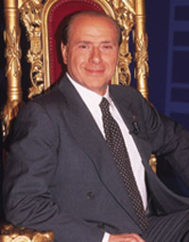
Il politicain si serve
(Politicians serve themselves)

Slide 178
“Italy is a nation where nepotism, corruption, & dishonesty are incarnate in the political leader.”
(For example, building & safety codes are seldom enforced in Italy due to collusion between builders & politicians.)

Slide 179
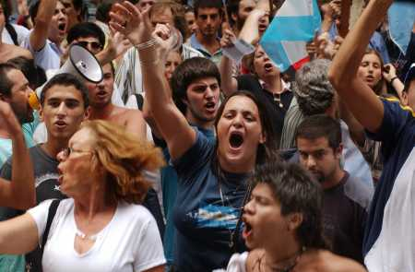
Paralizzato governo
The government is so paralyzed that
national referendums must be held
in order to pass most laws.

Slide 180
CAUSES OF ITALIAN & WESTERN GOVERNMENTAL PARALYSIS
Numerous splintered political factions that won’t compromise (“Red” vs. “Blue” states in America & Republican-Democratic paralysis)
Self-seeking politicians & lobbyists
Continuously re-elected incumbents
Voter apathy & cynicism

Slide 181
5. Power is based on (elite) people, not institutions
6. The corrupt know each other well
7. Special interest groups
know they can court Italian officials
“Pork barrel“ political projects (“earmarks” in America)
9. Organized corruption (the Mafia)
10. Good-ole-boy “justice” networks of lawyers, DAs, judges, police

Slide 182
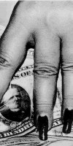
La società li serve
Most Italians liken their country
to a whore—used, but not loved

Slide 183
ITALIAN
CULTURE
TODAY

Slide 184
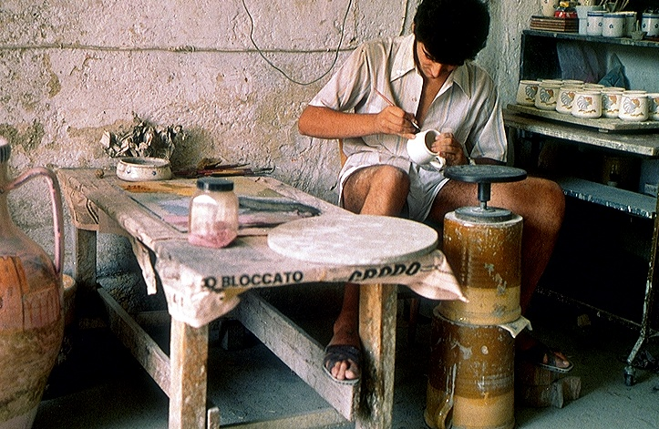
Commercio della famiglia

Slide 185
WHY THE FASHION INDUSTRY MAKES SENSE FOR ITALIAN CULTURE
1. Family-owned & run: the ideal form of business in Latin cultures
2. Requires little start-up capital
3. Non-institutional: hard for corrupt government officials to touch
4. Artistic: Being artistic is valued above simply making money

Slide 186
Italian family business owners practice community capitalism (multiple stakeholders): family comes before customers & quality of life before profit maximization. The family is king, not customers.

Slide 187
The customer is not king in Italy—the family firm runs things around the needs of the family (hours open, days off, speed of service, etc.)

Slide 188
YOU HAVE TO BE AN INSIDER
Want good service? Want to bargain? Want people who treat you in a genuine way? Then you’d better be an insider in Latin cultures: a member of the extended family, a long-time loyal customer or supplier, a member of the community, or least a trusted acquaintance of an insider. Latins place relationships ahead of money & top notch performance. They feel that who you do things for is more important than what you do. Working only for the $$$ makes you a professional “prostitute.”

Slide 189
STREET-WISE ITALIANO ADVICE:
Don’t invest your own money in a “rented house”—own your own business
Organizations are an abstraction; people are concrete
Profit maximization is strictly for those who don’t have an extended family
Business is artistic self-expression. Don’t sell your soul to an impersonal publicly-owned company that cares only about what you produce, not who you are.

Slide 190
THE CORDATA:
GODFATHER
ORGANIZATIONS

Slide 191
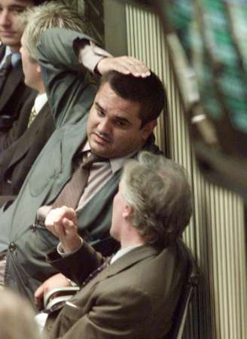
The cordata at work: A way to turn the scorned corporation into a family network

Slide 192
Semi-independent “godfather” bosses run their part of the company as if it were a family business. They hire their own employees who work for the “godfather” exclusively. Strong mutual loyalty is maintained. The various godfathers meet periodically to cut deals between them which shapes how the company operates.

Slide 193
FRENCH
SOPHISTICATION

Slide 194
France is the lifestyle culture (the outward “worldliness” of sumptuous cuisine, high fashion, & intellectual sophistication) within post-Enlightenment Western culture.
French cultural tradition is “fancy”: mellifluous language, escargot, snuff boxes, the Moulin Rouge, existentialism, Impressionistic painting, fine wines & cuisine, et. al.

Slide 195
COMMENT LA CULTURE FRANÇAISE EST-ELLE
SOPHISTIQUÉE?
(HOW IS FRENCH SOPHISTICATED?)
Moustache wax High heel shoes
Lingerie Parfume Garters
Snuff boxes French cuffs Waist coats
Cravats (neckties) Hoop skirts
Brassieres Hair nets
Pioneered porno photos

Slide 196
THE
FRENCH
DUAL
PERSONALITIES

Slide 197
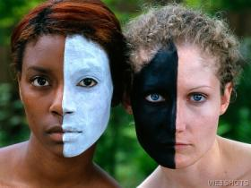
Française fendue (split) la personnalité: LIBERTARIANISM VS. BUREAUCRACY (Latin + Anglo-Saxon mixture)

Slide 198
A CULTURAL LEGACY OF TWO INCOMPATIBLE CULTURES
The French have a dual personality culturally with a volatile Anglo-Saxon/Latin blend—libertarianism + elitism.

Slide 199
Personality 1:
THE FRENCH LIBERTINE
1. Liberal lifestyles & uninhibited licentiousness (La Moulin Rouge & the infamous “Can-Can” dance & LA FEÉ VERTE (absinthe)
2. Mardi Gras (vs. Lent)
3. Self-indulgent sophistication
4. Political activism, strikes, unionism

Slide 200
Personality 2: FRANÇAIS LE BUREAUCRATE
Code Napoleon & a pervasive “Civil Service” system of professional employment
Competitive examinations
Rules for hiring, promotions, raises, etc.
The discipline of impersonal organization structure (the strange Anglo Saxon transplant)

Slide 201
The French show the bureaucratic/control side of their character today in their tough zero-tolerance anti-terrorism policies, often in tension with human rights.
All religious symbols are banned from public forums.
Unrestrained surveillance of Muslim activity within France.
“Offensive harassment” of the Muslin community via unannounced raids on suspected gathering places for terrorists
Limited human rights privileges for those under arrest or interrogation.

Slide 202
“The National Razor”
40,000 executed (many set up politically) in the “Reign of Terror”
Dr. Guillotine didn’t invent the guillotine but championed its use in the revolution on the grounds that it was “quick and painless” (in contrast to manual beheading with an ax)
88 lb. beveled blade
A half second to behead, but is the head still conscious for the next 30 seconds?

Slide 203
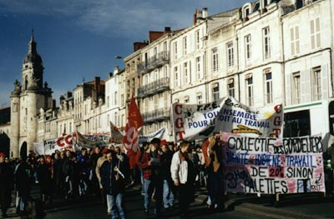
The French still love to protest, but without the rolling of heads!

Slide 204
“Only the Russian Bolshevik Revolution and the Spanish Civil War tore their countries apart in so great a rage as the French Revolution. Yet only 15 years after the fall of the French Bastille (prison) Napoleon crowned himself emperor.” So why was the revolution even fought?

Slide 205
FRENCH
SOCIAL
DUALITY

Slide 206
SIGNS THAT FRENCH CULTURE CAN’T ADAPT TO THE MODERN WORLD
Rioting in 2006 throughout France by Muslim minorities who have been excluded from the French economic system.
Three-fourth of young French want to become state employees because it ensures lifetime security.
French unemployment has remained at high levels (around 10%) because companies hesitate to create new jobs because legally-mandated employee benefits are so high.

Slide 207
Just 36% of the French agree that capitalism is the world's best economic system.
Modern French government has been unwilling to admit that French socialism (reflected by an average tax rate of 44%) has sapped national economic growth.
“The French seem to no longer know what they want.”

Slide 208
SECULARISM

Slide 209
Under French law, France is a non-religious, secular culture (which bars religious symbols in public venues)

Slide 210
“For many Euro secularists, America’s religiosity is its least attractive characteristic. They can’t believe that any modern person can be religious unless they are either stupid (Britain’s Private Eye dubs George Bush the leader of the “Latter Day Morons”) or insane (a former German chancellor was known to accuse Bush of ‘hearing voices—namely God’s’).”
Recent European polls found that most French & Dutch, & a large number of Brits & Germans think Americans are way too religious.

Slide 211
“The French have always been objects of admiration, hatred, pity, or terror, but never indifference.”

Slide 212
EXISTENTIALISM

Slide 213
It’s no accident that the skeptical French popularized the 20th century philosophy of Existentialism which holds that you must define truth for yourself to find some (subjective) meaning in life. Religion or philosophy won’t do because they claim to be based on absolute truth.
For most Existentialists, meaning in life stems from secular lifestyles, social causes, Internet activism, or in just plain partying (“eat, drink, and be merry”—French libertinism)

Slide 214
In the minds of many, modern corporate consumerism lies at the heart of post-modern illusion. “Consumerism is the myth that the individual will be gratified and integrated by consuming. Self-worth is gauged by buying power. The public substitutes consumer ideals for the lost cultural traditions of family, religion, and art. The commercial exploitation of culture and duplicity in media and advertising have become threats to the consciousness of objective reality.”

Slide 215
MODERNISM says there is no absolute truth.
POST-MODERNISM holds that there is no objective truth—that I have to (existentially) define what is “truth” for me based on my subjective feelings, tribal groups, & way of seeing reality.
Asked to define truth, high profile postmodern philosopher Richard Rorty replied simply: It’s what my friends let me get away with saying.

Slide 216
CHAPTER 10
CHINESE
CULTURE

Slide 217
COMMUNITY
COMMUNITY
COMMUNITY

Slide 218
Community = the network of people you and your family depend on most and who depend on you.
Something is an IDEAL if it enhances the community (but not necessarily individual members of the community, who are expected to sacrifice for the good of the community).

Slide 219
Forest (community) or trees (individuals)?
Are people part of their community
or separate from it?

Slide 220
ECOSYSTEM:
1. Life exists interdependently within
the nurturing community, but
never independently.
2. Community is interdependency.

Slide 221
REJECTING THEIR NICHE
The blades of grass want to be bushes;
the bushes want to be cedar trees; the cedars want to be Redwoods.
The steam is threatening to prosecute the grass for soaking up too much water.
The flowers are going on strike to demand their fair share of the bee’s honey profits.
The deer & squirrels are suing the trees for hiding hunters.
The environmentalists want to ban people from the forest.

Slide 222
THE WESTERN CULTURE OF INDIVIDUALISM
About the only community most Westerners ever belong to is the nuclear family.
Westerners are culturally “programmed” for PERSONAL success, which requires putting self before community.
Western culture does not have a tradition of ideals (which are community enhancers).

Slide 223
THE PRICE PAID FOR INDIVIDUALISM STEPPING ON COMMUNITY
Crime
Divorce
Litigation
Militant special interest groups
Pollution
War

Slide 224
COMMUNITY IS:
Others-before-self ritual etiquette
We > me
Occupying your social niche to maintain community stability
Cooperation > conflict
Ideals > pragmatism

Slide 225
COMMUNALISM

Slide 226
Asians are as self-centered as Westerners (because that’s human nature), but Asian interpersonal etiquette/expectations force Asians to put the community first.

Slide 227
Most behavior in Western culture is governed by laws vs. peer pressure in Asian cultures. Peer pressure is a more powerful human influence than laws because we internalize the etiquette reinforced by our peers (friends, work associates, etc.), while laws remain largely external to our daily lives. Laws motivate us through fear, while peer pressure motivates us through the much stronger human desire to be accepted and respected.

Slide 228
WHAT IS COMMUNITY CONSCIOUSNESS?
Sensitivity toward what
others expect you to do + What
traditional social
etiquette says you must do =
Built-in etiquette for putting the
community first

Slide 229
ETIQUETTE BUILDS COMMUNITY & CHECKS SELFISH HUMAN NATURE
Surface harmony sustains peaceful interactions (vs. conflict).
Putting others first creates cooperation and teamwork (vs. self-serving competitiveness).
Accepting your niche and duties promotes social stability (vs. revolution).
Sacrifice brings out the best
in others (while selfishness unleashes coarseness).

Slide 230
French culture is the most sophisticated in an outward way. Asian culture is the most inwardly sophisticated due to the many nuances of Asian etiquette built upon community ideals.

Slide 231
ETIQUETTE
IN ACTION

Slide 232
1. When receiving a business card from an Asian, never put it away in their presence. Treat the card as if it were the person who gave it to you. Neither should you write on the card in their presence (which ruins the formal status of the card).
2. Avoid body contact when meeting
most Asians. Use verbal greetings only.
3. Koreans are very protective of their boss’s mental harmony and avoid delivering bad news until late in the day.

Slide 233
When doing business in a Korean executive’s office, never put anything on his desk (violation of personal space).
Many Asians are very uncomfortable receiving personal praise or public notice for fear of showing up others, altering social relationships, or because they wonder if you’re trying to manipulate them.
Compliment the group rather than the individual.

Slide 234
When meeting Chinese, always recognize the oldest person first and inquire about his health.
Don’t “clean your plate” at a Chinese banquet, since this may be interpreted to mean that you were not served enough food.

Slide 235
To promote harmonious relationships with the Japanese, send negotiating questions well in advance of the meeting and don’t be surprised if executives engage in long pauses of silence before answering questions. The Japanese don’t like surprises in social situations.
“Yes, but” means “no” in most
Asian cultures.
11.In Asia , don’t open gifts in the presence of the giver. Receive and present gifts with both hands.

Slide 236
If you are applauded in China,
you should applaud back.
13.Seating arrangements are important, whether for business meetings or for dining. The principal guest sits next to the host when dining. The Chinese host will lose face is this protocol is not followed.
14.The Japanese may ask you a lot of personal questions. Don’t be upset, they’re merely trying to determine your social standing so they can address you with proper respect.

Slide 237
Westerners are individualistic, independent (of community), isolated, & separated. This reflects the Western deterministic scientific mindset of analyzing discrete (separate) objects in isolation of one another (such as the zoological classifications of life).
Asians are communal, interdependent & connected, reflecting the new scientific tradition of quantum physics ( a “spider web” universe).

Slide 238
ASIAN COMMUNITY vs.
WESTERN INDIVIDUALISM

Slide 239
Community
Community
(Separation)
Submissive
individualism
Egocentric
Individualism

Slide 240
1. In individualistic Western culture,
WHAT you do is more important than
HOW you do it or WHY you do it: “Just
do it!” This is because pragmatic
Westerners usually act on the basis of what
is best for them as individuals rather than
what may be in the best interests of the
community. Hence, how you achieve self
interest is not important, as long as you
achieve it. Why you do something is also a
given most of the time: to benefit yourself.

Slide 241
2. Asians feel HOW & WHY you do something is more important than what you do, because the interests of others (the community) come first. Since how you do things affects others around you, behavioral etiquette is followed in a way that looks out for the interests of others as well as your own interests. Why you do something is also important because things must be done to benefit the community in addition to self.

Slide 242
Asians have no personal identity apart from the communities they have interdependencies in—like a street person in the West who is separated from “polite society” & therefore “persona non grata. ”

Slide 243
ASIAN SUBMISSIVE INDIVIDUALISM
Meet the expectations of your community.
Humbly submit to your
social niche.
3. Give face (to receive face).
4. Maintain the etiquette of harmony.

Slide 244
AT ONE WITH THE PERFECT
IDEALS OF NATURE
Nature has no agenda, no goal, no purpose, except to exist as community.

Slide 245
COMMUNAL
HARMONY

Slide 246
Asian etiquette is like traffic laws: detailed rules everyone must follow to ensure a safe community.
Behavioral etiquette ensures harmony within the community, making it a better place for everyone to live.

Slide 247
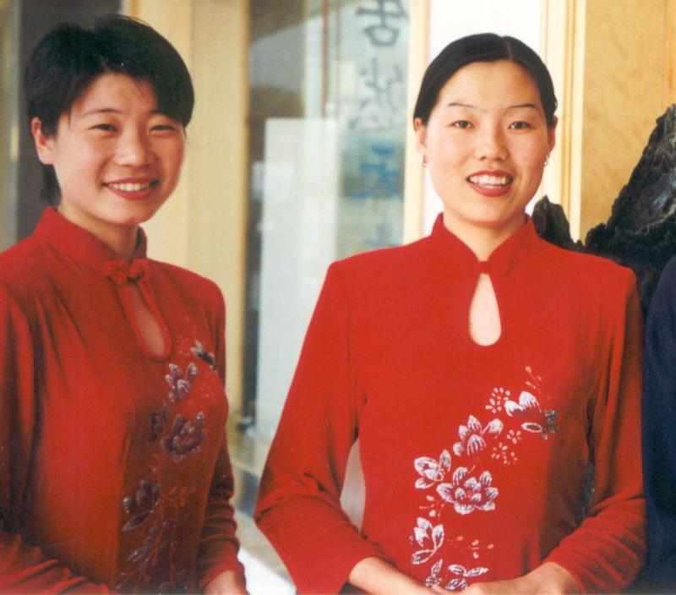
Behavioral etiquette starts with surface harmony

Slide 248
Interacting with others in a way that produces positive feelings for everyone.
Telling others what they want to hear (to avoid disturbing interpersonal harmony).
3. Treating others the way they expect to be treated.
4. Read-between-the-lines subtle messages.

Slide 249
“Your daughter is such a
committed piano student.
Last night I could hear her
practicing until midnight!”
Positive feelings?
Hear what they wanted to hear?
Treated the way they wanted?
Between-the-lines message?

Slide 250
EASTERN
vs.
WESTERN
PERCEPTION

Slide 251
WESTERN SEPARATENESS vs. EASTERN COMMUNAL INCLUSIVENSS
Western science views the world as a series of isolated, separate objects that must be examined apart from their natural environment (like a butterfly pinned to a display case) in order to “objectively” understand/control them--hence the scientist’s façade of “emotional detachment.”
Eastern communal inclusiveness holds that life can be understood only in its natural community (hence, zoos are no substitute for nature).

Slide 252
EAST & WEST SEE REALITY DIFFERENTLY
WEST: Focus on separate objects in the environment
EAST: Focus on the total environment
WEST: The individual shapes society
EAST: Society shapes the individual
WEST: I am always the same person
EAST: I am a different person in different social situations

Slide 253
WEST: I strive to be unique in the group
EAST: I strive to fit into the group harmoniously
WEST: I transmit information & must send it clearly
EAST: I receive information & must interpret it situationally

Slide 254
COMMUNITY
is the supreme ideal because it is the combination of all ideals: cooperation, harmony, sacrifice, teamwork, justice, human dignity, etc.

Slide 255
IDEALISM IN ASIAN
ETIQUETTE:
The means are just as important
as the ends.
HOW you
do something is as much of an ideal as what you do (because how you do things determines whether or not interpersonal harmony is achieved).

Slide 256
How gifts are wrapped
How food is served
How respect is shown to authority
Self-discipline as a sign of total commitment to a cause
Personal sacrifice as a sign of atonement for group failure

Slide 257
WESTERNIZED TAOISM
Christian Science (Mary Baker Eddy)
Norman Vincent Peale & “positive thinking”
Mary Kay Cosmetics, AMWAY sales rallies, & motivational speakers in business & sports
Jack Nicklaus “Zen golf”
Star Wars (the “Force” & Yoda)
Environmentalists & Wicans (Gaians)

Slide 258
BUDDHISM & ASIAN METAPHYSICS

Slide 259
UNDERSTANDING BUDDHISM
Zen Buddhism says, “be nothing, think nothing.” Zen involves meditation with an empty mind, achieved by freeing the mind of earthly thoughts and attachments. This is often achieved by mediating on an object such as a rock, pool, or flower. Zen teaches nothing and believes that only one essence exists (monism—one mind). Zen uses meditation as the means of attaining salvation by virtue of inner power. Zen stresses mental discipline, personal sacrifice, and disregard of physical pain.

Slide 260
Everything in the
universe is connected,
forming an
interdependent
community (“spider web” of relationships)

Slide 261
Western culture focuses on understanding reality, while Asian culture seeks to experience reality.

Slide 262
NEW
SOCIAL
TRENDS
IN
CHINA

Slide 263
FROM RACHEL DEWOSKIN, AUTHOR OF FOREIGN BABES IN CHINA
“Consumerism became a religion, with companies arriving like missionaries, converting employees, testing advertising strategies, and seducing the average Zhou Schmoe with products he had never known he needed.”
“New soap operas were offering up previous forbidden products: hard currency, the freedom to travel, liberated sex, international careers, & air-conditioned condominiums.”

Slide 264
3. “Privilege and its trappings had long been closely associated with Western imports, illicit movies, fancy cars, and frivolities in general. Once considered banes of Western civilization, they have became the new playthings of the politically advantaged Chinese class. Urban China sparkled; while rural citizens remained poor, its cities were getting rich. Chinese women stalked through China’s cities in miniskirts and heels, cell phones & pagers attached to their leather purses. They dyed their hair blond and had eyelid lifts to westernize their eyes.”

Slide 265
“The overall divorce rate in China soared during the 1990’s, beset by the problems of modern love. There was one divorce in every 9 marriages, 4 times higher than ten years earlier.”
“Deng Xiaoping’s famous statement, “to get rich is glorious,” took effect, resonating everywhere. But some would get wealth a lot sooner than others. This was a jarring shift for Chinese of all ages who had been deeply versed in the virtues of a communal society, where advantage and class distinction were largely erased.”

Slide 266
“Chinglish,” a hybrid of English and Chinese, is the new lingo used by hip Western foreigners in China today. Pinyin (“spell sound”) uses Western letters to decode how the speak and understand Chinglish.
There are 77,000 known characters in traditional written Chinese.
Chinese small talk is not about weather; it simply acknowledges what has already occurred, such as “You’ve arrived” as you enter the office.

Slide 267
THE LITTLE
EMPEROR
GENERATION

Slide 268
China’s one-child policy over the last generation prevented 300M births & unbalanced the gender ratio from a normal 105 males to 100 females to 118 males for every 100 females.
Boys are valued more than girls because they pass on the family lineage & brides must be paid a large dowry.
The “little emperor” generation (of spoiled single children) is producing a new wave of materialistic consumerism in China.

Slide 269
Fertility rate dropped from 2.29 children in 1980 to 1.69 today (2.1 is replacement rate)—300M fewer births in the last 30 years
118 males born for every 100 females via selective abortion (vs. the global norm of 105 male births to 100 female)
Permitted exceptions to the policy: in rural areas, couples can have a second child is the first is female; in urban areas parents who are only children are allowed 2 children

Slide 270
Richer Chinese sometimes circumvent the policy by paying assessed fines; using in vitro fertilization as a means of multiple births; having children abroad.
Penalties for breaking the policy: fines 3-10X annual income; state employees can be demoted of fired; children not allowed into better schools; forced abortion in some rural areas
The “4-2-1” pending future problem: 4 grandparents + 2 parents must be supported by 1 child
Other social problems: shortage of brides for men; “incest villages”; the ration of working age people to retirees will fall from 6 today to 2 by 2040

Slide 271
PRACTICAL ADVICE FOR
DOING BUSINESS
IN CHINA
From One Billion Customers, by James McGregor

Slide 272
The Chinese government uses competition from foreign companies to reform its own companies and economic system.
Although China is confident about becoming a world-class competitor, it is also paranoid and insecure about the outside world.
China is modernizing, not Westernizing.
China has lots of slogans but no prominent ideology other than to become rich and powerful through international trade and business.
Chinese negotiators are masters of making you feel that you need them more than they need you.
The Chinese will ask you for anything because you just may be stupid enough to agree to it.

Slide 273
The most important thing in conducting business with the Chinese is to know who you are dealing with and what they really want and need.
The Chinese always strive to get concessions from you.
Don’t take what Chinese negotiators tell you to be the actual truth. They often site nonexistent regulations or rules simply to put you in a negotiating bind or box.
Contracts in China are not a guarantee of anything. It is the relationship built in negotiating the contract that you build your future on.

Slide 274
Contract details matter less than personal relationships.
Treat Chinese partners with great respect and equality, because insults and slights are never forgotten, and retribution is certain.
Chinese employees want leaders and mentors, not dictators or risk-avoiding bureaucrats.
Chinese employees and officials are ethically confused due to the culture’s rapid conversion from community wealth to individualized capitalized wealth.
Officials clear the way for business; business paves the way for Chinese officials to accumulate assets. Senior Chinese officials seldom engage in direct corruption, preferring instead to use nepotism as the means of building family wealth. For the ruling elite, gathering family assets quietly is quietly accepted.

Slide 275
Choose legitimate business agents and consultants to obtain corporate licenses and approvals, and seek as little information as possible about how they are obtained.
Don’t attempt to bribe the Chinese. Nobody stays bought and the Chinese know bribery is against American laws. Instead, build long-term, win-win relationships with your customers through training them, offering them opportunities to travel and engage in recreation.
At its core, today’s China is all about self-interest. It is very strong on competition but week on cooperation.
Never put your business in the position where you are dependent on one individual for access to government officials.
Inform your suppliers that they will be dropped if they try to bribe your employees. Suppliers will appreciate being let off the hook.

Slide 276
Be tough in negotiating. The Chinese respect it.
Frame your negotiation arguments to show how your company is good for China, and don’t emphasize what is wrong with the Chinese system or government. Don’t make the Chinese look bad.
Enlist the help of your home government in negotiating, as well as relevant international organizations and trade associations.
Cultivate relationships with Chinese officials but spend more time with the customer than with politicians.

Slide 277
You don’t win in China by getting only to the top guy. You win by enlisting supporters at all levels. The most talented business professionals in China are keen human observers who know what makes people tick. Lawyers in the West look for legal loopholes; the Chinese find people who can nudge their business interests this way or that way.
You can’t ignore Chinese government officials but don’t sit and wait for their approval. The best strategy is to avoid forcing a government decision.
China is not one market, but rather a collection of many local markets, each with its own practices, traditions, and methods of local protectionism. The most carefully constructed legal contracts will quickly die when politics or relationships go against them.

Slide 278
When forced to share your technology in China, isolate any parts of the technology that are not immediately crucial.
Deep scars from the Cultural Revolution and the sudden upheavals of capitalism have created a get-rich atmosphere in which nobody trusts anybody. In China business, expect to be cheated.
The Chinese appear to be a collective society. They eat together, travel together, and recreate together. But below that collective surface a dog-eat-dog competitive drive make the Chinese among the most individualistic and selfish people.
China’s rush to get rich is accompanied by deep distrust of the system, and anyone outside the circle of close acquaintances. This has created a business environment steeped in dishonesty and lack of transparency.

Slide 279
CHAPTER 11
JAPANESE
CULTURE

Slide 280
A CULTURE
OF IDEALS

Slide 281
When something good “comes alive,” it’s an ideal. Ideals are the essence of life--both the ends and means of living. Westerners have little experience “experiencing” Asian ideas.
It’s hard for Westerners to understand Asian culture because ideals are less important to Westerners, who value individual freedom & independence more than community.
Westerners push away the ideal of community because of its emphasis on interdependency, sacrifice, duty, & etiquette, all of which detract from individual autonomy (driving fast, loud music & cell calls in public, smoking around others, etc.).

Slide 282
Shudan Ishiki Why do the Japanese have such a strong group consciousness?

Slide 283
Ethnic & cultural homogeneity
Predictable & rigid behavioral etiquette for every social situation
The pursuit of common ideals

Slide 284
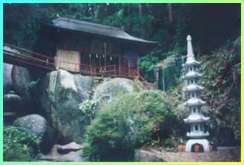
IDEAL #3: WA INTERPERSONAL HARMONY
Nature has no agenda. It simply
exists as a harmonious ideal.

Slide 285
LIVING IN THE TRIANGLE OF HARMONY
Internal harmony
External harmony Interpersonal harmony

Slide 286
1. The work environment is more
important than the work itself,
because the environment
determines what work can be
accomplished.
2. The underlying foundation
of the Japanese work
environment is harmony vs.
conflict in Western companies.

Slide 287
BEHAVIOR IN JAPANESE BUSINESS DEPENDS ON:
The context: the occasion, the people involved, the purpose
The behavioral model of the employee’s boss--the “geisha” (depository) of workplace ideals

Slide 288
3. Avoiding (2-way) social embarrassment by anticipating the consequences of your behavior on the community you are part of

Slide 289
A good leader doesn’t have to work hard to get others to work hard.

Slide 290
TELEPATHIC
COMMUNICATION
HARMONY

Slide 291
Tatemae/Honne Façade vs. reality
Communicating reality through a
screen of polite harmony.

Slide 292
1. “Safe” business meeting agendas
2. Criticism protocol via
intermediators
3. “Barbarians” within the business
delegation: Don’t speak before
your boss does; don’t disagree
with your team publicly.
4. Vague communication during
negotiations to avoid steamrolling
others

Slide 293
“We will give your generous offer a great deal of thinking.” (“No”)
“We are surprised that your product costs so little to make.” (“Your product’s cost estimates seem unreasonably low.”)
“We know that your company will be very successful in the future.” (“We do not want to work with you in a joint venture.”)

Slide 294
EXAMPLES OF SCREENED HARMONY
Telling people what they want to hear, expecting them to politely “drag” the truth out of you.
Making comments that require “reading between the lines”: “That project is very difficult to complete” (Translation: “We’ve run into some problems”)
Using third parties to communicate areas of disagreement or misunderstandings

Slide 295
Most Japanese companies are like a “balloon” because there are no openings in a balloon—no openings for foreigners to become part of the company. Foreigners who wish to do business with a Japanese company must have an insider “champion” (madoguchi) to “import” the outsider into the company, thus giving them face (a legitimate status to interact with insiders).

Slide 296
Japanese companies are also like a
ringed target: executives occupy
the bulls-eye; middle managers
occupy the middle circles;
foreign business partners occupy
the outer ring. Anyone the
company doesn’t do business with
is outside the circle (lacking
status, or face, completely).

Slide 297
GETTING TO HOME BASE WITH THE JAPANESE
1. Getting to first base: Getting a champion in the Japanese company
2. Getting to second base: Hierarchical networking of executives in both companies
3. Getting to third base: Interpersonal bonding via karaoke, communal baths, etc.
4. Scoring a run: Suspending etiquette (honest, straight forward business negotiations with no ceremony)

Slide 298
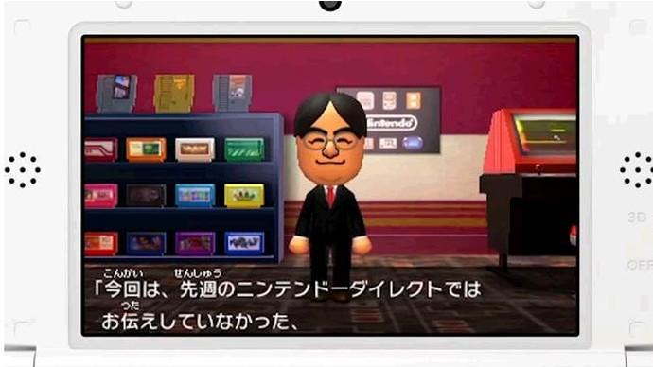
Third party representatives

Slide 299
Expect it to take a solid year
before your company “gets to first base” with a Japanese
Company.
They don’t want to work with a foreign company that is “in lust” rather than “in love.”

Slide 300
DURING THE “DATING GAME”…
Be psychologically prepared for “circular” (communal consensus) Japanese business practices.
Why do the Japanese generally ask for more and more and more information about your company? (making sure everyone saves face by knowing a lot about who they are about to do business with)

Slide 301
3. Waiting patiently for
the right introductory ceremonial occasion (You can’t celebrate Christmas
in April.)
4. The Japanese reluctance to take on new friendship obligations—sense of duty always run ahead of emotions.

Slide 302
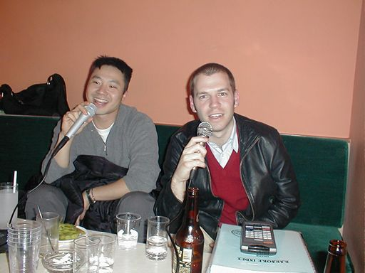
Karaoke (“empty orchestra”)

Slide 303
Nightlife is a cultural necessity in Japan because negotiations require safe ceremonial settings where people can be open & honest without breaking harmony—such as drinking in a bar where you can claim you were drunk & thus not aware of what blunt/honest things you may have said.

Slide 304
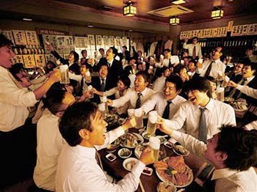
Getting drunk etiquette

Slide 305
IDEAL #4: MUGA THE ART OF ACHIEVING PERFECTION

Slide 306
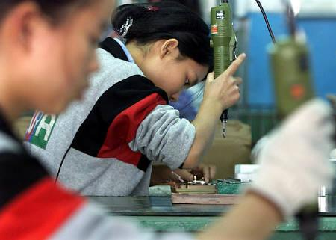
Dami Oshi Making doubly sure

Slide 307
Perfection = Internal commitment + Group pressure

Slide 308
Not workaholics, but rather:
Duty-aholics
Perfection-aholics
Ideal-aholics

Slide 309
Japanese “Triangulation”
Internalized ideals
Team
oversight Statistics
PERFECTION

Slide 310
The Japanese set up a mutual accountability system to drive workers toward more perfect performance. Individual workers dedicate themselves to numerous ideals relating to performance excellence (head work, customer-orientation, sweating the details, etc.); their individual work is closely monitored/coordinated by the work team; performance statistics are used as an objective measure of everyone’s overall success. Performance is seen as too important to leave in the hands of employees working alone.

Slide 311
JAPANESE MANAGEMENT STYLE

Slide 312
Transactional vs. Transformational leadership

Slide 313
Transactional management, characteristic of the individualistic West, is the “quid-pro-quo” approach to work of “I’ll do this for you if you do this for me.” Managers in Western companies are expected to motivate & lead workers into pursuing organizational interests in return for providing competitive wages & benefits, possible merit pay & promotions, & agreeable work conditions. The organization looks after its interests & employees look out for their interests.

Slide 314
Japanese transformational management requires that employees motivate themselves on behalf of the organization by internalizing the workplace ideals of this boss (sempai). Managers serve as role models of organizational ideals for employees to sacrificially emulate. Employees aren’t promotable until they rise above self-interest, doing what the organization wants, the way it wants.

Slide 315
Vague goals, Clear ideals

Slide 316
CHAPTER 14
THE UNIVERSAL (UGEN) CULTURE

Slide 317
A new generation adapted for a new world:
Globalism > nationalism
Digital technology
Virtual communal culture
Massive institutional change
Transition from West to East

Slide 318
Emergence of the world’s first universal generation
(young people who carry little from the past & are more like one another globally than like their parents)

Slide 319
UGEN culture emerged to compensate for:
Loss of institutional authority & the resulting erosion of existential meaning in Western culture
Growing marginalization of the nuclear family

Slide 320
UGEN culture is enabled by:
Virtual relationships technology
Rise of post-modernism (decline of external authority)
Real time work environment

Slide 321
WHY A UNIVERSAL GENERATION?
Dissolving nationalistic barriers--nationalism replaced by tolerance of diversity
2. Acceptance/tolerance of lifestyle & “spiritual” diversity
3. Global networking technology is universally available
4. Emergence of an integrated global economy
5. American exports of popular culture

Slide 322
UGENs are the first generation adapted for the work & social environments of the 21st century.
Over the next 50 years, world cultures will lose much of their 20th century distinctiveness.
Current UGENs already have shed much of their parent’s traditional cultural programming.

Slide 323
THE UGEN MATRIX
The emerging universal (UGEN) culture is a “combination of historical processes, identities, & power relations whose roots go back at least 6 centuries to the dawn of the modern era of Western civilization.” These historical influences have formed a 21st century matrix similar to the one humans were plugged into in the movie Matrix. The UGEN “matrix” consists of 4 components: secular culture, capitalism, consumerism, & individualism. Because today’s industrialized cultures are programmed by the 4 quadrants of this UGEN matrix, a universal culture has emerged.

Slide 324
CULTURAL TRENDS DRAWING TO A CLOSE
The age of the scientific mindset (“objective” reality)
Nationalism & its emphasis on mastering & conquering
Moral certainty
The authority of institutions

Slide 325
GOVERNMENT: No longer trustworthy or honorable
MILITARY: Imperialist & rogue
CAPITALISM: Greedy
HISTORY: Revisionism
MEDIA: Intellectual wasteland & ideological

Slide 326
ORGANIZED RELIGION: Irrelevant & self-serving
WOMEN: Unisex culture; same social role as men
MINORITIES: Empowered; politically correct
LIFESTYLES: “Do your own (existentialist) thing”
CONSUMERISM: Ecological destruction & global warming

Slide 327
“There’s no such thing as absolute truth. What you see varies according to what you are looking for. The story depends on who is listening and watching, as well as who is acting and talking.”

Slide 328
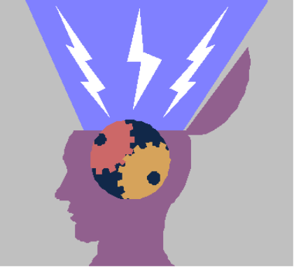
Authority of (tribal) SELF

Slide 329
Tribal (extended cultural family) lifestyles

Slide 330
Truth is discovered by self (tribe), not via religions, institutions, or science (which are only given consideration).
“I (my tribe) know what’s
best for me, not an
external authority source.”
Notes:
330

Slide 331
“I do what’s best for
me, not what external
authority figures may
expect me to do.”
“I act on the basis of my
wants & feelings, not
external authority.”
Notes:
331

Slide 332
AUTHORITY OF SELF LIFESTYLES
C21 examples of being your own authority (1) Premarital sex-cohabitation; (2) Expecting organizations to accommodate your lifestyle; (3) Bringing your personal life into the workplace via cell phone, email, and friendships on the job.

Slide 333
MANIFESTATIONS OF C21 CULTURAL
SUBJECTIVE
REALITY

Slide 334
Digital private worlds; tweets, Facebook, YouTube, IPODs, texting, etc.
Advertising, PR, ideological talk shows, political campaigning
Entertainment/ideology-driven media

Slide 335
Political & religious polarization
Political correctness (lifestyle libertarianism)
Icon worship: music, sports, movies, politicians
Single-issue social activist groups

Slide 336
CULTURAL INTELLECTUAL CHAOS
Libertarianism
Single-issue (“litmus-test”) politics & voters
Domestic & international ideological terrorism
“Religious” cults & institutionalized pedophilia
Revisionist history

Slide 337
THE UGEN MATRIX

Slide 338
Baudrillard depicts the post-modern “murder of reality” as the perfect crime, which has destroyed reality and replaced it with a virtual, subjective world of information, simulated experiences, and illusions. “People accept illusion and appearance (the reign of the object) and give up the quest for truth and reality.” The post-modern illusions of the virtual screen world become the false truth of the object (the images, sounds, experiences, and feelings of post-modernism). POMO reality is subjective illusion.

Slide 339
“In a society where everything is a commodity that can be bought or sold, people are alienated from community. Commodities, media, and technologies provide a universe of illusion and fantasy where individuals become overpowered by consumerism, media ideologies, and fleeting celebrity role models. This leads to a destruction of the real and negates reality—the ‘perfect crime’ by the media and technological forces that created postmodern social hyper-reality.”

Slide 340
“The central concept of the Matrix is that the world you think you live in is not the real one. We are controlled and influenced by forces (media & technological symbols?) we don’t easily see. Everyone is so firmly locked into a false consciousness that they no longer see the real world. Society is dominated by a matrix of thinking machines which humans are connected to by cybernetic implants (IPOD symbol?) which keeps their minds under control.”

Slide 341
The Matrix prompts us to ask: To what extent are the 21st century media, Internet, consumer marketing, PR firms, virtual reality games, pop culture icons, advertising, political sloganing, & “innertainment” (such as IPODs, online gambling, online pornography, etc.) creating a subjective world of unreality in the minds of the emerging universal generation, thereby perpetrating Jean Baudrillard’s “perfect crime”?

Slide 342
THE UGEN PRIORITY OF HAPPINESS
Higher priorities than “happiness” common to past generations: Self-sufficiency, duty, commitment, sacrifice, religion, etc.
How happy would you be if you gave serious attention to external authority figures (parents, preachers, teachers, advertisers, etc.) “nagging” you about the “right” way to live your life?
The only way to achieve happiness is to “tune out” most of these conflicting authority figures by asserting your own subjective (tribal) values.

Slide 343
THE AUTHORITY OF FEELINGS
Do what “feels” right: lifestyle choices, code of morality, situational ethics, etc.
Does it make me happy (feel good)?
Serial lifestyles (continually
remaking yourself)
Vibes from popular culture
Some UGENs are still religious, but in a different way from previous generations of believers. Previous generations of believers tended to say, “Believe what you know”; UGENs are more likely to say, “Believe what you feel.”

Slide 344
FEELINGS > FACTS
Many UGEN college students obsess over grades because they “feel” they are an A student even if their academic performance says otherwise. “Since I feel like I’m a straight A student, my grade of B in this class is obviously a mistake or unfair.”
UGEN often shirk mundane responsibilities (being punctual, dressing appropriately, paying bills on time, etc.) because they didn’t “feel” like it at the time.
UGEN live in the moment & resist interrupting its “flow” by planning ahead or setting time priorities.

Slide 345
“Over-scheduling fits right in with the mass consumer mentality. I’m busy, therefore I am, seems to define us. In order to validate our existence, we fill our lives with a lot of things to do and a lot of stuff to consume.”

Slide 346
The universal generation is well suited in the following ways to cope with the emerging new economic & geopolitical uncertainties of the 21st century (global warming, international terrorism, US economic instability, natural resource scarcities, nonlinear development of technology & corresponding business markets).

Slide 347
1.The UGEN spontaneity & go-with-the-flow mentality makes them more adaptable to unexpected changes & challenges.
2. The UGEN communal, don’t-go-it-alone, temperament augers to make this generation more open to multilateral solutions to new global problems.
3. The digital networking penchant of UGEN provides a powerful resource for creative thinking, open-mindedness, collaboration, & win-win problem-solving.

Slide 348
UGEN
PORTALS

Slide 349
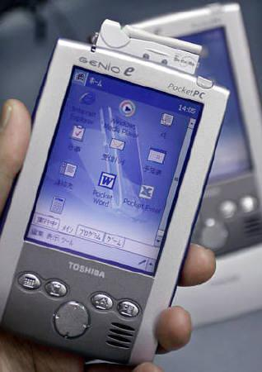
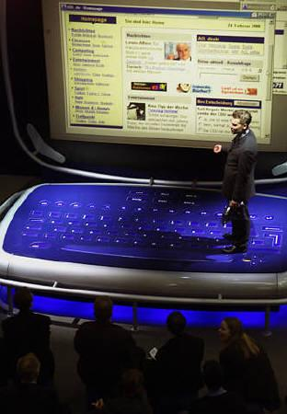
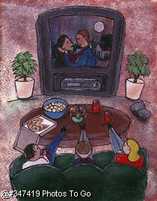
SCREEN CULTURE: FILTERING REALITY THROUGH SUBJECTIVE SCREENS

Slide 350
THE 3T’s: THE NEW UGEN PORTALS
#1 Technology: Transports UGEN to the virtual tribes via cell phones, IPODs, the Internet, chat groups, blogs
#2 Tribes: Transport UGENs to self-identity, communal championship
#3 Travel: Transports UGEN to alternate cultural realities & endless universes of subjective experience

Slide 351
FACING AN UNKNOWABLE FUTURE
The technology for your serial career(s) doesn’t exist yet
The world is remaking itself faster than people can adapt to it
Reality is now virtual
The definition of life is being redefined
You redefine yourself periodically

Slide 352
Reality is communal

Slide 353
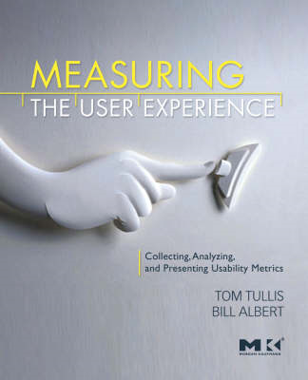
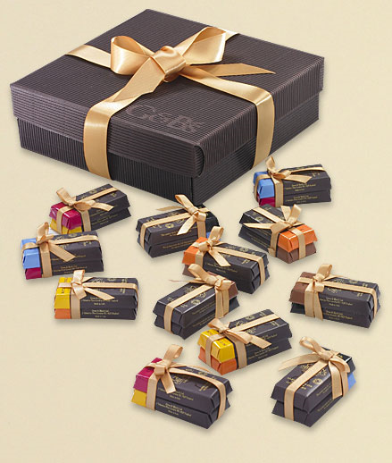
Experience collecting

Slide 354
Travel
Entertainment diversity
Serial lifestyles
Serial jobs
Serial “spiritual” pursuits
Serial sexual relationships
Shopping (physical & digital)
Job relocations
Plastic surgery
Recreational drugs
Bisexuality

Slide 355
UGEN LIFE IN THE NOW

Slide 356
Living in the now consumes high quantities of the time & energy it takes for UGEN to network with tribal members, reacting to the ever-shifting matrix of tribal spur-of-the-moment decisions, relationships, & digital communications. Little time & energy is left over for dealing with the past or future.

Slide 357
C21 REAL-TIME WORK
People in C21 always have more to do than the time to do it in, so life cannot be highly planned, scheduled, and routinized. Much of C21 work has to be done in a real-time mode, because of the challenge of coordinating the “radar screens” of UGENs. Much of C21 work consists of crash projects (not 8:00—5:00 work scheduling) when employees are able to temporarily postpone their current lifestyle priorities to give the organization’s project their exclusive attention.

Slide 358
THE
UGEN
COMMUNAL
LIFESTYLE

Slide 359
3. Technology (cell phones & the Internet) supports communal interaction. Networks are the new virtual neighborhoods of community. These networks are communities built around personal experience, self-expression, nurturance, group-sharing, and helping others.
4. Western UGENs are less independent than previous generations (because their values are communal)

Slide 360
VIRTUAL COMMUNITIES HAVE REPLACED PHYSICAL COMMUNIITES
Western culture has devolved & fragmented into special interest/special lifestyle groups existing within physical space (mainly cities & organizations). Because people who want to align with these special agenda groups are physically separated, virtual membership exists via the Internet & pop culture (movies, TV, radio, etc.). The proliferation & cultural significance of these virtual communities are highly visible:

Slide 361
UGEN CONNECT TO:
The Internet & mass media
Pop culture icons
Global &”New Age” music
Lifestyle experiences
Self-expression
Tribal (virtual) community
Real-time living in the now

Slide 362
UGENs TEND TO DISCONNECT FROM:
The past (history)
Civic involvement & voting (due to lifestyle/career mobility)
Current events (in lieu of tribal events)
Institutional participation (church denominations, political parties, public schools, Fortune 500 corporations, etc.)
Unpleasant realities of the world (which are simply ignored)

Slide 363
UGEN
WORK
CULTURE

Slide 364
Project-based (communal)
work requires that people get
along, which requires fitting
together, which requires
Mutual acceptance with no
agendas = a different
workplace for a new Universal
Generation.

Slide 365
UGEN WORK CULTURE
Informality
Flex scheduling
Teamwork
Project-based
Unisex
Spontaneous & temporary
Simultaneous pursuit of professional & personal agendas

