Slide 1
CHAPTER 2
CLASSIFYING
CULTURES

Slide 2
CULTURE CLASSIFICATION PRISMS
Why are cultures really simple to understand?
What makes some cultures more difficult to adapt to than others?
How do cultures perceive reality differently?
How is it possible to understand your own culture as it really is?
Do tourists really understand the cultures they are visiting?
Why do you have to experience a culture before you can understand it?

Slide 3
WHY DO CULTURES SEEM SO COMPLEX?
Because of the outward superficial differences between cultures:
Ethnic features
Language
Fashion
Cuisine
In reality, understanding cultures is much easier than it looks.

Slide 4
THE
BIG 3
CULTURE
CLASSIFICATIONS

Slide 5
Cul Class #1:
TRAFFIC LIGHT
MODEL

Slide 6
THE TRAFFIC LIGHT MODEL OF CULTURE
Green light: Go ahead
Yellow light: Be careful
Red light: Stop!

Slide 7
Green light cultures: Individualistic
Behavior needs little coaching and can be fairly spontaneous
Yellow light cultures: Extended family
Behavior needs some coaching and moderate training in culturally-appropriate etiquette
Red light cultures: Community/group
Behavior needs close coaching and extensive training in culturally-appropriate etiquette. Spontaneity should be avoided.

Slide 8
What kinds of behaviors require coaching?
Business protocol, negotiating, conducting meetings, rapport-building, social etiquette, giving work instructions, etc.

Slide 9
Cul Class #2:
INDIVIDUALISM
EXTENDED FAMILY
COMMUNITY

Slide 10
INDIVIDUALISM CULTURES (primarily Anglo-Saxon)
Institutions more important than family
Etiquette is optional
Individualism to accommodate capitalism
Achievement for identity & social status
Defining your own social responsibilities

Slide 11
EXTENDED FAMILY CULTURE (Latin, Middle Eastern, African)
Extended family > institutions
Unconditional acceptance > achievement
Appreciation of the free (non-materialistic) things in life
Religion & traditions > secularism & careerism

Slide 12
COMMUNITY (Asian) CULTURES
Community = your interdependency network of “insiders”
Focus on ideals, esp. harmony & “face”
Mandatory social etiquette to show respect to community members

Slide 13
Individualistic culture: I define myself (not society)

Slide 14
The I Culture
Individualism
Institutions
Independence
Internal locus of control

Slide 15
Individualistic cultures see society as a conglomeration of separate individuals rather than as interconnected people integrated into a holistic community. The concept of community is vague or missing all together. Surrogates for community are such things as bowling leagues, church attendance, social clubs, & especially online virtual communities.

Slide 16
DEFINING YOURSELF EVERYDAY
1. Individualistic cultures necessitate that people continually define & redefine themselves through career; lifestyle decisions; how money & time are spent; external appearance; hobbies; friendships, etc.
2. Your self-identity must be reinforced throughout the day as you make decisions, set priorities, & schedule your commitments.

Slide 17
INDEPENDENCE & CONTROL
Controlling your life & environment is essential in individualistic (I) cultures, because how you spend your time defines who you are. As a result, I cultures tend to be technological (Control mechanisms) Cultures:
Clocks, Cars, Chemicals, Careers, Cash, Credit Cards, Choices, Channels

Slide 18
For example, birth control has liberated (made independent) women to pursue careers as a personal alternative to full-time domestic responsibility. Birth control opens the door for women’s careers, family planning, & non-traditional self-identities.

Slide 19
American men & women in I cultures now marry at an average age of 25 & don’t have children until about 28 years of age.
American nuclear families are normally small enough to enable the mother to maintain a part-time or full-time career with the support of institutionalized child care.
The high divorce rate in I cultures & rise in single-parent families may be due in part to the greater economic independence of economically self-sufficient women.

Slide 20
What Do These Drivers Have In Common?
Both use the style of their car to
express their self-identity

Slide 21
Personal identity in individualism cultures can come not only from your career, but also from what can possibly come with it: power, social status, achievement, recognition/awards, travel, and $$$.

Slide 22
How can you manufacture your
own personal identity?
Affiliate with “tribal” (similar
lifestyle) groups & special interest
groups that express your lifestyle
& values:
Social media/Texting; Sports teams; Political parties; Social clubs; Religious denominations; Social activism

Slide 23
College students look forward to their senior year so they can “get out of jail,” but many become nervous at the prospect of choosing a job upon graduation because career= personal identity. What if they can’t land the job that delivers the personal identify they envision for themselves? Or can they somehow define themselves via a non-career orientation such as family or special interests (like those in the next slide)?

Slide 24
Social/political activists, environmentalists
Feminists, gays, vegetarians, astrologists
Drug culture, blended families, gun activists
"New Agers," terrorists, humanists
Atheists, euthanasianists, Libertarians
Skin heads, leisure-seeking retirees
"Texas Republic," welfare families, Wicans
Home schoolers, right-to-lifers, street people
Net chat groupies, investigative reporters
Christian Scientists, est, Scientology, bikers
Military, MBA, religious cults, “”tea party”
Occultists, reality TV, chat groupies, etcetera

Slide 25
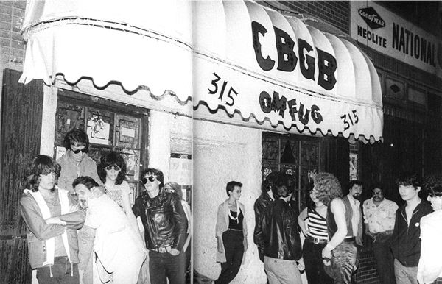
Play by the rules vs. Make your own rules to live by

Slide 26
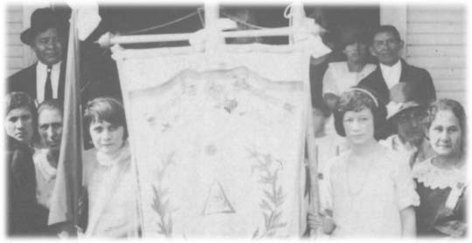
Extended Family Culture:
The family is my
identity & lifeline

Slide 27
Non-institutional cultures
Family > Organizations
People > Productivity
Quality of life (relationships & family) > Quantity of life (materialism)

Slide 28
In nuclear family (individualism) cultures, identity is largely self-determined. In extended family cultures, identity is more apt to come from outside of yourself: gender role, birth order, who you know.

Slide 29
Community Culture:
Community = interdependency networks: family hierarchies; co-workers; permanent friends; neighbors
Etiquette (“ethics”) = showing respect via rituals to those you depend on most
Ideals = behaviors that promote & sustain community harmony

Slide 30
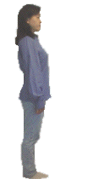
Maintain interpersonal harmony via ritualistic
SOCIAL ETIQUETTE: Friendship bonding rituals; Bowing; Meeting/greeting rituals; Gift-giving rituals; Entertaining

Slide 31
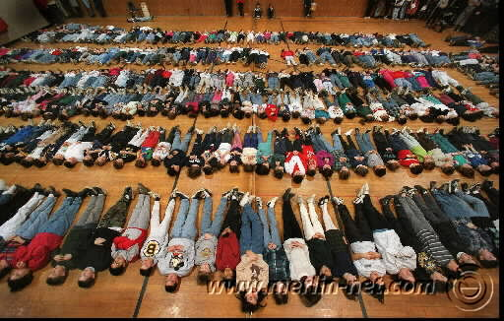
Social behavior is complex because it is dictated by situational etiquette, not by universal rules
Meditating on company success

Slide 32
CULTURE CLASH:
CAREER CULTURES
vs.
FAMILY CULTURES

Slide 33
Cultures with different profiles sometimes mesh, but not always. “Achievement” cultures (individualistic, mastery, monochronic, quantity of life) inevitably clash with “traditional” cultures (extended family, adaptive, polychronic, quality of life).
For example, American culture during the “Manifest Destiny” 19th century fatally clashed with the Native American cultures, all but exterminating them in the process. The disunited Amerindian tribes were no match for the superior military technology (the product of entrepreneurial commercial institutions) of the U.S. government with its strong institutional power.

Slide 34
One of the few times the Amerindians defeated the U.S. military was at the infamous battle of Little Big Horn (South Dakota) when a number of tribes centralized their power under Sitting Bull. But lacking the institutional infrastructure to permanently centralize power, the various Amerindian tribes were quickly wiped out by the institutional U.S.
A major cause of contemporary friction between Western & Islamic nations is cultural: secularism vs. theocracy, institutional vs. extended family, gender role differences, etc.
The USA faces a tough political challenge in seeking to install a Western-friendly form of government in the Middle East, because the region has never known strong secular institutions, but representative government necessitates strong institutions.

Slide 35
THE CULTURAL IMPACT OF QUANTITY OF LIFE & ON FAMILY STRUCTURE
1. Western culture’s strong emphasis on quantity-of-life productivity has led to a cycle of decreasing family size & prominence: Women in the workplace Delayed marriage Having children later in life + Fewer children Reliance on institutional child rearing in day care centers & public schools
2. Career emphasis has also meant a huge growth in the singles culture to accommodate the intrusiveness of institutional work on private life (long work hours, commuting, team projects, career mobility, etc.).

Slide 36
GENDER ROLE CULTURE CLASH
The traditional nurturing role of women in Western culture underwent massive change during the second half of the 20th century as many women sought personal identity in careers & greater social/economic independence.
Other women became breadwinners in order to supplement their spouse’s income to enable a higher material standard of living.
The singles & living together unmarried subcultures emerged as a new socially acceptable role for both women and men who put career & organizational life ahead of family life.

Slide 37
This redefined gender role of women led to domestic role overload for many “supermoms” who were expected to simultaneously maintain both nurturing & professional roles.
In addition, the new role of women as careerists in the workplace led to gender culture clashes in many organizations centering around sexual discrimination & harassment; the “glass ceiling” (not promoting women into executive positions); & the discomfort of many women professionals in male-dominated organization cultures built around aggressive competitiveness instead of cooperation, & authoritarian-style management instead of participative management.

Slide 38
THE SOCIAL REQUIREMENTS OF CAREERIST CULTURES
Social Darwinist culture (make it on your own)
Unisex culture (economic productivity as the primary societal role of both men & women)
Small families or childless marriages (to accommodate the time demands of institutions & organizations)
Institutional childcare (as a substitute for family care during the workday): public school systems, daycare centers, nannies, after-school programs & extracurricular activities
Widespread availability of birth control technology

Slide 39
Civil rights legislation protecting the rights of women & ethnic minorities
Geographically mobile lifestyles to accommodate career opportunities
Separation of church & state to avoid discrimination against religious minorities & the growing ranks of non-religious secularists
Secularized values to accommodate the high materialism required by a commercial culture based on the pursuit of careers.
Government socialism (unemployment & welfare benefits, medical care assistance, college loans, etc.) to provide for social welfare needs no longer met by the family.

Slide 40
THE SOCIAL REQUIREMENTS OF EXTENDED FAMILY CULTURES
A social culture of extended families, clans (extended families connected by intermarriage) & tribes (extended clans connected by intermarriage)
Gender role differences
Large families (to provide for the relative absence of social institutions)
Prominent, publicly visible religion to hold the culture together at the grassroots level in the absence of of institutions
Communal capitalism which seeks to meet the needs of multiple people, not just financial stockholders

Slide 41
Cul Class #3:
CULTURAL
DNA CODE

Slide 42
DNA #1:
MONOCHRONIC vs.
POLYCHRONIC
CULTURES

Slide 43
Monochronic—Polychronic:
Some rivers flow, others are dammed up
(Control time vs. enjoy time)

Slide 44
Monochronic cultures control time via schedules to promote personal productivity: appointments, deadlines, private offices, organization charts, etc.
Polychronic cultures put relationships before professional responsibilities & are thus less time efficient & organized.

Slide 45
Privacy is more important in monochronic cultures than polychronic, because personal productivity & stress maintenance necessitates withdrawal from the external environment.
Polychronic cultures are more open & less private to facilitate relationship-building & care-taking of the extended family.

Slide 46
5.Work stress is high in monochronic cultures due to the constant press to perform efficiently:
Work deadlines
Goals
Performance-based pay
Competitiveness
Serial busyness

Slide 47
POLYCHRONIC MARK TWAIN
Huck Finn & his friend Jim relax their way down the Mississippi River (symbolizing the flow of life), never hurrying to meet deadlines like the river boat pilots.
Every time Huck & Jim leave the river (going into monochronic civilization), they encounter problems & aren’t accepted.
Huck & Jim want to enjoy their environment, not control it.

Slide 48
DNA #2:
LOW vs. HIGH
CONTEXT
CULTURES

Slide 49
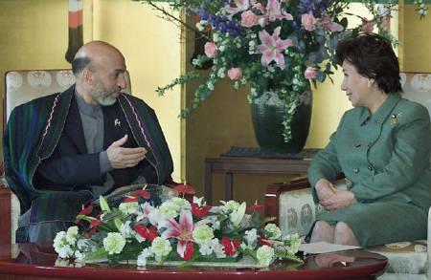
Low vs. High Context Treat everyone the same vs. cater to background characteristics

Slide 50
In high context cultures, people’s background characteristics (family name, wealth, gender, age, who they know, etc.) determine their social status more than personal achievements (which define identity in low context cultures)

Slide 51
What aspect of American history influenced Americans to
be low context? (Immigrants from all over the world had to minimize their differences in melting-pot frontier America).

Slide 52
DNA #3:
MASTERY vs.
ADAPTATION

Slide 53
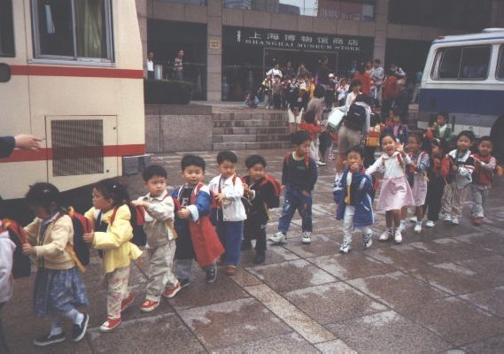
Mastery vs. Adaptation cultures (Controlling vs. adapting to the environment)

Slide 54
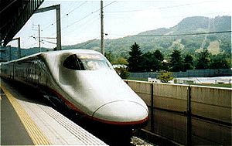
Master society via institutions, master organizations via management, & master nature via science/technology

Slide 55
Bureaucratic forms of organizational controls include job descriptions, chain of command organization charts, systems & procedures, performance reviews, etc.
Most managers in Western organizations prefer control to employee “empowerment.”
Business schools focus heavily on quantitative skills as the key to controlling organizations.
Western culture is on the brink of ultimate control via cloning, abortion, stem cell research, atomic weapons, etc.

Slide 56
HOW NON-MASTERY CULTURES ADAPT:
Heavy reliance on agriculture & self (non-institutional) employment
Dependence on the extended family rather than institutions
Central role of religion rather than career-centered secularism
Most adaptation cultures are also quality of life cultures which emphasize the “7F’s”: Free, Family, Friends, Fun, Fiestas, Food, Faith

Slide 57
THE STRENGTH OF ADAPTATION CULTURES
The capacity to absorb social change without violence & revolution
Less anxiety about what the future holds
Less violent crime
A smaller generation gap
Lasting religious traditions
Stronger families & marriages
Fewer people dispossessed by business, technology, & social change

Slide 58
DNA #4:
QUALITY
vs.
QUANTITY
OF LIFE

Slide 59
Quantity vs. Quality of life (material vs. lifestyle wealth)

Slide 60
Quantity of Life
Materialism
Wants > needs
Secularism
Singles & nuclear family
Technology
Imperialism
Workaholism
Novel experiences
Quality of Life
Extended
family
Needs-based economy
Status quo
Religion & social traditions
Jobs > careers

Slide 61
What enabled
the biggest
productivity
jump in USA
history? (Women becoming career-oriented like men)
Which is
the only
American
state that
has a
quality of
life
culture?
(Hawaii)

Slide 62
DNA #5:
TOLERANCE OF
SOCIAL
AMBIGUITY

Slide 63
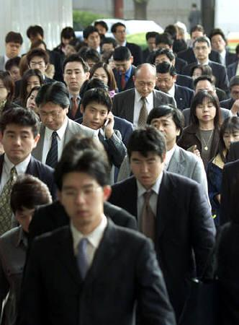
High vs. low tolerance of social ambiguity (diversity)

Slide 64
“Political correctness” & unisex culture are natural byproducts of cultures that tolerate diversity & non- conformity. Diverse lifestyles must be tolerated because there are so many of them & people derive their personal identity from them.

Slide 65
DNA #6:
POWER
DISTANCE

Slide 66
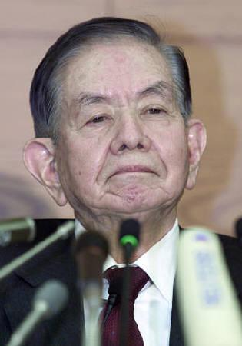
Low vs. High power distance (shared power vs. power elites)

Slide 67
Low power distance cultures decentralize power into many different organizations & job positions. Powerful people are not that much different from everyone else.
High power distance cultures centralize power into a small group of power elites who are treated with great deference.

Slide 68
LOW POWER DISTANCE
First name basis
Participative management style
Informality
People from different levels of the hierarchy interact frequently & comfortably.
Stress on personal accountability

Slide 69
HIGH POWER DISTANCE
Autocratic management style
People from different levels of the hierarchy seldom interact.
Paternalism: taking care of employees in return for loyalty & obedience
Formality

Slide 70
DNA #7:
EMOTIONAL
EXPRESSIVENESS

Slide 71
Emotionally Neutral vs. Expressive (self discipline vs. animation)

Slide 72
EMOTIONALLY NEUTRAL
Impersonal & formal
Inhibited about expressing feelings & “poker face”
High personal space; limited physical contact
Privacy (offices) & quiet
Avoiding personal style or charisma

Slide 73
EMOTIONALLY EXPRESSIVE
Uninhibited expression of feelings
High touch
Spontaneous
Opinionated & love of debate & arguing in the passionate pursuit of life

Slide 74
GOING “POSTAL”
People in emotionally neutral cultures are more likely to “lose it” emotionally than those in emotionally expressive cultures.
This can be caused not only by the tendency to “hold in” strong emotions, but also to frustrations associated with the stresses of organizational life in institutional cultures: corporate politics, deadlines, workaholism, autocratic decision-making, etc.

Slide 75
Body language
Ritual
Silence
How are emotions
expressed silently?

Slide 76
DNA #8:
LOCUS OF CONTROL

Slide 77
INTERNAL LOC
I am mainly responsible & in control of what happens to me in life.
I make myself what I am, & choose my own identity & niche in life.
I run my own life, make my own decisions, set my own goals, & deserve the success I achieve. I am the pilot of my own ship.
I make things happen in life.

Slide 78
EXTERNAL LOC
Many things control what happens to me in life. I can’t do anything about them.
I was born into a certain kind of life chosen for me by external factors: my gender, culture, family, religion, ethnicity, class status, past colonialism, etc.
There are many things in my life that I must accept.
Life happens to me. I must adjust & adapt.

Slide 79
ILOC vs. ELOC
Changing – Status quo
Leading – Following
Proacting – Reacting
Doing – Waiting
Talking – Listening
Secular – Religious

